Slide 1
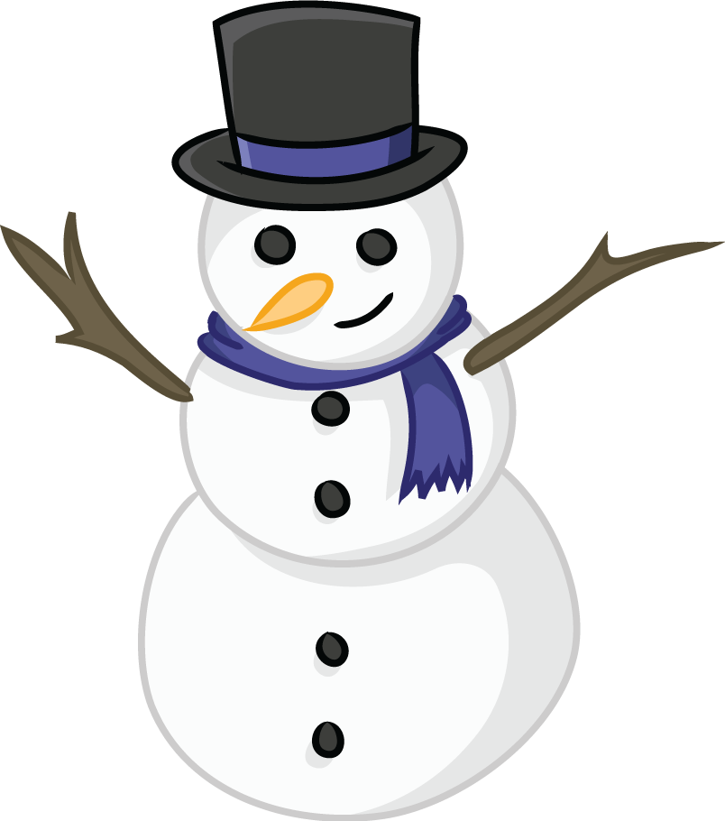
Home Learning January 17-21, 2022
Make a snowman with the template and construction paper provided. Color your snowman!
Remember to get outside and get some exercise and fresh air!! Build a snowman.
Literacy
Please remember to read each day!
Read WINTER WORD.
Write a story about my favorite Winter Activity (hockey, skating, sliding).
Practice Spelling words with op word family – mop,top,hop,pop,shop,drop.
Math
The main focus in Math this week will be Place value with numbers to 50. I sent home two worksheets and a place value mat with rods (tens) and units (ones). Remember when counting rods they are worth ten so you need to skip count by 10s.

