Slide 1
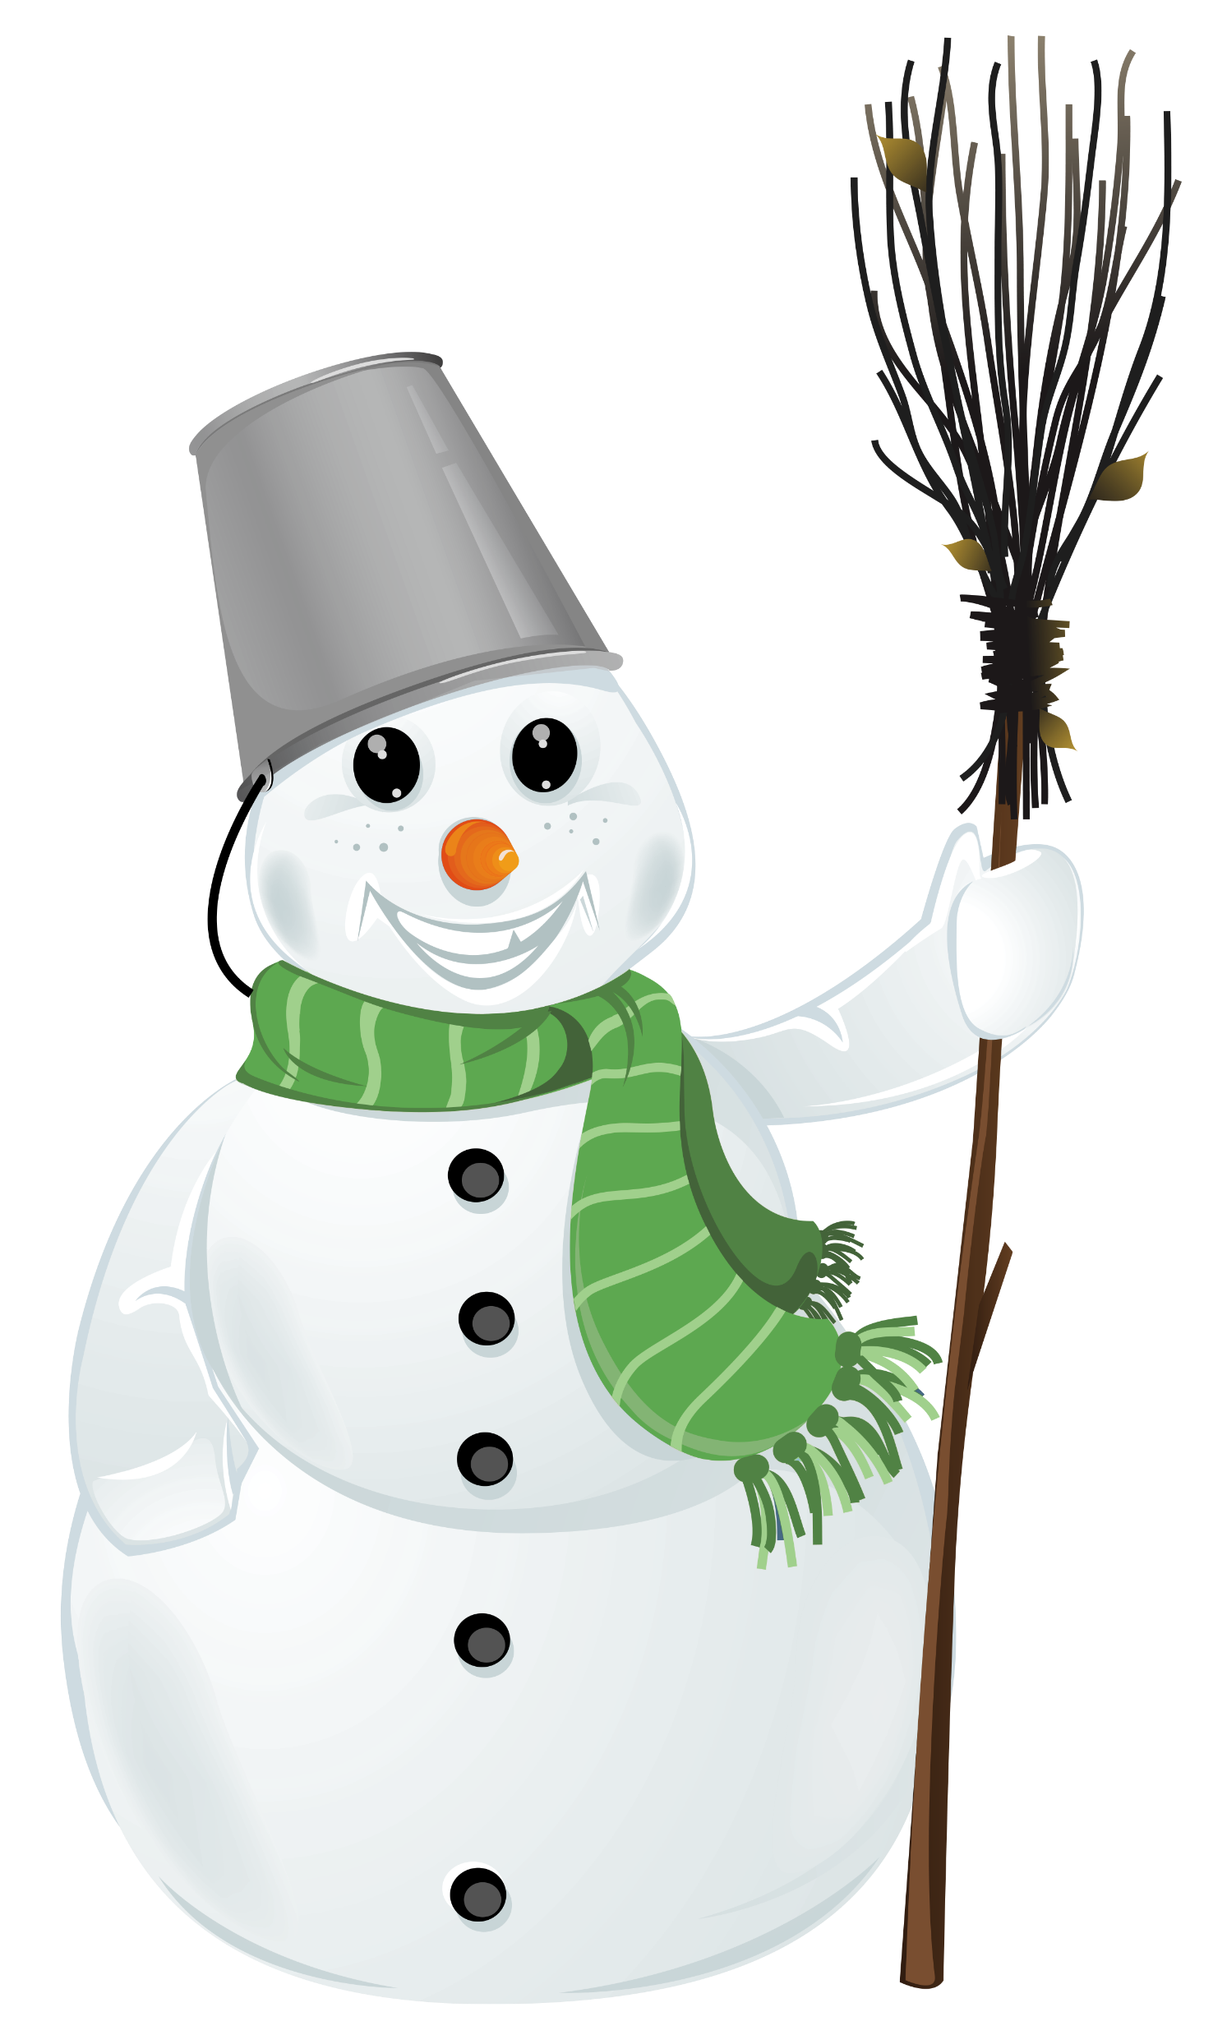
Home Learning January 10-14, 2022
This week please work on the packet that was sent home in November. I have added a few more sheets in your homework
bag.
Remember to get outside and get some exercise and fresh air!!
Literacy
Please remember to read each day!
I have included a writing page along with WINTER WORDS to read and use in your story if needed!
Spelling – review words
Math
The main focus in Math this week will be 3D shapes. Please continue counting to 50 forwards and backwards.
Practice skip counting by 2s, 5s, and 10s.

