Slide 1
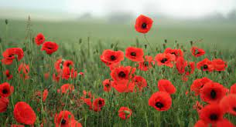
Nov.8^{th -} Nov. ^{12th}
Practice counting to 20.
YouTube videos:
Les chiffres et les nombres de 1 à 20 : https://www.youtube.com/watch?v=UsEz58BblMY
Review dialogues on the FLORA Website:
https://flora.nbed.nb.ca/FLORA_lvl1_mod1_HTML5_v4/story.html
Bonjour, comment ça va?
Je m’appelle_____.
Comment t’appelle tu?
Comprehension activity: Place the sentencesfrom the dialogues in the correct order.
Practice these with a family member.
Bonjour, comment ça va?
Ça va bien merci et toi?
(Hi, how are you? I am well thanks, how are you?)
Je m’appelle_____.
(My name is___.)
Comment t’appelle tu? (What’s your name?)
FLORA Games:
Students are encouraged to play any of the games on the FLORA website for Level 1, Module 1.
https://flora.nbed.nb.ca/FLORA_lvl1_mod1_HTML5_v4/story.html
Remembrance Day:
No assignments

