Slide 1
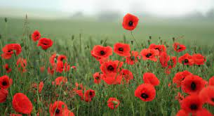
Nov.1^{st-} Nov. ^{5th}
Practice counting to 30.
YouTube videos:
Les chiffres et les nombres de 20 à 50 - alain le lait : https://www.youtube.com/watch?v=wlYqz2unHKc
Listen to Dialogue 2 on the FLORA website:
https://flora.nbed.nb.ca/FLORA_lvl1_mod2_HTML5_v4/story.html
Quel âge as-tu? (How old are you?)
Example: J’ai neuf (9) ans.
Où habite-tu?
(Where do you live?)
Example: J’habite au Nouveau-Brunswick or J’habite à Blackville.
Comprehension activity: Place sentences in the correct order.
Orally discuss with a family member:
Quel âge as-tu?
Où habite-tu?
*practice until fluent.
Students are encouraged to once again review basic body parts.
Games:
Students can play any game on the FLORA website
https://flora.nbed.nb.ca/FLORA_lvl1_mod2_HTML5_v4/story.html
Remembrance Day
No assignments

