Slide 1
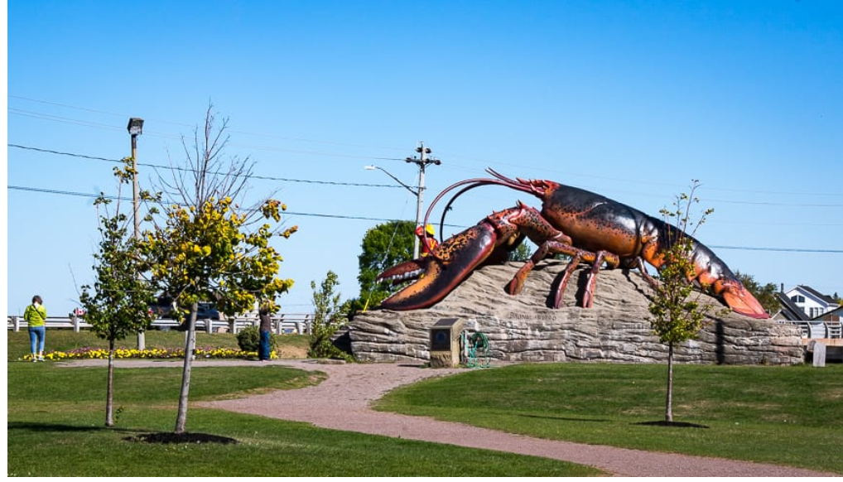
New Brunswick Facts
The inventor of the ice cream cone was born in Sussex, NB. His name is Walter Donelly.
The world’s largest Lobster can be found in the town of Shediac.
It weighs 90 tonnes.

