Slide 1
Lesson: Website Design

Slide 2
What is a website?
A website is a digital space that potential customers can visit for information about your business, browse your products/services, purchase products/services or to communicate with your business.
A website is associated with a web address also known as a domain – for example, https://www.bhsice.com/

Slide 3
Design Inspiration
A great way to get design inspiration is to browse website you like!
Large companies invest substantial money into designing and building their website. You can pick up design tips by browsing their sites and choosing elements that may work for your website!

Slide 4
Examples
Here are a few example of simple, yet effective websites!
https://www.bhsice.com/high-school.html
www.shaybear.ca
www.countryliberty.ca
www.dooryardco.ca
www.kienna.com
Search for some of your favorite products online, and check out their websites!

Slide 5
The Purpose of This lesson
Web design can be as complicated as you wish it to be.
For the purpose of this lesson we will focus on keeping it simple. If you already have web design experience and would like to go further, please contact Mr. Hallihan directly for additional suggestions and instructions as I manage the bhsice.com website.

Slide 6
Our Focus
We will focus on these three key components:
Website Theme / Template
This refers to the overall layout of your website, for example, where your logo is located, where your navigation is located, the size and colors of different sections and much more!
Website Content
This refers to the content on your website pages, it’s very important to keep your content simple and to the point. No one wants to read an essay on your website. Be thoughtful in what you write and ensure there is a purpose to what you write.
Calls to Action
There should be several calls to action on your website, preferably a call to action on every page. A call to action is a button that encourages customers to make an action. Your call to action could be, Buy Now, Contact Me, Book an Appointment, etc.

Slide 7
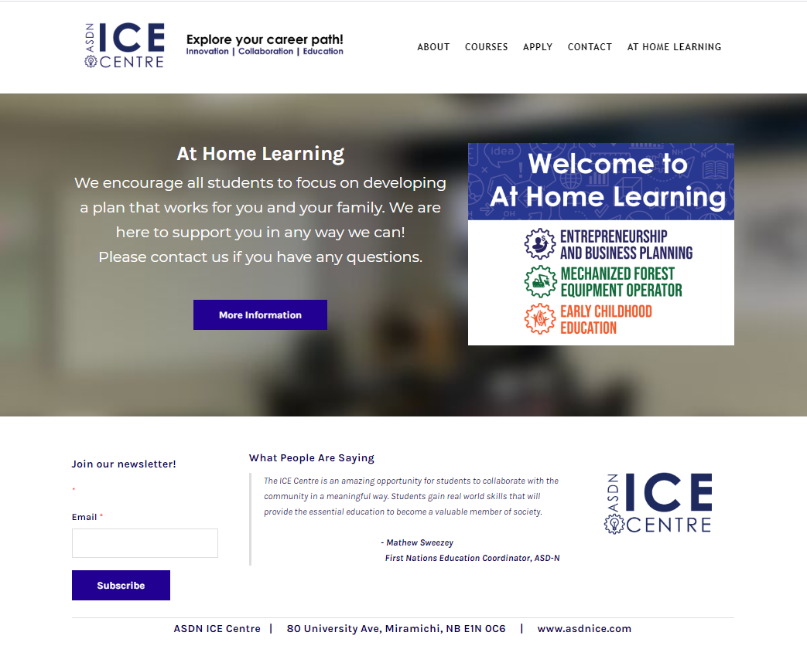
Basic Components of a Theme
Navigation
Header
Content
Button
Footer

Slide 8
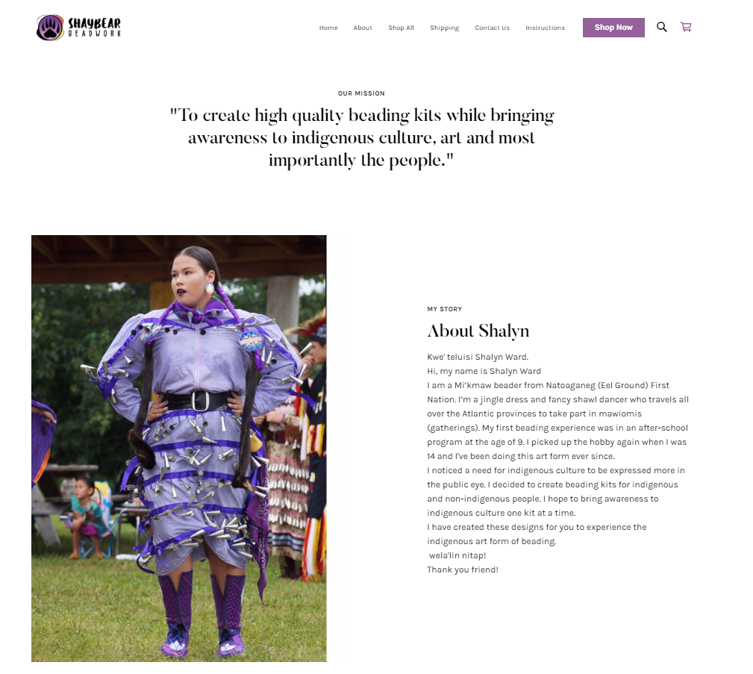
Website Content – Keep it Simple
Simple and meaningful content

Slide 9
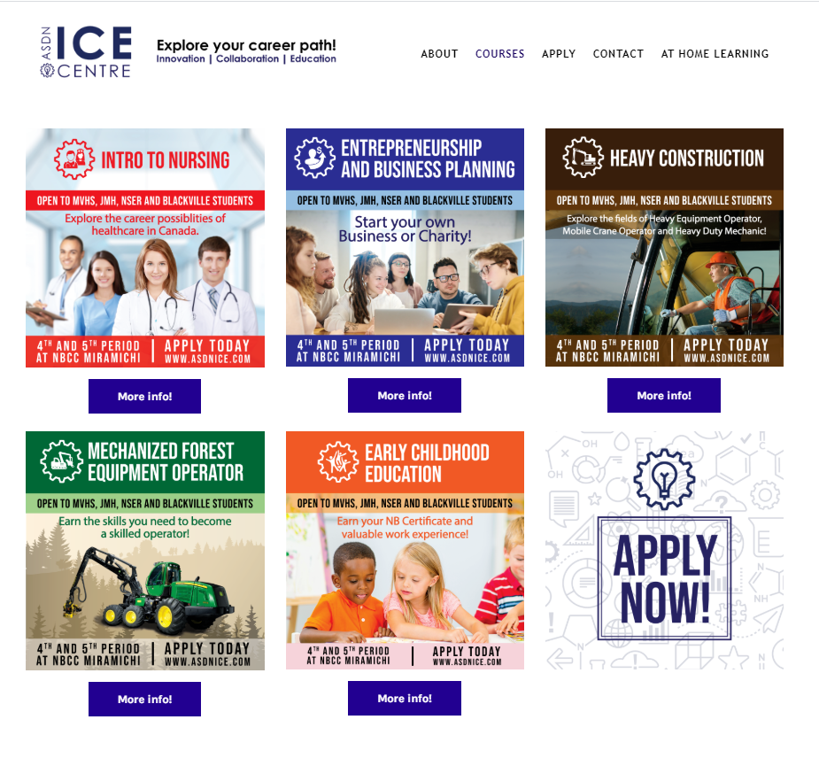
Calls to Action
Calls to Action!

Slide 10
Website Pages
Your website you should have the following pages:
Home Page (Landing Page)
This page should be simple and eye catching. It is the first page customers will see, so it is your first chance to impress and engage customers.
About Us / Our Story
This page should provide a brief history of your business and your business story. This may or may not include personal information about yourself as the business owner.
Shop / Products / Buy Now
This page should provide a list and description of all your products and or services. If you wish to sell online this will be an important page!
Contact Us
This page should either include a contact form or direct contact information for your customers to contact you!
You may wish to include other pages for your specific business,
however these 4 pages must be included!

Slide 11
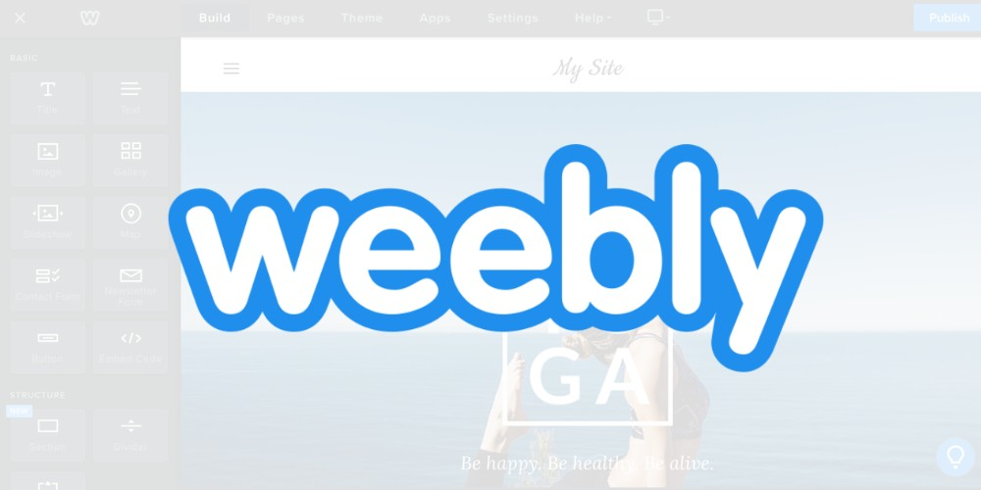
Website Design Platforms
There are many options for choosing a platform to design your website.
For the purpose of this lesson we will focus on building a website using Weebly.
If you already have experience using a different platform, please feel free to continue.

Slide 12
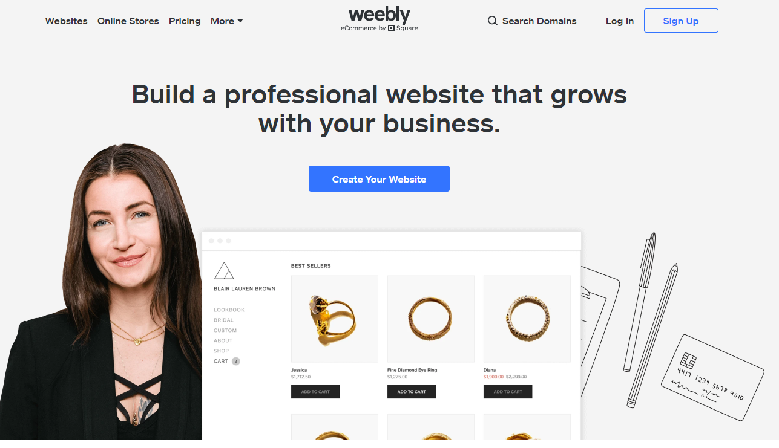
Sign Up
Start by signing up for a Weebly account at www.weebly.com

Slide 13
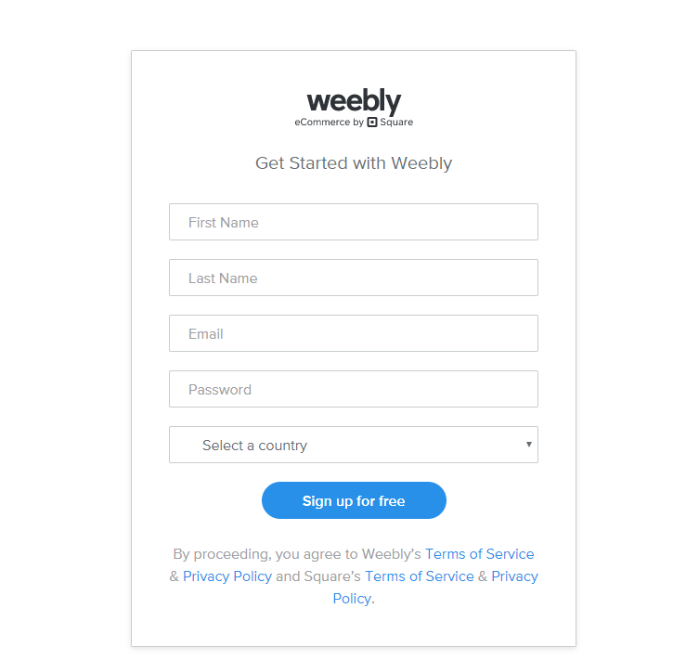
Sign Up
Sign up using your student email address or the address you use the most

Slide 14
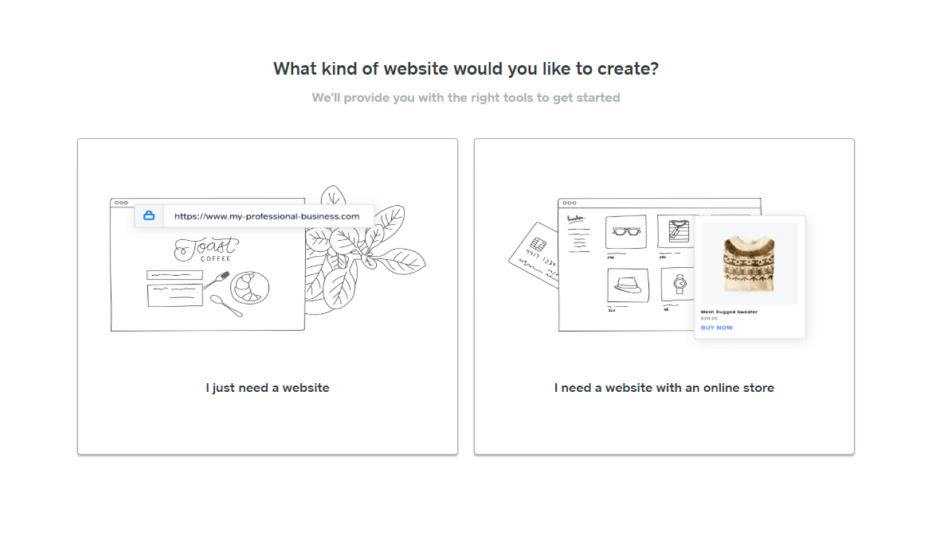
Selecting the Type of Website
Select “I just need a website” – if you are already prepared to begin selling online please contact me for more information.

Slide 15
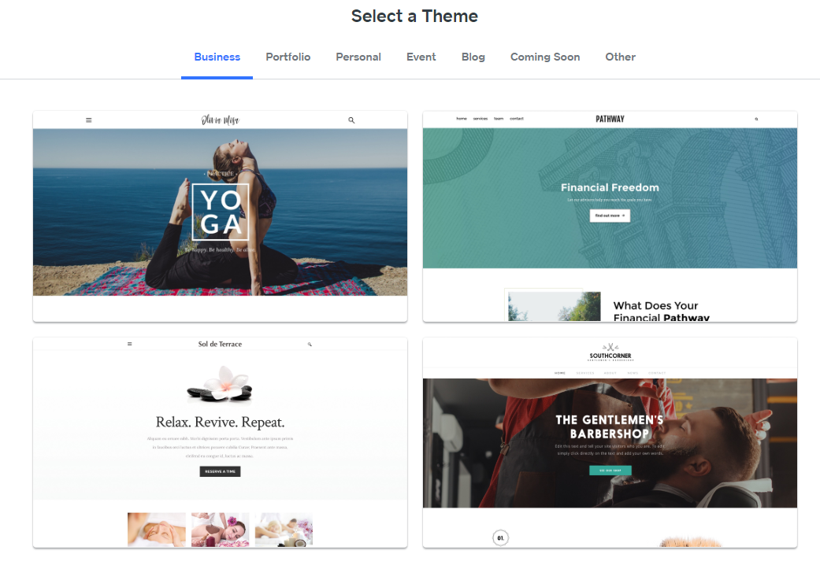
Selecting a Theme
Browse the themes and find one that’s suits your business.
Please note you can always change this later.

Slide 16
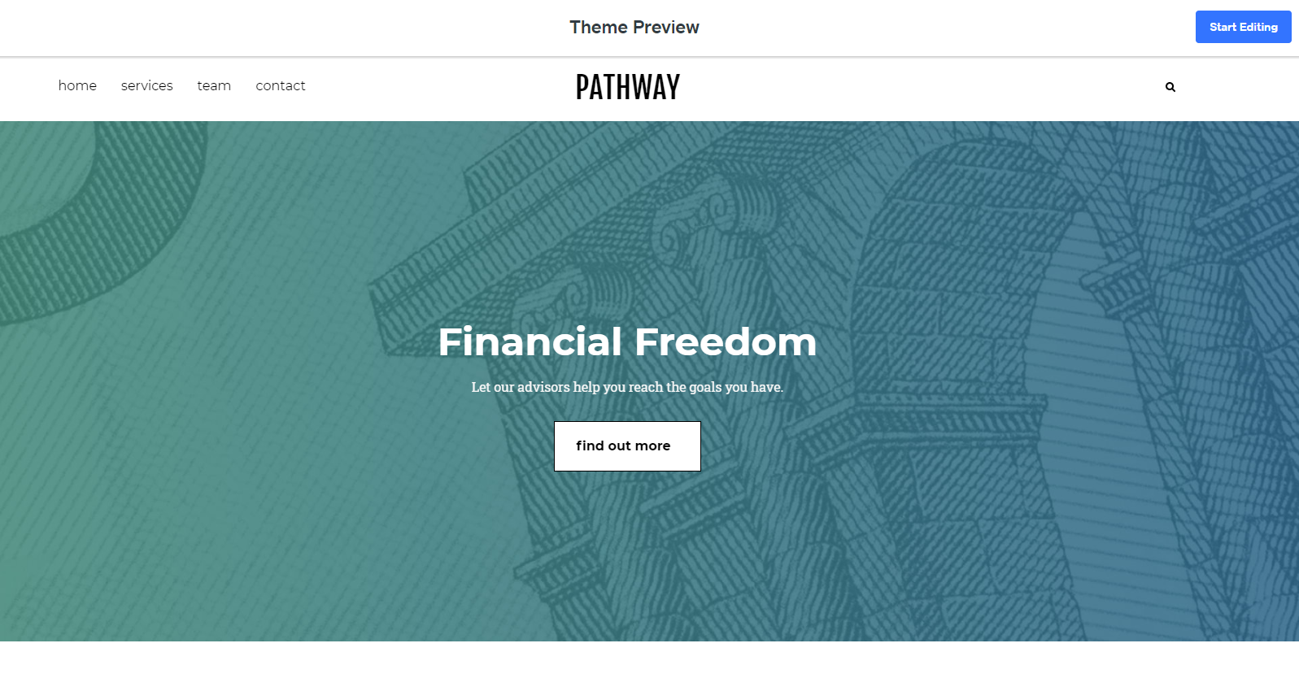
Selecting a Theme
Once you have viewed and choosing a theme, click Start Editing.

Slide 17
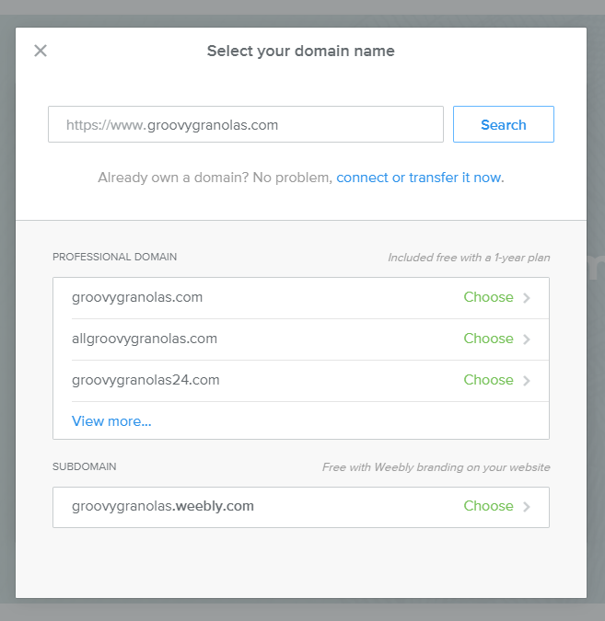
Selecting a domain name www.domain.weebly.com
For now you will use a free weebly domain, if you wish to purchase a domain please contact me.
Your domain will be www.domain.weebly.com for now

Slide 18
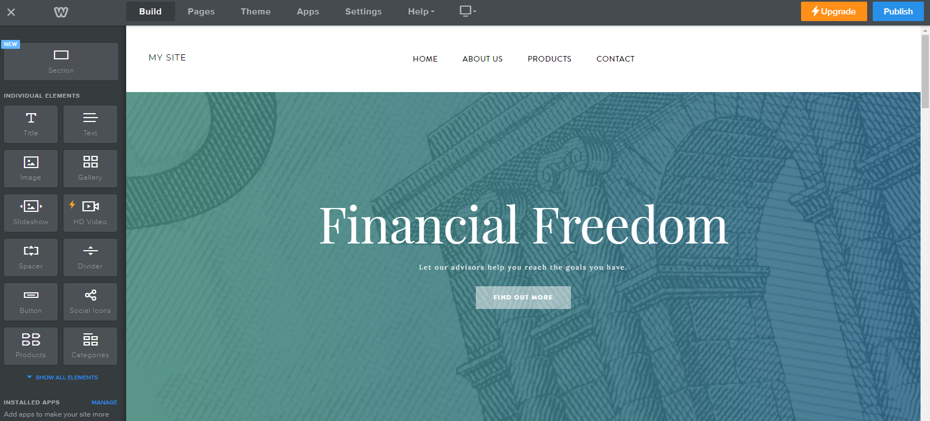
Building Your Website
For now we will focus on some simple features of the build tab.
Title: This provides text for a large title
Text: This provides text for a paragraph or smaller text.
Image: This provides you the opportunity to add an image
Spacer: This will be used to space different sections
Button: This will be used for your calls to action

Slide 19
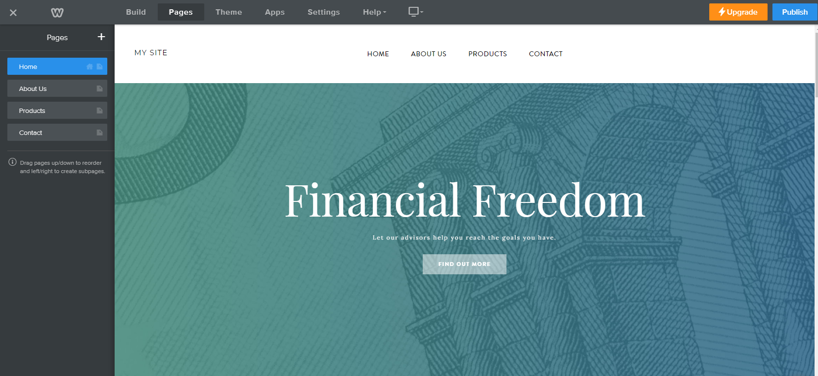
Building Your Website
Pages:
This tab will be used to add pages or change the name of your pages.

Slide 20
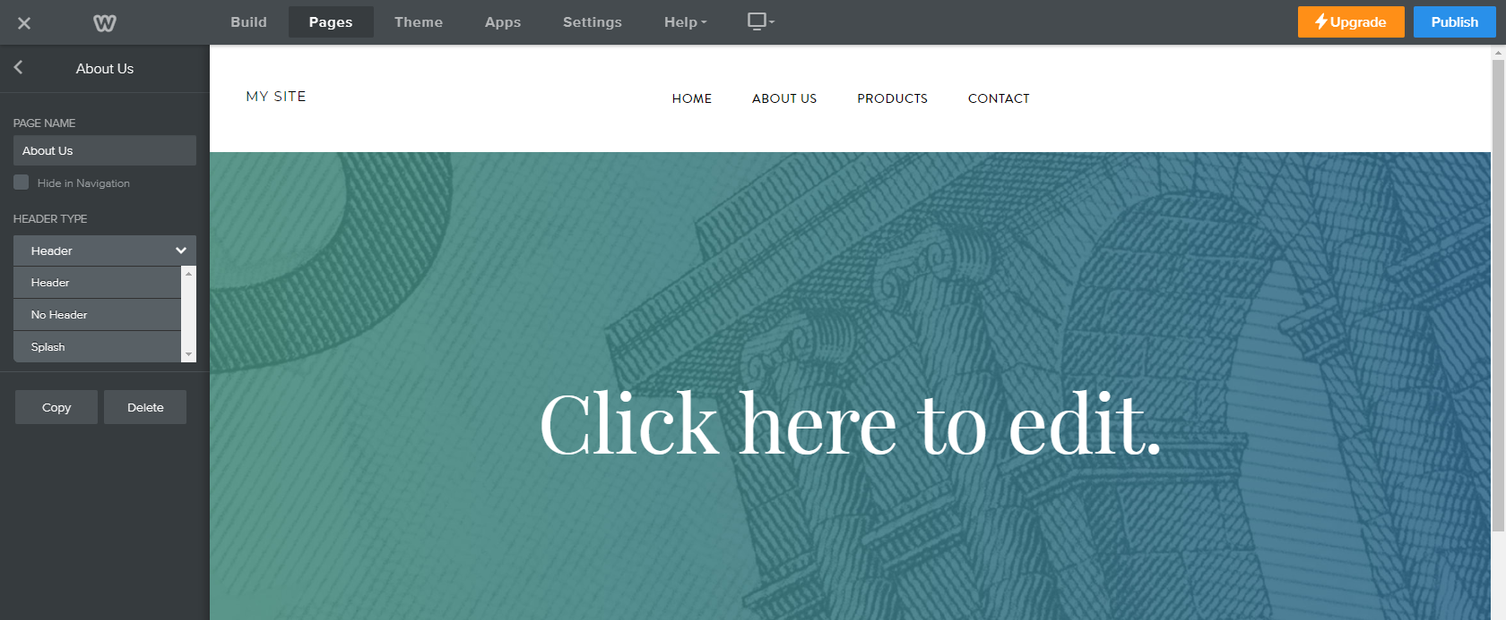
Building Your Website
Pages:
You change choose a header or no head for each of your webpages. This will look different for each theme so it’s important to preview this and choose what you prefer.

Slide 21
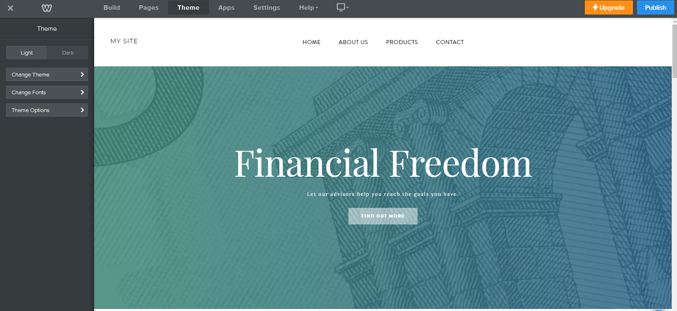
Building Your Website
Theme:
This tab will be used if you wish to change your theme or change the fonts used on your website.
Depending on your theme there may also be some options specific to your theme.

Slide 22
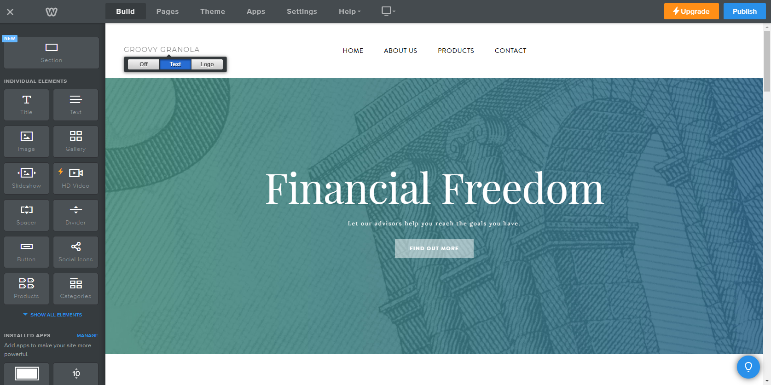
Building Your Website
Logo / Company Name:
Hover over the logo / company name and add your logo or company name.

Slide 23
Building Your Website
Logo / Company Name:
Hover over the logo / company name and add your logo or company name.

Slide 24
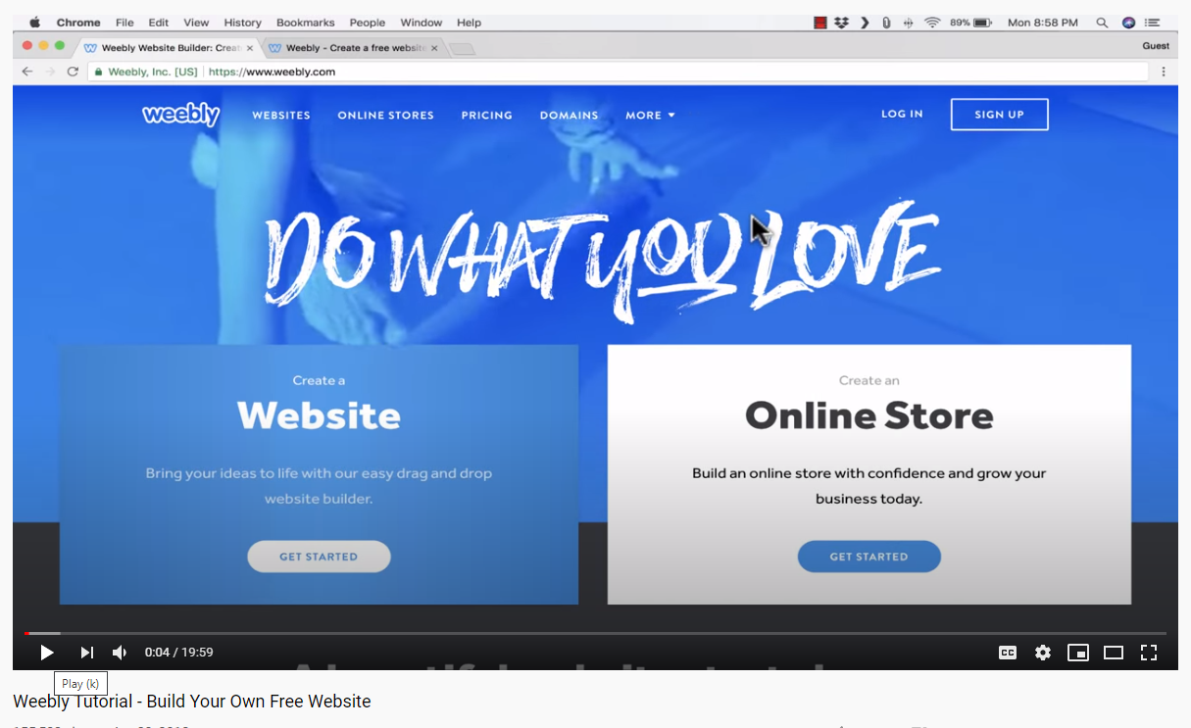
Building Your Website
You will find Weebly is a very intuitive platform to use. Everything is drag and drop and you can always delete items you add. Please take some time to get familiar and test different elements. If you have specific questions, please contact me directly.
There is also a video provided by Weebly with more in depth instructions
https://www.youtube.com/watch?v=v81nRa_W9Fk

Slide 25
Keep It Simple
Simple website are often the most effective website.
In order to keep it simple you must be thoughtful in your web design and identify what the purpose of your individual site will be.
Do not overload customer with information
Your website should be easy to navigate
Customer should easily be able to browse, shop or contact you
Use appealing colors and easy to read text
Use pictures that align with your business

Slide 26
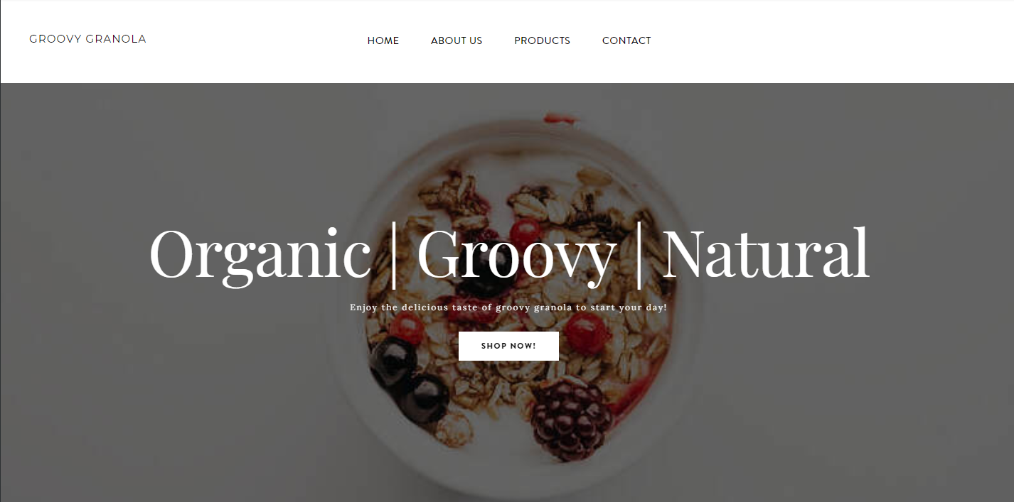
Example – Groovy Granola
This is a good example of keeping it simple. There is nothing complex about the webpage, it is clear and to the point. There is a call to action to Shop Now. The colors coordinate well and do not distract the customer.
Good luck!
Let me know if you have any questions or need any help!

