Slide 1
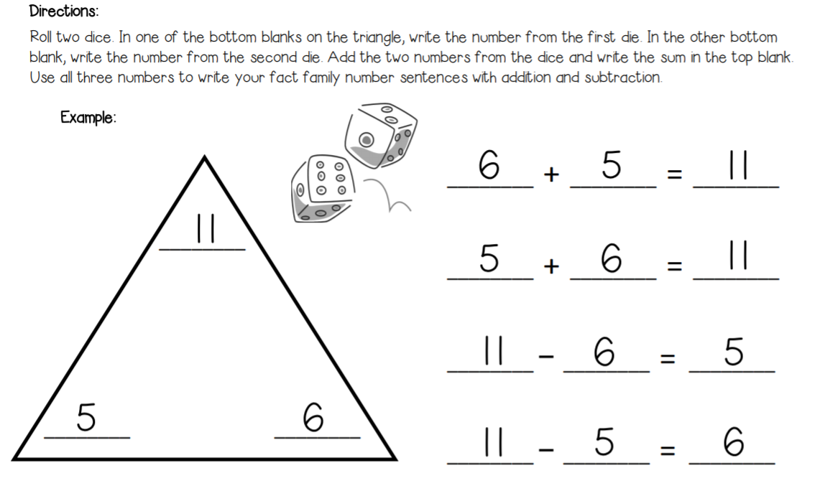
Fact Family Triangles

