Slide 1
Business Plan
‘An Electronic Document that has all the details to your Business venture’

Slide 2
What is a Business Plan?
Why is it important to create a business plan?
You’ll want to conveying the opportunity and strategy:
Goal or objective: What are you trying to do?
Strategy: How will you achieve it?

Slide 3
Business Plan
A business plan is the written presentation of a business idea.
It predicts the success of a business and outlines how it will operate.
A good business plan is based on solid research.

Slide 4
DRAGON’S DEN ADVICE…
https://www.youtube.com/watch?v=CE9xdIThIS4

Slide 5
Helpful Hints
Business plans are written in the third person
Visual aids like diagrams, drawings, photos, advertisements, logos are required.
You can add extra sections if you feel they are needed.
The information should be meaningful, not there to fill space.

Slide 6
Components of a Business Plan
Cover Page
Table of Contents
Business Model Canvas
Mission Statement
Business Overview
Management Profile
Market Research
Marketing Plan
Suppliers/Employees
Financial Summary

Slide 7
Business Model Canvas
TASK: Take a picture of your latest business canvas
https://leanstack.com/lean-canvas

Slide 8
Mission Statement
TASK: Tells the story of how and why you became passionate about this idea. Helps the audience get to know you and care about your casual idea.
A mission statement is a formal summary that explains:
What you do.
How you do it.
Why you do it.
A good mission statement can surprise, inspire, and transform your business. They provide a clearly stated purpose of your business and the goals you have for succeeding.

Slide 9
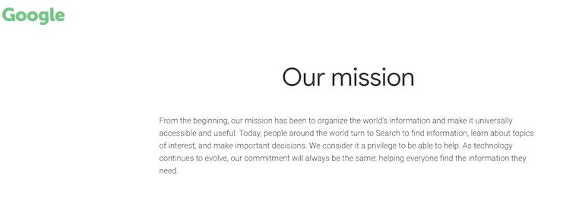
Mission Statement Examples
Starbucks: "To inspire and nurture the human spirit – one person, one cup and one neighborhood at a time."
Microsoft's mission statement expresses their belief in what people make possible. These beliefs and values are translated directly into their products and corporate culture.

Slide 10
Business Overview
TASK (1-2 paragraphs): Explain exactly what your business does and
how it does it by answering the following questions:
What does your business do?
What is the opportunity in the market that justifies your business idea?
Who are the business owners?
Where is the business located?
What form of business ownership will the business have?
What market will be serviced?
What is unique about your business?
How will your business be better than your competitors?
What stage is the business in? (Start-up for us)
What is the size of the business? (small for us)

Slide 11
Business Overview Examples…
ABC Laundry Soap Inc. will be laundry detergent manufacturer located in warehouse space at Lansdowne Place in Saint John’s North End. John Smith will be the sole owner of the incorporated company that will employ 15 workers that will focus on manufacturing a quality liquid laundry detergent.
Skyrocketing freight prices and the high value of the Canadian dollar have created a great opportunity for a local manufacturer to supply Maritime grocery stores and department stores with an affordable alternative to their current suppliers in the U.S. The challenge the business faces will be to persuade customers that the product has consistent quality and will appeal to their customers. The product will be environmentally friendly and unique in that it will donate a portion of its profits to the Environment Trust Fund. It is hoped that this will appeal to consumers who are becoming environmentally and socially conscious. The detergent will be packaged in the factory and sold by sales agents throughout Atlantic Canada.

Slide 12
Management Profile
TASK (in point form): Create your Management Profile by answering the following questions…
Who are the owners and key managers of the business?
What role will each person have in running the business?
What are their backgrounds?
What are their strengths and skills that they bring to the business?
How much time and money will each owner be contributing to the business?
How will the management team be paid?

Slide 13
Management Profile Examples…
Croutons R Us Bakery understands that its success depends primarily on a strong management team.
Marion Green will lead the baking team because of her strong baking background which includes ten years of baking experience at Ben’s Bakery and three years of management experience.
Don Black brings a strong financial background to the business which includes a CA designation and ten years of managing the finances of a reputable bakery in British Columbia.
Tina Reid will be responsible for developing marketing materials and for managing human resources. She brings six years of experience in working for a PR firm with her.
All members of the team will be working full-time and be paid a yearly salary.

Slide 14
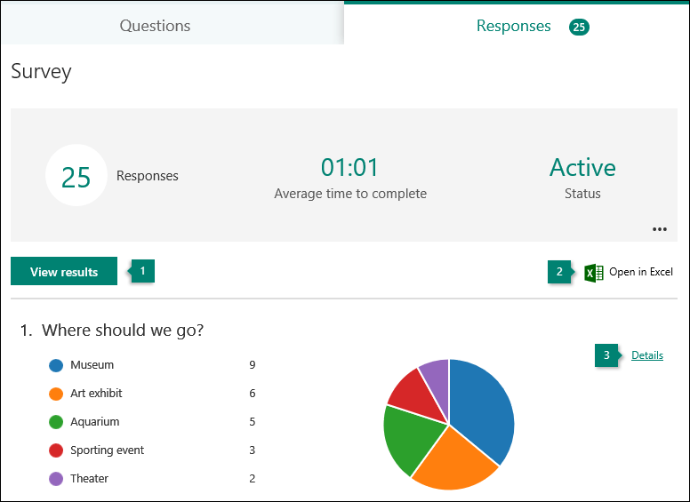
Market Research Results
TASK: Go to your Market Research Form and provide screen shots to the results from your survey.
EXAMPLE…

Slide 15
Marketing Plan…TASK #1
TASK #1 (point form): Create a Customer Profile
Should describe your target market by addressing the following questions:
Who are your customers?
Where do they live?
How many are there?
Describe their age, income, population, etc.
Are there any trends influencing your market?
What will influence their decision to buy your product or service?
This section will contain the results of your market research survey.

Slide 16
A. Customer Profile Example
Green Health Food Supplements is a multi-use product and will focus on three different customer groups.
The primary target group will be allergy sufferers. This group is growing at 15% a year with 32,000 potential customers in the Greater Saint John area. Allergy sufferers are known to try many products in their quest to rid themselves of allergy symptoms so they are often quite willing to try new products.
The second target is medical professionals and doctors in particular. This segment is also growing at 15% with 14,200 potential people served by doctors in the local area. Doctors are quickly beginning to understand the benefits of natural products and are beginning to refer patients to them.
The last group is the health conscious group. This segment is typically making modifications to their diet based on their desire to become healthier and prevent the onset of disease. This niche also is growing at 15% with 48,000 possible customers. Health conscious consumers frequently read about and try new products in their quest to find products that help them feel strong.

Slide 17
Marketing Plan…TASK #2
TASK #2 (point form): Describe your Competition
Profile your major competitors and how your business will compete with them.
Identify major competitors and describe their company in terms of size, location, and name.
List the strengths and weaknesses of each competitor, including: product quality, price, image, etc.
Predict how your business will compete

Slide 18
Competition Example
In today’s childcare market, parents are often looking beyond price willing to pay a little more for quality educational programming that will give their children an advantage at school. Programming, service, certification and reputation are critical success factors in the child care services industry. The Children’s College will compete well in the market by offering a leading edge educational program delivered by certified college-trained instructors.
There is no competitor in the market that is offering a focused, quality educational childcare program. Our educational approach is unique and will be difficult to duplicate by competitors.
Main Competitors
Those facilities located within a 5 mile radius are considered to be the company’s main competitors. They are as follows:
South End Church Day Care:
South End Church Day Care is located in the basement of the South End Church at 52 Bay Drive. There are 6 employees on staff and they are licensed to take up to 45 children.
Strengths: Large church congregation. Already established in market.
Weaknesses: May not appeal to customers of different religious beliefs. The staff don’t have any accredited training. The program offered is play based with no emphasis on education.

Slide 19
Suppliers / Employees
TASK (point form): Describe your Supplies and Employees
Describe where you got your supplies as well as providing details on anyone who may have helped with your business.

Slide 20
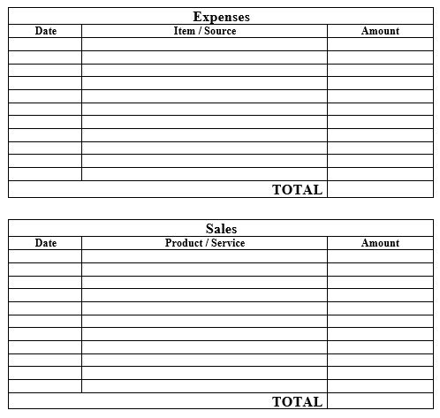
Financial Summary
TASK (point form): Complete a table that list all expenses and revenue. In the end, did you make a profit?

