Slide 1
How to stay smart online?
CyberImmunization
Created By:
For:

Slide 2
What do you like about Internet?
Notes:
Start a discussion in class, what do kids like about the internet?
Possible answers: Knowledge, sharing information, connecting with friends

Slide 3
Notes:
Not everything on the Internet is good. There are many things that we could change. What would you change?

Slide 4
If you want to be safe on the Internet, you should learn to protect yourself

Slide 5
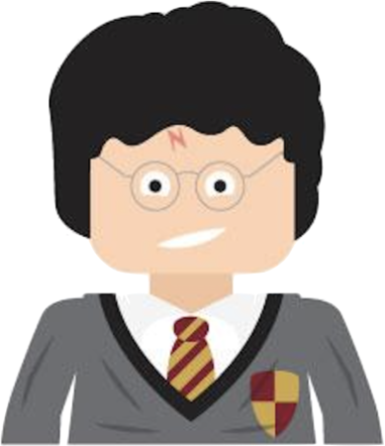
What would you want to protect?
Chances are if you like something, it is worth protecting! Your personal information, family and favorite pictures are worth protecting!
Notes:
Chances are if you like something, it is worth protecting! Your personal information, family and favourite items are worth protecting!
So how can we protect ourselves?

Slide 6
Who are we protecting from?
Hacker
Hacker is person illegally accesses somebody else’s information and devices.
Notes:
Hacker is person who hacks computers, i.e., illegally accesses somebody else’s information and devices.
An example: There is someone who makes money selling photos online. They get photos by logging onto your social media and stealing your photos! They have stolen your assets and are intruding on your privacy!
Any data posted online can be a dangerto us! So how do you identify an attack?

Slide 7
Vulnerabilities
A vulnerability is a weakness or fault that could be used to cause harm.
Example: Using a common password which an attacker could easily guess. The easily guessed password is a vulnerability.
Oops I forgot to lock my house.
Notes:
Next, we’ll talk about vulnerabilities. A vulnerability is a weakness or fault that could be exploited to cause harm. ​
​
Some examples of vulnerabilities are: a password that can easily be guessed.
These are considered vulnerabilities because they are weaknesses to the system that can be exploited by attackers, but on their own, do not cause harm.

Slide 8
Attack
An attack is what eventually happens if a vulnerability is not fixed.
Example: Someone logged in to your computer and stole all of your photos! They are now holding them hostage for money.
This is an attack.
Someone broke my broom! I should have protected it better!
CRACK!
Notes:
An attack is what a threat ultimately becomes if a vulnerability is not fixed.
When action is taken and done to cause harm to the user or system.
Let’s ask ourselves: How can we protect ourselves from cyber attacks?

Slide 9
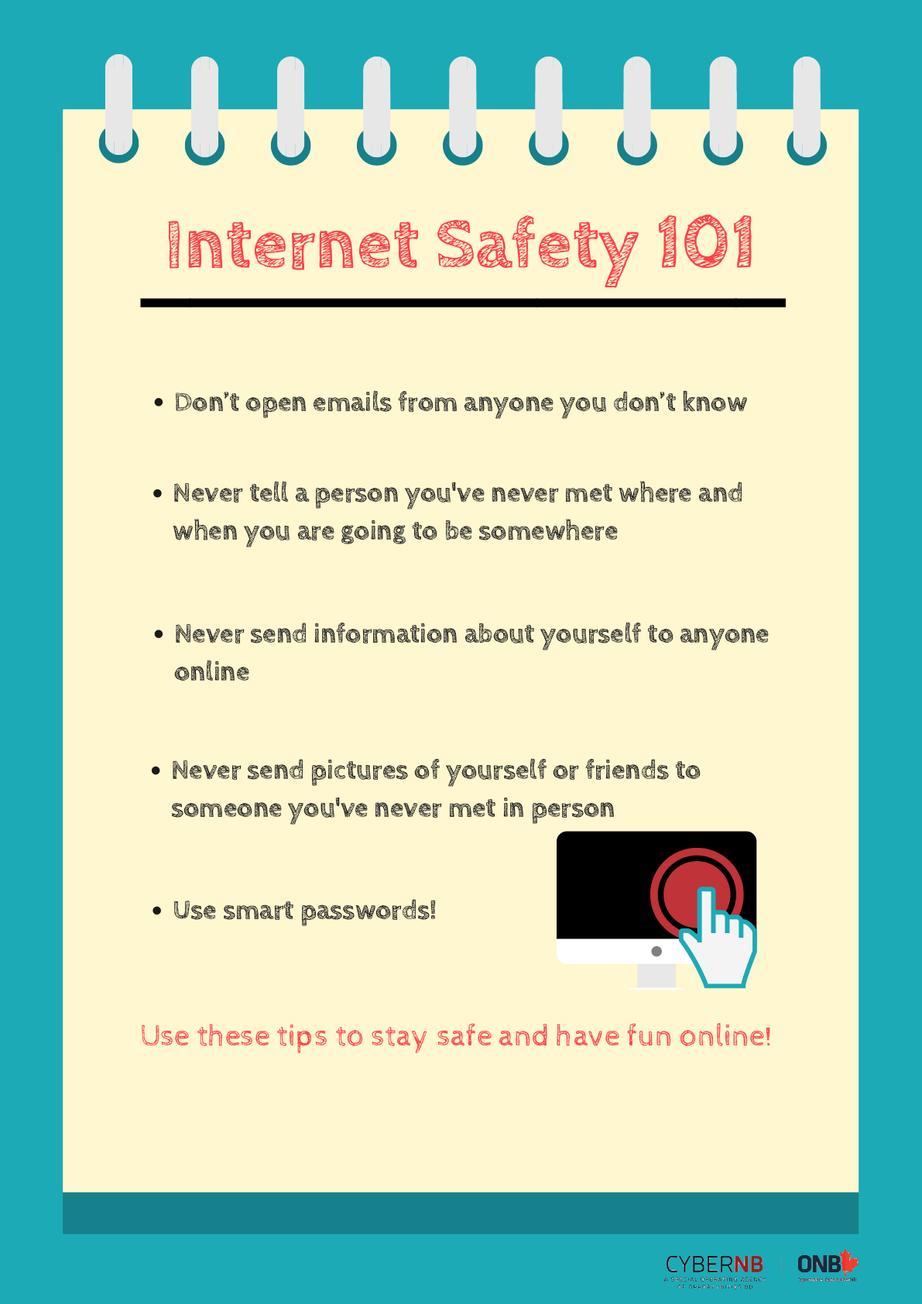
HOW TO PROTECT YOURSELF!
Remember that learning how to protect yourself and knowledge is your best weapon!
Notes:
Over the next few weeks we will learn more ways to protect and educate ourselves against cyber attacks!

