Slide 1
Basic Infant Care

Slide 2
Holding infant
Give support to baby’s head, for several months until baby can hold its head up alone
Carry your baby so his chest is against yours and his head is resting on your shoulder
Cradle the baby in your arms
Always be aware of the soft spots
When picking baby up, hold under its head and bottom

Slide 3
Crying Infant
Crying Newborn – Learn the reason for crying
1. Distinguish between hunger or fatigue cries
2. Check to see if baby is wet/dirty diapers,
3. Hungry,
4. Too hot or too cold

Slide 4
Soothing Infant
Soothing Methods for Crying Baby
1. Nurse or Feed Baby
2. Rock, move side to side, walk holding baby in arms or in front sling
3. Stroke head/tummy or give gentle body massage. Patting back may help release trapped gas or help to burp
4. Short walk outside, fresh air/distractions help
5. Swaddle in security blanket or swaddle blanket6.

Slide 5
Infant Sleeping
Make a bedtime routine by:
changing baby for bed,
sing,
rocking, or
a goodnight kiss/hug

Slide 6
Swaddling
- Helps to settle the infants plus it will keep the infant warm
Lay receiving blanket on flat surface, make a shape like a diamond, & fold down the top corner. Place baby on his back with his neck on the fold.

Slide 7
Swaddling
Hold baby’s right arm down flat at his side. Pull left corner of blanket over his right arm & across his body, then tuck it under his left arm, roll him to your left to wrap the remaining under his back.

Slide 8
Swaddling
Hold the baby’s left arm down & pull the bottom corner up over his left shoulder. Tuck extra around his left arm. Leave enough room at the bottom of the blanket for baby to bend his legs up and out from his body.

Slide 9
Swaddling
Bring the loose right corner of the blanket straight out, then pull it across the baby’s front, roll him to your right, wrap the corner all the way around his back

Slide 10
Feeding
Feeding a newborn is a round-the-clock commitment and a Bonding time
Feed your newborn on demand. Most newborns need eight to 12 feedings a day — about one feeding every two to three hours

Slide 11
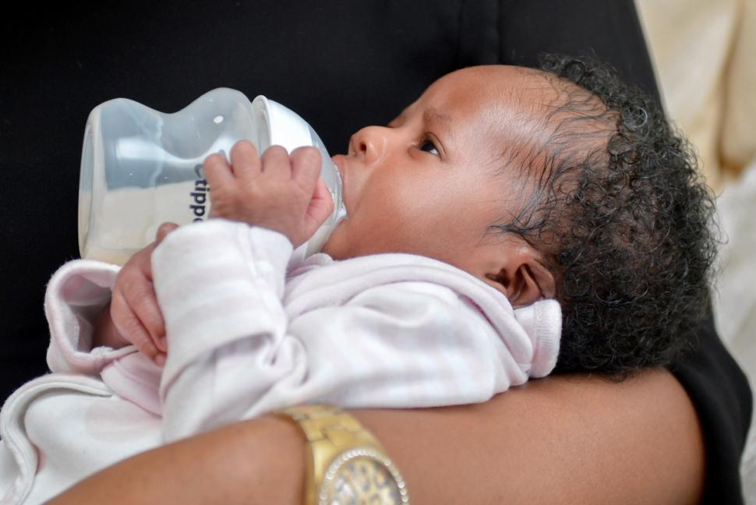
Feeding
The Infants’ signs of hunger:
stirring and stretching,
sucking motions and lip movements.
Fussing and crying are later cues.
The sooner you begin each feeding, the less likely you'll need to soothe a frantic baby.

Slide 12
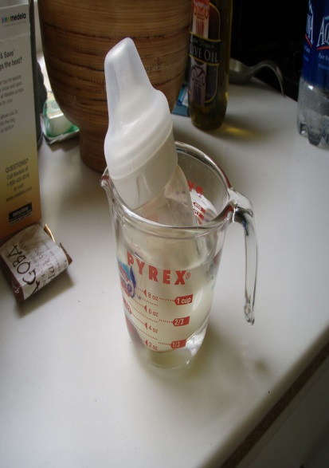
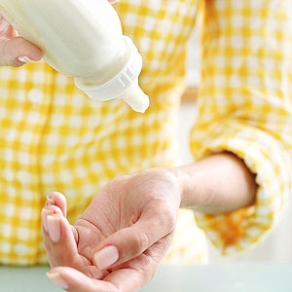
Feeding
Some infants prefer their milk or formula warm. Be sure to test the temperature of the milk by sprinkling a few drops on the back of the hand or the inside of the wrist. It should be warn…not hot.
When using a microwave, only heat the water in a cup/bowl then place bottle in water to warm. Putting formula/milk in the microwave can damage the nutrients for the infant.

Slide 13
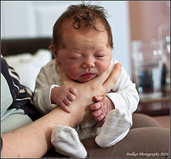
Burping
Three Methods for Burping
Sit upright and hold your infant against your chest. Your infant's chin should rest on your shoulder as you support the infant with one hand.
Hold your infant sitting up, in your lap or across your knee.
Lay your infant on your lap on his or her belly.

Slide 14
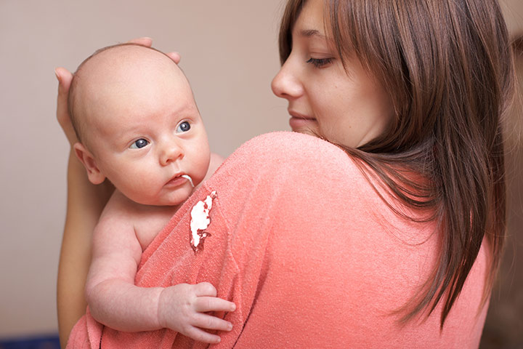
Spit up or Vomit
About half of all infants experience gastroesophageal reflux (infant reflux), during their first three months.
Spit up is normal flow from stomach to mouth, however vomit is flow that is forced.

Slide 15
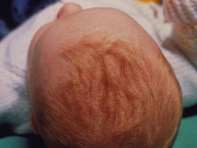
Cradle Cap Care
Cradle Cap is a scalp condition common in newborns. Dry skin that looks like dandruff, but can appear anytime from birth to several months.
Massage scalp and shampoo then rinse.

Slide 16
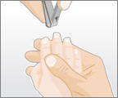
Newborn Fingernails Care
Newborn nails are soft, but sharp, grow fast, which can scratch his face. They need to be cut a few times a week. Toenails require less trimming.
Best time to cut an infant’s nails, when he is asleep.

Slide 17
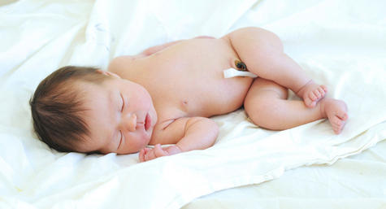
Infant’s Umbilical Cord Stump
Keep umbilical stump clean and dry. It takes 10-21 days to dry up & fall off
The belly button make take a few more days to heal completely, leaving a little blood on the diaper.
Fold the diaper below the stump, avoid tub baths, in warm weather allow air to circulate and aid the drying process. Give an infant sponge baths, any change swelling, redness, pus, call the doctor

Slide 18
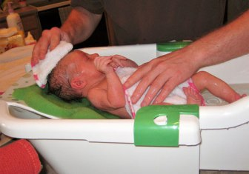
Bathing a Newborn
Sponge bath for the first weeks, with a warm, damp washcloth, cleaning face, hands, and genital area after each diaper change.
Support baby’s head,
Keep towel over body,
to keep warm. Test water
With elbow feeling the
Temperature of water.

Slide 19
Bathing a Newborn
After umbilical cord stump falls off, area heals, then newborn can have a tub bath. It is in sink, or small plastic tub filled with warm water. For some babies it is soothing, others scream the whole time. Baths can occur three times or so weekly. Bathing too often can dry out their skin.

Slide 20
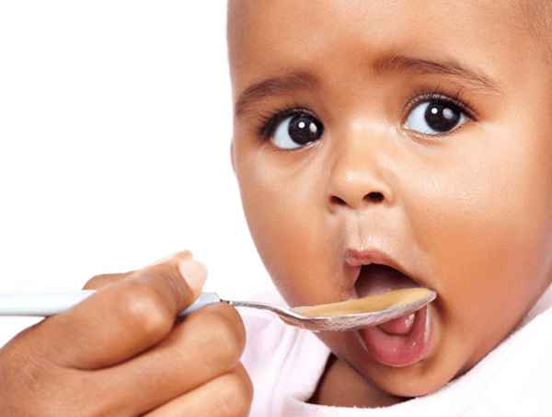
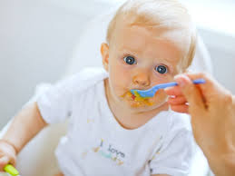
Feeding solid foods to infants
Solid Food should be given when the infant can hold head up, stops using tongue to push food out, and can sit up alone.
Solid foods can be given between 4 & 6 months of age.
Only give 1 new food every 3-4 days.

Slide 21
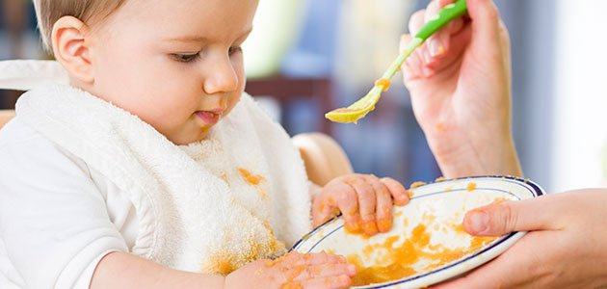
Feeding solid foods to infants
Foods that should be avoided for the entire first year, as baby has or easily develops allergies to them:
1. chocolate,
2.citrus fruits,
3. peanut butter (it also presents a choking hazard for children under 3),
4. egg whites,
5. honey (may contain botulism food poisoning), wheat products, cow’s milk

Slide 22
Feeding solid foods to infants
Beta-carotene is the orange pigment that gives carrots, sweet potatoes, and other vegetables their characteristic coloring.
Sometimes too much orange can discolor the infant’s skin to look like jaundice.
Peaches, oranges, are some foods that are too acid for infants, can cause digestion or rash.

Slide 23
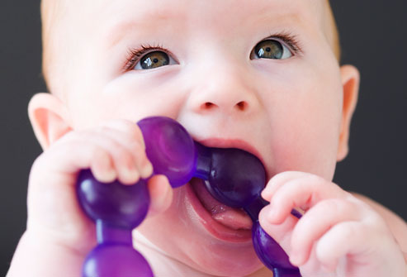
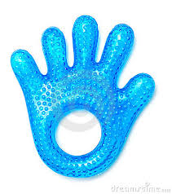
Teething
Signs of teething are:
1. drooling,
2. irritability,
3. gum swelling and sensitivity,
4. sleeping problems,
5.refusing food,
6. the urge to bite on hard objects and possibly a low grade fever.
Teething usually is about 6-8 months, but can be earlier or later in life.
Use teething rings, cold washcloth, or numbing medicine.

Slide 24
Infant Diaper Changes
Infants need 10-12 diaper changes daily. Do not use powder on newborns, they can breathe it in causing problems.

Slide 25
Diarrhea
infant's diarrhea may be caused by a gastrointestinal infection, antibiotics, too much fruit or juice in the diet, food poisoning, an allergy to milk sugar (lactose), an enzyme deficiency, and perhaps even teething due to extra swallowing of saliva.
Electrolyte solutions such as Pedialyte and sports drinks such as Gatorade can help hydrate an infant. They can live on these for 3 days and will like them since they are slightly sweet. Then, they may need to go to the doctor.
Some infants have loose stools normally.

Slide 26
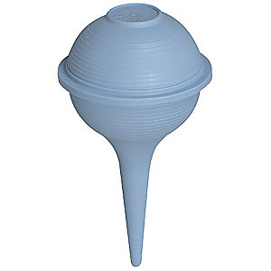
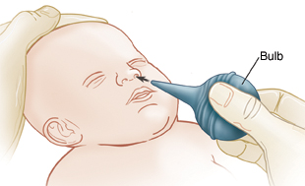
Infant’s nose/mouth
Bulb Syringe will help clean out the mucous out of the baby’s nose and mouth (being stuffy).
To use, first squeeze the bulb until it is collapsed. Place it in one nostril and quickly release the bulb. This will bring the formula or mucus into the bulb.
Remove the bulb syringe from the nose and squeeze the bulb quickly into a tissue to get rid of this material.

Slide 27
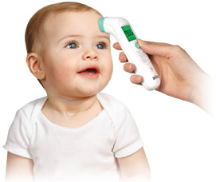
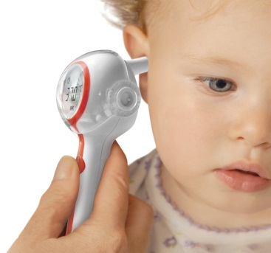
Infant’s Temperature
Digital thermometers use electronic heat sensors to record body temperature. They can be used in the rectum (rectal), mouth (oral) or armpit (axillary) –less accurate.
Digital ear thermometers use an infrared ray to measure the temperature inside the ear canal.
Digital pacifier thermometer, child simply sucks on the pacifier until the peak temperature is recorded.
Temporal artery thermometers use an infrared scanner to measure the temperature of the temporal artery in the forehead.

Slide 28
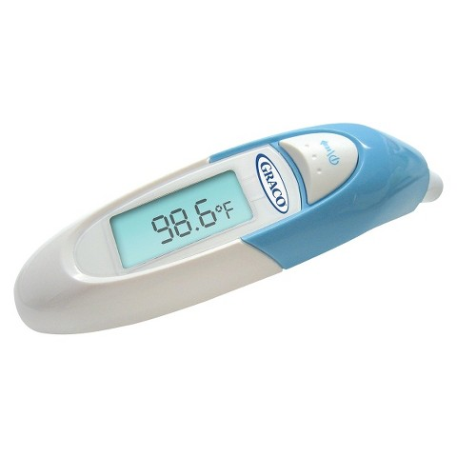
Infant’s Temperature
Most doctors recommend the digital ear or temporal artery thermometers for the best and accurate temperature.
Call the doctor, tell him how old the child is, how you took the temperature, what medications have been given to the child.
Wait 20 minutes after giving the child a bath or has been swaddled to take the temperature
The high temperatures read as: 106 degrees rectal,105 degrees oral,104 degrees axillary

Slide 29
Infant’s Colic
Cause of Colic
immature digestive system, or nervous system.
Infants cry for 3 hours or more a day, for more than 3 days of a week. It can last for 3 weeks or 3 months.
The Five S's are some of the main solutions for calming infant’s colic
swaddling,
shooshing loudly in an infants ear,
swinging baby,
sucking on a pacifier,
laying her on her side or stomach (across your forearm or lap with her head resting in your hand).

Slide 30
Washing Infant’s Clothes
Wash infant’s clothes separate from the family.
Use soaps –Ivory or Dreft, (not detergents)
Rinse twice
Use oxygen bleaches, not chlorine bleach
Do not use fabric softener

