Slide 1
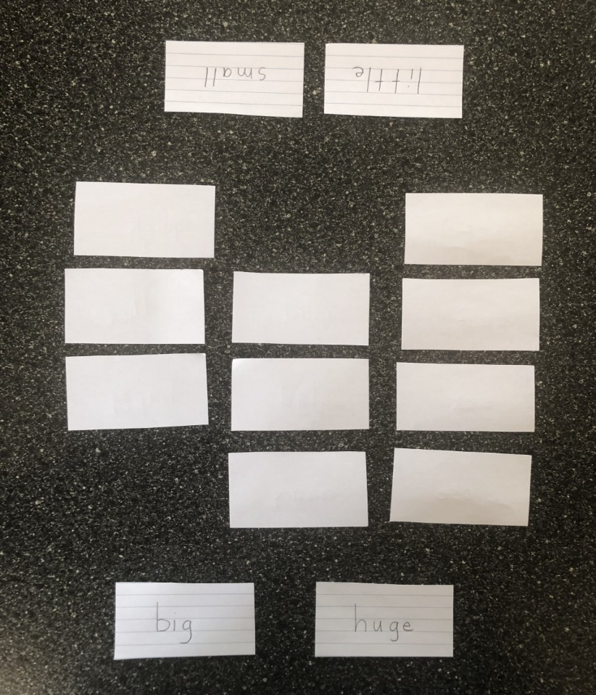
Synonym Memory Game
Make cards with synonyms on them and then turn them over and try to make matches.
The player with the most matches wins.
Use these synonym pairs
big – huge mad - angry
small – little hop - jump
shut – close ill - sick
glad – happy noisy - loud
quick – fast begin - start

