Slide 1
INNOVATION | COLLABORATION | EDUCATION

Slide 2
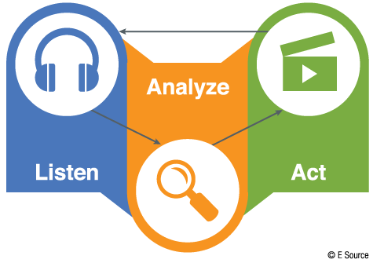
Market Research Survey
A market research survey is used to collect data from potential customers. It is a valuable tool for all entrepreneurs and is a simple way to gather information.
The most important part of a market research survey is how you analyze the data. It’s very important to ask questions that will help you make decisions for your business.

Slide 3
Key to success
In person is always best
Surveying potential customers in person is always the most useful, with direct contact you can dive deeper and use open ended questions to gather feedback.

Slide 4
Key to success
Online surveys are the next best thing
It’s easy to conduct market research online. Using an online survey is an affordable (free) and reliable way to gather information from your target markets

Slide 5
Key to success
Survey as many people you don’t know as possible
Surveying friends and family can create biased results. If you are doing this in person go to a public place and survey people you don’t know. If your survey is online try to get friends to post your survey for their friends to reach more people you may not be connected to.

Slide 6
Key to success
Analyze the data and understand bias
There are a variety of factors that lead to bias in primary market research, however for the purpose of your survey please know that there will be some bias and please consider that in your market research results.

Slide 7
Key to success
Collect as many responses as possible
The more responses you have the better. A combination of in person and online response will be the best and provide you with the most
relevant data.

Slide 8
Reading #1
Market research is IMPORTANT!
An old article, but very much on point
https://hbswk.hbs.edu/item/clay-christensens-milkshake-marketing

Slide 9
Reading #2
Avoid these mistakes!
https://www.surveymonkey.com/mp/5-common-survey-mistakes-ruin-your-data/

Slide 10
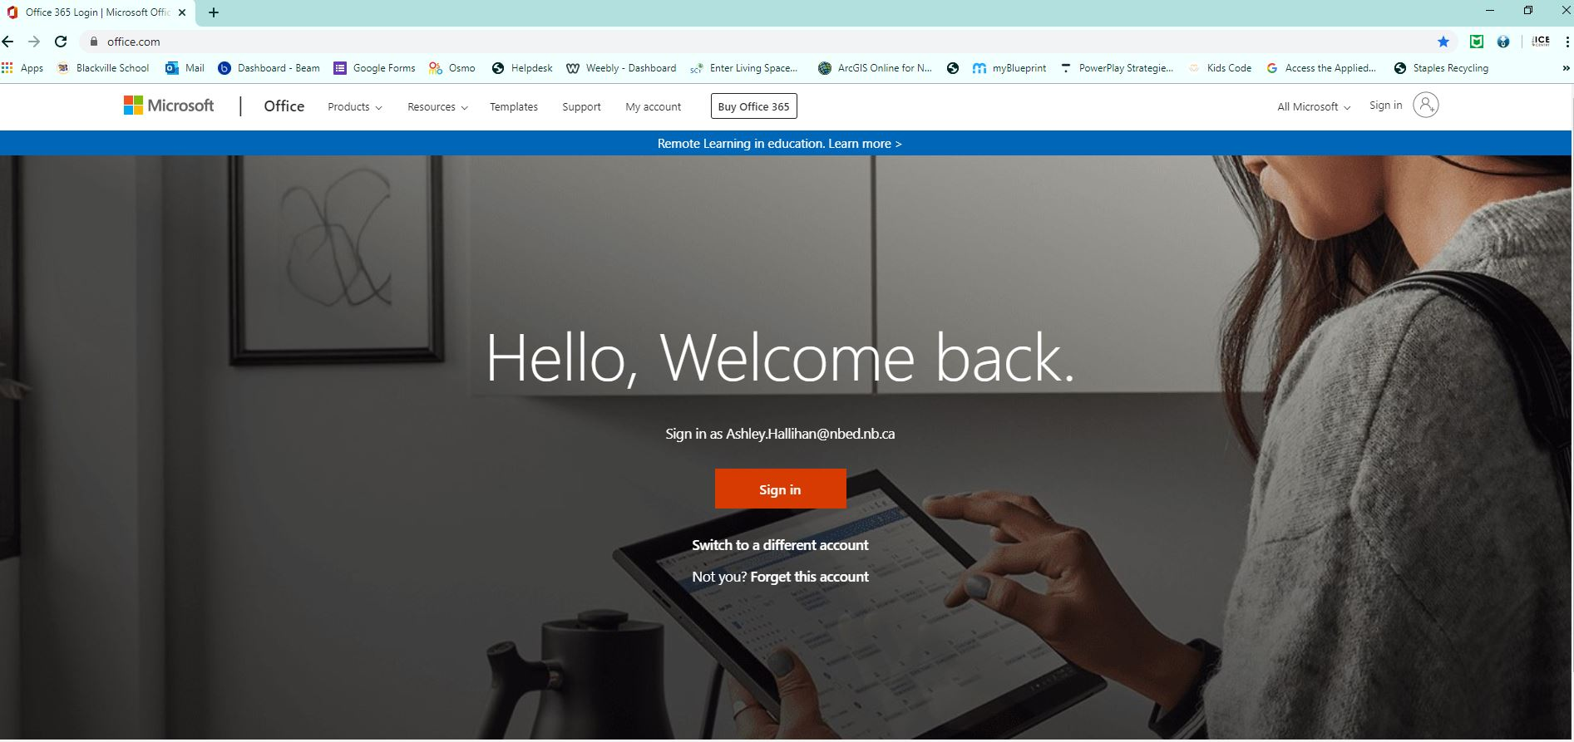
How to create your survey
Creating a form (survey) with Microsoft Forms
Login to Microsoft Office
Need to use school email/password…
username@nbss.nbed.nb.ca
3. Select Forms

Slide 11
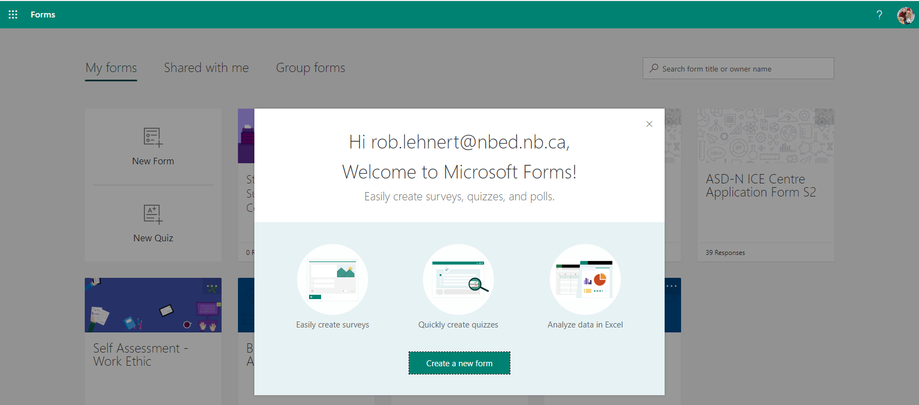
How to create your survey
4. Select create a new form

Slide 12
How to create your survey
5. Create a title and short description of your business

Slide 13
How to create your survey
6. Choose a choice or text questions
Use choice for multiple choice answers and text for open ended questions.

Slide 14
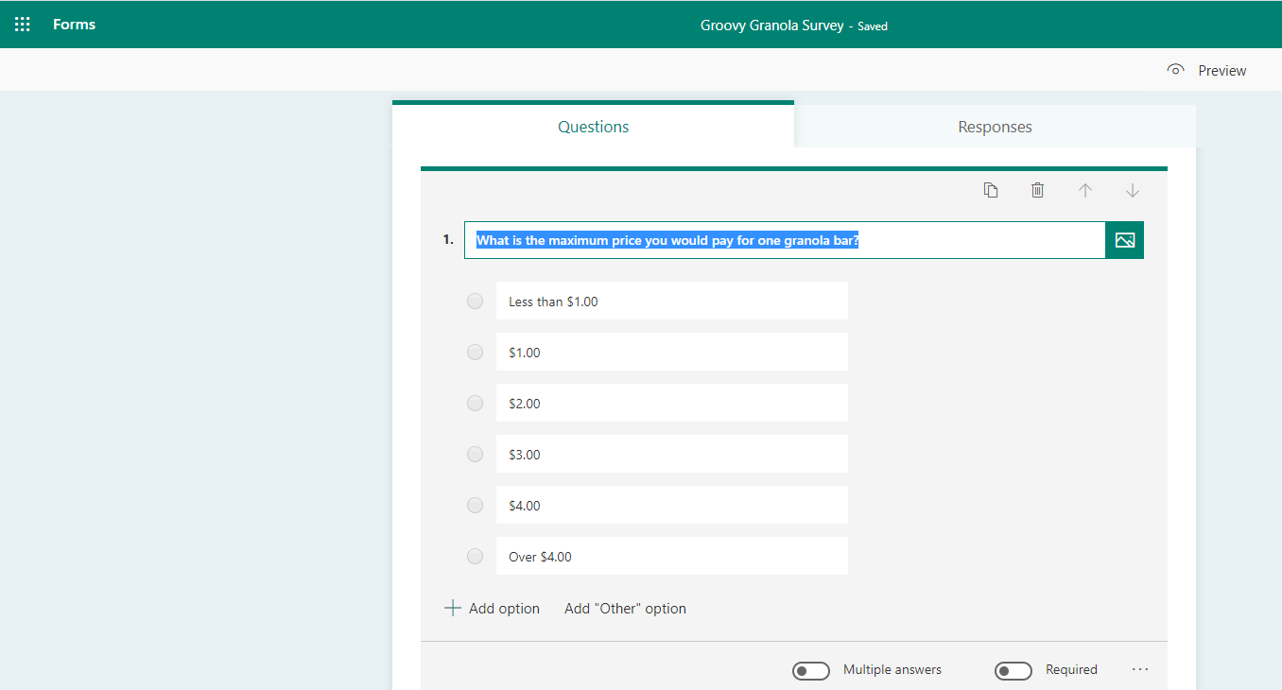
How to create your survey
7. Choose multiple answers or required if applicable

Slide 15
How to create your survey
Now add all your questions to the survey!

Slide 16
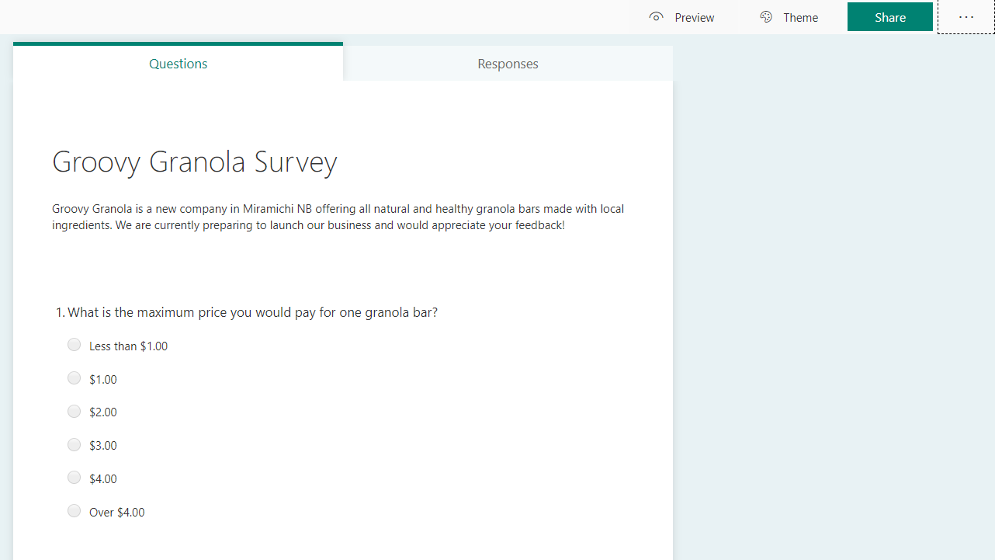
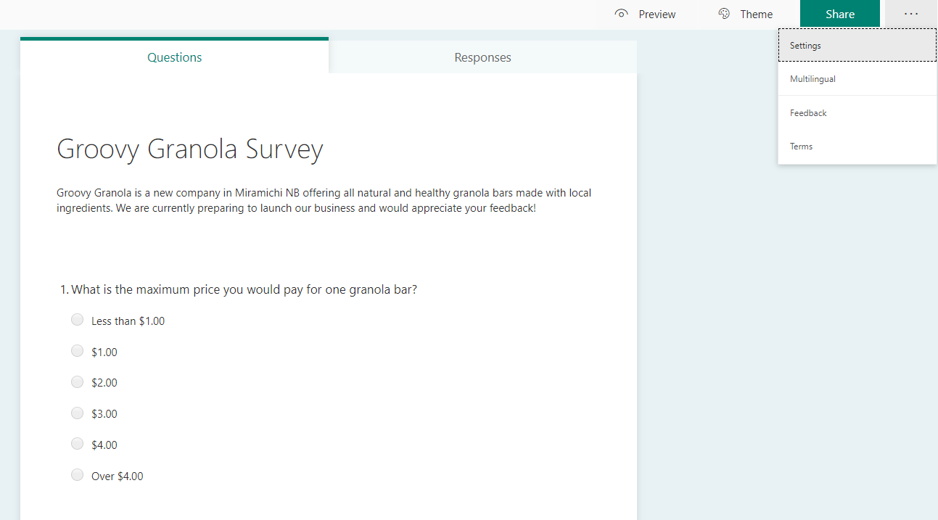
How to create your survey
8. Adjust your settings to open the survey to the public.
9. Select the three dots in the top right corner
10. Select Settings

Slide 17
How to create your survey
11. MAKE SURE you have the settings set to
“Anyone with the link can response”

Slide 18
How to create your survey
12. Share the survey with me by sending the link to the survey (Ashley.Hallihan@nbed.nb.ca)

Slide 19
How to create your survey
Please create your survey and share the link with Mr. Hallihan
Once I have reviewed the survey
you may share with the public!

Slide 20
Tips for posting your survey
Post with a picture with the link!
This will attract more attention to the post
Use a picture of your product if possible
Ask friends and family to share or post individually
This will expand your reach and hit customers you do not know
Post on multiple platforms, Instagram, Facebook, email etc
This will expand your reach

Slide 21
Questions?
If you have any questions or run into any issues please send me an email!
Ashley.Hallihan@nbed.nb.ca

