Slide 1
INNOVATION | COLLABORATION | EDUCATION

Slide 2
Professional Communication
What is the purpose of communication?

Slide 3
Professional Communication
How do we communicate?
How do businesses communicate?

Slide 4
Professional Communication
Keys to successful communication
Identify your purpose
Know your audience

Slide 5
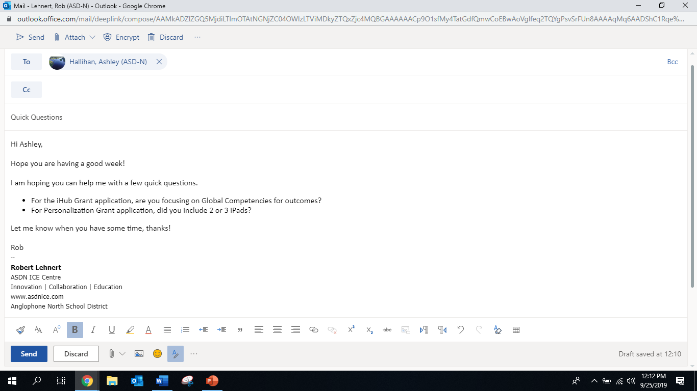
Email Communication
Subject Line – short summary
Hi, Good Morning, Good Afternoon
Greeting, introduction
Content, short and sweet
Thank you,
Signature

Slide 6
Phone Communication
Prepare !
Greeting
Introduction
Short and sweet
Thanks!
Follow Up

Slide 7
E-Mail Signature
Login to your Outlook Email
Go to settings and search “signature”
Create your own signature
Example:
--
Ashley Hallihan
BHS ICE Centre
Innovation | Collaboration | Education
www.bhsice.com Anglophone North School District

Slide 8
E-Mail Signature
Find a business owner to contact!
Anyone you can find!
Send them an email, cc’d me on the email!
Introduce yourself, explain your business idea and
ask 3 questions:
Example: What is one piece of advice you would give a young entrepreneur?
Ashey.Hallihan@nbed.nb.ca

