Slide 1
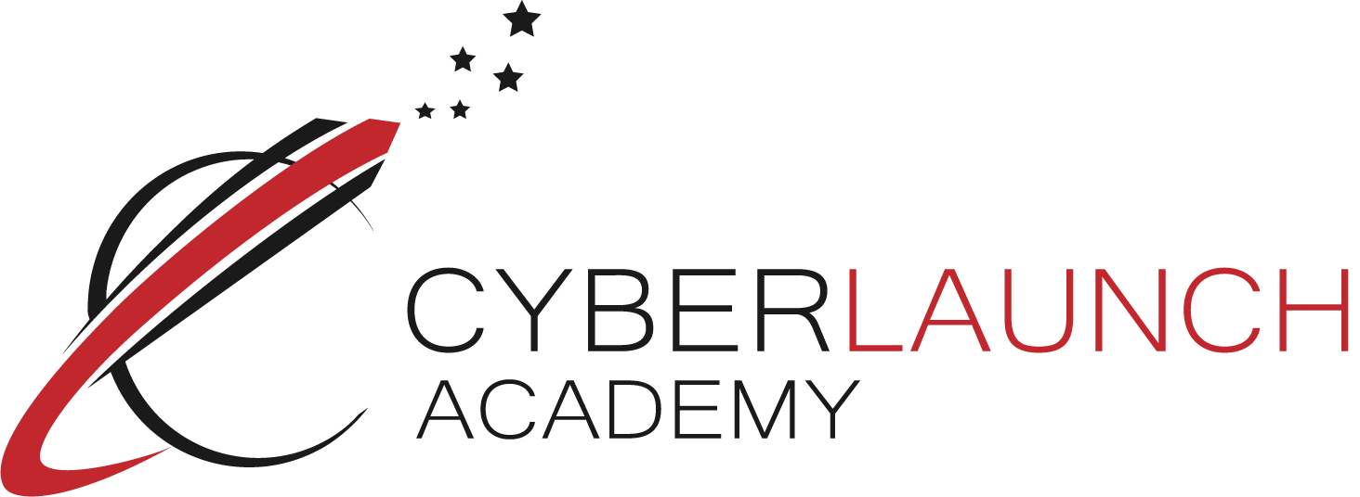
Passwords
Created By:
For:
Why they are impo

Slide 3
Why do we use passwords?
Passwords help keep our information safe and secure!
It’s like a lock and key. If you have the proper key (or password) then you are granted access to what’s behind the lock!
Notes:
Ask the question: “Why do we use passwords? What do we use them for?”
Passwords help keep our information safe and secure! Using passwords also help with confidentiality and making sure that information is only given to those allowed to see it!
An example of how we use passwords is a lock and key. The proper key unlocks the lock and gives up entry to whatever is behind the lock. Just like using the proper password gives us access to our accounts! (Examples of accounts: email, social media and logging into a computer!)

Slide 4
Weak Passwords
All lowercase or uppercase letters
Common words (princess, dragon, your pet’s name)
Not using a mixture of numbers and symbols!
Contains less then 8 characters! TOO SHORT!
A weak password can be easily guessed!
Notes:
What makes a password weak?
Lots of things! Using all of the same case (uppercase and lowercase). Using common words, not using numbers and symbols and having a short password are all bad!
An easily guessed password means losing your information and accounts!

Slide 5
My password was princess123 and now someone is pretending to be me online!
HOW COULD I HAVE FIXED THIS????

Slide 6
Strong Passwords
Something that is not easily guessed and includes a combination of upper case and lower case letters, symbols and numbers!
Examples: 12Maple_wood89
*IloveMy_#1Dog
CU_L8Tr_Sk8rT478
Notes:
What is a strong password?
Something that is not easily guessed and includes a combination of upper case and lower case letters, symbols and numbers!

Slide 7
How to make your passwords stronger
Step 1: Don’t reuse old passwords!
Step 2: Add some uppercase or lowercase letters!
Step 3: Add random numbers! DO NOT JUST ADD 123
Step 4: Add in some of the following symbols!
% $ # ! _ - / ? * & ^
Notes:
Step 1: Don’t make it an easily guessed word!
Step 2: Add some uppercase or lowercase letters!
Step 3: Add random numbers! DO NOT JUST ADD 123!
Step 4: Add in some keyboard symbols!

Slide 8
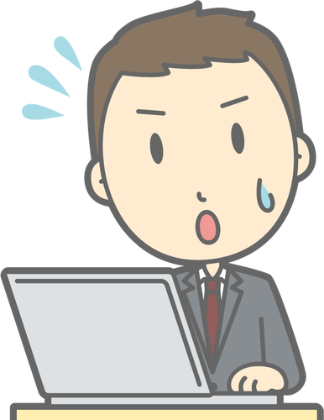
WHAT’S WRONG DAD?
SOMEONE STOLE MY PASSWORDS AND LOCKED ME OUT OF ALL MY ACCOUNTS!

Slide 9
ALL OF YOUR ACCOUNTS !?!?!
EVEN MY ONLINE BANKING
WAIT DAD… YOU DON’T REUSE THE SAME PASSWORD DO YOU?

Slide 10
WELL…. YES
OH DAD… NOT AGAIN.

Slide 11
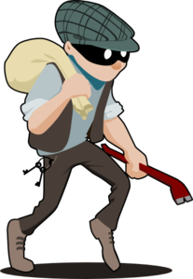
Password Attacks
But how do people find out my password?
By attacking it
Different types of attacks include:
Brute Force Attack
Dictionary Attack
Notes:
Ask the question: “But how do people find out my password?”
There’s different kinds of attacks attackers will use to discover passwords! Today we’ll go over two of them: Brute Force Attack and a Dictionary Attack.

Slide 12
Brute Force Attack
A brute force attack is where an attacker tries every possible combination they can think of until a combination works. This attack takes a lot of time and effort.
Think of how much time it would take to try to call every phone number in the world until you finally reach your friend next door, that’s a long time!
Notes:
A brute force attack is where an attacker tries every possible combination they can think of until a combination works.
This attack takes a lot of time and effort. Think of how much time it would take to try to call every phone number in the world until you finally reach your friend next door, that’s a long time!

Slide 13
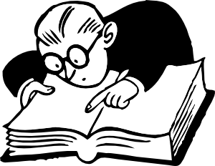
Dictionary Attack
A dictionary attack is a method of searching by common words and combinations of names.
Common combinations include:
Capitalizing only the first letter
Ending your password with a single digit.
It’s like searching through a dictionary of known words until you find the correct word you’re looking for!
Notes:
What is a dictionary attack?
A dictionary attack is a method of searching by common words and combinations of names.
Common combinations include capitalizing only the first letter and ending your password with a single digit.
It’s like searching through a dictionary of known words until you find the correct word you’re looking for!

Slide 14
Most Common Passwords of 2016
password
qwerty
123456
google
12345678
111111
123123
mynoob
123321
654321
These are the worst passwords I’ve seen!
They don’t even use symbols! $%#!_-?!!
Notes:
Here’s a list of the most commonly used passwords in 2016. Can you tell that these passwords do not meet any of the strong password criteria? There’s no mixture of upper and lower case letters, numbers and symbols.

Slide 15
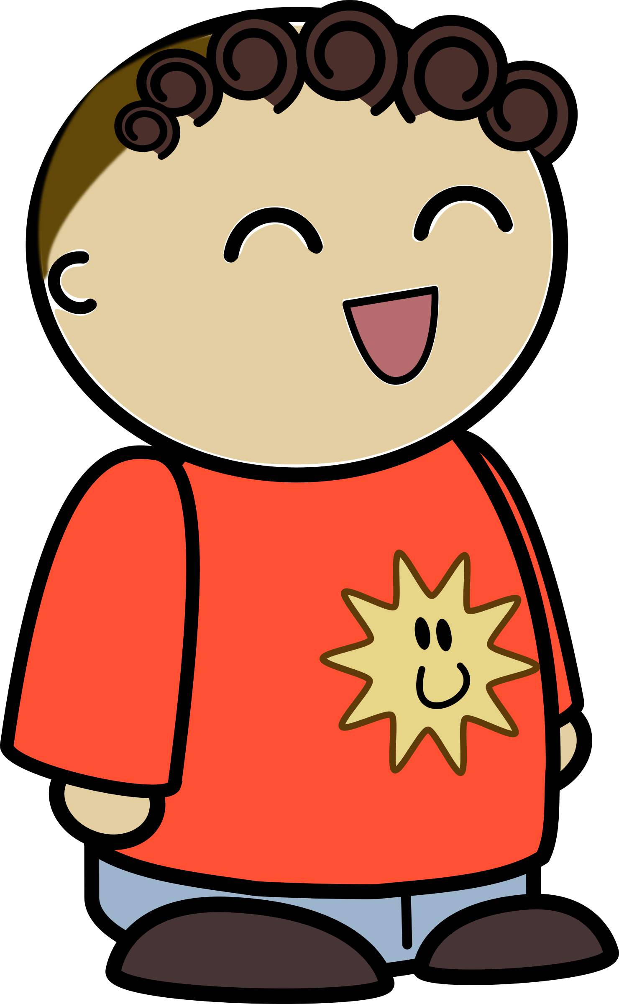
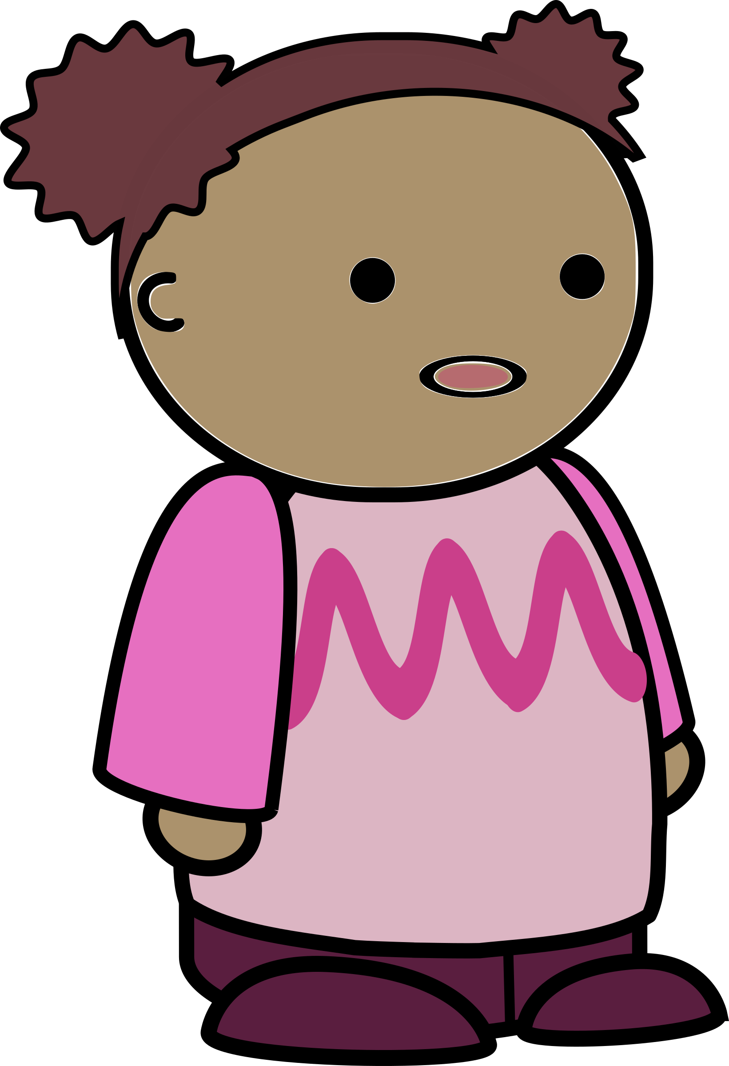
I finally have a new password!
… It’s not I-FORGOT-MY-PASSWORD is it?

Slide 16
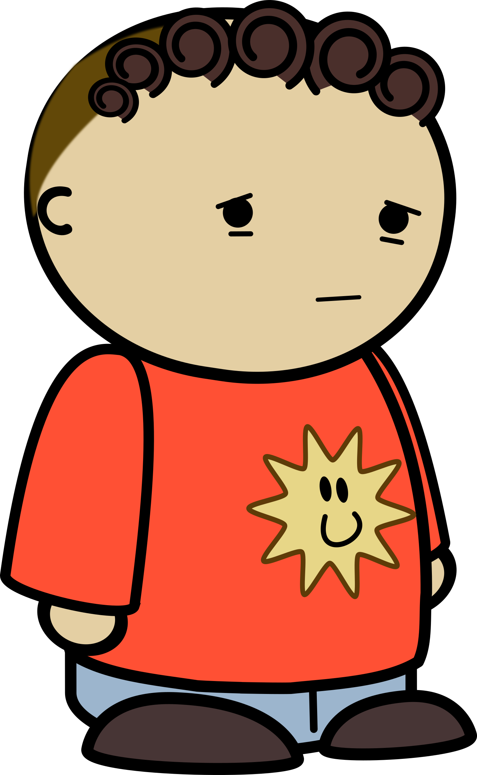
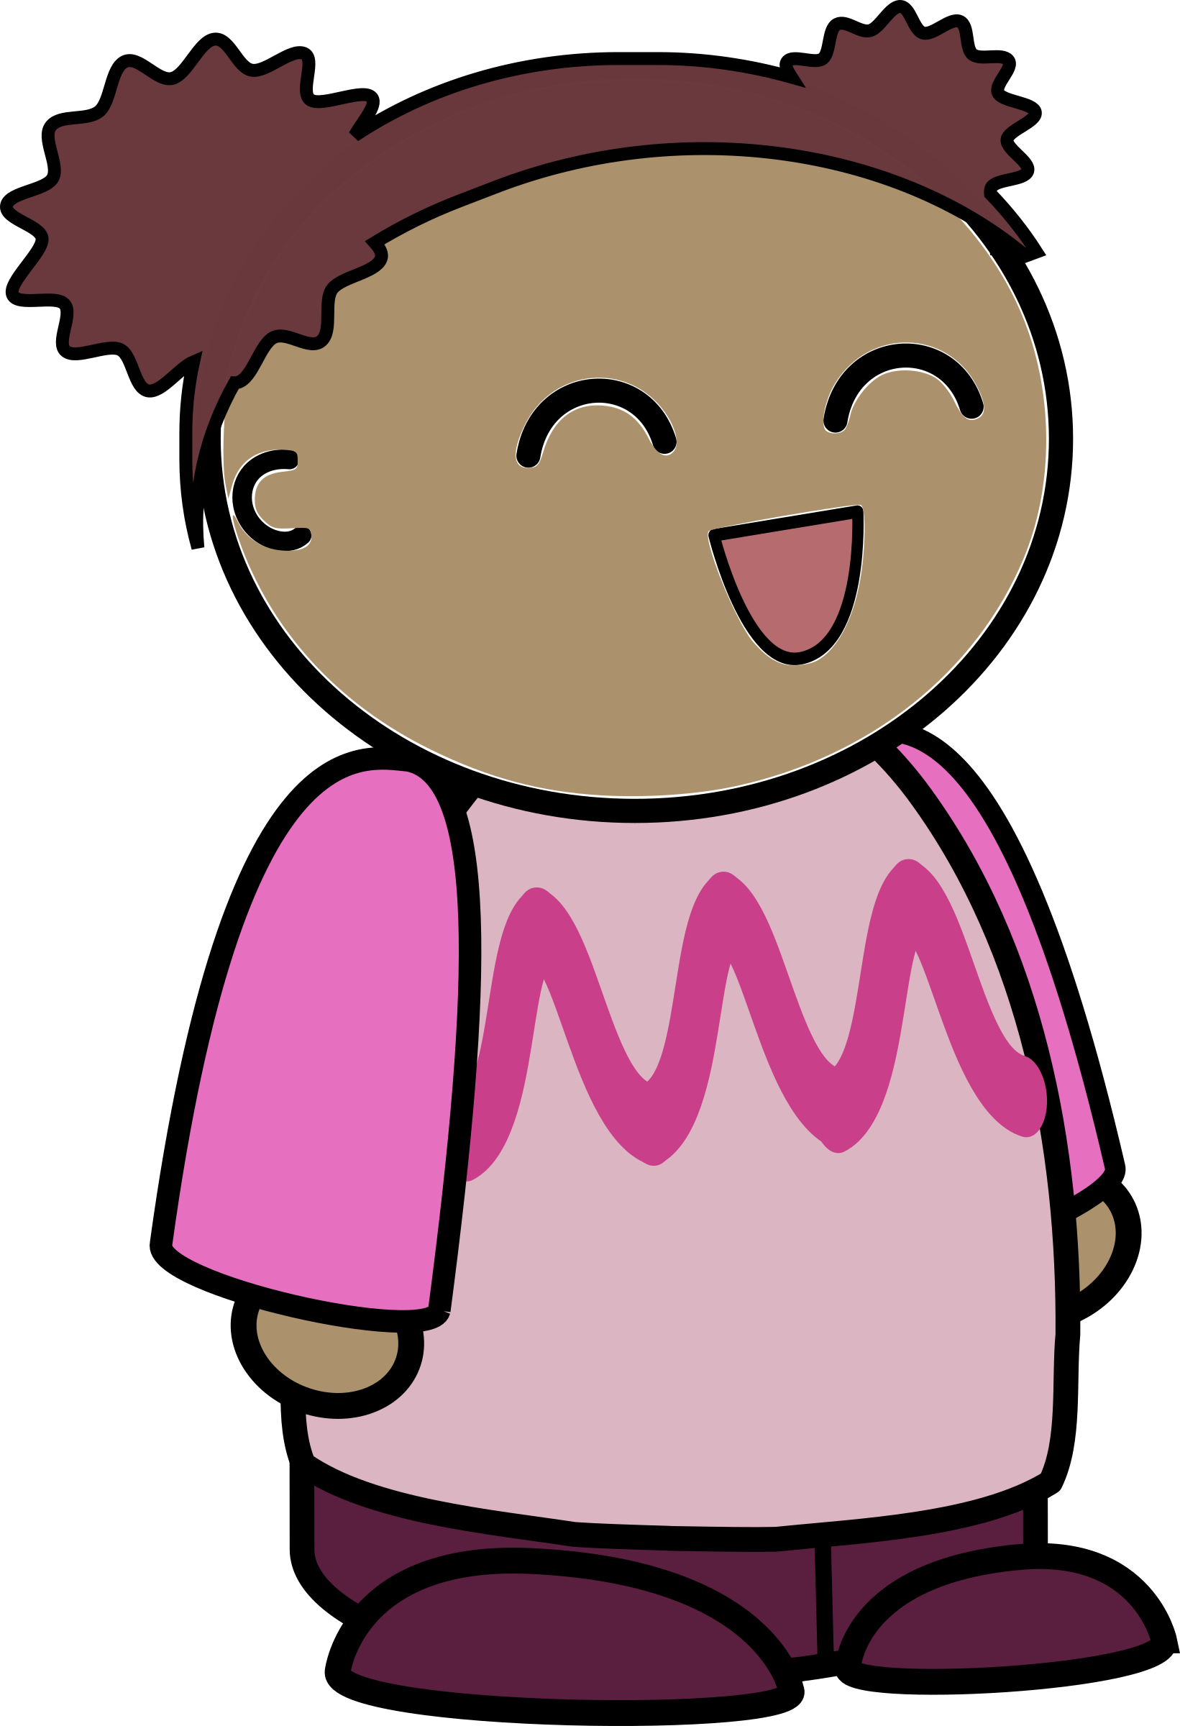
How did you know….?
You reuse that every time you forget your password, at this rate I’ll have renamed you McChickenMan on all your accounts muahahah

Slide 17
Recap
Strong Password Criteria:
Longer then 8 characters
Contains a mixture of upper and lower case letters
Contains a mixture of numbers
Contains a mixture of symbols !@#$%^&*_-
Brute Force Attack: A method of trying every possible combination until a combination works.
Dictionary Attack: A method of searching by common words and combinations of names.

