Slide 1
Bridging Technology and Safety
Grade 6 Cybersecurity Immunization Program
Cyber Hygiene
Cyber Safety
Cyber Literacy
Cyber Ethics
Cybersecurity

Slide 2
Skills but not Skilled
Our most vulnerable
Students are connected like never before and are voracious consumers of content.
Likewise they are prolific contributors.
All this with very little regulation, accountability or understanding of consequences.
Habits are formed early.
Intervention as early as possible can help produce fewer issues downstream.

Slide 3
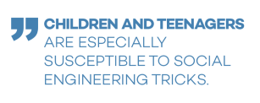

Slide 4
Sobering Thoughts
A survey of 825 adults and children between the ages of seven and 16 found one out of eight parents allowed their children to use the internet from the age of two. Consequently, only one out of 10 make their children wait until they are 10 or older, as recommended by experts.
Studies found that over 71 percent of parents do not supervise their children's internet use after the age of 14, yet a shocking 72 percent of all missing children cases that begin online involve children who are 15 or older.

Slide 5
More Sober Thoughts
Unfortunately, nearly 32 percent of teenagers hide or delete their browsing history from their parents.
Only 62 percent of teens have their Facebook account set to private. A staggering 17 percent have all of their information, including contact information and whereabouts, public.
Children are victims of identity theft more often than is known. In fact, compared to adults, children under the age of 18 are 51 times more likely to have their identities stolen. Criminals target children because they have clean credit records and, as previously reported, frequently post personal information publicly. Criminals are sometimes able to use an unsuspecting child's identity for years unnoticed.

Slide 6
Cyber Immunization
Our goal is to ensure that all students in New Brunswick are given a primer in cybersecurity in grade 6.
Grades 6 through 12 will present ample opportunities for coursework and career information
This project will be an introductory point for all.

Slide 7
The Program
5 day Program @ 1 period (50-60 minutes) per day.
Designed for CyberNB by CyberLaunch Academy.
Activity-based learning.
Based on five outcome pillars
Smart Online Behaviour
Passwords
Phishing
Malware
Digital Privacy

Slide 8
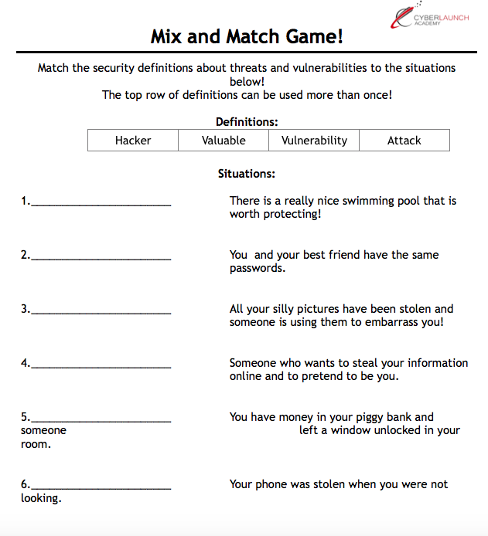
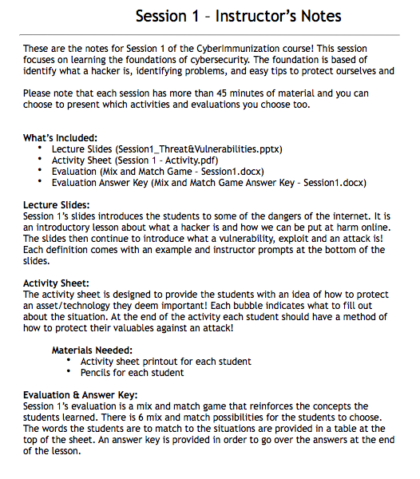
Stay Smart Online
Session 0ne
This session focuses on learning the foundations of cybersecurity. The foundation is based of identify what a hacker is, identifying problems, and easy tips to protect ourselves.
What’s Included:
Lecture Slides
Activity Sheet
Evaluation
Evaluation Answer Key

Slide 9
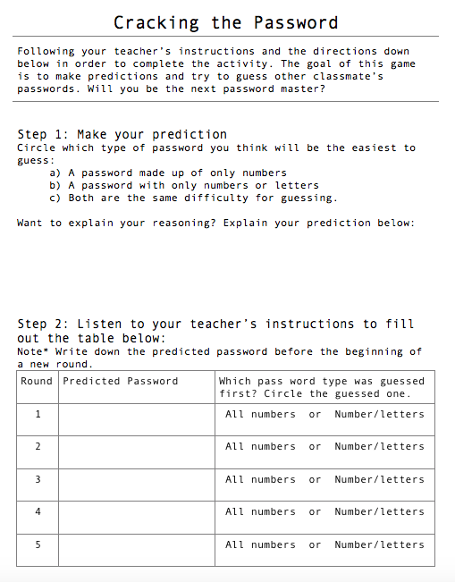
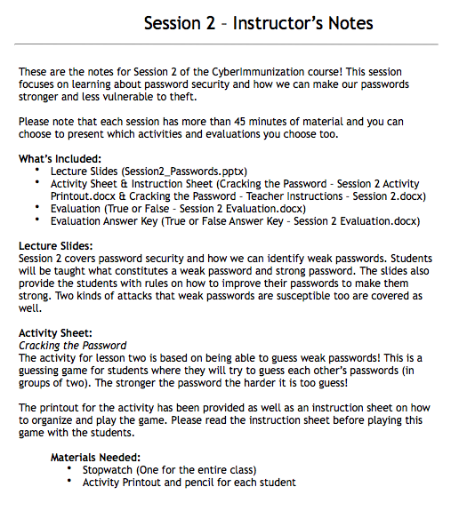
Passwords
Session Two
This session focuses on learning about password security and how we can make our passwords stronger and less vulnerable to theft.
What’s Included:
Lecture Slides
Activity Sheet & Instruction Sheet
Evaluation
Evaluation Answer Key

Slide 10
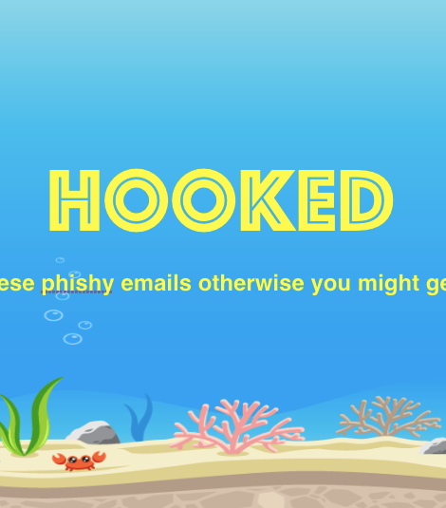
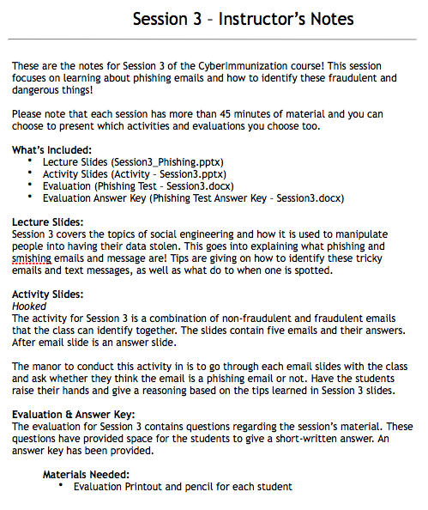
Phishing
Session Three
This session focuses on learning about phishing emails and how to identify these fraudulent and dangerous things!
What’s Included:
Lecture Slides
Activity Slides
Evaluation
Evaluation Answer Key

Slide 11
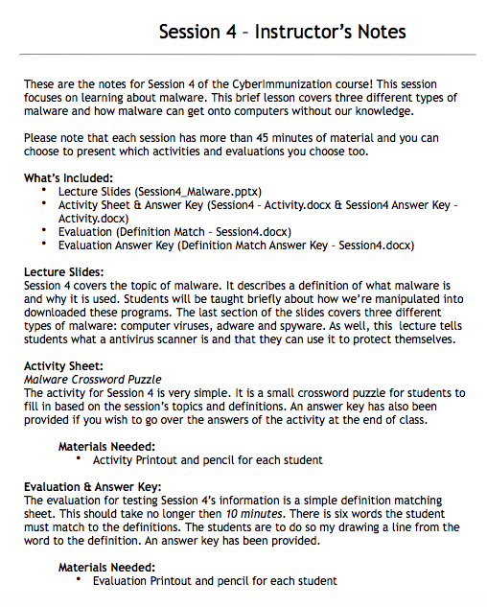
Malware
Session Four
This session focuses on learning about malware. This brief lesson covers three different types of malware and how malware can get onto computers without our knowledge.
What’s Included:
Lecture Slides
Activity Sheet & Answer Key
Evaluation
Evaluation Answer Key

Slide 12
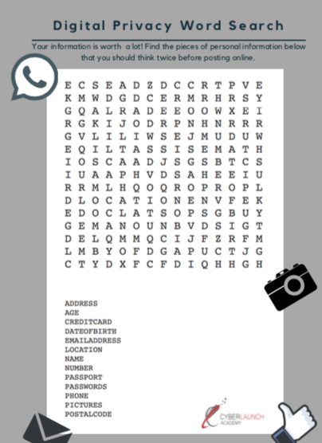
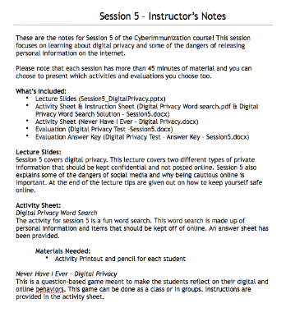
Digital Privacy
Session Five
This session focuses on learning about digital privacy and some of the dangers of releasing personal information on the internet.
What’s Included:
Lecture Slides
Activity Sheet & Instruction Sheet
Activity Sheet
Evaluation
Evaluation Answer Key

Slide 13
Reinforced by Reverse
Follow the exploits of Ethical Hacker, Reverse and her friend Sparky as they respond to a cyber attack on the Cityville Power Plant.
Mal Ware, the combined dark forces of the internet, is a formidable foe.
However with friends like Sparky and CyBear, Reverse has all the tools she’ll need to foil Mal and prevent further attacks.

Slide 14
Schedule
The Fine Details
October is Cybersecurity Awareness month.
We would like to offer this program to schools free of charge.
We would also like the opportunity to meet with and train teachers who would be presenting this program.
We would like to schedule delivery as soon as possible.

Slide 15
Think nobody sees what you do online?
What’s your google number?

