Slide 1
Digital Privacy
Created By:
For:
Cyberimmunization

Slide 2
The Facething & Tweetamajig
Notes:
Instructor: show this vide as a start of conversation with kids
https://whatsyourstory.trendmicro.com/blog/entry/1-a4a0/
What are they talking about? – Digital privacy
Note for teachers: these terms were made up by these two guys just for this video.

Slide 3
Privacy
Control what others can know about you, and what others can do with that information
Notes:
What is privacy?
Privacy is the ability to control what others can know about you, and what others can do with that information.
Our information is valuable and our privacy should be taken seriously.

Slide 4
What kind of information should you be keeping private?
Personal Information
Sensitive Information
Notes:
What kind of information should be kept private from the web?
Well we can start with Personally Identifiable Information and Sensitive Identifiable Information.

Slide 5
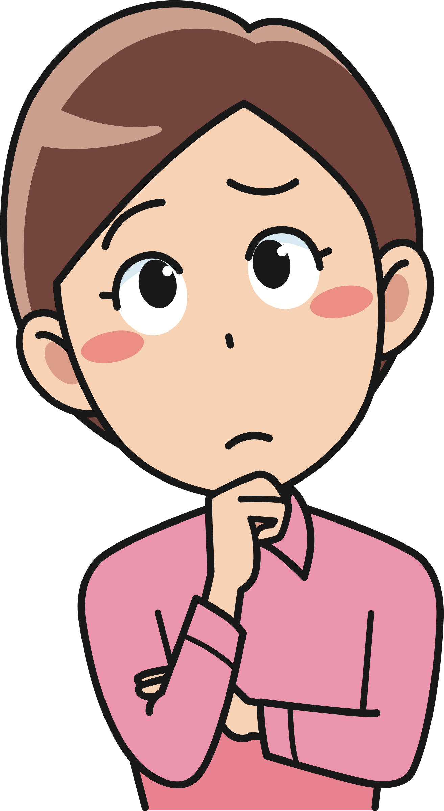
Any information that can be used to identity a specific individual is Personally Identifiable Information
Anything that can make it possible to locate, contact or identify an individual.
Any ideas what this can be?
Notes:
Personally Identifiable Information, or PII, is information that can be used to identify a specific individual.
Ask kids to brain storm 10 items of personally identifiable information.

Slide 6
Is this personally identifiable information?
birthdate
school name
your parents’ phone number
your pet name
A postal code, gender and date of birth can be enough information to find a person online.
Notes:
What kind of information is personally identifiable information? Some examples are birthdates, postal codes, address, phone number and gender.
It doesn’t take much to be able to identify someone, all it takes is a zip code, gender and date of birth.

Slide 7
Sensitive Identifiable Information
Information that if put into the wrong hands, could be very harmful to the individual.
Sensitive Identifiable Information is information that if taken by someone could be used to steal a person’s identify.
Notes:
What is Sensitive Identifiable Information?
Information that If put into the wrong hands, could be very harmful to the individual.
Sensitive Identifiable Information is information that if taken by someone could be used to steal a person’s identify.

Slide 8
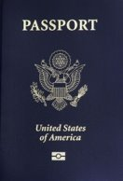
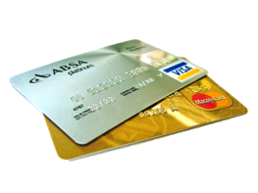
Sensitive Identifiable Information
Social Insurance Number
Driver’s License Number
Bank account information
Credit Card Number
Passport Information
Notes:
What kind of information is sensitive identifiable information?
Some examples are social insurance numbers, driver license numbers, bank account information, credit card numbers and passport information.
These should be kept very private!
Anyone of these bits of information could be used to steal your identity.

Slide 9
Social Media
Notes:
Do you recognize any of these websites? You might find facebook, instagram, twitter and youtube to be familiar.

Slide 10
Nothing posted online is private!
How can this possibly harm me?
Social media can broadcast information to identity thieves.
Notes:
Social media can make people vulnerable to leaking out and broadcasting private information.
This allows for identity thieves to potentially use that information to steal your identity and pretend to be you.

Slide 11
Social Media
Social media websites and apps have settings for privacy, but you have to change them yourself.
Friends can tag you in their photos and post, putting your privacy at risk!
Notes:
Even if you have good privacy policy in place, which you have to consciously change, friends can tag you in their photos or posts, compromising your privacy.

Slide 12
Phone/Tablet Apps
Apps on your phone and tablet ask for permissions that put your privacy at risk. For example, accessing your social media account to log in!
Tablets and phones are easier to steal then a bulky computer! If your device is stolen, so is all your information kept on it!
Phones and Tablets have GPS, this means that it can tag your location and know where you’re going! YIKES!
Notes:
Phones and tablets are super handy and fun to have, but they too can harm our privacy.
Apps on your phone and tablet ask for permissions that put your privacy at risk. Like accessing your social media account to log in!
Tablets and phones are easier to steal then a bulky computer! If your device is stolen, so is all your information kept on it!
Phones and Tablets have GPS, this means that it can tag your location and know where you’re going! YIKES! You can turn off this in your devices settings.

Slide 13
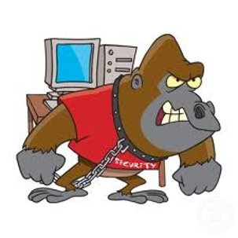
How to protect your computer & yourself?
Notes:
What can we do to protect ourselves and our computer? Let’s go over some guidelines we can apply when using the internet at home, in public and at school.

Slide 14
Privacy Guidelines
Don’t give strangers information about yourself
Do not give out your name, address, phone number, school name.
Don’t put personal information on your social media
No one needs to know your phone number or address. Your real friends already would know it, so why give it to strangers?
Notes:
Don’t give strangers information about yourself
Do not give out your name, address, phone number, school name.
Don’t put this information on your social media
No one needs to know your phone number or address. Your real friends already would know it, so why give it to strangers?

Slide 15
Privacy Guidelines
Do not give out your password to anyone
Keep your password a secret! Your privacy is extremely important!
Logout of your account on a website after using it
Be sure to ALWAYS logout.
Especially on a computer in a common area.
Notes:
Do not give out your password to anyone. Keep your password a secret! Your privacy is extremely important!
Logout of your account on a website after using it. Be sure to ALWAYS logout, especially on a computer in a common area.

Slide 16
Privacy Guidelines
Check your privacy settings on social media
The default privacy must be changed in order to make sure your posts and information aren’t public to everyone.
Do not except random friend requests
Don’t know them in real life? Deny the request! This is a safe option to take instead of adding fake profiles or dangerous people who could harm you.
Notes:
Check your privacy settings on social media
The default privacy must be changed in order to make sure your posts and information aren’t public to everyone.
Do not except random friend requests
Don’t know them in real life? Deny the request! This is a safe option to take instead of adding fake profiles or dangerous people who could harm you.

Slide 17
Privacy Guidelines
Think before you post
There is no reason to put all your personal information and day to day lives online! Never gives away your address, phone number, social insurance number or even your birthday!
Ask a parent or trusted adult
It’s fun to post pictures of friends and trips, or talk to friends online. The best thing you can before posting anything is asking your parents or a trusted adult if it is okay.
Notes:
Think before you post
There is no reason to put all your personal information and day to day lives online! Never gives away your address, phone number, social insurance number or even your birthday!

Slide 18
Recap
Privacy: The ability to control what others can know about you, and what others can do with that information.
Personally Identifiable Information: Information that can be used to identify a specific individual.at could be exploited to cause harm.
Sensitive Identifiable Information: Information that If put into the wrong hands, it could be very harmful to the individual. od fog advantage of a known vulnerability.
Stay safe and be smart! Remember the guidelines!

