Slide 1
Malware
Created By:
For:
Cyberimmunization

Slide 3
Malicious software
Malware is like a sneaky evil villain that hides in your computer and does unwanted things.
Notes:
Malware is a common name for malicious software.​
Malware is a program that is inserted onto a digital device with the purpose of harming or stealing the user’s data. Malware doesn’t always have to cause harm but it can be annoying to the user.
Basically, malware is a software that is created with bad intent, that gets installed user’s computer and performs actions without the user’s consent. ​
​
There are a variety of different forms of malware, such as viruses, Trojans, worms, ransomware, which we will discuss.

Slide 4
How do we get Malware?
Phishing messages often come with malware
Notes:
How does malware get downloaded onto our devices?
Attackers get malware on our devices through emails and websites. We learned, phishing and websites last week in session 3.
Did you know the phishing messages and emails often come with malware?

Slide 5
Did you know that you can get infected with malware by simply visiting a website?
It is called
drive-by-download
Notes:
An infection mechanism are websites, which contain drive-by downloads of malware.
Drive by download websites work by visiting an infected website. If it is successful, the malware is downloaded onto the user’s computer.

Slide 6
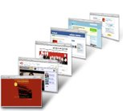
Drive-by-download
Infected website secretly downloads malware on your computer or phone
Visit an infected website
Notes:
Malware doesn’t just affect your computer, it can also download onto your phone

Slide 7
Drive-by-download
The malware will download automatically, so there is no way to tell if you are being tricked or not.
Do not visit untrusted websites
Notes:
The user does not have to be tricked into downloading the malware, as it happens automatically.
A safe way to avoid malware is by not visiting untrusted or unfamiliar websites.

Slide 8
It’s all malware
Computer virus
Adware
Spyware
Notes:
There are a variety of different forms of malware, such as Viruses, Adware and Spyware. Let’s talk about them!

Slide 9
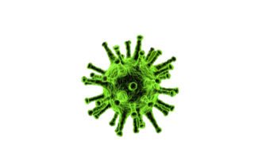
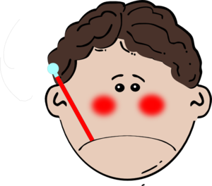
Computer Viruses
Just like human virus makes your computer sick
Computer viruses are sneaky and hide themselves behind other programs on your computer!
Notes:
Now we’ll talk about the different types of malware.
There’s lots of different types of malware. One of them is a computer virus. You’ve probably heard of this before since it is a commonly used term.
Computer viruses are sneaky and hide themselves behind other programs on your computer! A program (piece of code) that attaches itself to other programs​ and makes your computer sick.

Slide 10
Adware
Adware is a program that downloads or displays unwanted advertisements. It can infect your computer by being added onto a free product or simply by visiting an infected website.
A safe practice is to NOT click on these ads!
Notes:
Another type of malware is called Adware. Maybe you’ve seen adware before! It’s very common and very annoying.
So what is adware? Adware is a program that downloads or displays unwanted advertisements.
It can infect your computer by being added onto a free product or simply by visiting an infected website.
A good practice is to not to click on these ads! Avoid them!

Slide 11
Spyware
Malware that collects data about a user without their knowledge.
What does it collect:
your personal information
your pictures
keystrokes
your backing information
what website you visit
what you like to buy
The spyware sends the collected information to data collection agents.
Notes:
The last type of malware we’ll explore is spyware.
Spyware is a malware that collects data about a user without their knowledge.
The spyware sends the collected information to data collection agents.

Slide 12
Spyware
Takes videos and pictures of you and your room
Always cover your webcam if you are not using it!
Notes:
Did you know that spyware can take videos and pictures of you and your room through your computer?
If you can a webcam on your computer or laptop you should cover it!

Slide 13
Protecting yourself
Antivirus programs are used for scanning arriving files for malware.
Example: Your friend sent you an email with an attachment. You download that attachment and the antivirus scanner checks the attachment for malware.
Notes:
Malware is dangerous, how can we protect ourselves and our computers from harm?
What does an Antivirus Scanner do?
Antivirus programs are used for scanning arriving files for malware.
Example: Your friend sent you an email with an attachment. You download that attachment and the antivirus scanner checks the attachment for malware.

Slide 14
How can you protect myself?
Always install & update anti-virus programs
Don’t be stupid online!
Notes:
A good practice is to always install an anti-virus program. Make sure to update it as well!
Use common sense online, do not go to untrusted websites or click on strange ads.

