Slide 1
Phishing
Created By:
For:
Cyberimmunization

Slide 2
What should you know
Phishing
Smishing

Slide 3
What is phishing?
The act of trying to get user information through tricking people with fake messages.
5 lucky winners will receive $5000. Send your name, address, bank account number to PO Box 4532, Toronto, ON
Notes:
Have you heard of phishing before?
Phishing is where hackers try to obtain user information through tricking people with fake emails and messages.

Slide 4
How are we tricked?
Appeal
Phishing messages usually offer something that we want.
Congratulations your mobile number was selected as winner of a new iPhone8. To claim your prize , send your name and social insurance number to notfakeemail@gmail.com
Notes:
How do we get tricked with phishing emails? Simple, these messages seem realistic. They have appeal, which means they usually offer something that we want: money, to be famous, to appear on TV.
Anything that appeals to us can be used to grab your attention.

Slide 5
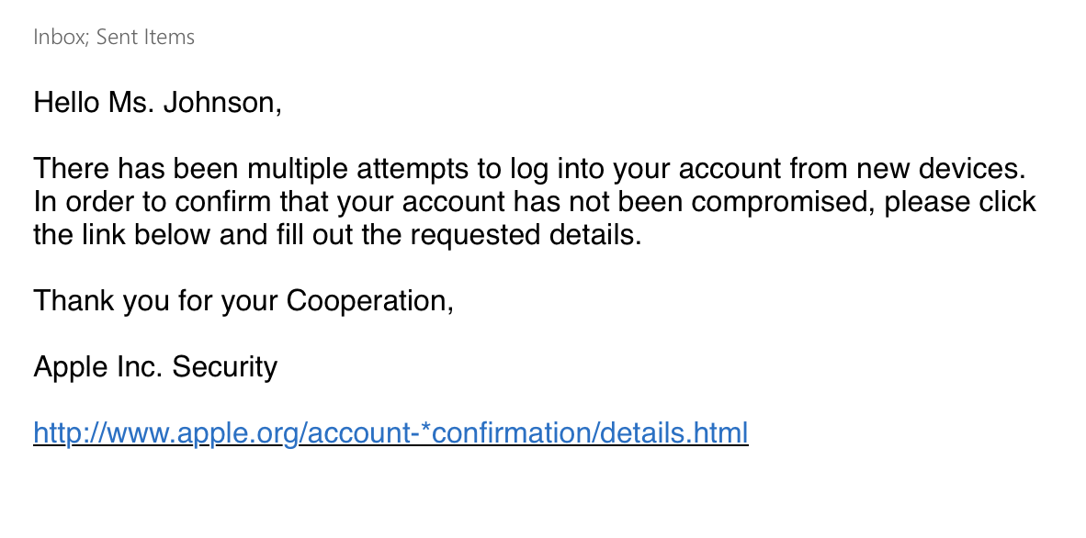
How are we tricked?
Legitimacy
Phishing messages should appear to be very real.
LOOKS REAL, BUT IT’S FAKE! WATCH OUT!
Notes:
Legitimacy is when something appears to be real. Phishing messages and emails can look very realistic and trick us into believing them!

Slide 6
Notes:
This video should lead to the discussion on how to avoid phishing

Slide 7
Tips to Avoid Phishing
Misspelled words or all capital letters
Unfamiliar and strange looking sender
Asks you to click on a link or reply with personal information
Flashy content and pop ups in the email
Too good to be true!
Notes:
Tips on how to identify a phishing messages:
Look for misspelled words or all capital letters, especially in the header of the emails. Unfamiliar and strange looking senders, often the email that sent it to you looks very strange!
If the email asks you to click on a link or reply with personal information this is a red flag! Any official website or bank will not ask you to provide your information or click on a link!
If there’s flashy content and pop ups in the email it is usually a sign it wants something from you.

Slide 8
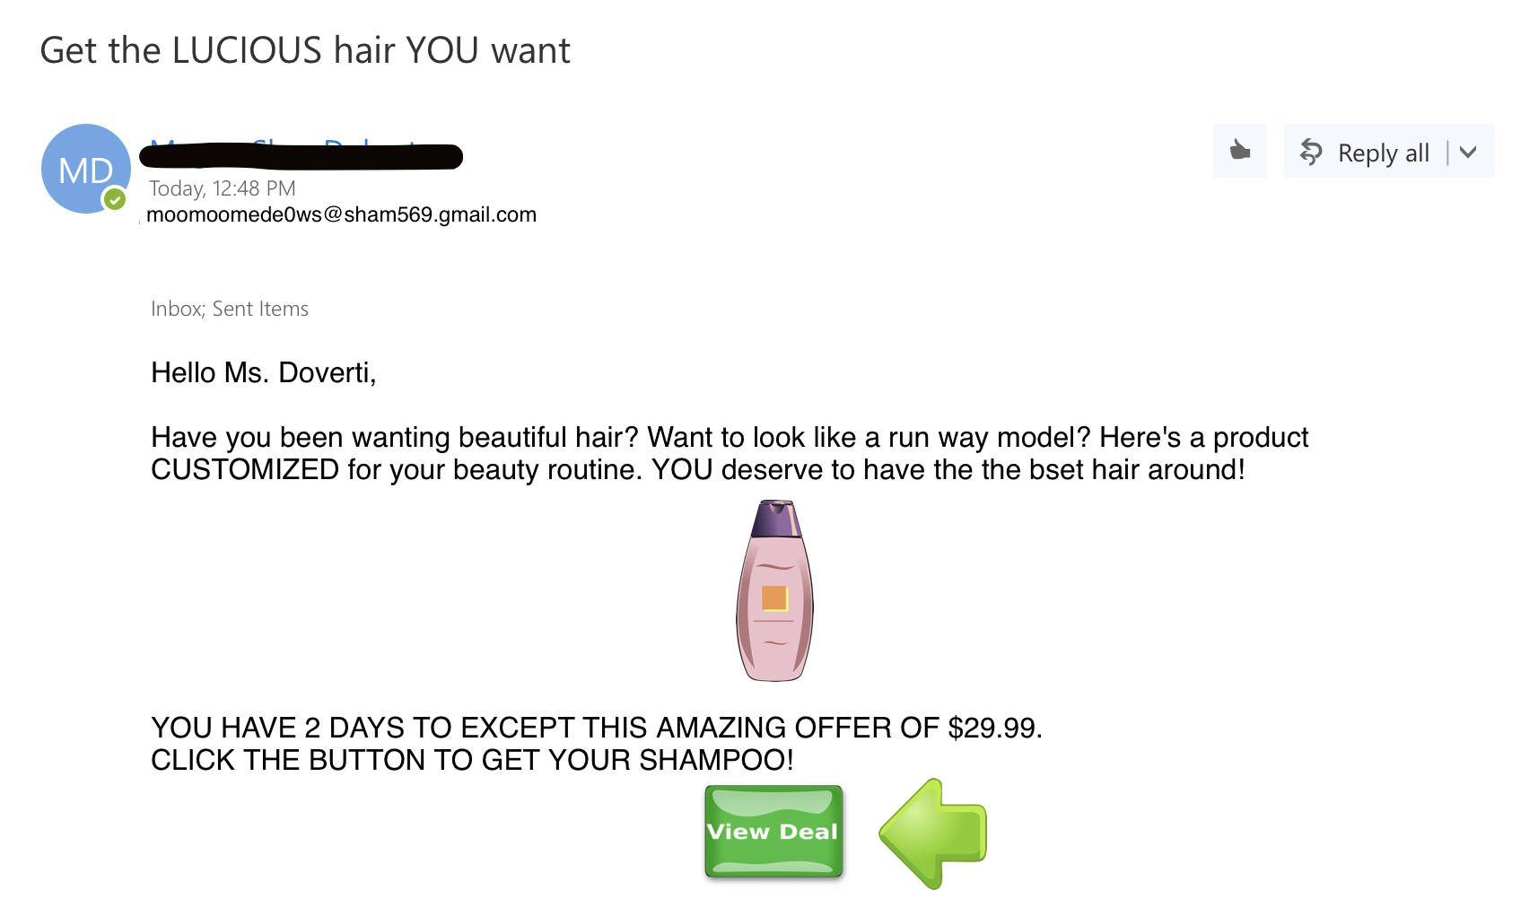
Tips to Avoid Phishing
Weird email sender
Trying to make you feel special
Flashy button, wants you to click on it
Misspelling of easy word
Notes:
Let’s take a look at this email.
The sender of this email doesn’t have a real name and their email address is odd and unfamiliar. This raises a red flag.
The email greets you with Congratulations, this is too make you feel special and get you to click on the button.
In the sentence there’s a simple word that is misspelled.
There’s a button that the email wants you to click to give you a bottle of the product.
The email doesn’t even tell you what the product is!

Slide 9
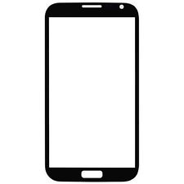
Smishing
SMS phishing = smishing
Enter a valid mobile number to claim your prize
Do not fall for this scam!
Entering your phone can lead to your phone being charged premium charges
Cell phone number:
Notes:
The name sounds funny, but it is very similar to phishing.
These messages are sent in masses to randomly generated phone numbers. If you confirm your number, you tell them that your number is real, you are inviting more scams!

Slide 10
What to do when you’ve spotted a phishing or smishing message:
Delete it! These messages are worthless!
DO NOT REPLY!
DO NOT CLICK ON THE LINKS!
Notes:
There’s lots of ways you can handle phishing and fake messages. You can simply delete it or report them. It is very important not to click on the links in these types of emails or to reply to them! This is because it could download a computer virus and steal your information.

