Slide 1
Digital Vision Board

Slide 2
What Is A Vision Board?
A vision board is a tool used to help clarify, concentrate and maintain focus on a specific life goal.
It is a board on which you display images that represent whatever you want to be, do or have in your life. (Or in this class it’s a digital image of these items).
The purpose of your vision board:
Identify your vision and give it clarity
Reinforce your daily affirmations
Keep your attention on your goals, dreams, feelings, etc.

Slide 3
What Is On A Vision Board?
Anything inspiring or motivating
Quotes, Photos, Scriptures, Lyrics, etc.
Items that have special meaning to you:
Notes, Pictures, Awards, Items from past events
Visualization on your feelings
How you want to feel as a person (happiness, driven, optimistic, etc.)
How you want to treat others
Things you want out of life
Future goals, career, family, happiness,
Photos of loved ones or friends
Other Items:
Relationships
Career and finances
Home
Travel
Personal growth (including spirituality, social life, education)
Health

Slide 4
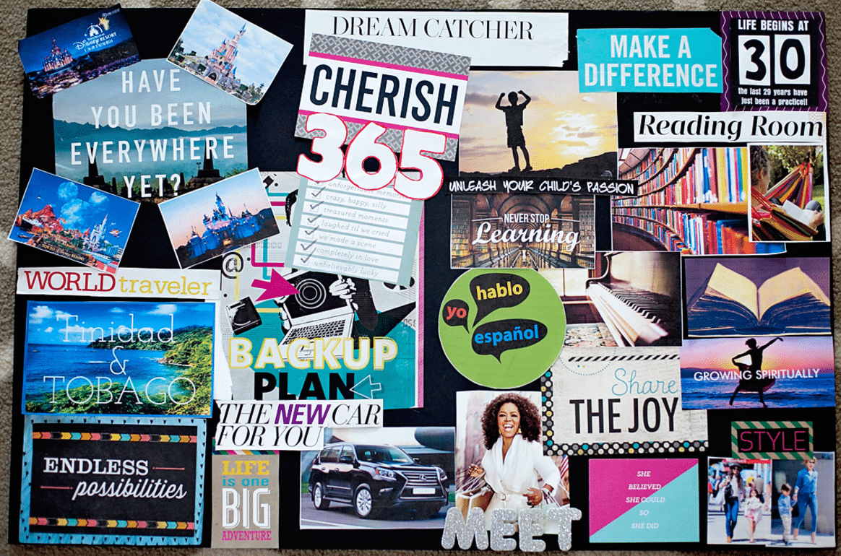
Why Use A Vision Board?
Creating a picture that displays what you want can actually bring it to life.
When you create a vision board and place it in a space where you see it often, you essentially end up doing short visualization exercises throughout the day.
Visualization is one of the most powerful mind exercises you can do.

Slide 5
Cool Fact
Olympic athletes have been using this for decades to improve performance.
Psychology Today reported that the brain patterns activated when a weightlifter lifts heavy weights are also similarly activated when the lifter just imagined (visualized) lifting weights.

Slide 6
Where Does A Vision Board Go?
You place it somewhere you can see it often.
The whole purpose of a vision board is to visualize it often.
Locations:
Phone screen
Fridge
Bedroom
Front of binder
Screen saver

Slide 7
How Do I Make A Vision Board?
You will be completing a worksheet to have you write out your visions before you start creating your vision board.
Then you will complete a project where you will digitally create your vision board online.
You will have the option to print your vision board once you are done.

Slide 8
Work Cited
https://www.huffingtonpost.com/elizabeth-rider/the-scientific-reason-why_b_6392274.html
https://www.makeavisionboard.com/what-is-a-vision-board/

