Slide 1
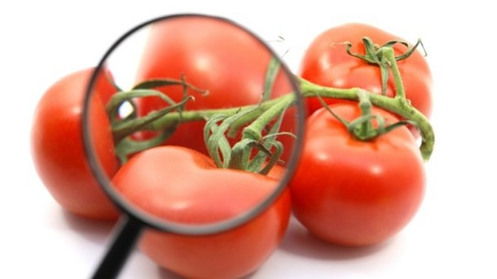
Keeping Food Safe
An Introduction to Food Safety

Slide 2
Foodborne illness
Defined as a disease or illness transmitted to people by food
When 2 or more people get sick with the same illness after eating the same food it is called a foodborne illness outbreak

Slide 3
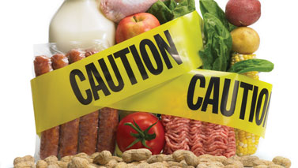
Forms of contamination
In order to protect food you must be aware of the things that can make food unsafe. These are referred to as hazards.
Food becomes contaminated when these hazardous materials are present in food.
Food can become unsafe in a variety of ways.

Slide 4
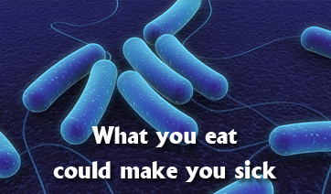
HOW FOOD BECOMES UNSAFE
Poor personal hygiene transfers pathogens from your body to food.
Time-temperature abuse allows foods to stay at temperatures that allows pathogens to grow
Cross-contamination transfers pathogens from one surface or food to another
NOTE: pathogens are
microorganisms that
cause illness (think “germs”)

Slide 5
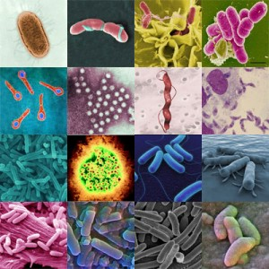
Biological Contamination
Pathogens are the biggest threat to food safety.
There are 4 types of pathogens that can contaminate food. They include:
Viruses
Bacteria
Parasites
Fungi

Slide 6
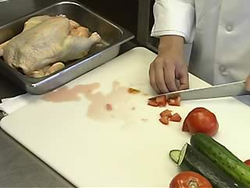
HOW FOOD BECOMES UNSAFE
Poor cleaning and sanitizing can allow contaminated surfaces to have contact with food

Slide 7
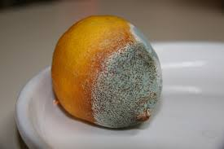
Biological Contamination
While they often cannot be seen, viruses, present in food can cause illness.
Some fungi though, like mold, can change the appearance of food, but may not cause illness.
There are many ways to fight contamination!

Slide 8
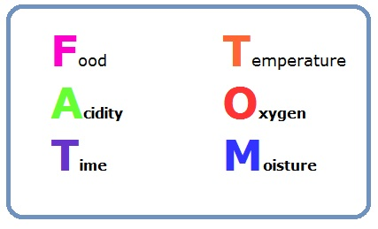
FAT TOM
Pathogens need special conditions to grow.
These conditions can be made easy to remember by using the acronym FAT TOM.
Foodhandlers can keep food safe by controlling FAT TOM conditions which include:
FOOD -- TIME
ACIDITY -- OXYGEN
TEMPERATURE -- MOISTURE

Slide 9
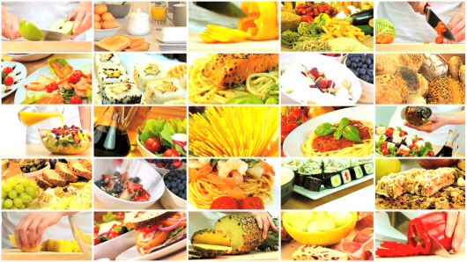
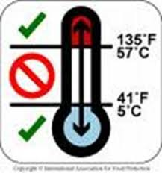
FAT…
FOOD: Pathogens need an energy source; food provides this.
ACIDITY: Pathogens grow best in food that have little or no acid. Acid levels between 4.6-7.5 are most ideal for pathogen growth.
TEMPERATURE: Temperatures between 41*F and 135*F allow pathogens to grow at rapid rates. This temperature range is referred to as the temperature danger zone (TDZ).

Slide 10
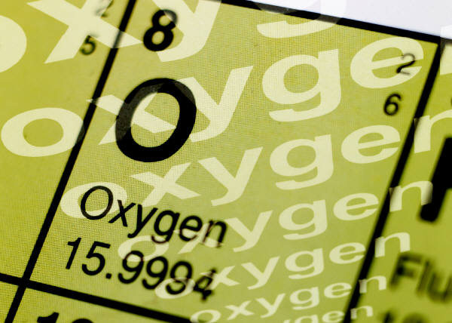
TOM
Time: Pathogens need time to grow. When food is in the TDZ, pathogens grow rapidly. It takes about 4 hours for pathogen growth to reach levels that can make someone sick.
Oxygen: Some pathogens need oxygen to grow. Other can grow without it.
Moisture: Pathogens need moisture in food to grow. Therefore, foods like tomatoes and melons easily support pathogen growth.

Slide 11
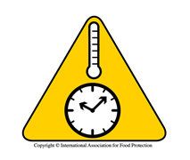
TCS FOODS
Some foods are more vulnerable to pathogen growth than others. These foods require greater control of time and temperature when handling and are referred to as TCS or Time-Temperature for Safety foods.

Slide 12
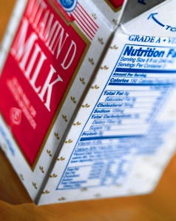
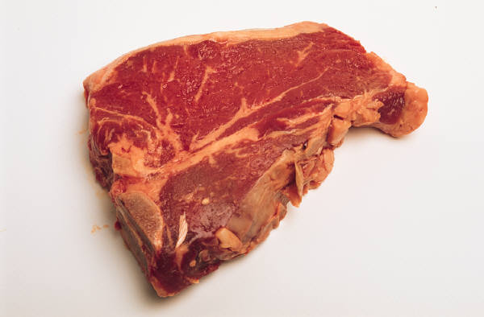
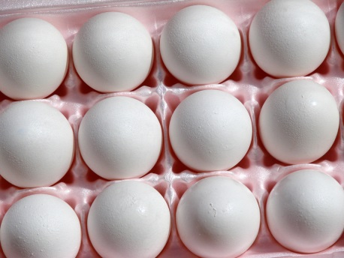
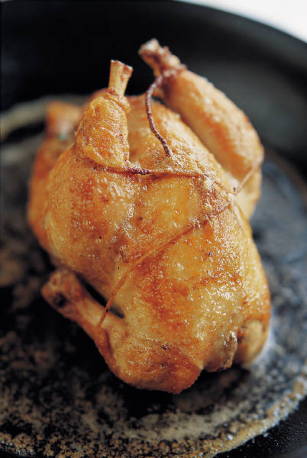
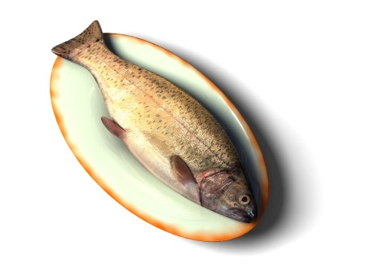
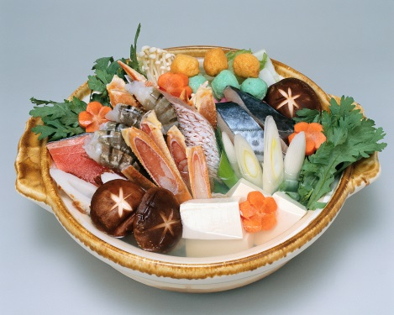
TCS FOODS
Foods most likely to become unsafe or TCS foods include:
Milk and Dairy Products
Meat; beef, pork, lab
Eggs
Poultry
Fish
Shellfish

Slide 13
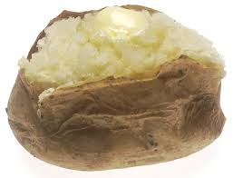
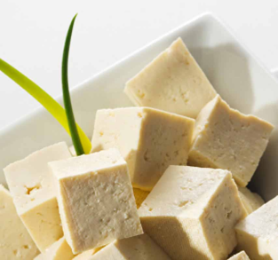
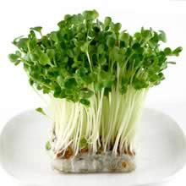
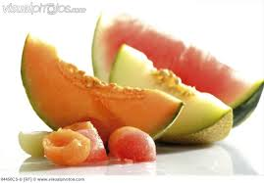
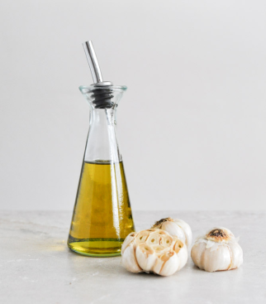
TCS FOODS
Other TCS foods include:
Baked Potatoes
Cooked Rice, Beans, Vegetables
Tofu and Soy Products
Sprouts and Seeds
Sliced Melons and Cut Tomatoes
Untreated Garlic and Oil Mixtures

Slide 14
CHEMICAL CONTAMINATION
Cleaners, sanitizers, polishes, and machine lubricants can contaminate food and cause foodborne illness.
For this reason it is important that chemicals are stored separately from food and that you follow manufacturers guidelines for use at all times.

Slide 15
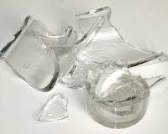
Physical Contamination
When objects get into food it is called physical contamination. These objects can be naturally occurring (like fish bones) or result from an accident.
Other examples include:
Metal shavings from cans
Glass from broken lightbulbs
Fingernails, hair, and bandages
Jewelry
Fruit Pits
Thankfully, most physical contamination can be prevented by close inspection of food.

Slide 16
Keep It SAFE!
As you can see, there are many potential hazards to food safety. As a food handler it is your responsibility to be aware of these hazards and follow proper protocol to avoid them.
Eating unsafe food is too great to risk it. Anytime you have a question or are unsure of the safety of something you should not eat it but throw it out.
When in doubt throw it out.

