Slide 1
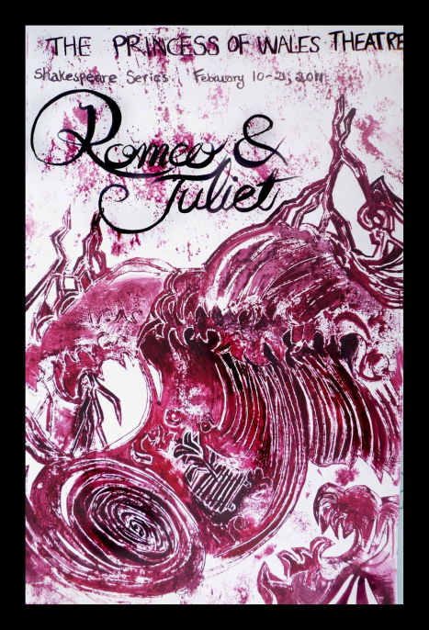
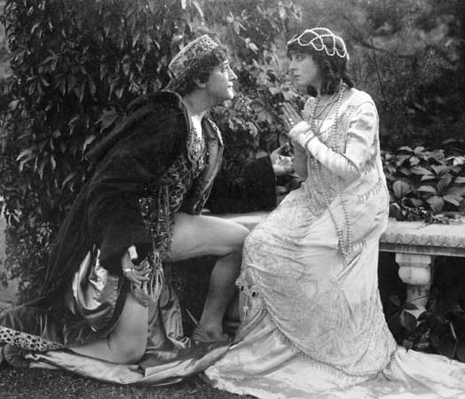
Romantic love can be beautiful and grand
By: Hello Kitty

Slide 2
Romantic Love can be beautiful and grand
http://www.youtube.com/watch?v=r_8ydghbGSg
~Romeo being in love with Rosaline and her rejecting his love.
~Skyscraper
Demi Lovato
“ Out of her favour where I am in love.”
- Romeo I, I, 159
“ A right good mark man! And she’s fair I love
- Romeo I, I, 197
“ This is the love I feel though no one loves me back.
- Romeo I, I, 172-173
“Skies are crying I am watching Catching teardrops in my hands Only silence as it's ending, like we never had a chance Do you have to, make me feel like there is nothing left of me?”
“You can take everything I have You can break everything I am Like I'm made of glass.”
“Go on and try to tear me down I will be rising from the ground.”
~ The connection between the quote and the song is, Romeo is getting over Rosaline and is trying not to break down and in the song by Demi Lovato she is getting over a relationship and is saying you can take everything away from her but she will still rise, this relates to why love is romantic love can be beautiful and ennobling because it still brings out a positive that you have the power to move forward like Romeo did when he saw Juliet at the Capulet party

Slide 3
Romantic Love Can Be beautiful and grand
http://www.youtube.com/watch?v=8xg3vE8Ie_E&ob=av3n
~ Romeo and Juliet fall in love at the Capulet Party.
~Love Story
Taylor swift
“ My lips, two blushing pilgrims ready stand to smooth that rough tough with a tender kiss.”
- Romeo I, V, 95- 96
“ Oh this is a heavy price to pay! My life is in the hands of the enemy.
-Romeo I, V, 118-119
“ prodigious birth of love is to me, that I love a loathed enemy.”
-Juliet I, V, 140-141
“ See you make you make your way through the crowd and say hello.”
“ And my daddy said stay away from Juliet.”
“ Romeo take me some where so we can be alone.”
~ The song and lyrics show the theme because in the song Romeo makes his was across the room to meet Juliet at a party/ ball room dance and they fall in love. In the quotes above and Taylor Swift loves story song , Romeo and Juliet are born into two family’s that are feuding and they fall in love which makes love beautiful and ennobling because they learn to love and except each other even though fro their families past.

Slide 4
Romantic Love can be beautiful and grand
http://www.youtube.com/watch?v=TdN5GyTl8K0&ob=av2e
~Romeo and Juliet confess their love for each other
~ I wont give up
Jason Marz
“Oh Romeo, Romeo wherefore art thou Romeo? Deny they father and refue thy name, or if thou will not be sworn my love and no longer be a Capulet.”
-Juliet II, II, 33-36
“ By love, that first prompt me to inquire.”
-Romeo II, II, 80
“ He lent me counsel and I lent him eyes.”
-Romeo II, II, 81
“ When I look into your eyes its like watching the night sky or a beautiful sunrise.”
“ I wont give up on us even if the sky's get rough.”
“ Cause even the stars they burn some even fall to the earth we’ve got a lot to learn.”
~ The connection between the quotes is Romeo and Juliet saying they are going to be together no matter what happens and in the song by Jason Marz he is saying he wont give up on his love no matter what obstacles are thrown at him, this makes love Beautiful and Ennobling because they bring out the best love for one another even love it is forbidden.

Slide 5
Romantic Love can be beautiful and grand
http://www.youtube.com/watch?v=HwzDLCRiUYY
~ Romeo and Juliet get married
~ walk me down the middle
The Band Perry
“Ah, Juliet, if the measure of thy joy
Be heaped like mine.”
-Romeo III, III, 24, 25
“Amen, amen. But come what sorrow can, It cannot countervail the exchange of joy.”
- Romeo III, III, 3-4
“But my true love is grown to such excess, I cannot sum up sum of half my wealth.”
- Juliet III, III, 34-35
“ I ways meant to be by your side and I waited here a Long time.”
“ Walk me down the middle of my momma’s church.”
“ Let the whole world know you belong to me, you belong to me.”
~ The connection between the quotes and song is Romeo and Juliet being happy and getting married and showing their love and affection, and in the song by The Band Perry she wants her loved showed off by walking her down the middle, romantic love can be beautiful and ennobling because it bring out the romantic and beautiful love in a marriage shared between two people like Romeo and Juliet

Slide 6
Romantic Love can be beautiful and grand
http://www.youtube.com/watch?v=7NJqUN9TClM&ob=av3e
~ If I die young
The Band Perry
~ Juliet waking up and seeing Romeo dead beside her
“Poison, I see, hath been his timeless end. O churl, drunk all, and left no friendly drop. To help me after?.”
-Juliet V, III, 174-176
“I will kiss thy lips. Haply some poison yet doth hang on them, To make me die with a restorative.”
- Juliet V, III, 176-178
“Then I’ll be brief. O happy dagger,
This is thy sheath. There rust and let me die.”
-Juliet V, III, 182-183
“ The sharp knife of a short life well, I’ve had just enough time.”
“ There’s a boy in town says he love me forever who ever thought forever could be severed by the sharp knife of a sharp knife well I’ve had just enough time.”
“ The ballad of a dove go with the peace gather up your keep em’ in your pocket save for a time when your really going to need them.”
~ The connection between the quote and song it Juliet killing her self with a dagger and in the song by Band Perry because she also kills herself with a dagger., this is a example of how romantic love can be beautiful and ennobling because Juliet killed herself to be with Romeo.

