Slide 1
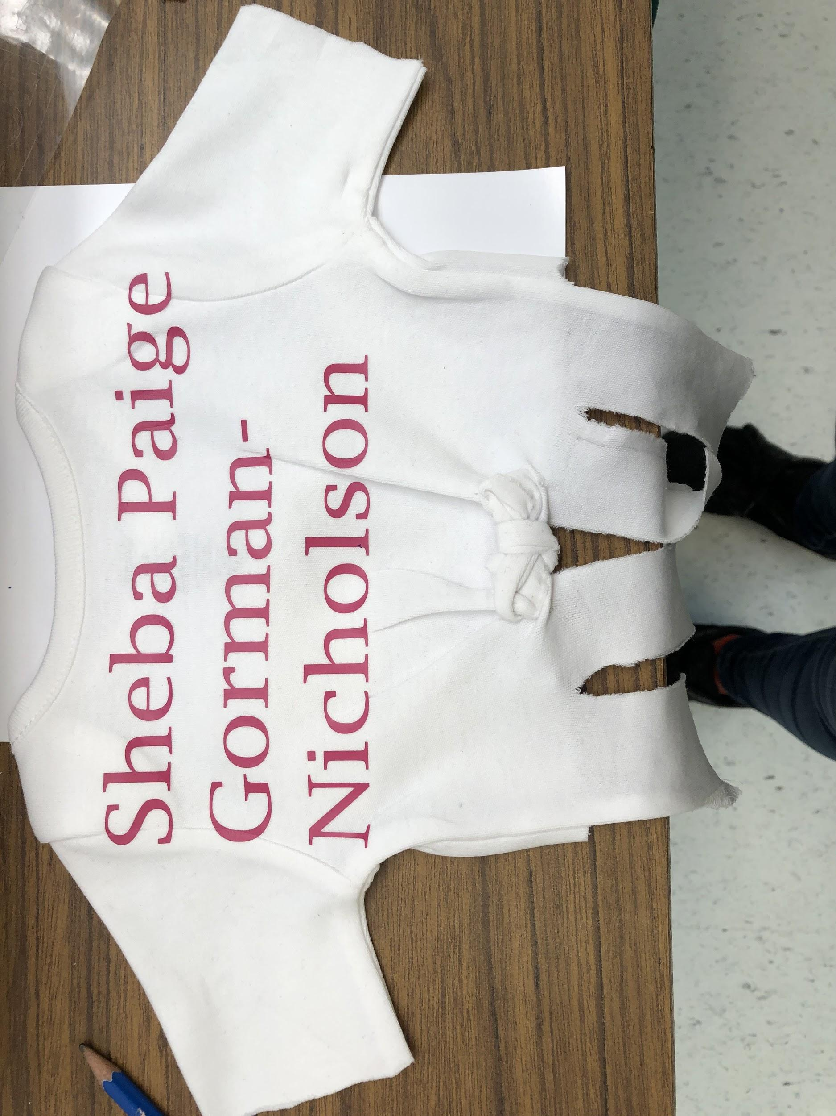
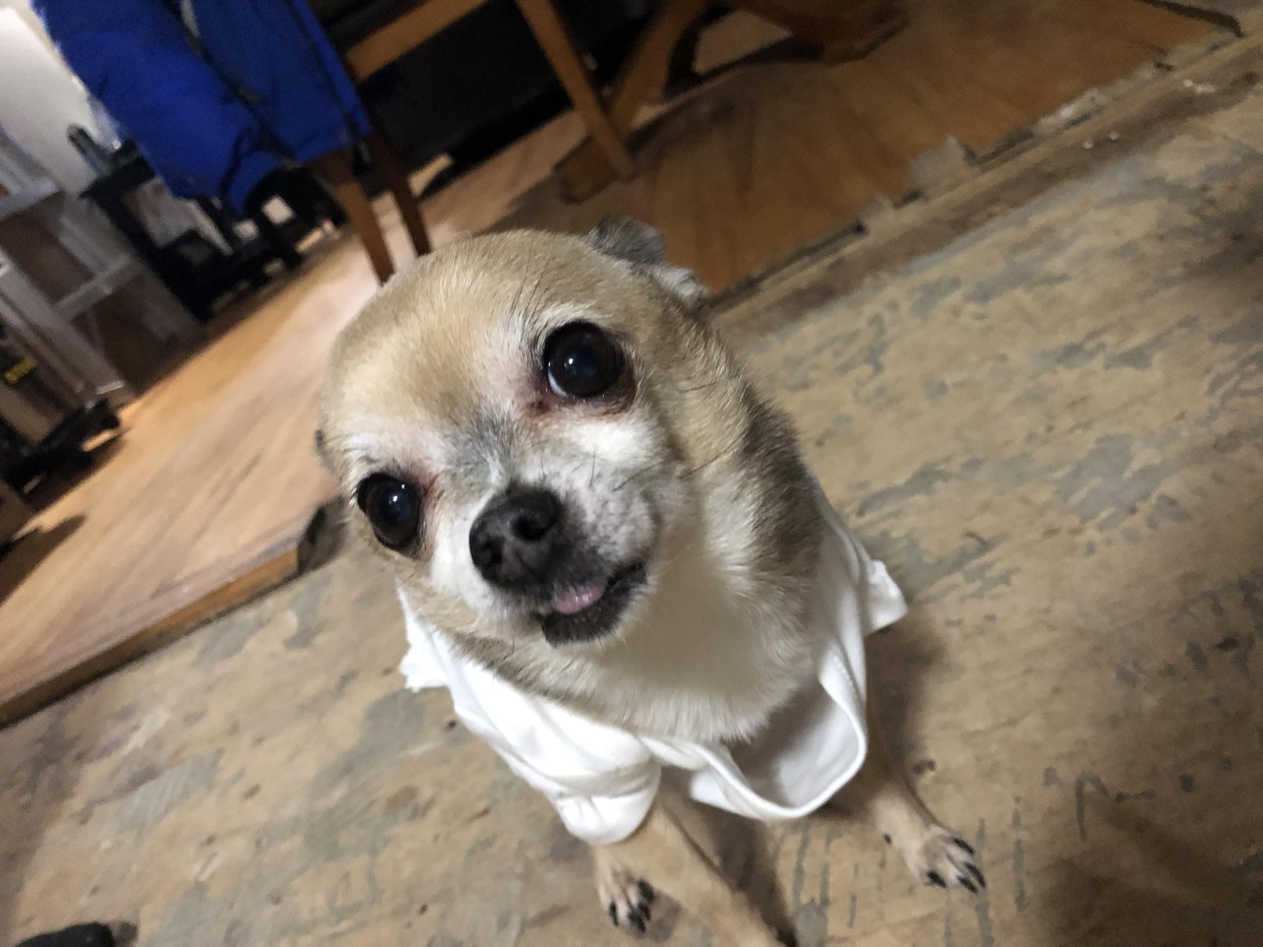
Paige’s Paw Apparel

Slide 2
Summary
For this project I wanted to create dog clothing out of baby onesies. The highlights of this project was actually getting and finishing the clothes. The hardest part of making dog clothes was measuring my dog and cutting and sewing the shirts correctly. The heat press was difficult at first, but I learned how to use it well after a while.

Slide 3
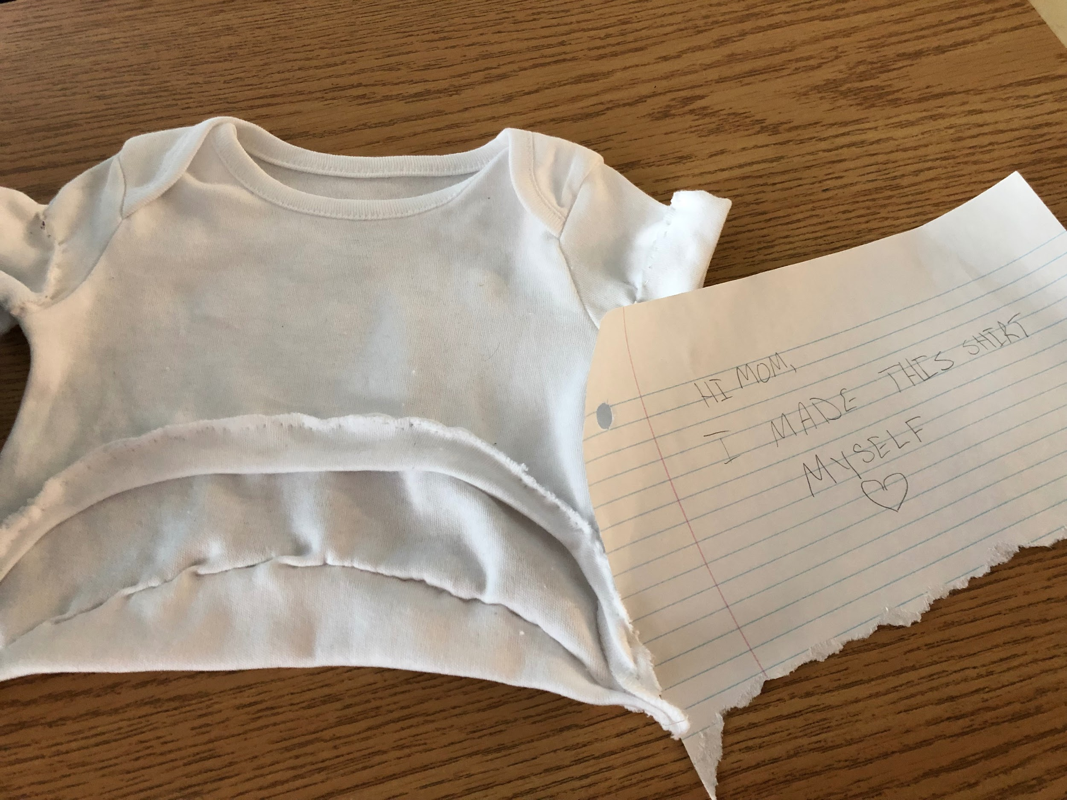
Stage 1
The first stage was to measure my dogs Tiny and Sheba. After That, I researched heat pressed and sewing techniques. Then I cut and sewed the shirts and make a design for them.

Slide 4
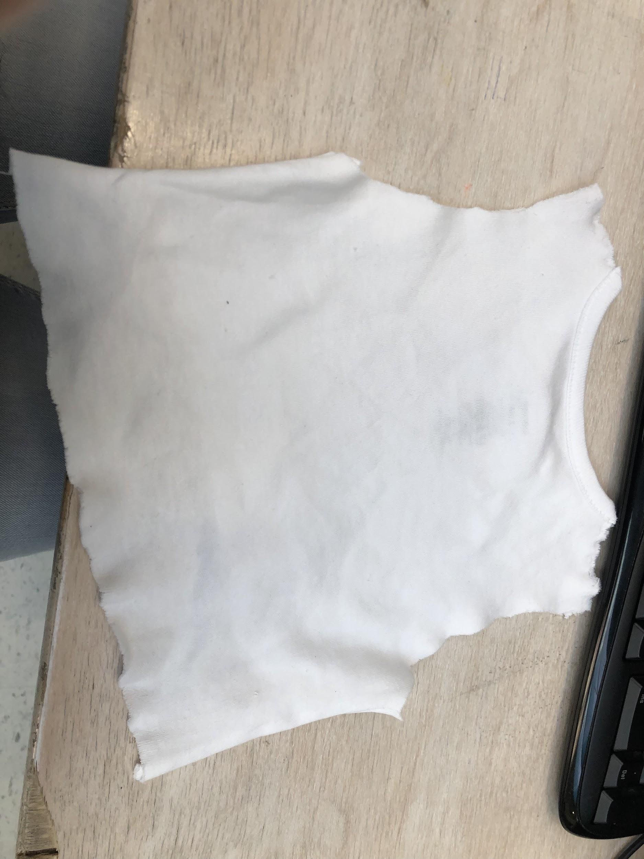
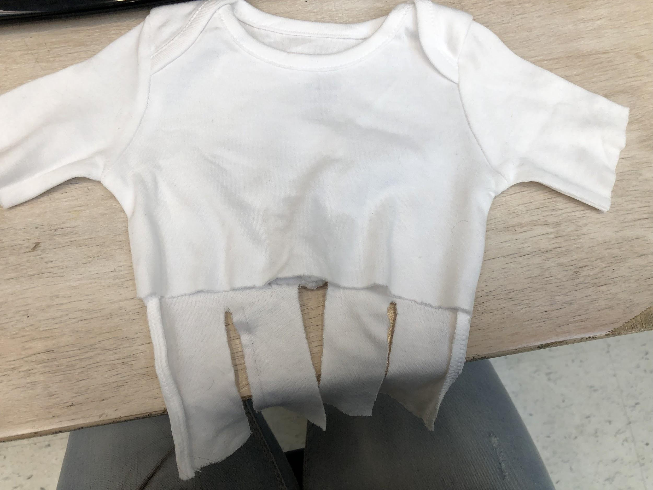
Stage 2
Secondly, I sewed the shirts a second time to make sure the did not rip when my dogs actually wore them. I took the designs and put them on a software and prepared to vinyl cut.

Slide 5
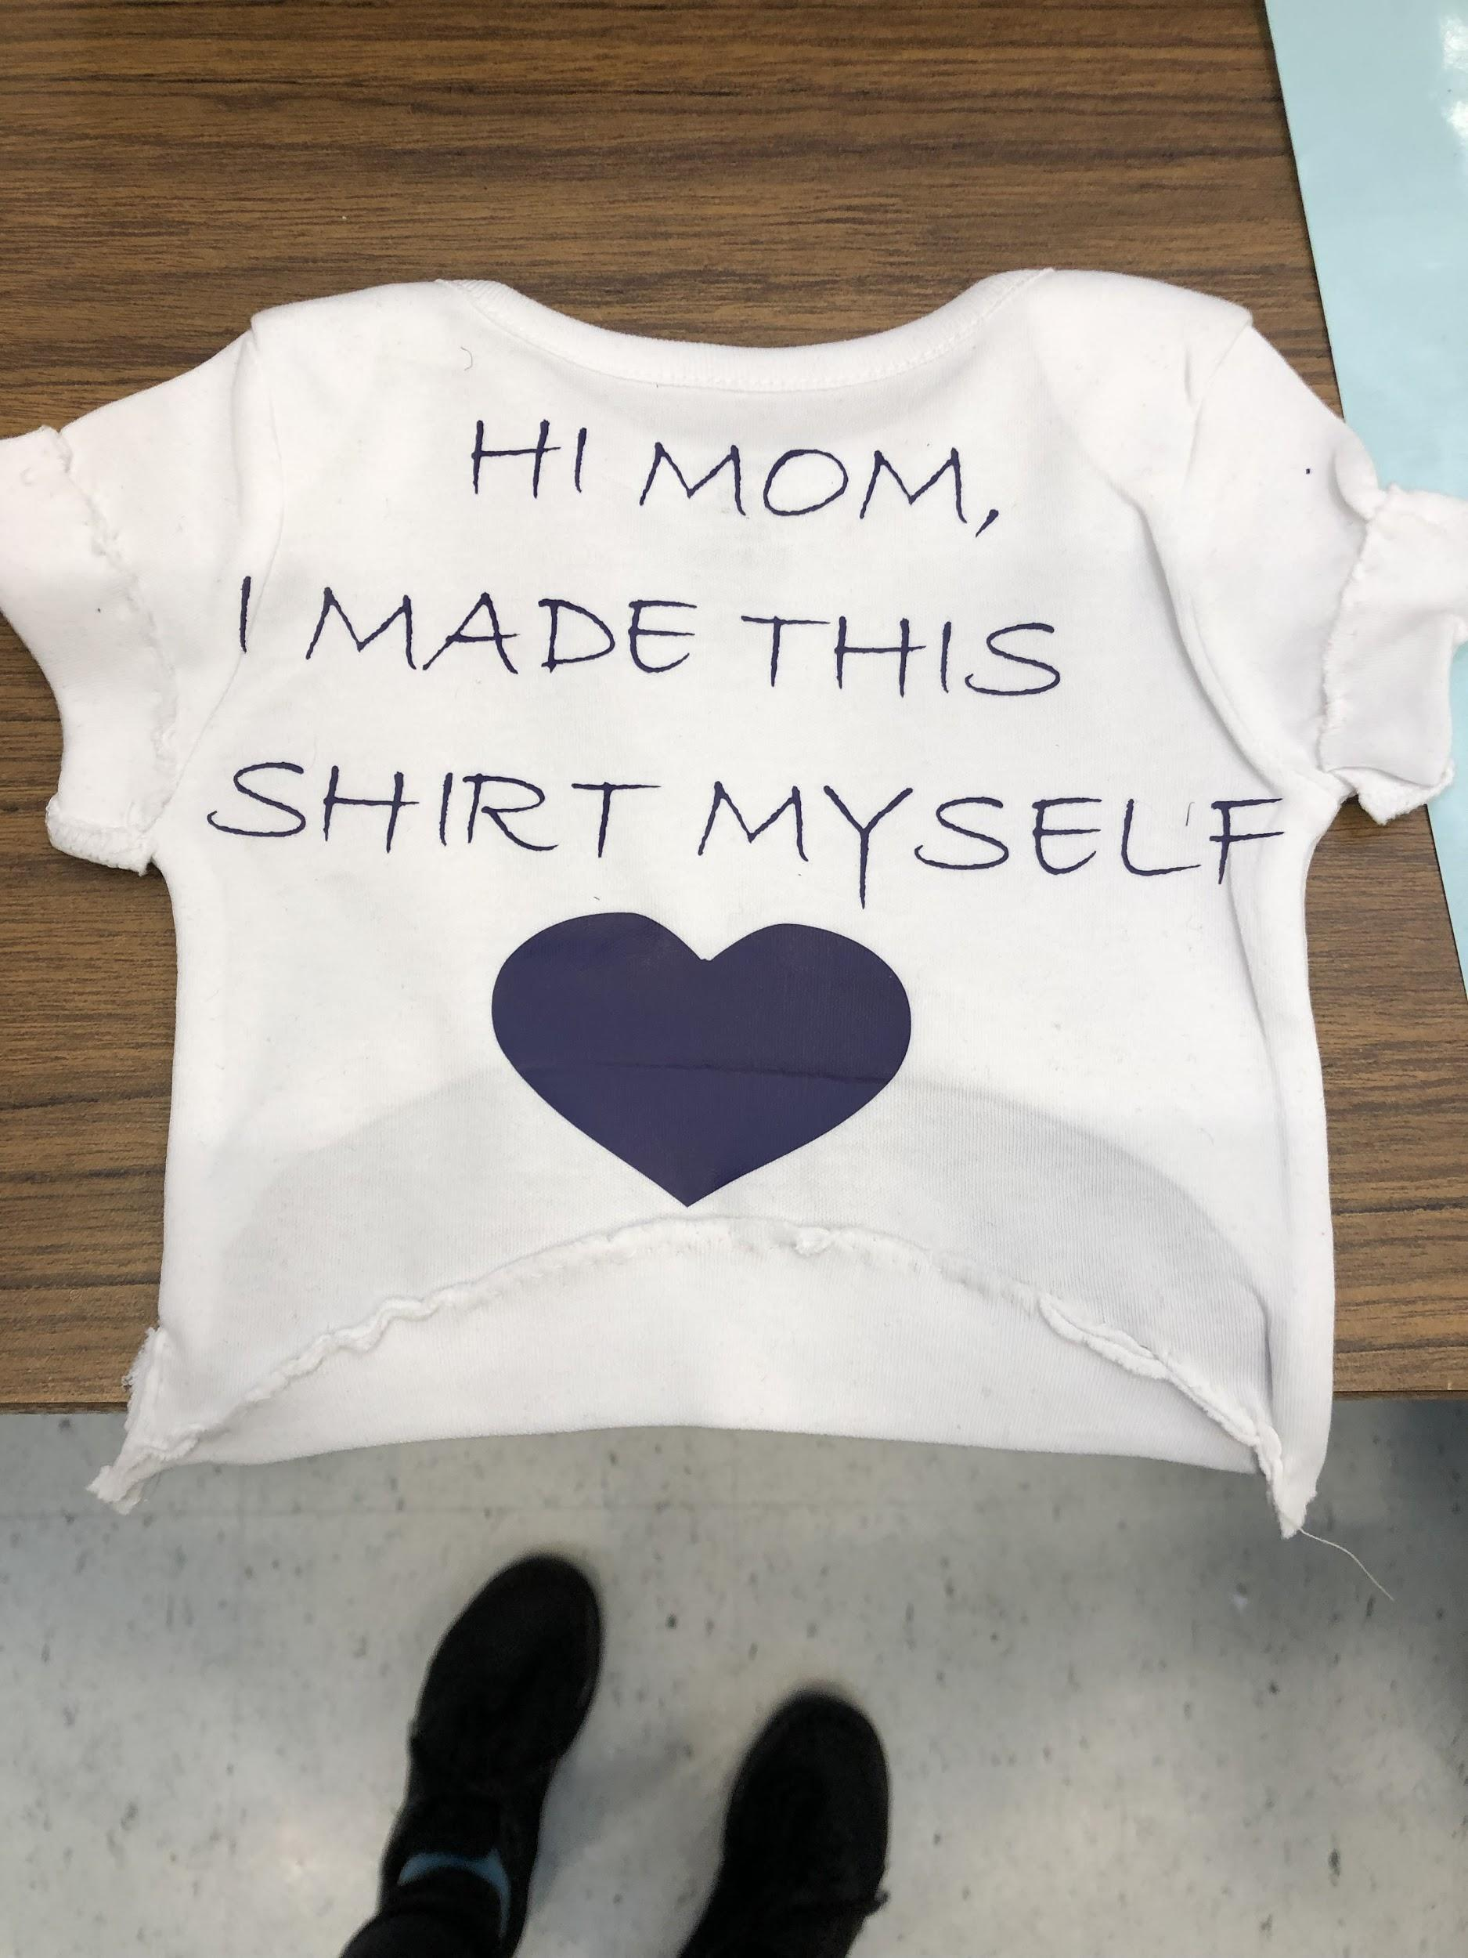
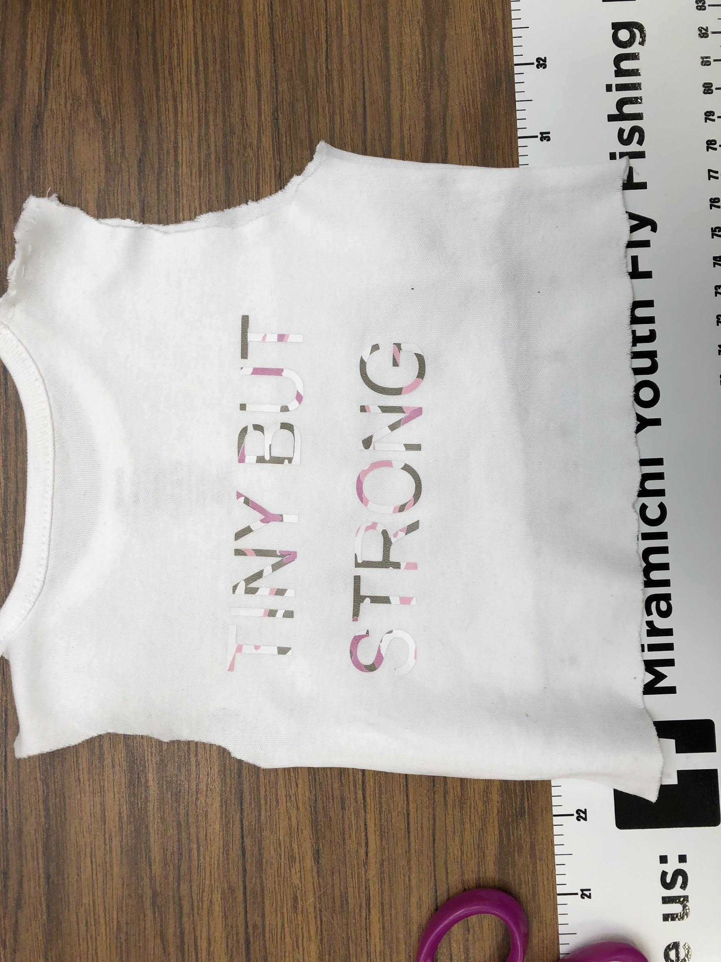
Stage 3
Finally, I placed the vinyl where I wanted it on the shirt and used the heat press.

Slide 6
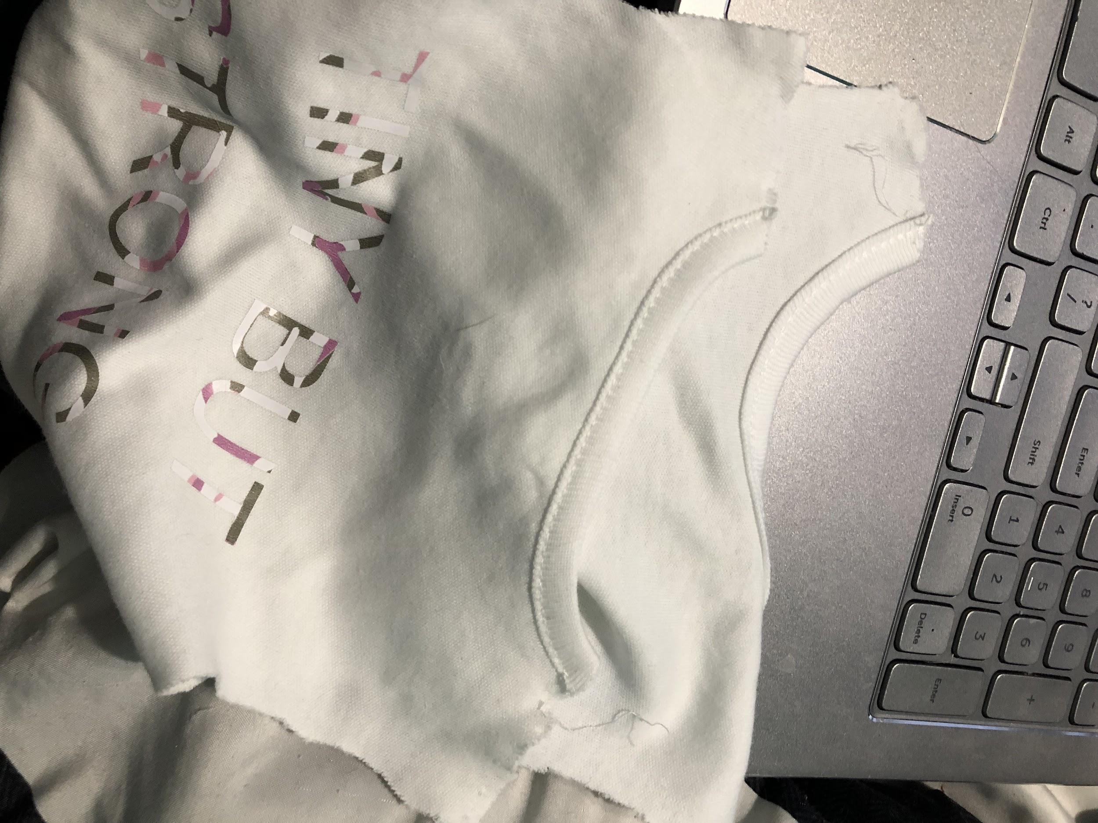
Problem
One problem I faced when I got home was that a shirt tore. This was annoying, but easy to fix. Next time I know to double check the sewing.

