Slide 1
Sumobots
Abby and Malcolm

Slide 2
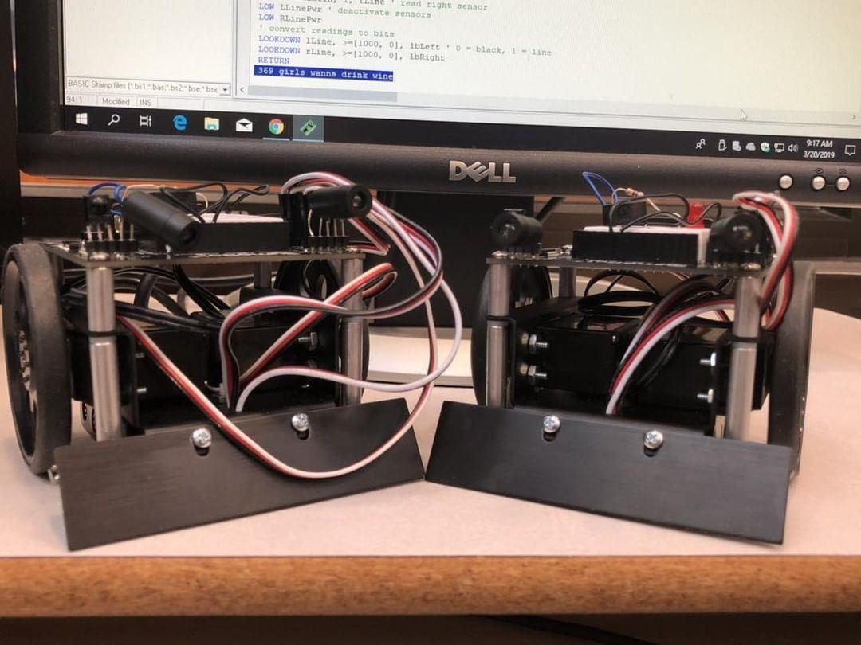
Why we chose this project:
When we both had to decide on what kind of project we wanted to do for this class, one of our first (and only) ideas we came up with was anything with robotics.
We looked into it more online, and we came across Sumobots. We instantly decided that was what we were going to do, because it included being able to build two robots, and allowed us to code them as well.

Slide 3
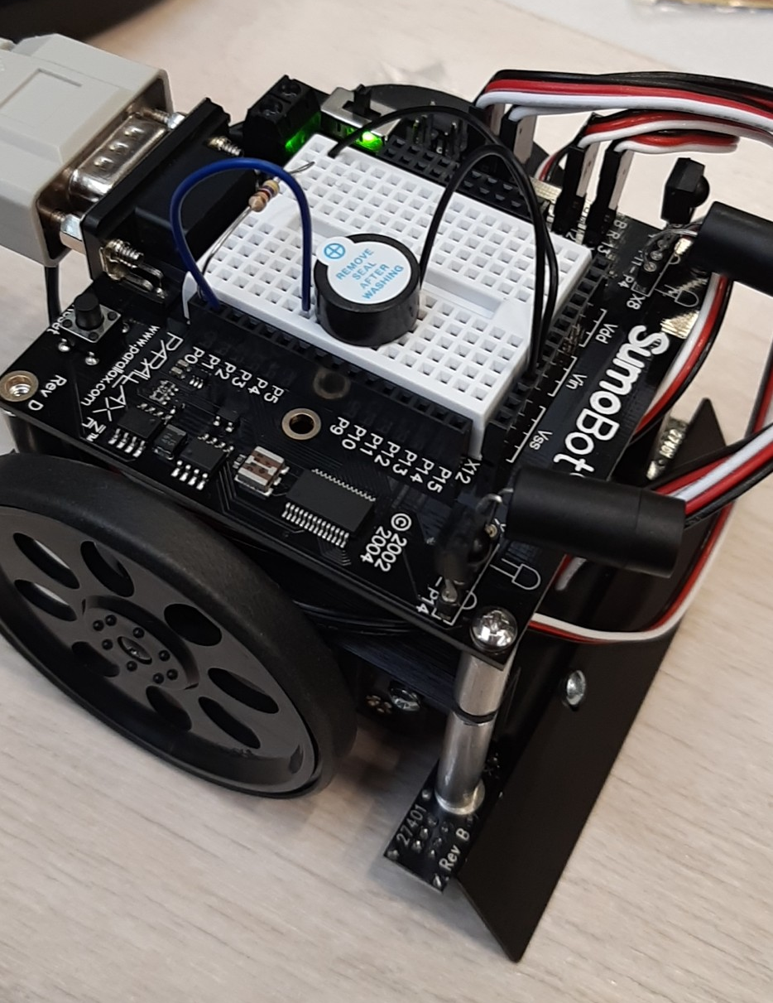
Low points:
During our time building and coding our robots, we’ve had way more issues than we would like to admit. By day two we already faced many issues with coding our robots. We couldn’t get the computer to detect either of the robots, meaning we couldn’t even start to try programming them. When we finally got the computer to detect them, nothing we tried to program them to do seemed to work.

Slide 4
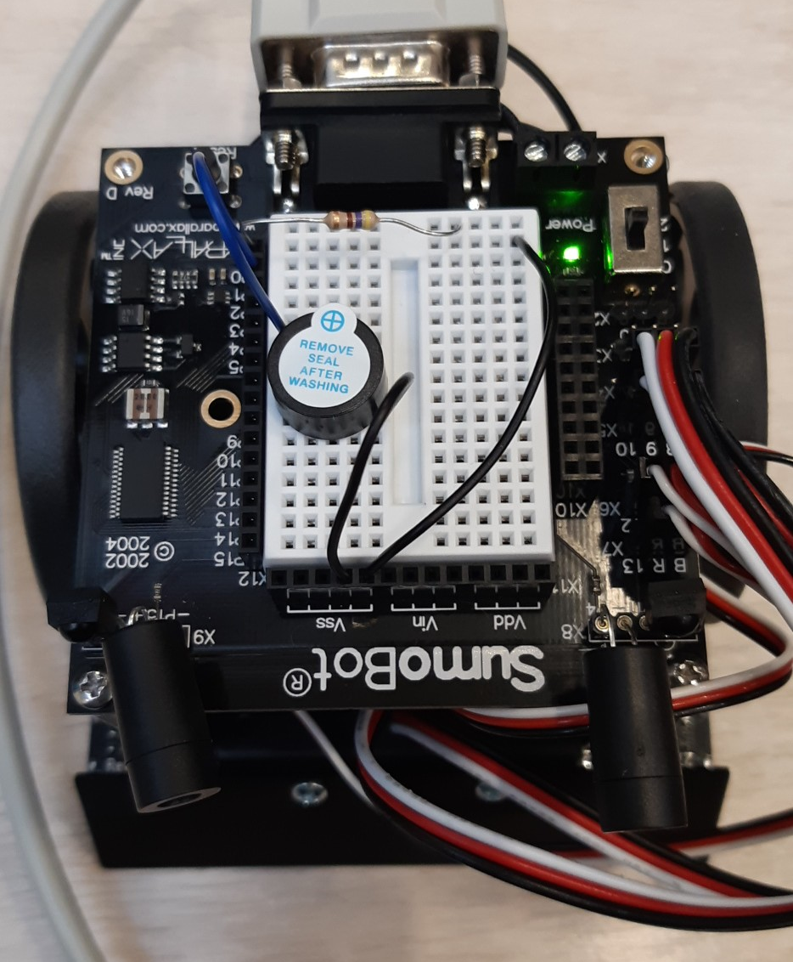
High Points:
After a LOT of messing around with different codes from online and from our manual, we finally were able to make them move. The only thing they could do at first was just spin around in one spot, but things went up from there. We were soon able to code them to detect when they’re on the competition mat (meaning they could technically battle), and they could see things in front of them. Though we still have a long way to go to actually perfect our robots, we’re definitely on the right track.

Slide 5
