Slide 1
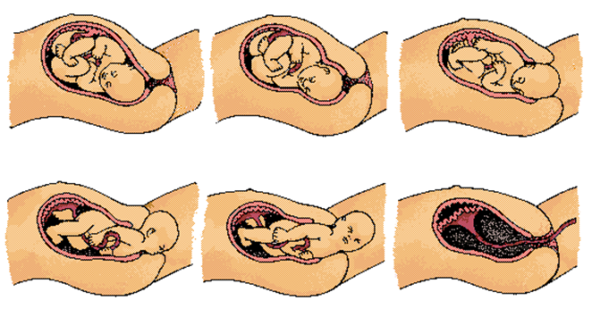
LABOR & DELIVERY
For 9 months, the unborn child has been developing in the womb. Now the baby is ready to make an exit….or an entrance.

Slide 2
Lightening
The baby settles deep into mom’s pelvis during the 9th month.
This happens weeks or days before labor begins
The hormone relaxin is released into the pelvic area.
a. helps ligaments become stretchy
b. Bones of pelvis can move to allow baby to pass through.

Slide 3
Reliable Indicators that labor has begun
The Show / Mucus Plug
Keeps amniotic fluid from leaking out
Prevents infection from getting to the fetus.
Spotting of blood because of the mucus plug coming out as the cervix begins to dilate.

Slide 4
Reliable Indicators that labor has begun
Water Breaks: Rupture of amniotic sac causing fluid to leak through cervix and out the birth canal.
Does not always happen naturally.

Slide 5
Contractions
Contractions are the rhythmic tightening and relaxing motions of the muscles of the uterus.
Braxton-Hicks Contractions are called “false labor.” They can occur throughout the pregnancy and typically involve the back, not the uterus. They are not regular and can go away with exercise.

Slide 6
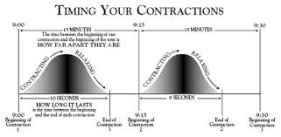
Doctors look for three signs to determine if it is false labor or real labor.
Are contractions regular & rhythmic?
Are contractions getting increasingly stronger?
Do contractions stop if mom walks around or showers?

Slide 7
Labor is
the energy and effort used to push the baby out of the womb through a period of irregular uterine contractions in which the cervix thins, softens, and may begin to dilate.
As labor progresses, the contractions increase in frequency and severity.
For women giving birth for the first time, labor will usually last between 12 to 24 hours. However, for women who have given birth before, labor usually averages only 6 hours.

Slide 8
Induced Labor
Sometimes the body just does not go into labor or the doctor needs to control when labor begins so the doctor will induce labor.
A doctor causes labor to begin by injecting Pitocin which begins the contractions.
A doctor ruptures the amniotic sac to begin contractions.
A doctor will strip the membranes (show).

Slide 9
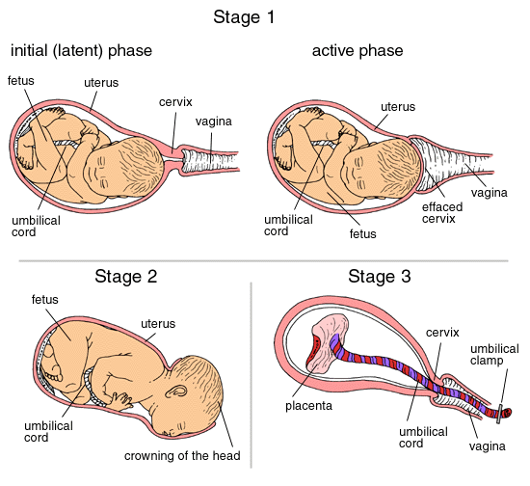
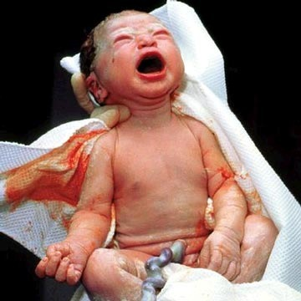
Labor is commonly divided into three stages.

Slide 10
First stage of Labor (Dilation)
Dilation is when the cervix dilates from 0 – 10 cm.
Uterine contractions begin (left) and are usually spaced from 10 to 20 minutes apart.
Initially the contractions are gentle, but they tend to become more powerful or stronger, sometimes uncomfortable, last longer, and become more frequent.
With each contraction the cervix becomes larger (dilation) reaching to a 7cm. (right picture)
With each contraction the cervix becomes thinner (effacement).
Longest Stage of labor
Average length is two to ten hours
Microsoft ® Encarta ® Encyclopedia 2002. © 1993-2001

Slide 11
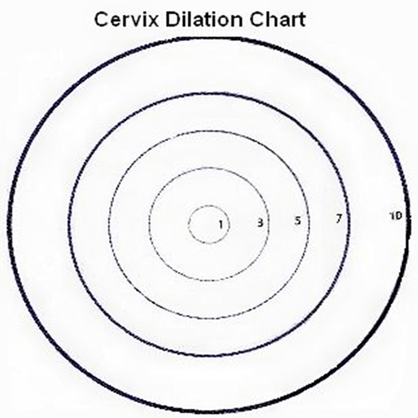

Slide 12
Effacement is the thinning of the cervix.
The cervix goes from 10 saltine crackers thick to 1 saltine cracker thick.

Slide 13
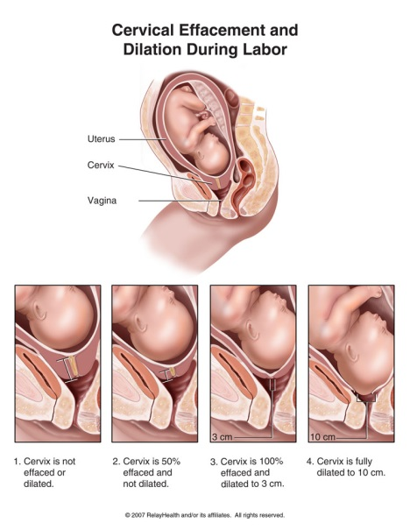

Slide 15
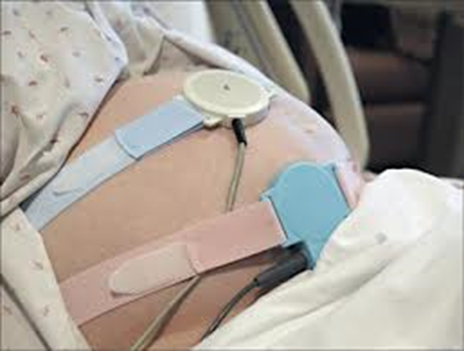
Fetal monitor is attached to the mom to observe the baby.
Fetal monitor is attached to the mom to observe the baby.

Slide 16
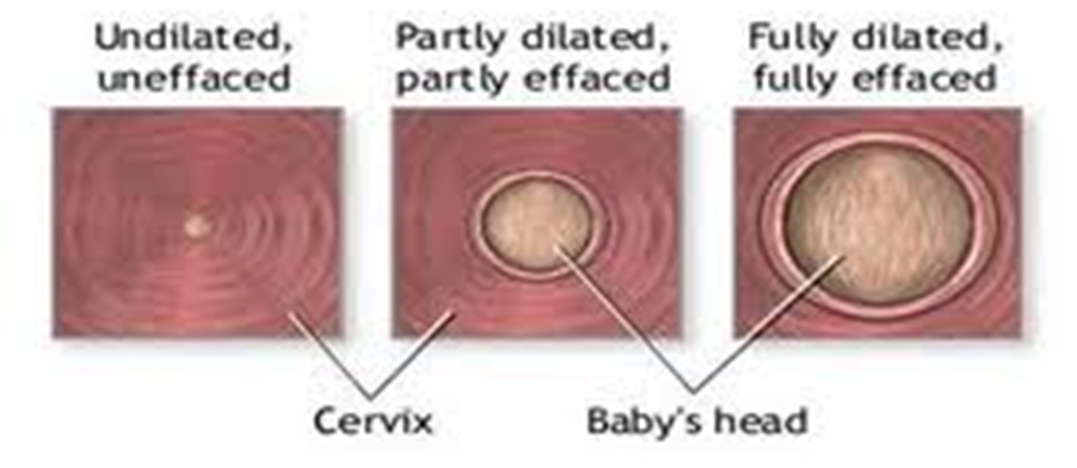
Crowning is when the head of the baby can be seen at the outside edge of the vagina and remains visible without slipping back in.

Slide 17
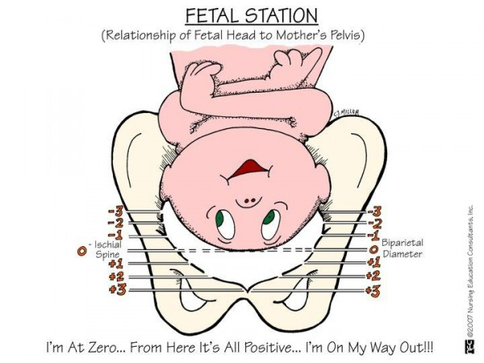

Slide 18
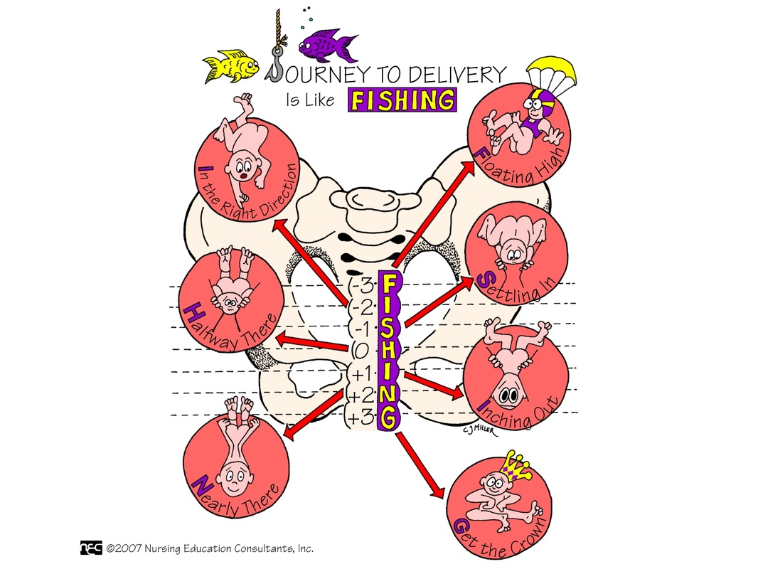

Slide 19
Transition
Regular, powerful, contractions every two to three minutes that last up to 60 to 90 seconds
Last about 90 minutes
Baby’s head enters birth canal and crowns.
Cervix dilates to a complete 10 cm.

Slide 20
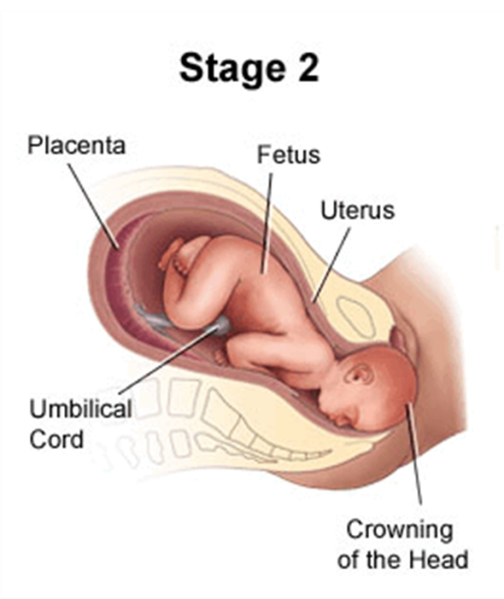
Second stage of Labor (Expulsion)
The mother pushes, or bears down, in response to pressure against her pelvic muscles and the baby is expelled from the uterus or when the baby is born.
Contractions continue to occur throughout this stage to help push the baby out of the mom’s body.
Fontanels soft spots on a baby's head which, during birth, enable the bony plates of the skull to flex, allowing the child's head to pass through the birth canal.

Slide 21
As the head emerges entirely (left) the physician turns the baby’s shoulders (right), which emerge one at a time with the next contractions. The rest of the body then slides out relatively easily, and the umbilical cord is sealed and cut.

Slide 22
Baby is delivered

Slide 23
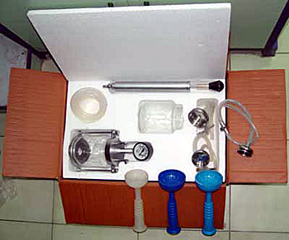
DELIVERY & EQUIPMENT
Sometimes extra procedures are used if delivery progress is not being made and the baby is in the birth canal too long.

Slide 24
EPISIOTOMY
A surgical cut in the perineum done before delivery.
Given to enlarge the vaginal opening and to prevent the skin from tearing.
C. Stitched after the 3rd stage of labor.

Slide 25
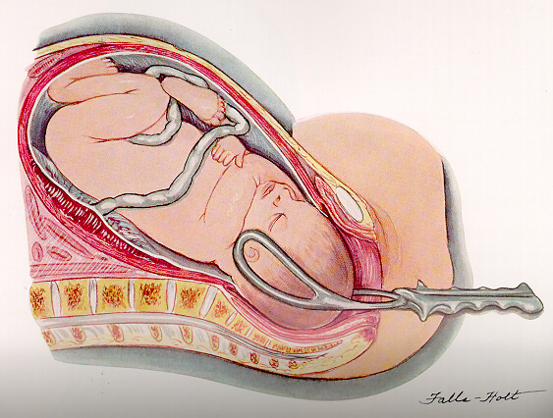
FORCEPS
Specialized tongs made of surgical steel, made to fit the baby's head.
Helps baby emerge more quickly or slowly if needed.

Slide 26
VACUUM EXTRACTOR
A vacuum hose that first on the baby’s head.
Used to guide the
baby during delivery.

Slide 27
Third Stage of Labor
The third stage occurs within ten minutes of the baby’s birth.
The uterus continues to contract.
The placenta pulls away from the uterus and is expelled (delivered) with the amniotic sac and remaining umbilical cord. This is called the afterbirth.

Slide 28
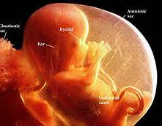
Amniotic Fluid
Amniotic Sac
Holds the amniotic fluid.
Is a clear transparent membrane.
Is very strong until broken.
Guards against jolts
Keeps the fetus at a constant temperature.
Keeps the fetus from forming adhesions to the uterine wall.
Fluid volume increases as the fetus grows

Slide 29
Umbilical Cord
The Placenta
Is an organ that develops between the embryo and the uterus during pregnancy.
It filters nutrients and oxygen to the fetus.
Passes oxygen, and nutrients from the mother to the child.
Returns waste products back to the mother.
Connection between the the Umbilical Cord fetus & the placenta.

Slide 30
VAGINAL DELIVERY
Vaginal Delivery – Baby is delivered vaginally through the birth canal.
Preferred because it helps the baby expel the amniotic fluid from its lungs which helps to clear away any blockages in the lungs and nasal areas naturally rather than with extra medical attention.
Babies ingests protective bacteria as they pass through your birth canal. This bacteria colonizes in their intestines and forms a balanced immune system as they develop from childhood into adulthood.

Slide 31
Positions for Giving Birth
Lie on back
Squatting
Lie on side
Sitting
Kneeling
In water

Slide 32
CAESAREAN Section Delivery
A major surgical procedure in which one or more incisions are made through a mother's abdomen and uterus and then the baby is delivered through the incision in the abdomen and uterus.
Cesar is said to have been born this way
Takes 6 weeks or more to fully recover.

Slide 33
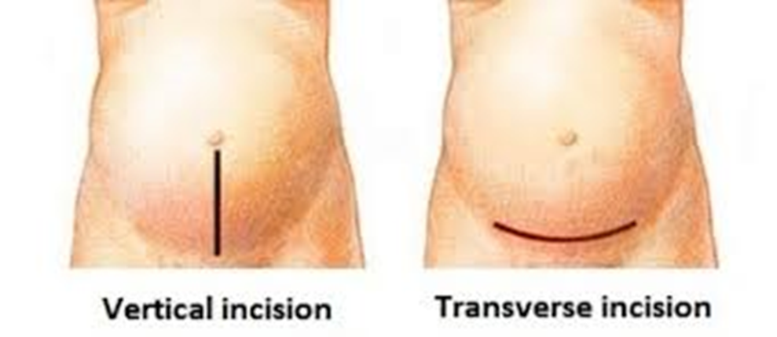

Slide 34
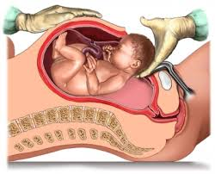
http://www.babycenter.com/2_live-birth-c-section-surgery_3656510.bc

Slide 35
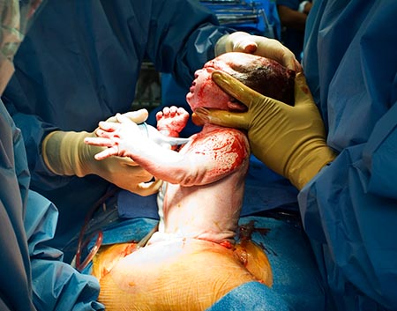

Slide 36
Cesarean Delivery Used When:
The labor is long and difficult and the life or the baby or mother is threatened.
Umbilical wrapped around baby’s neck.
The fetal monitor shows a drop in heart rate. Fetal distress.
Placenta Previa = placenta is covering the opening to the cervix.
The woman’s bone structure is too small to allow vaginal delivery or the baby is too big.
Prolapsed cord = the umbilical cord drops (prolapses) through the open cervix into the vagina ahead of the baby
Poor presentation = breech, transverse, posterior
Placenta abruption = placenta peels away from the inner wall of the uterus before delivery either partially or completely
STDs
Previous C-section
Toxemia

Slide 37
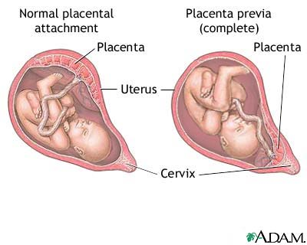
Cesarean Delivery is necessary in Placenta Previa

Slide 38
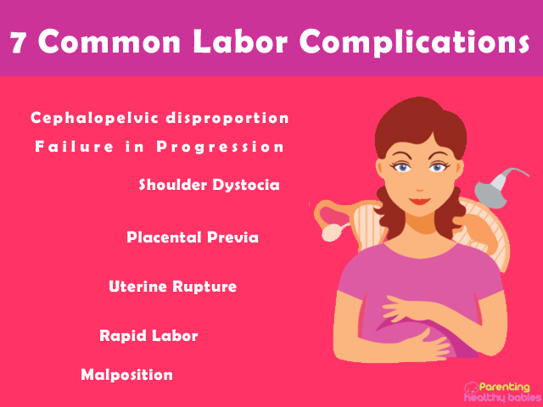
Possible Complications

Slide 39
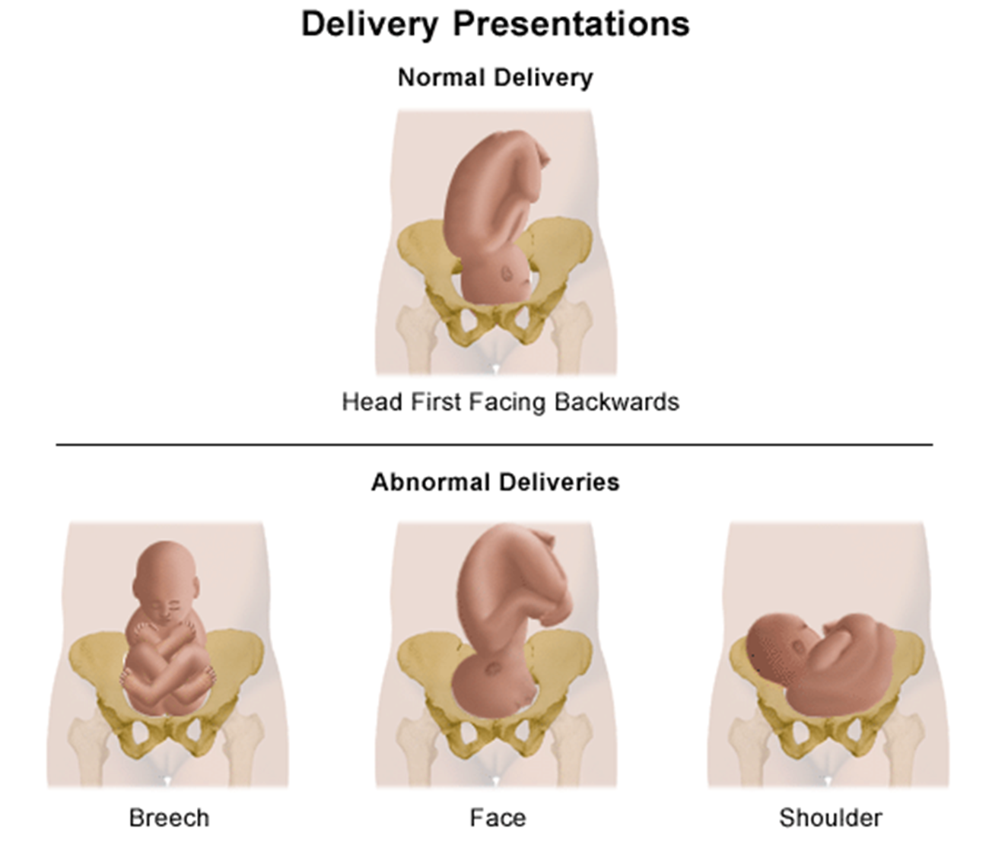
Delivery Presentations

Slide 40
BIRTH POSITIONS
Normal
Head first, face down, looking to the back of mom.
Delivered vaginally

Slide 41
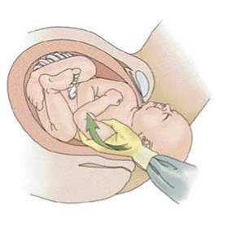
BIRTH POSITIONS
Posterior
Head first, face up, looking to the front of mom.
Delivered vaginally.

Slide 42
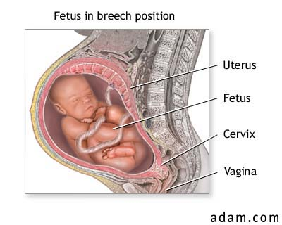
BIRTH POSITIONS
Breech
Feet or buttocks is first
Delivered caesarean

Slide 43
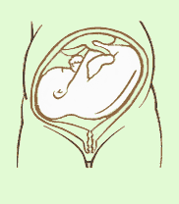
BIRTH POSITIONS
Transverse
Fetus laying sideways
Delivered caesarean

Slide 44
Who are these People?
Obstetrician - pregnancy doctor who delivers the baby.
Midwife – A midwife is a trained health professional who helps healthy women during labor, delivery, and after the birth of their babies. Midwives may deliver babies at birthing centers or at home, but most can also deliver babies at a hospital. Women who choose midwives usually want very little medical intervention and have had no complications during their pregnancy.
Labor and Delivery Nurse - They care for women during labor and childbirth, monitoring the baby and the mother, coaching mothers and assisting doctors. As a Labor and Delivery Nurse, you'll prepare women, and their families, for the stages of giving birth and help patients with breastfeeding after the baby is born.

Slide 45
Birthing room
Option A: Labor and deliver in one room and then moved to another room to recover.
Option B: Labor, delivery, and recovery all occur in the same room.

Slide 46
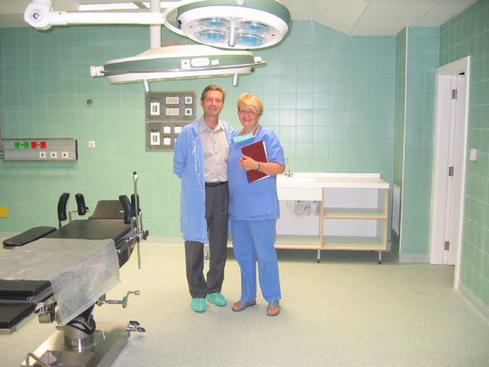
Operating Room
Operating room – used for cesarean deliveries or other complications

Slide 47
Natural Childbirth http://www.babycenter.com/natural-childbirth
Childbirth without medication.
If you choose to go this route, you accept the potential for pain and discomfort as part of giving birth. But with the right preparation and support, women often feel empowered and deeply satisfied by natural childbirth.
Here are the pros:
Most natural childbirth techniques are not invasive, so there's little potential for harm or side effects for you or your baby.
Many women have a strong feeling of empowerment during labor and a sense of accomplishment afterward. Despite having to endure pain, many report that they'll choose an unmedicated birth again the next time. For some women, being in charge helps lessen their perception of pain.
There's no loss of sensation or alertness. You can move around more freely and find positions that help you stay comfortable during labor. And you'll remain able to participate in the delivery process when it's time to push your baby out.
Your partner can be involved in the process as you work together to manage your pain.
You can use the breathing exercises, visualization, and self-hypnosis you learn both during labor and later on. Many new mothers find themselves drawing on their relaxation techniques in the early days of breastfeeding, while coping with postpartum discomfort, or during those times when caring for a newborn feels especially stressful.

Slide 48
Epidural
Injection in back next to spinal canal.
Numbs the lower half of the body
Given when mother is dilated to about 4 cm.
Mother remains awake and the epidural does not affect her state of mind
Usually takes away the pain of labor
Very little of the medication enters the baby’s blood stream.

Slide 49
EPIDURAL
Injection Location

Slide 50
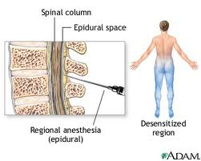
Epidural

Slide 51
Epidural Disadvantages
Mother and baby must be constantly monitored
Can slow labor
Pushing stage may be prolonged
Increased risk for instrumental delivery (forceps or suction)
May cause maternal fever, requiring possible separation of mother and baby and additional testing on baby
Must have IV fluids before epidural
Must be in bed for remainder of labor
No use of gravity
Pitocin may be needed to speed labor
Mother must be catheterized
Increased risk of additional interventions and cesarean section
May cause itching and shaking
Risk of severe headache

Slide 52
Post Partum (after delivery)
Lochia is vaginal discharge after giving birth containing blood, mucus, and uterine tissue.
Lochia discharge typically continues for 4 to 6 weeks after childbirth.

Slide 53
Post-Partum
Most full-term babies (born between 37 and 40 weeks) weigh somewhere between 5 pounds 8 ounces (2,500 grams) and 8 pounds, 13 ounces
The new mom will need rest (giving birth is like running a marathon), food because she has eaten since labor started, understanding of her needs and new role, and time out of bed to get up and move around.
The average total price charged for pregnancy and newborn care is about $30,000 for a vaginal delivery and $50,000 for a C-section, with insurers paying out an average of $18,329 and $27,866, according to a recent report by Truven Health Analytics. Jul 1, 2013

