Slide 1
Shirt making
By: Kendra & Laura

Slide 2
Summary
When we first started making shirts, we struggled to think of ideas but as we got more advanced with using the machine it became easier to think of ideas and faster to make things.

Slide 3
Highs and Lows
Some highs:
Our first good shirt
Figuring out how to layer
Some lows-
Measuring the vinyl
Shirts not turning out
Not making the perfect cut

Slide 4
Problems-
Coming up with new ideas.
Making sure the vinyl fits on the shirt good.
Finding good pieces of vinyl to use.

Slide 5
Idea
Our first idea was to make socks, but as we started using the machine we enjoyed making shirts and did not bother to start with the socks.

Slide 6
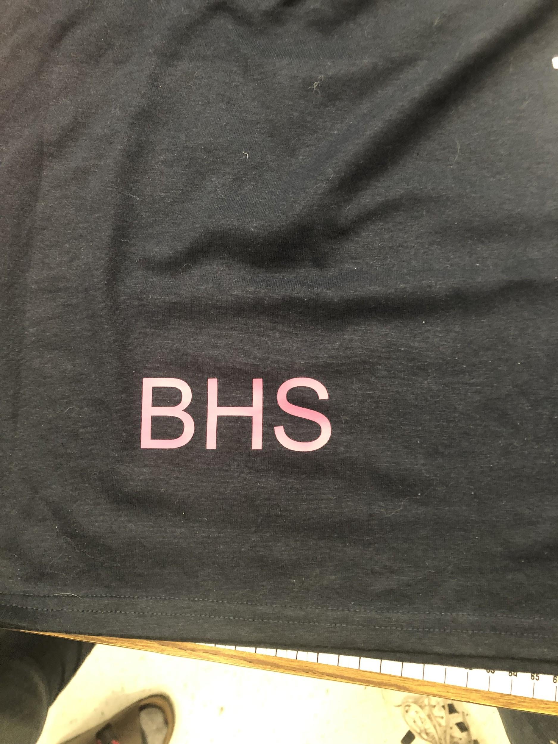
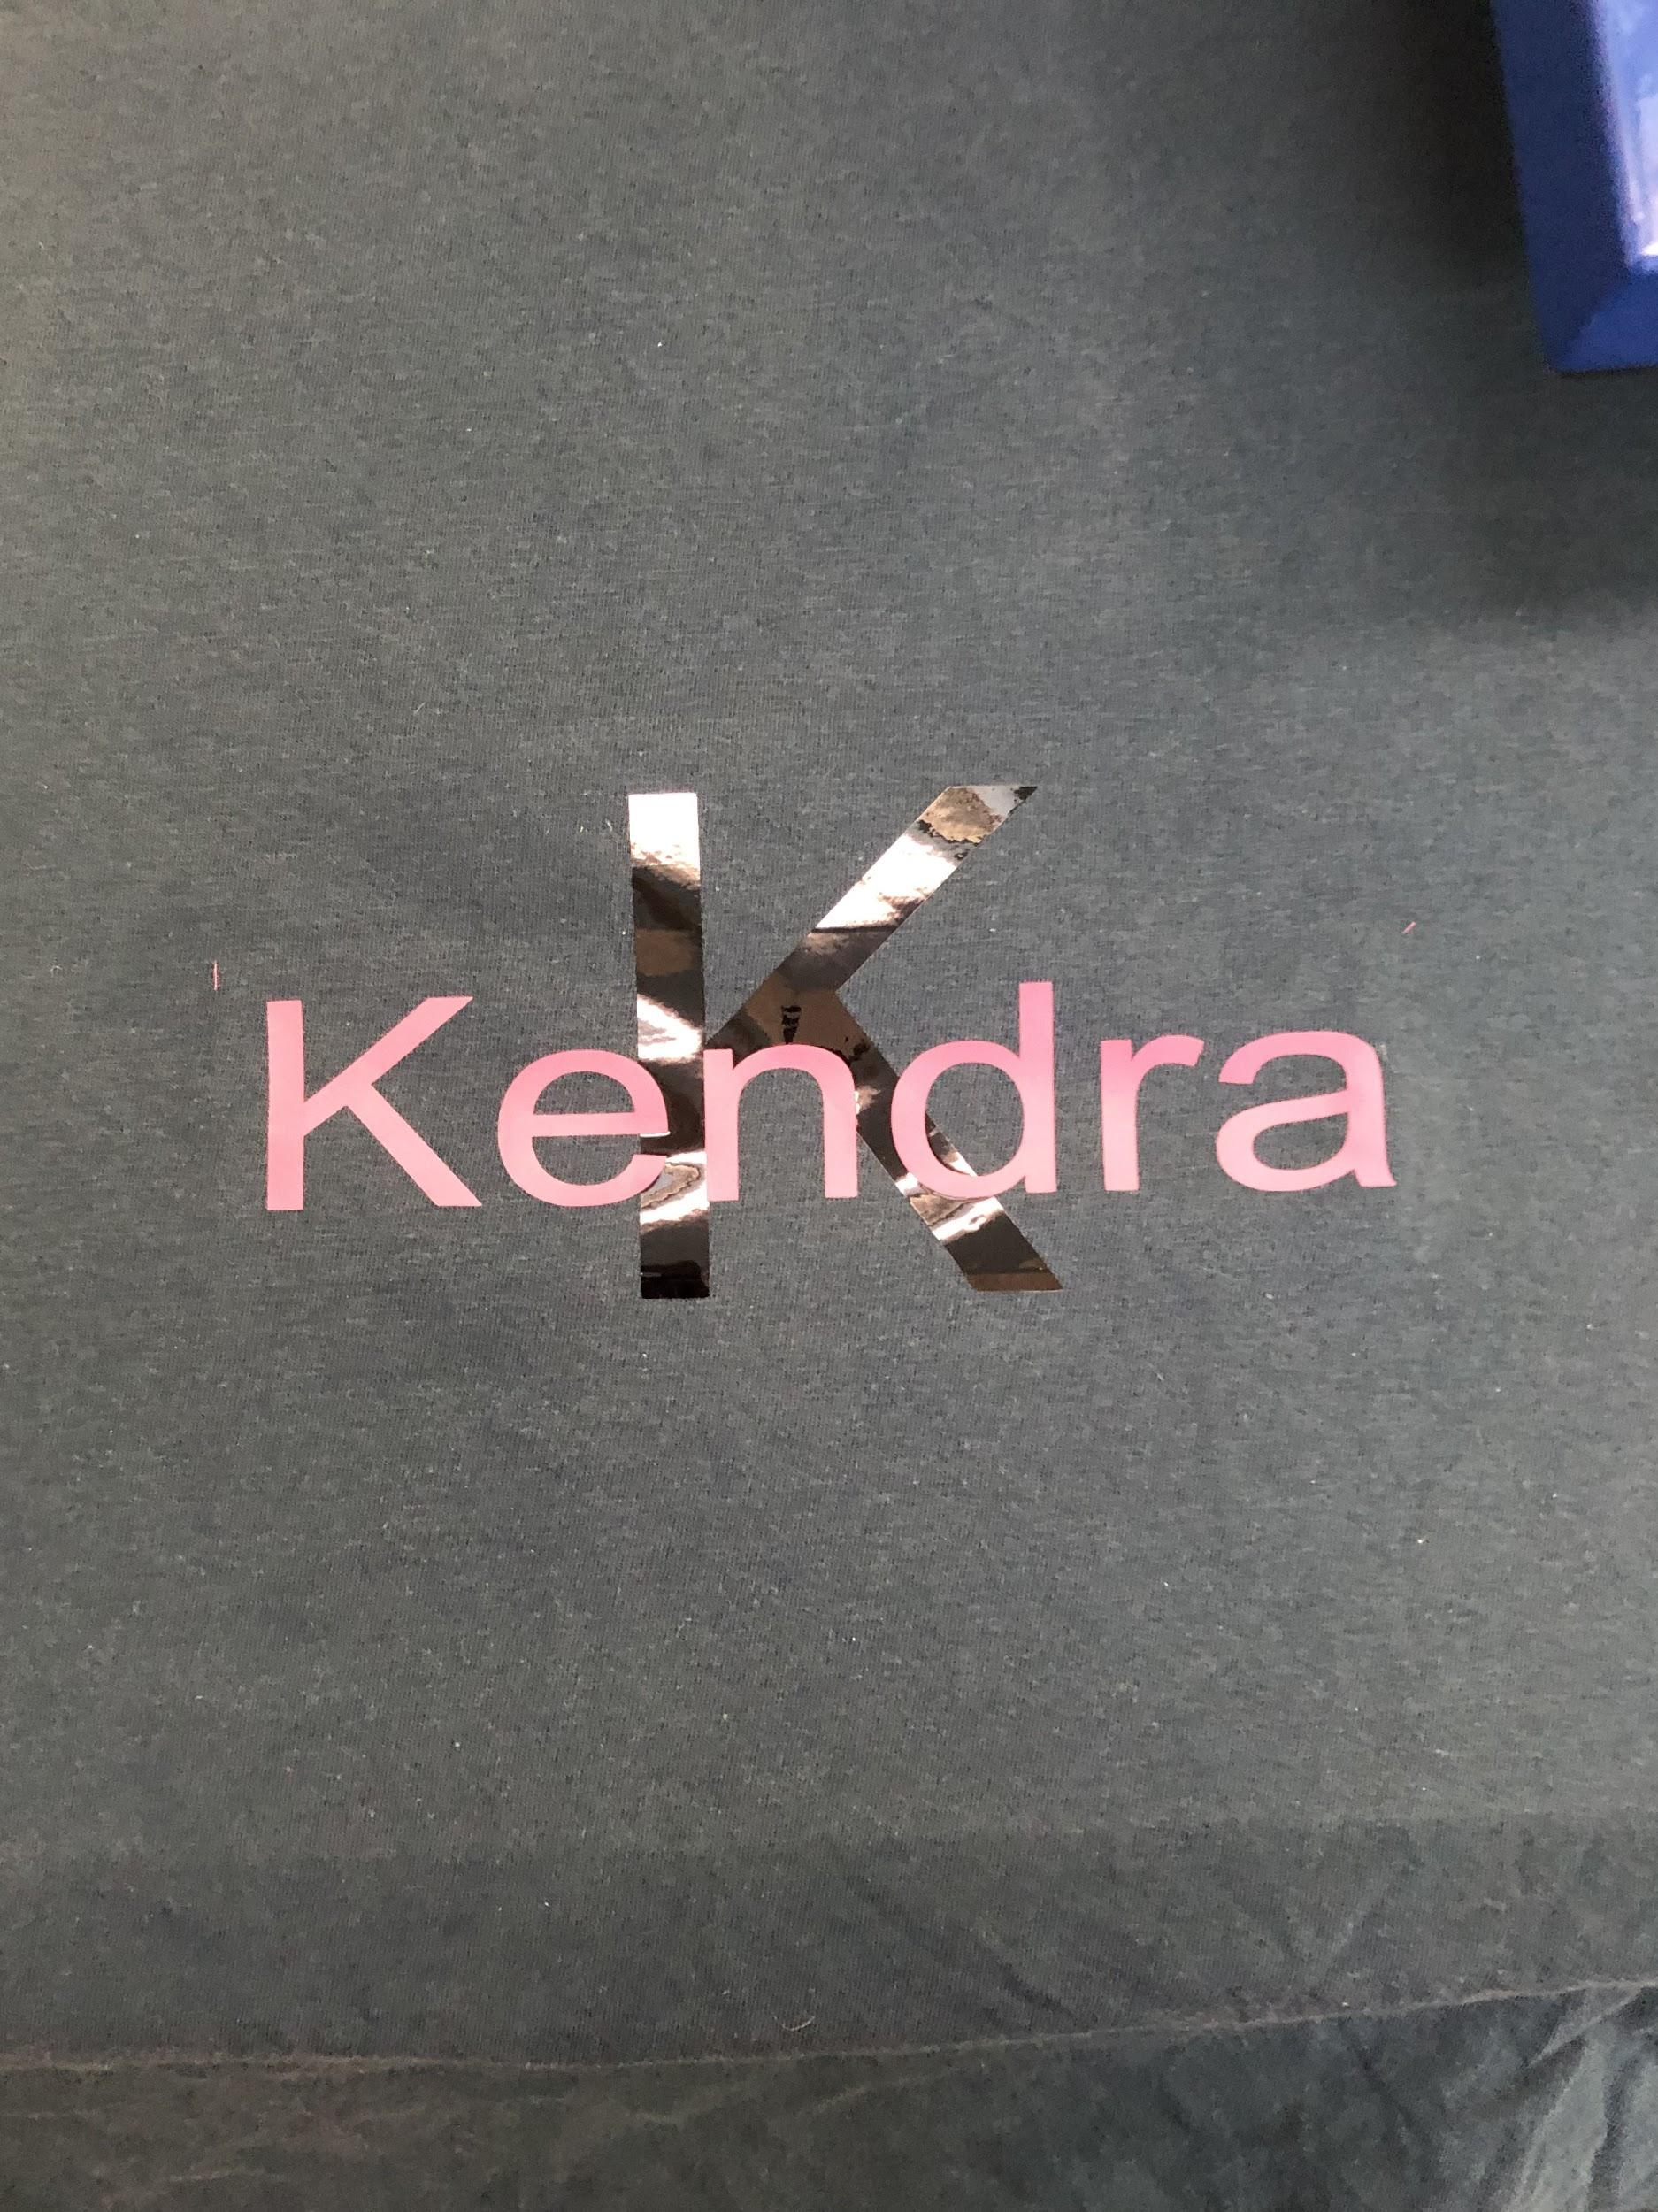
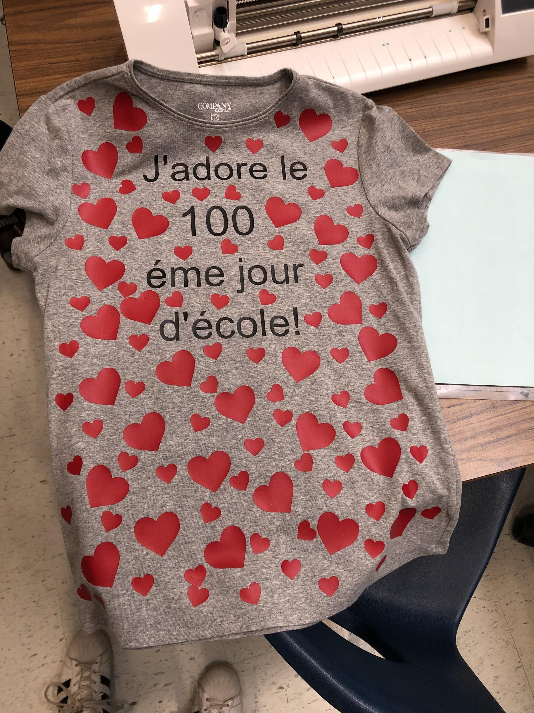
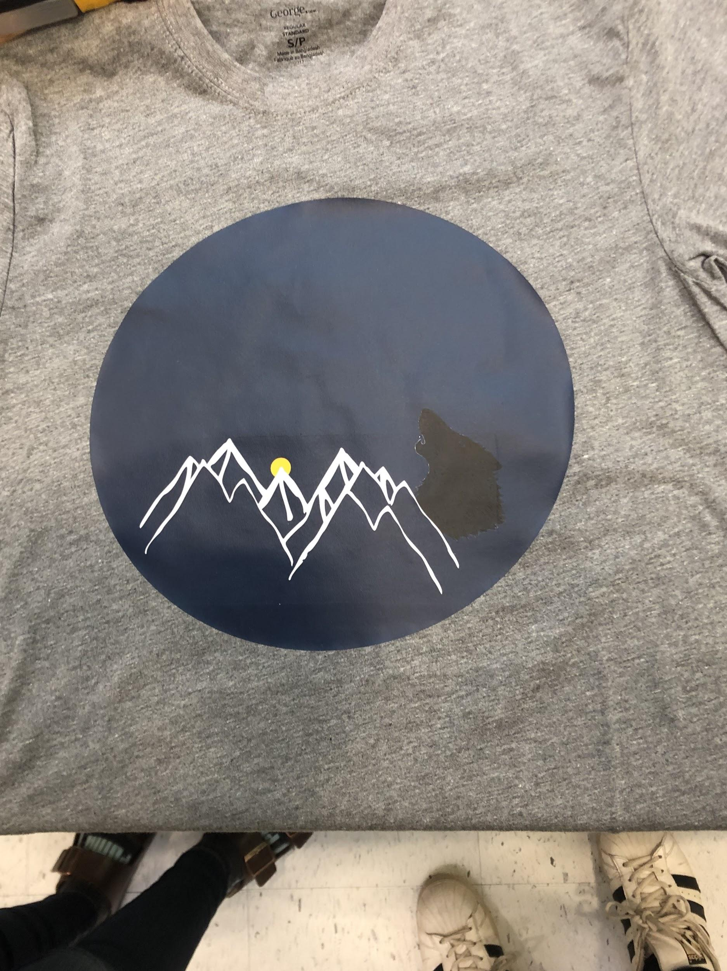
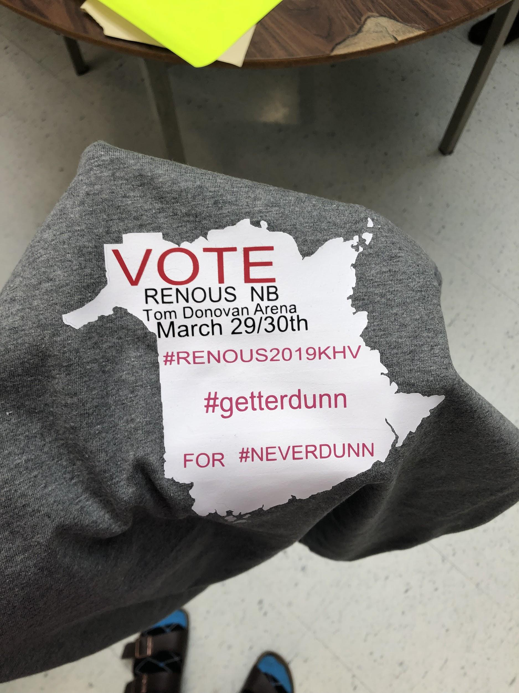
Pictures
1
2
3
4
5

