Slide 1
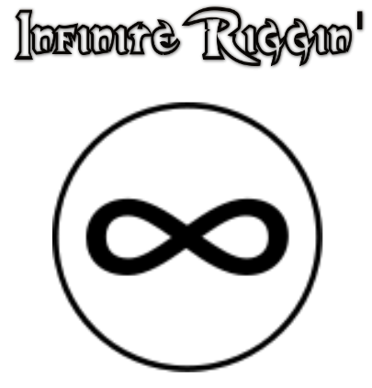
By: Ronan & Kel
Infinite Riggin’

Slide 2
Our Project
Our project is four tie dyed tee shirts with various designs and neat color patters. We also have our own logo to put on them as well.

Slide 3
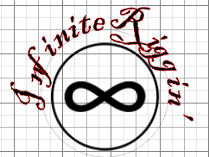
Our Idea
Our idea was to create something that was simple but unique at the same time, so we decided to make tie dyed shirts with our own logo on them. We also plan on making more shirts with different designs and new logos.

Slide 4
The Process
To make the tee shirts we had to pre wash them, fold them into the shape we wanted them, then keep it steady by tying it with elastic bands. After we had to pour the dye onto the shirts how we wanted them and let them sit for 6-8 hours.
Video: https://www.youtube.com/watch?v=41K_OJ_HFZQ

Slide 5
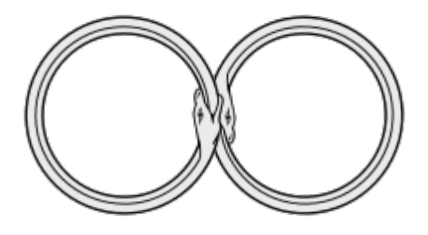
What we plan
We plan on creating more clothing and are going to make new logos and experiment more with tie dye to keep our clothes having new designs to keep our business fresh. We also plan on hopefully branching off into new clothing like hats and hoodies.

Slide 6
What we hope to achieve
We hope that our business gets some attention and people take interest in our product. We think we have a pretty good idea and have good plans for the future.

