Slide 1
Coulter’s 3Dponics
Jenna Coulter

Slide 2
What I Started With:

Slide 3
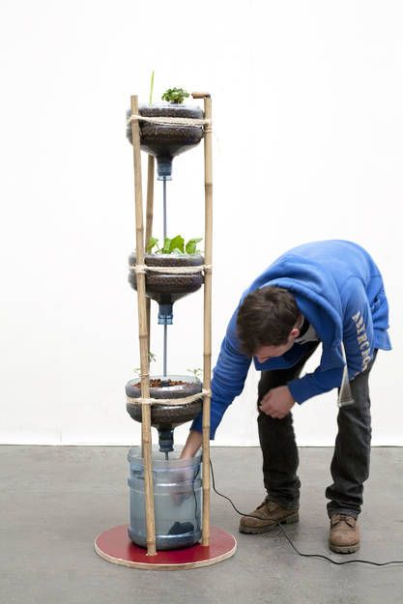
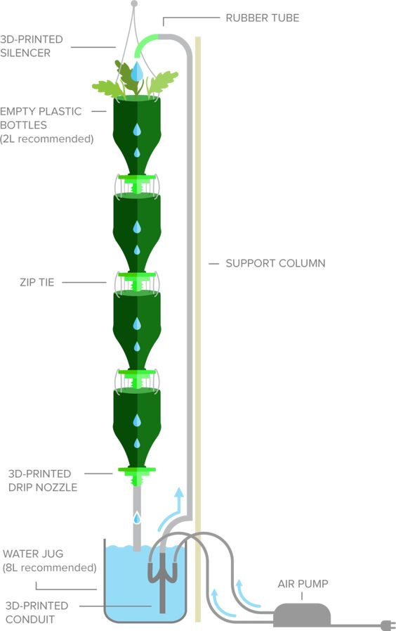
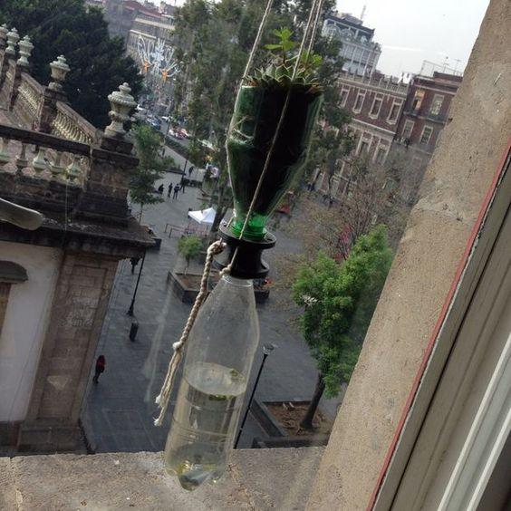
My Main Idea:
https://www.3dponics.com/

Slide 4
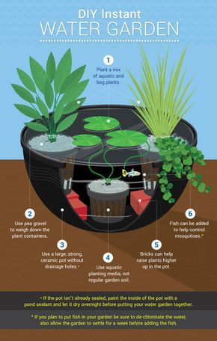
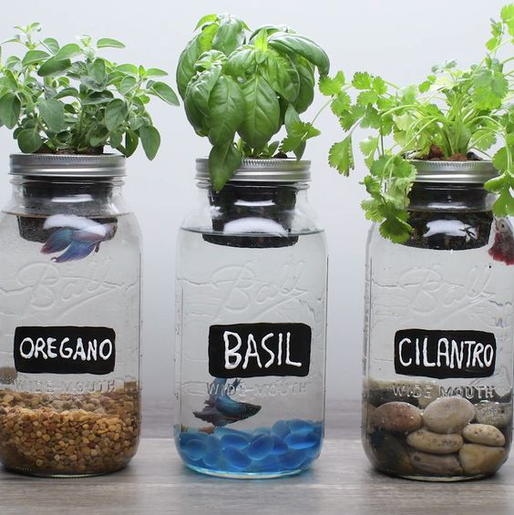
Ideas I’ve Thought About:

Slide 5
The Growing Process:

Slide 6
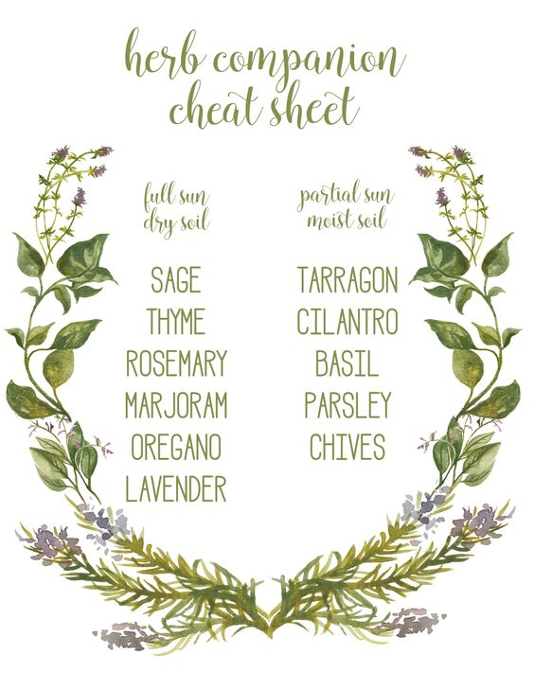
What I Learned:
Growing plants together
Taking care of plants
Changing an idea

