Slide 1
Devoh Designs by Garett and Denver

Slide 2
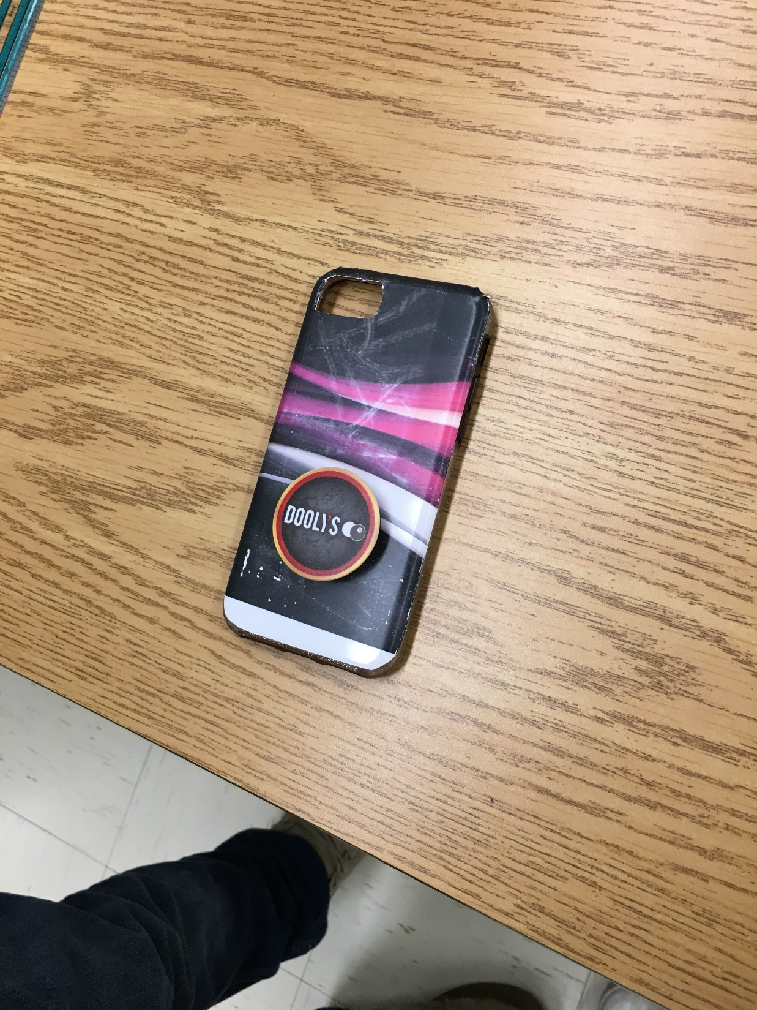
Our Company?!
Our company was made to produce vinyl wraps/stickers for the customers.
We wanted to put a custom spin on everyday items

Slide 3
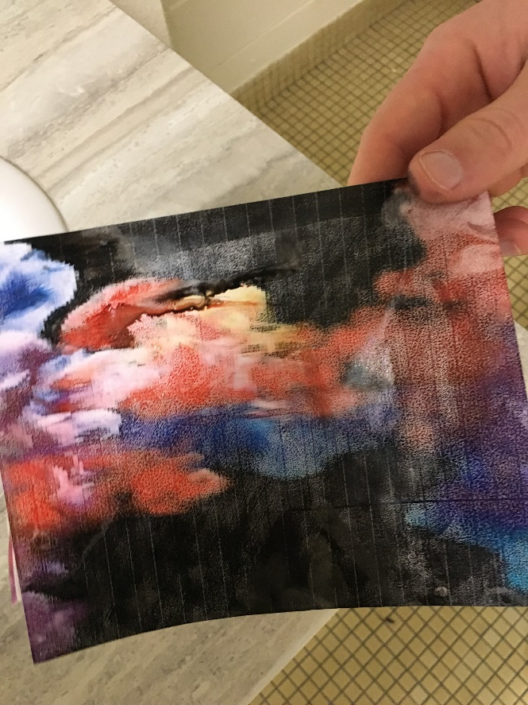
Troubles!
We tried printing on vinyl but the color would run down the vinyl
We switched to the LaserJet printer but the vinyl melted off..

Slide 4
Success!
We made some very nice stickers for our phones…
We also fully wrapped a phone case that turned out well…

Slide 5
Summary..
Our first thought when we started this whole thing was to start with wrapping controllers, then when that didn’t work we switched to phone cases
The phone cases went well until we tried to print in color and after that everything went downhill…

