Slide 1
Makey Makey Guitar Hero
By: Deanna Nordin and Emileigh Jardine

Slide 2
What is it?
For this project, we replicated Guitar Hero on a cardboard guitar that we created, and a Makey Makey- a circuit board that uses a USB cable to plug into your computer that you can run a program on and play on your Makey Makey.

Slide 3
How does it work?
As previously mentioned, the Makey Makey is a circuit board that plugs into your computer via USB cable. When plugged in, the circuit board allows you to run a program and play it through the Makey Makey. The Makey Makey comes with alligator clips that can clip onto anything that will conduct electricity, this allows us to play programs such as Guitar Hero on random objects, even bananas!

Slide 4
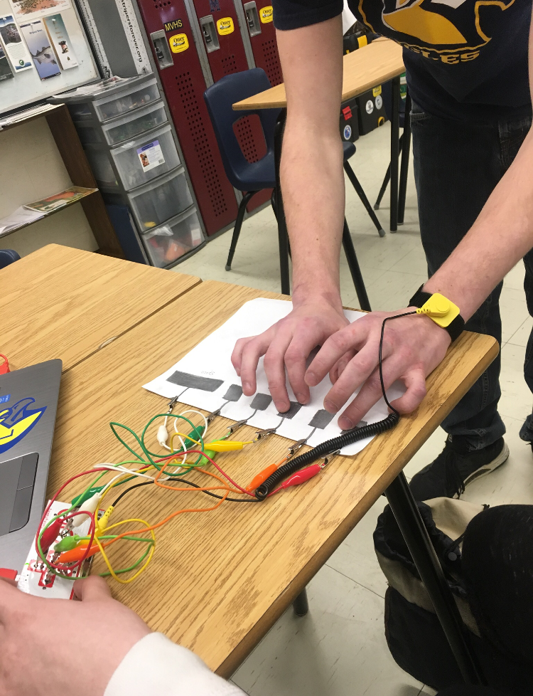
Progress Photos
We started the project by messing around with the board to get familiar with it, we drew out a simple keypad on paper using pencil lead to test the waters in the beginning.

Slide 5
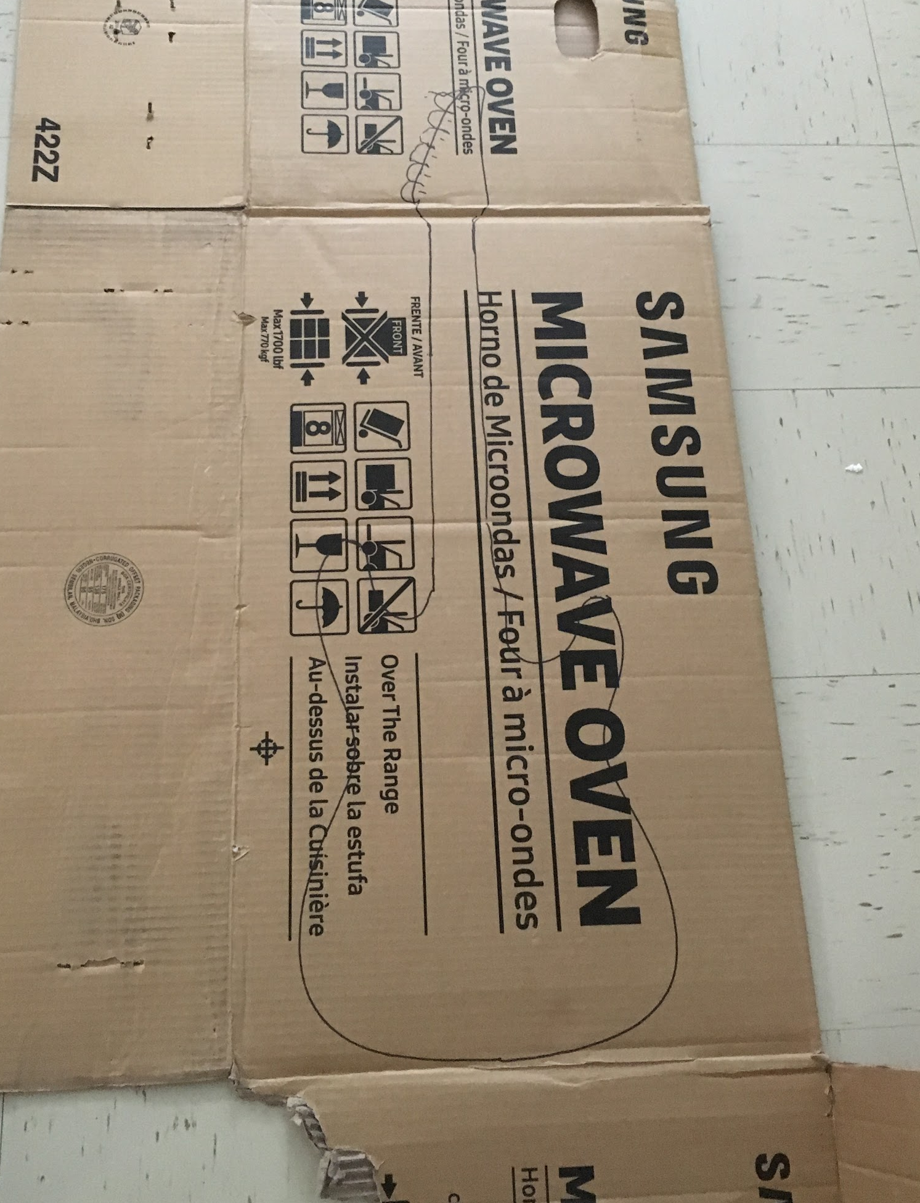
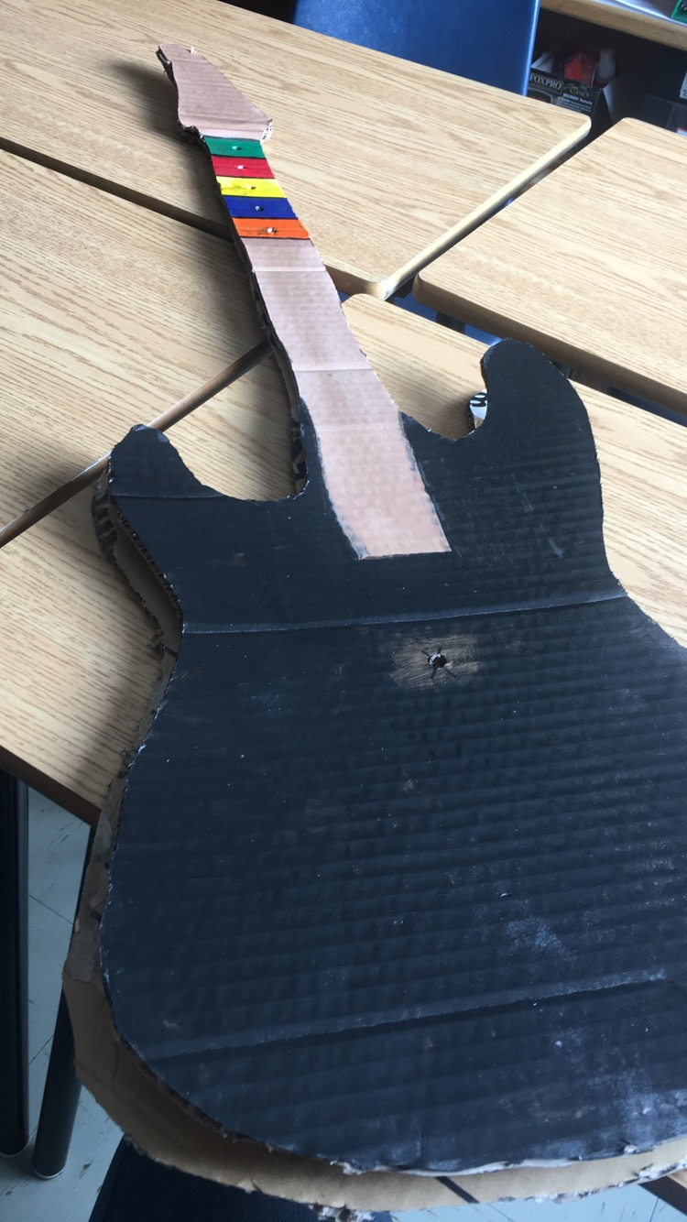
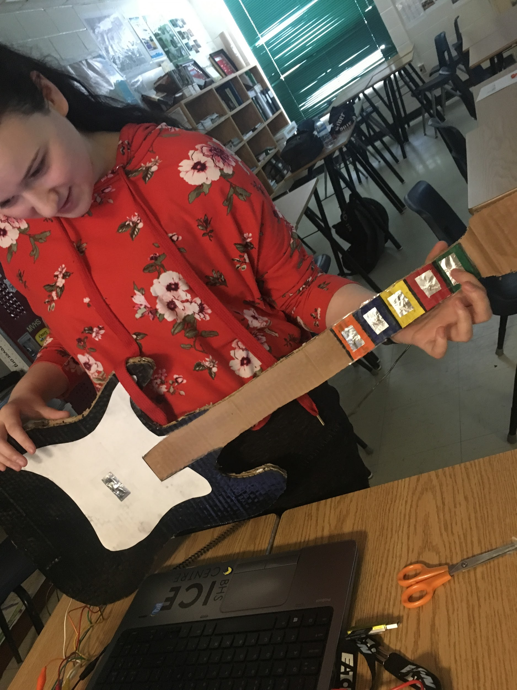
Progress Photos
Our guitar underwent a few major changes before coming to the final result that you see here today. We made this guitar from cardboard, craft paint, and some wiring that happened to be trickier to use than expected. Below are a few progress photos that we took along the way.

