Slide 1
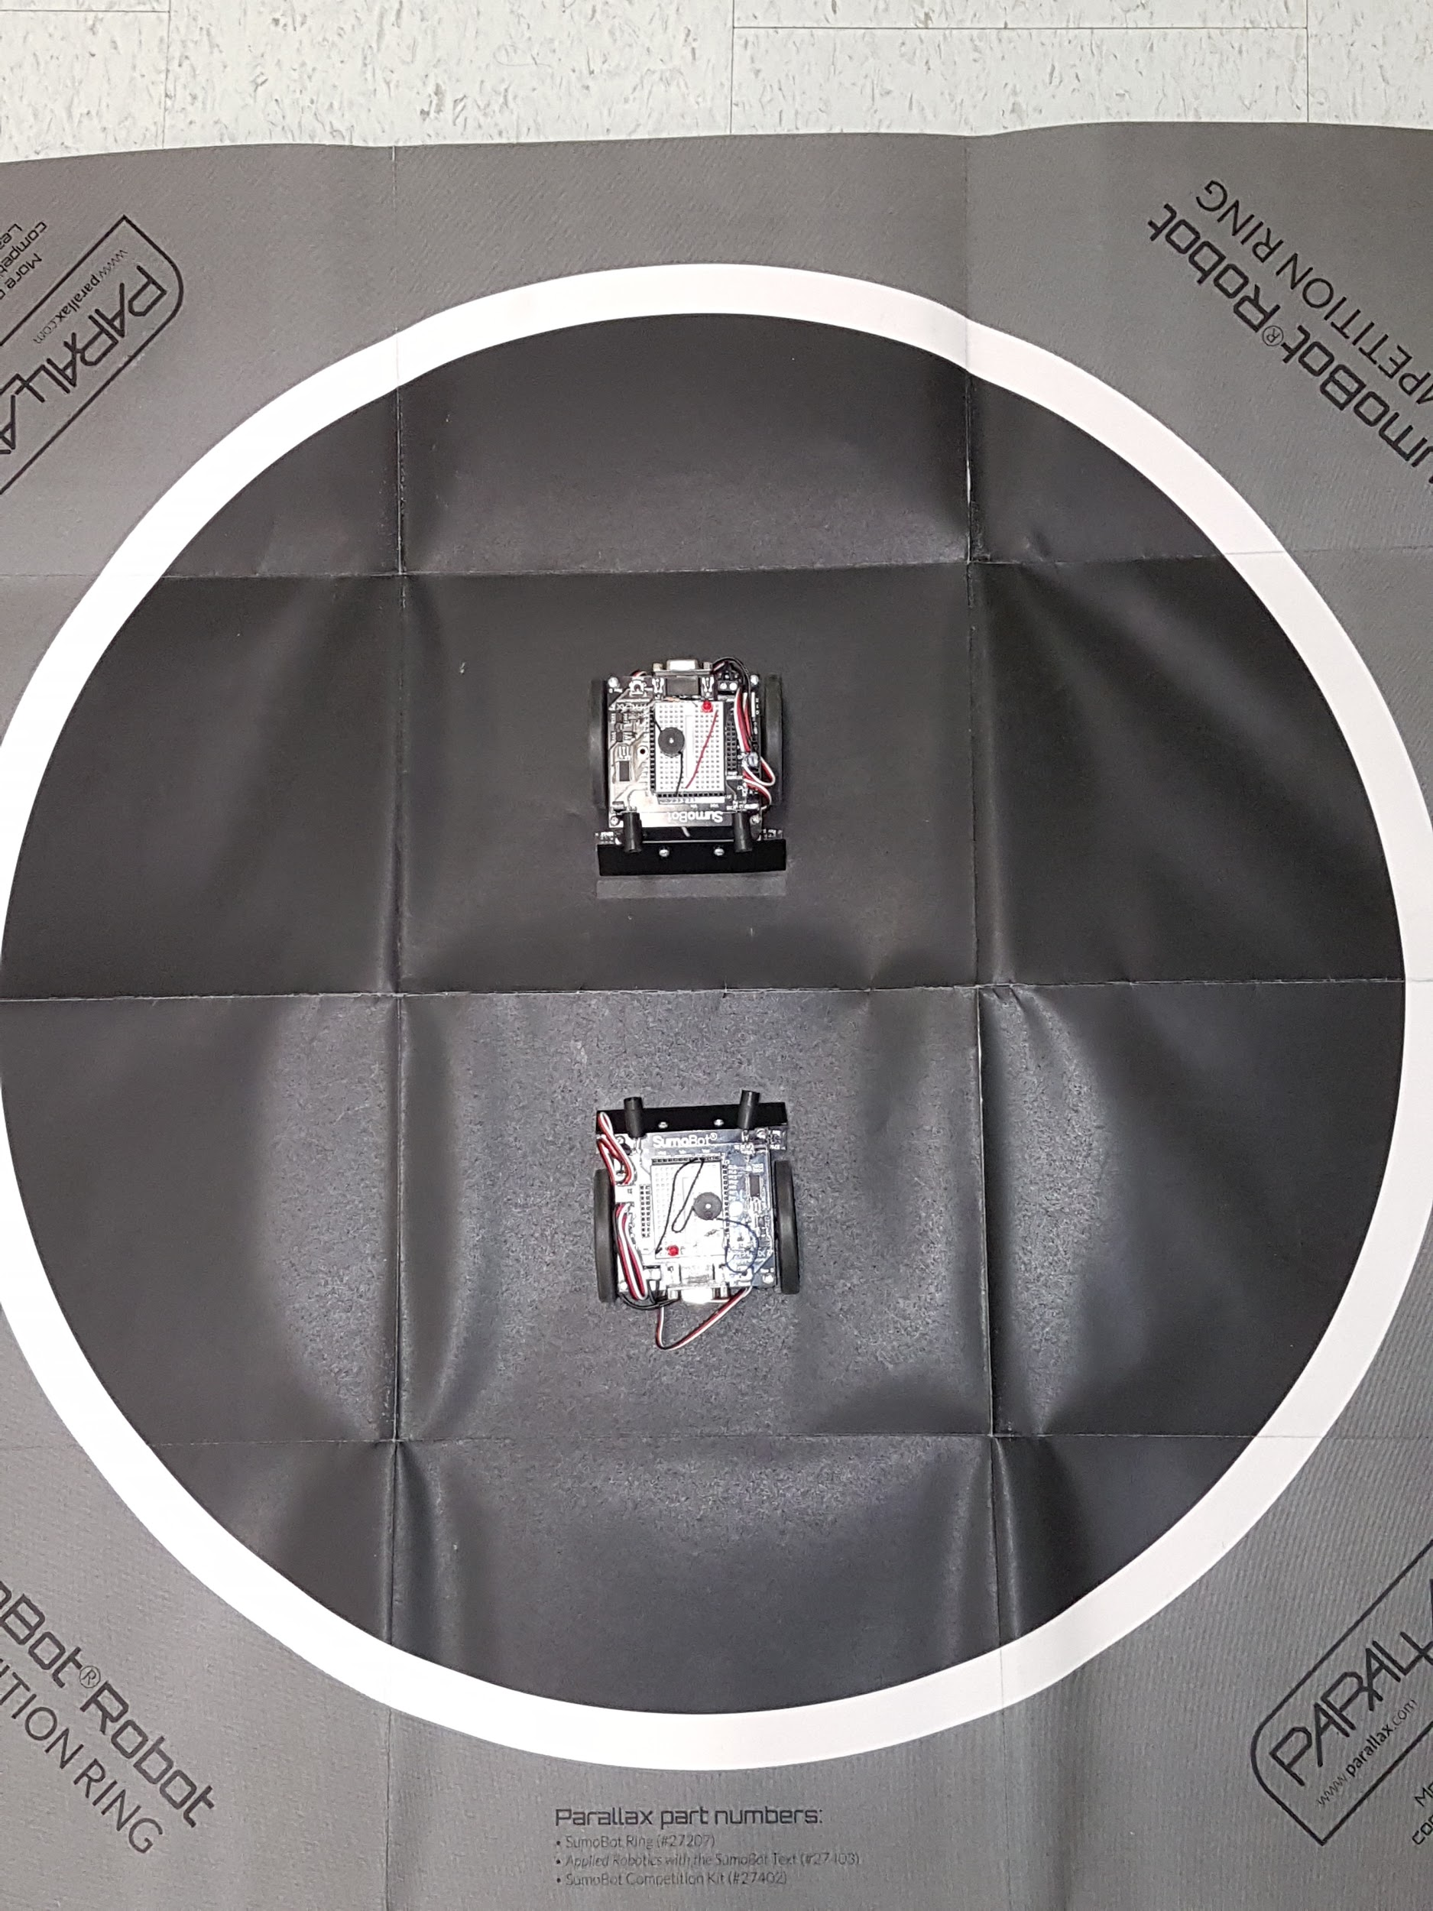
SUMO-BOTS
By:
Logan Burke
Christopher Underhill

Slide 2
WHAT ARE THEY?
These bots came from PARALLAX INC. They donated this too the school for students to explore the basics of coding and and a little bit of wiring. They are easy to use, challenging at some parts to figure out how they work, but in the end it's all fun to watch them battle it out.

Slide 3
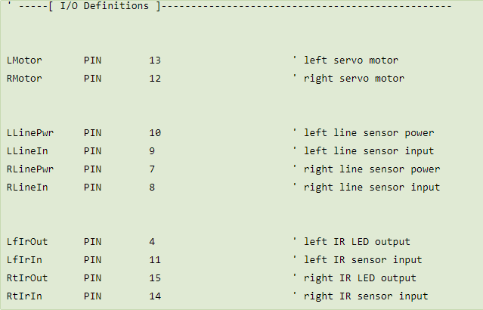
What is in a Sumo-Bot?
Not only is this a cube of nuts and bolts, but it has a lot more in it that you can’t actually see, and it was not easy getting it all there. The hardware was a task itself, but the coding is what really tests you. But once you get it then you are able to make your bot move, sense, and fight whatever robot is within its vicinity.

Slide 4
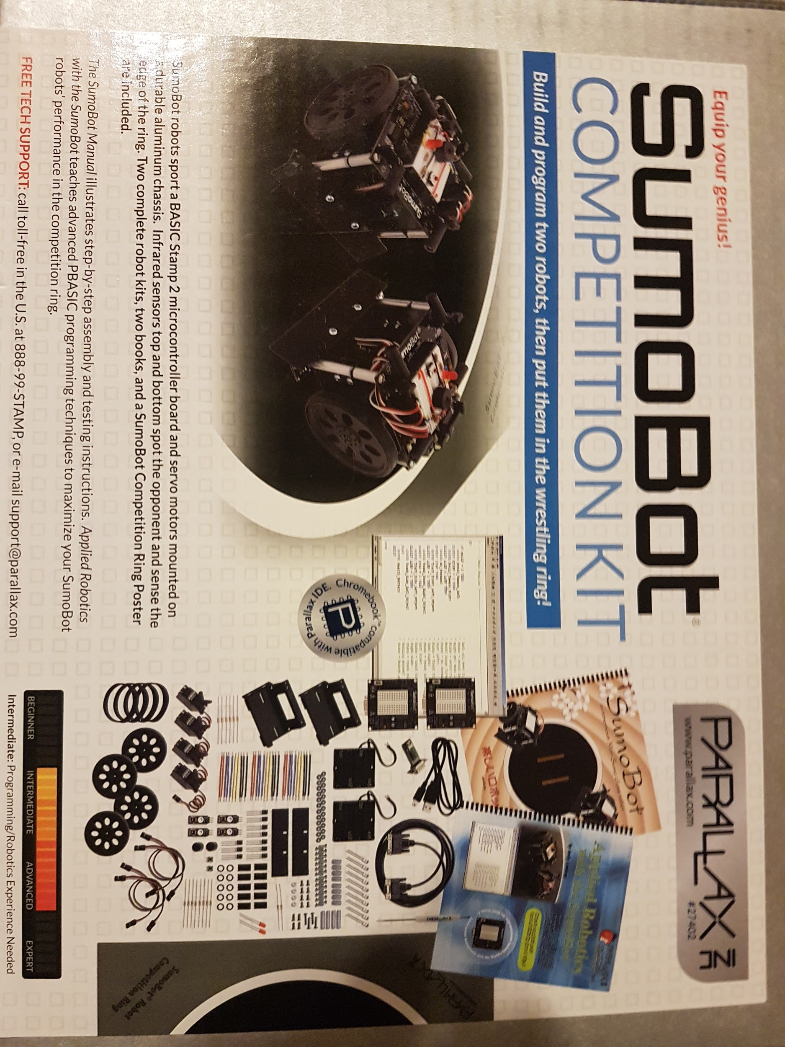
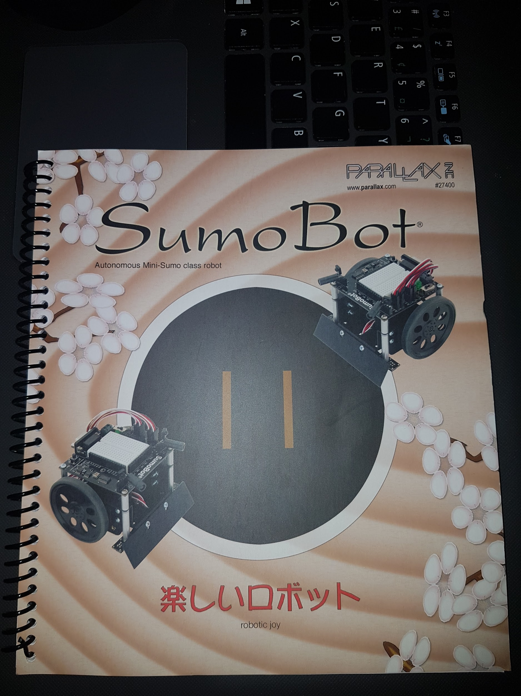
Start-Up
Well it all started with box set, then from there on the assembling part of the robot itself was not all that challenging, just finding what pieces fit in right was pretty well the only rough part. But once it came to writing code, that was the rough part; and that's when the most problems occured, such as:
Figuring out why it would not sense other robots
Why it would only go in a circle
Why the code would not transfer to the bot

Slide 5
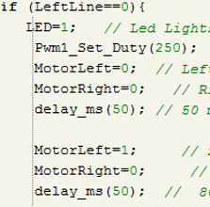
What can you learn from this
For a student who has never done coding, nor do anything with robots, we was able to manage how to figure out how to write certain lines of code, commanding the Sumo-bot to do different actions. Now we am able to look at my own code and find out some different errors and places that I need to rewrite what is there.

