Slide 1
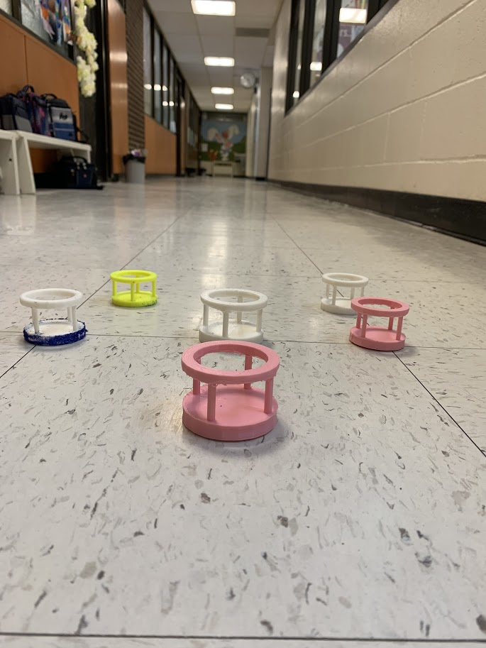
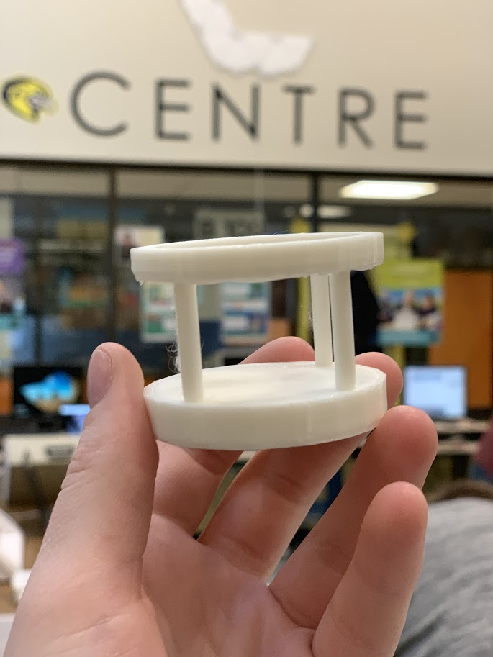
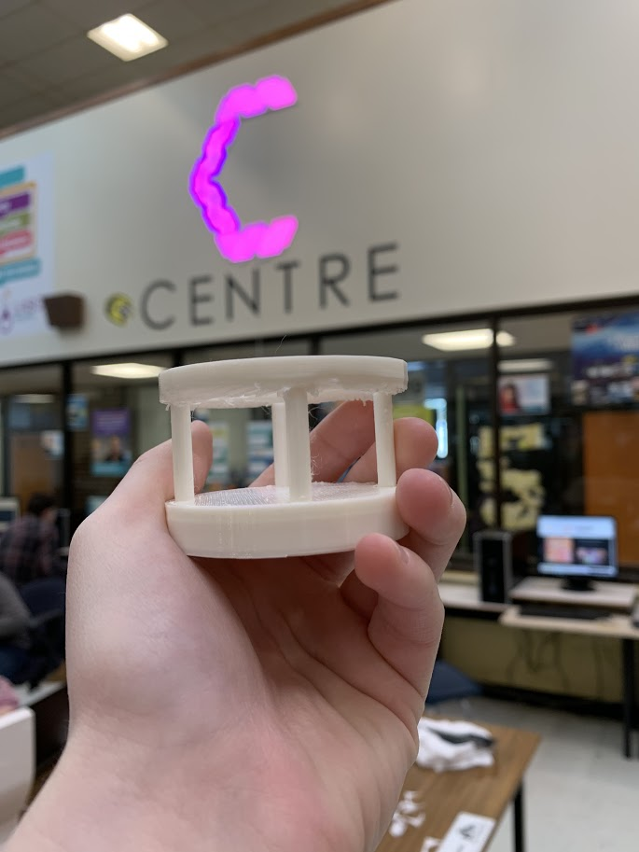
Beauty blender holder using 3d printing
By: Julie Jardine and Chloe Donovan

Slide 2
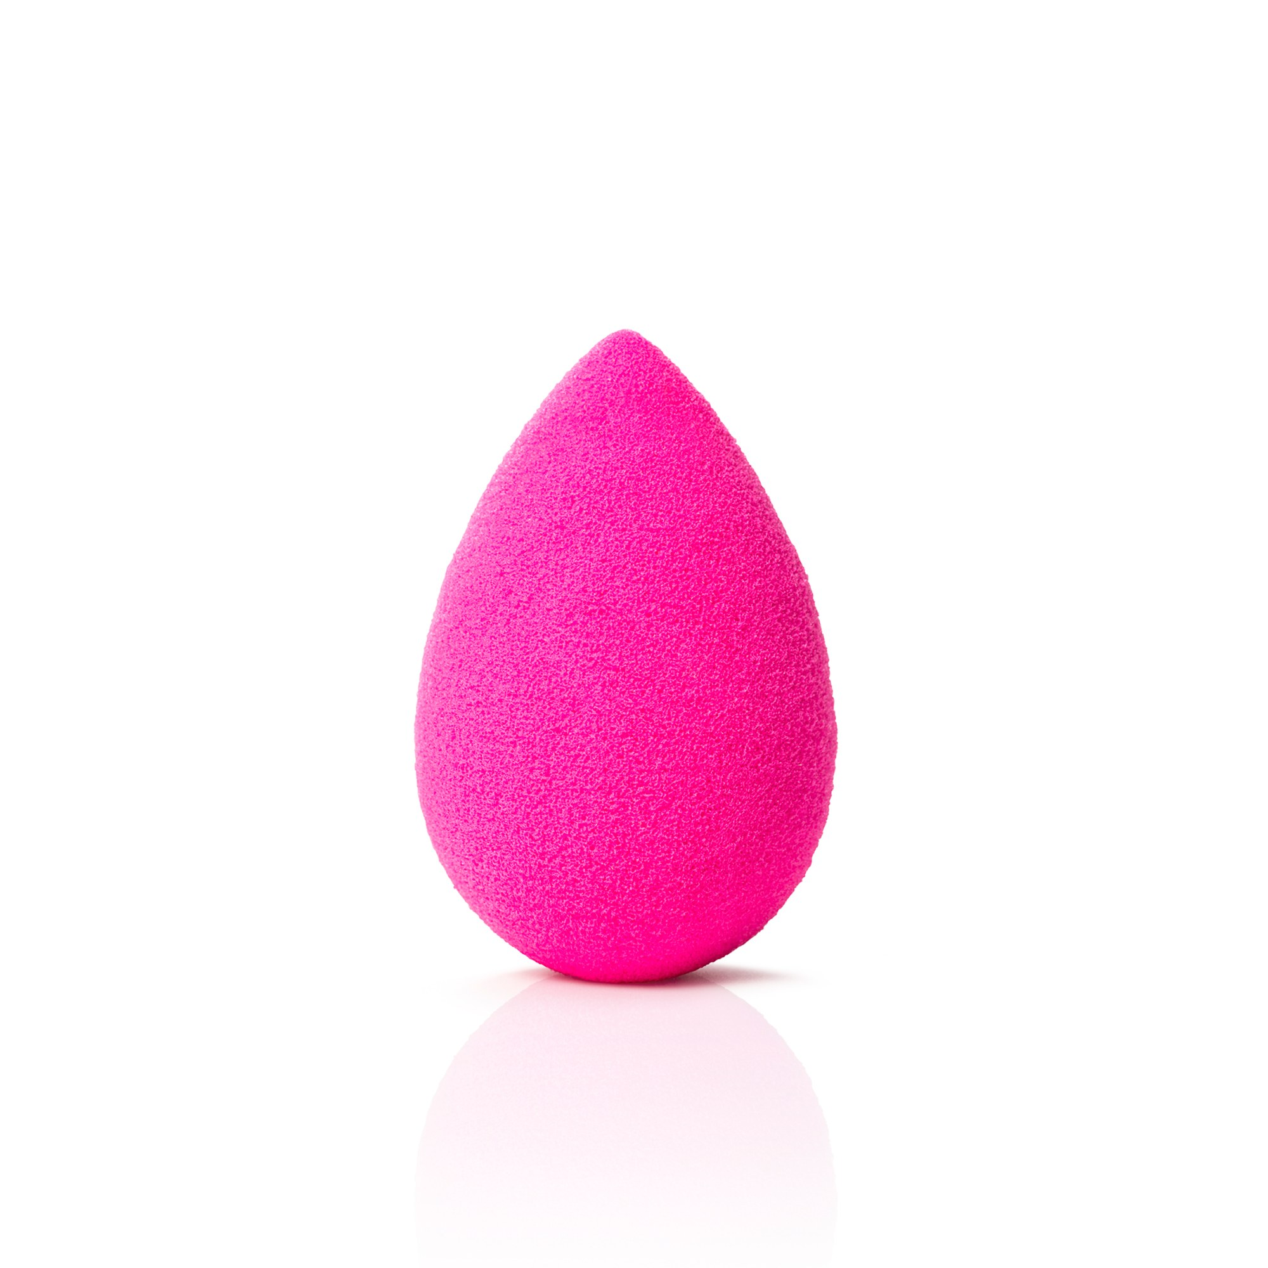
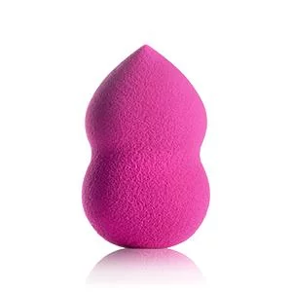
What is a beauty blender?
A beauty blender was created and its real purpose is to hold water, not product, also by evenly distributing and blending the perfect amount of cream, powder, or liquid formulas into skin without lines.

Slide 3
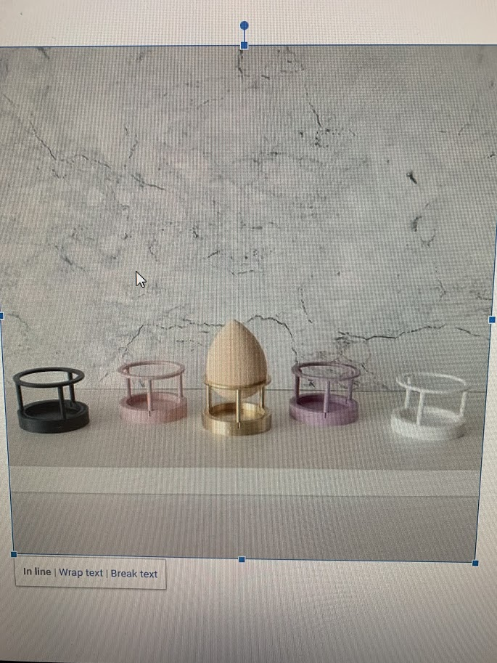
how we got the idea
We got the idea when we were on Pinterest on one of the first days of the semester, we saw this picture of a holder for a beauty blender which is something mostly every girl has in there makeup bag, so we decided this could be a really unique, cute idea.

Slide 4
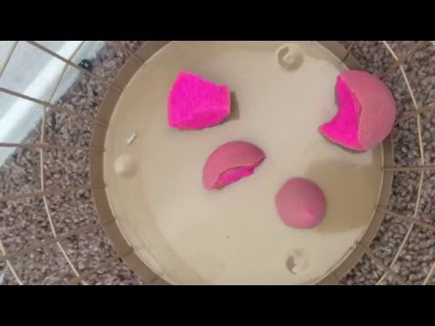
What is the purpose of it?
The purpose of the beauty blender holder is when you use it everyday it gets wet and full of makeup, it leaves it smelly and gross, so the holder prevents that so you can leave it out of the makeup bag and in the holder. it prevents them from ripping and get badly damaged like a make bag would cause and it will give your beauty blender a longer usage time. Did you know, you can use the beauty blender for many things including applying sunscreen, dying your hair so the holder can prevent it from getting everywhere.

Slide 5
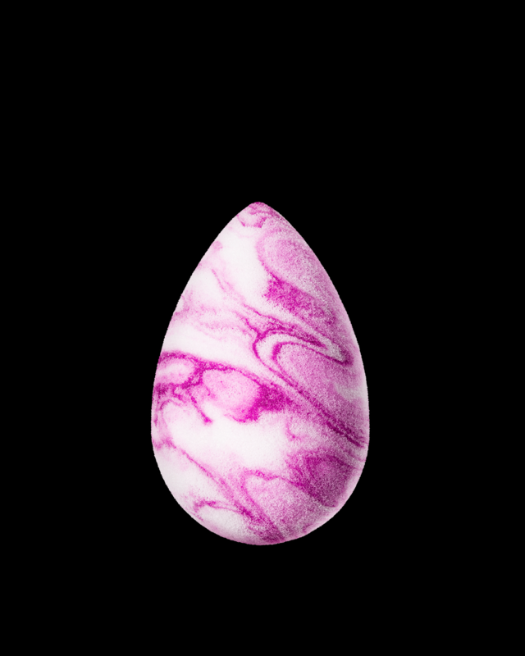
Where we started 3d printing
When we first started designing the holder we used the tutorials on tinker cad to teach us where to begin, after we practiced for two days we decided we were ready for our first print.

Slide 6
First beauty blender
The first beauty blender holder wasn’t a huge success but the pros are that we did the design right and how we wanted, but the cons was that we just made it to small, it was small enough to fit a mini egg.
What we learned from this is that we needed to be super sure of our measurement before we print

Slide 7
Second beauty blender
For the second design the size was perfect and it turned out ideal, but the negative was that we tried to apply glitter to spice it up and the glitter became very chunky and came off, so we learned that glitter was a no go.

Slide 8
Third beauty blender
The third beauty blender was a huge breakthrough and this one turned out perfect, the only thing we wanted to change was the color

Slide 9
Forth beauty blender
The forth beauty blender holder was the first attempt at putting our names into it, and the size was very good, the only thing was the color the was in Julies opinion a no no

Slide 10
Fifth beauty blender
The last one turned out perfect with the color we wanted and the perfect size and length, this one was a huge success!

Slide 11
Conclusion
In conclusion we learned how to use the 3d printer and make this and we have many more plans for the holder as we plan to improve and make it multi usage in the future just like the beauty blender is meant for, we believe this could be a good venter due to the fact that over 6.5 million sponges are owned by people

