Slide 1
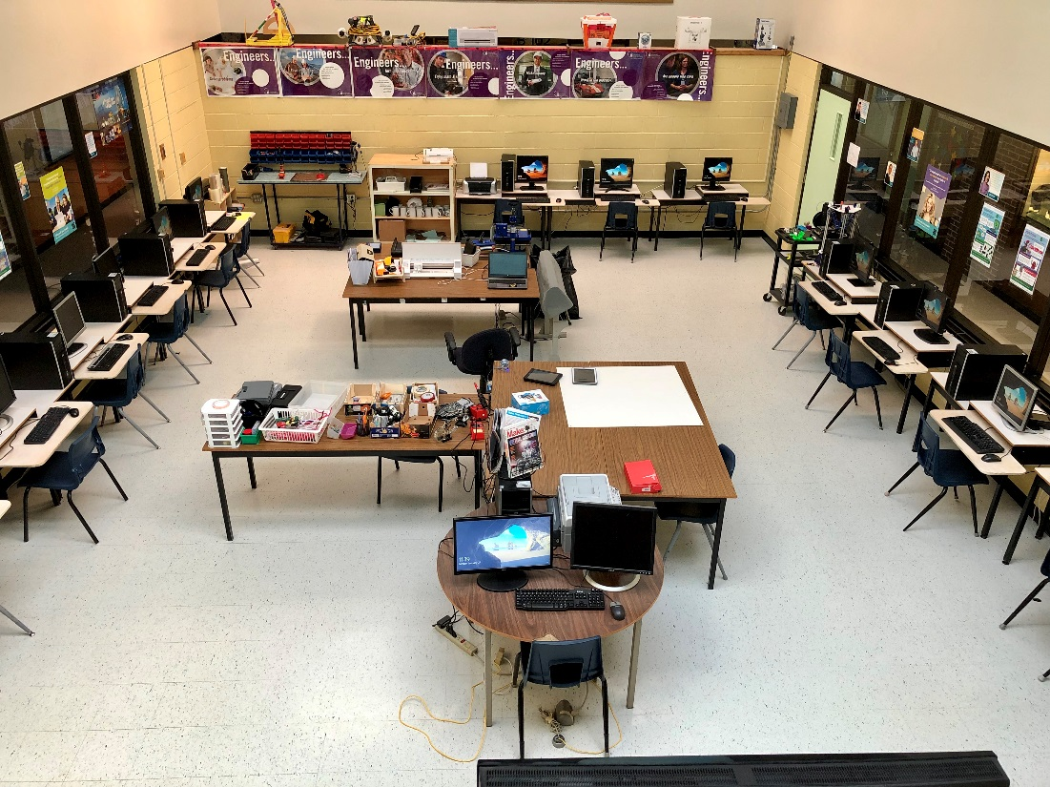
Mr. Hallihan

Slide 2
Why take Entrepreneurship?
It is a practical, hands-on class.
Social Entrepreneurship can change the world.
Our goal is to give you the ability to apply your entrepreneurship knowledge and skills to real-life issues and situations.
You will use the skills you develop in this class in real life.

Slide 3
“Entrepreneurship encompasses those characteristics and skills that prompt and equip a person to take the initiative to launch new ventures of all kinds that addresses problems, needs and wants in our society”
Entrepreneurship for Canadian’s: The Spirit of Adventure

Slide 4
Why do you think they equate being an entrepreneur with being a kid?
The idea that kids are creative, innovative, have a love of life and are passionate about what they are doing/playing with are all characteristics of good entrepreneurs!

Slide 5
Protect Your Dreams
Pursuit of Happiness
Answer the following question in your scribbler…
Question #1
What is entrepreneurship?

Slide 6
Question #2
What is something you love to do?
Brainstorm ideas of how you could possibly turn it into a business.
EXAMPLE…
I love to HUNT & FISH so I could open a:
Outfitter Business
Youth Fishing Programs
Adventure Video Production
Online Fly Shop
Sporting Camp

Slide 7
Definitions you NEED to know:
An Entrepreneur is someone who creates and runs his/her own business.
(See our definitions as well!)
To be entrepreneurial means to think or act like an entrepreneur.
Entrepreneurship is the process of being an entrepreneur.

Slide 8
KEY TERMS…
Venture – A business startup or undertaking
Venture Plan – A written summary or what a venture can accomplish and how it intends to do so.
Need – Something that is essential to life.
Physical - food, water, sleep
Physiological – love, companionship
Want – Human desires that are not essential for human survival

Slide 9
What makes an entrepreneur?
Think of as many characteristics as you can to describe what makes an entrepreneur and add them to your scribbler…

Slide 10
What Is An Entrepreneur?
Read the attached article and answer these questions https://www.thebalancesmb.com/entrepreneur-what-is-an-entrepreneur-1794303
Article Questions…Answer for Homework!
What are the types of entrepreneurs that the article identifies. Can you think of any types that might be missing?
There are several characteristics listed in the article. What do you think are the top 3 and why?
In your opinion, are entrepreneurs born to be successful, or are they made? In other words, could anyone become a successful entrepreneur?
Respond Using Google Forms... Link on my teacher homepage

Slide 11
Types of entrepreneurs…
Type | Description
Small Business | Any business with less than 500 employees Examples: Partnerships, Sole Proprietors, Local
Home-Based Business | A small business that it is run from home
Online Business | Business is run online…can be small, home or even large coorporations
Inventors | In order to become an entrepreneur one needs to go beyond the idea stage and get it to market
Serial Entrepreneur | Starting a business, sell it and invest in another…having multiple businesses on the go
Lifestyle Entrepreneur | A business built upon their interests and passion so that the business supports their lifestyle

Slide 12
Do you have what it takes?

Slide 13
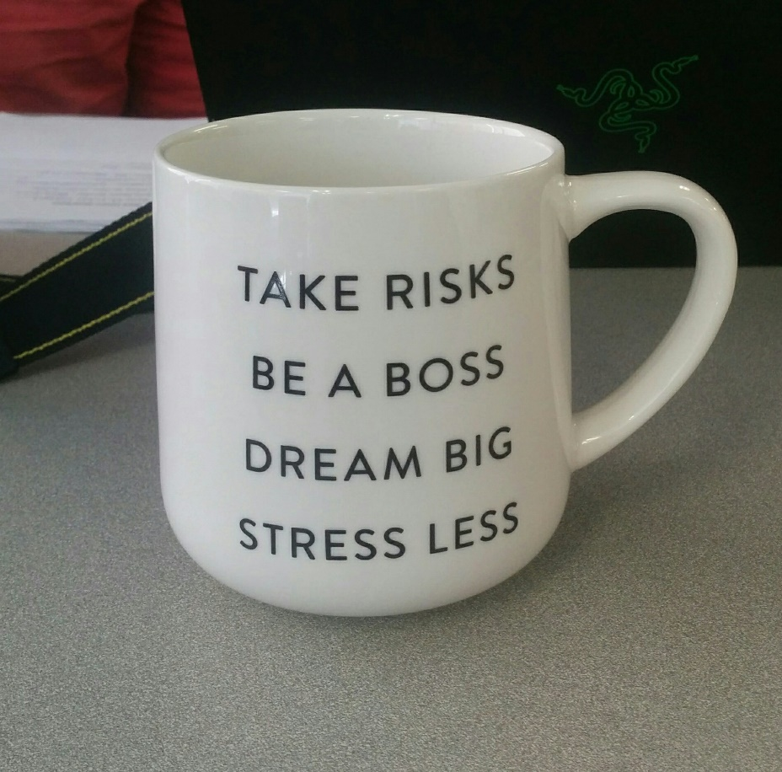
Answer yes or no to the following:
1) Would you like to be your own boss?

Slide 14
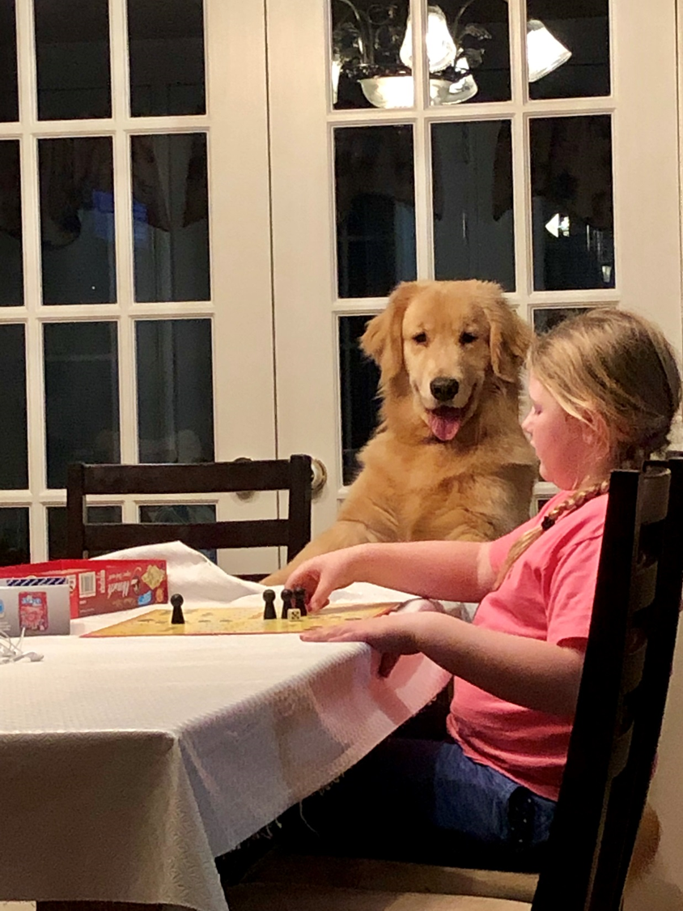
2) Do you have a high level of energy?

Slide 15
3) Are you willing to risk losing money or personal assets?

Slide 16
4) Are you able to inspire and energize others?

Slide 17
5) Are you strong willed?

Slide 18
6) Do you have an ability to learn from failures?

Slide 19
7) Are you willing to devote a lot of time and
effort to your ideas?

Slide 20
8) Are you competitive? Are you highly motivated?

Slide 21
9) Do you have business skills?
Or, are you willing to gain them?

Slide 22
10) A "never, never, never quit" attitude?

Slide 23
If You Answered Yes to 7 Questions….
You Might Be Interested In Starting a Business…

Slide 24
The Characteristics of an Entrepreneur…
Vision! Awareness of problems, needs and opportunities
Adventurous
Self-confident
Innovative and Creative
Persistent
Positive Attitude
Integrity / Strong ethics and morals
Patience
Ability to deal with failure
Leader

Slide 25
REFLECTION Questions:
Which of these traits do you feel you already have?
Which traits do you know you need to work on?
Do you want to be an entrepreneur? Or would you rather work for someone else?

Slide 26
Myths about Entrepreneurs
MYTH
Successful entrepreneurs are those who come up with the most creative, original ideas for their businesses.
REALITY
70-90% of ideas for new businesses come from an entrepreneur’s previous employment. The more experience you get working for someone else, the more likely you are to come up with a new idea.

Slide 27
#2…
MYTH
Most entrepreneurs are motivated by money or greed.
REALITY
Way, way off. Most are motivated by a desire to work for themselves, and a passion for solving problems. Most successful entrepreneurs will tell you that if you’re “in it for the money” get out now! It’s easier to make money working for someone else.

Slide 28
#3…
MYTH
Entrepreneurship is a young person’s game; most first-time entrepreneurs are either in university or right out of it.
REALITY
The average age of a first-time entrepreneur starting a business is 39.

Slide 29
#4…
MYTH
Entrepreneurs are “born different.”
REALITY
A good number of entrepreneurs never planned to be. The characteristics of successful entrepreneurs can be taught .

Slide 30
#5…
MYTH
Most entrepreneurs are millionaires and lead relatively easy lives.
REALITY
Most new businesses fail. The average entrepreneur makes less than they would working for someone else. Entrepreneurs work more hours than those working for someone else.

Slide 31
#6…
MYTH
You can’t be an entrepreneur without somebody rich investing in your idea, and it usually costs millions of dollars to start a business.
REALITY
65% of entrepreneurs finance their companies themselves and use their own savings to do so. The average amount of money used to start a business is between $15,000 and $20,000.

Slide 32
Mark Zuckerberg and Bill Gates Comparison
Watch the video on Mark Zuckerberg here:
Mark Zuckerberg Story
While watching the video, Answer the following questions…
Who is Mark Zuckerberg?
What did he create?
Identify at least 3 characteristics or
personality traits that Mark Zuckerberg
possesses that have enabled him to
become successful.

Slide 33
Watch the following video on Bill Gates here:
Bill Gates' Story
Answer the following questions in a word document.
Who is Bill Gates?
Identify at least 3 characteristics that Bill Gates possesses that have enabled him to become successful.
Are there any similarities between Bill Gates and Mark Zuckerberg? Differences?

Slide 34
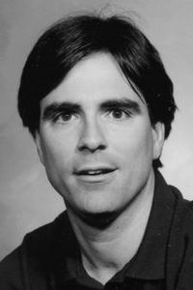
Really Achieving Your Childhood Dreams
On September 18, 2007, computer science professor Randy Pausch stepped in front of an audience of 400 people at Carnegie Mellon University to deliver a last lecture called “Really Achieving Your Childhood Dreams.”
He was sick with pancreatic cancer and knew that he only had a few months to live.
Randy’s lecture has become a phenomenon, as has the book he wrote based on the same principles, celebrating the dreams we all strive to make realities.
He died in July, 2oo8
The LAST Lecture

Slide 35
Write a summary that consists of at least one paragraph that describes what the video was about and what your thoughts and feelings are after watching the video.

Slide 36
LOCAL ENTREPRENEURS…
http://www.mypie.ca/
https://www.facebook.com/startupmiramichi/
https://www.startupcan.ca/
https://nbcc.ca/entrepreneurship/oasis

