Slide 1
Exploring New Brunswick Business Ideas
Entrepreneurship 110

Slide 2
Made in New Brunswick Success…
think of as many successful
made-in-NB businesses
as you can?

Slide 3
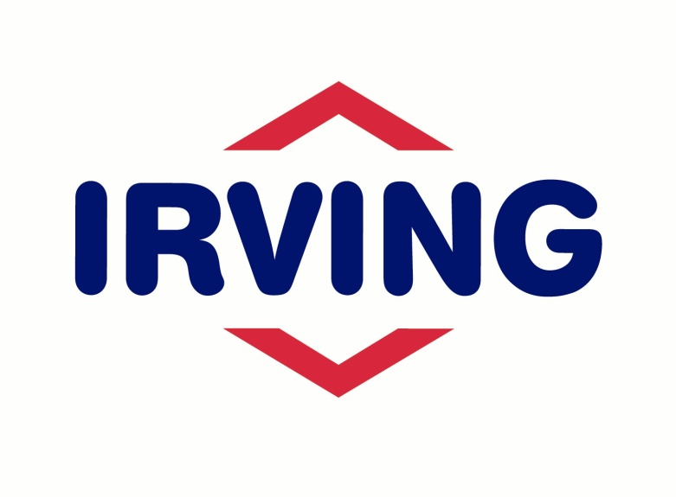
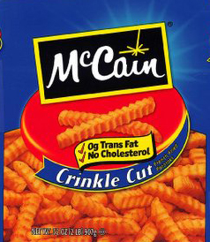
We’re more than...

Slide 4
Cheesy Video Time!!
http://www.gnb.ca/0398/index-e.asp
Promotional video for potential investors in New Brunswick.
DURING WATCHING
What do they highlight on the map?
Write down three potential industries that entrepreneurs could explore
Write down three advantages that would appeal to investors.

Slide 5
LG 4.1 Shipping/Port

Slide 6
LG 4.2: Agri-Food

Slide 7
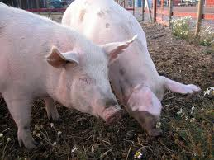
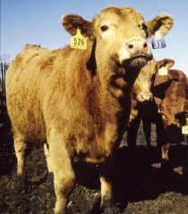
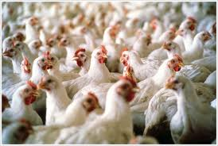
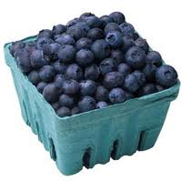
NB’s Major Crops

Slide 8
LG 4.3 Information Technology

Slide 9
Radian6
Monthly fee – companies sign up and can track and analyze with everything that is said about them on social media cites.
Got their first client in January, 2008
Now – has 1500 clients including: Dell, Microsoft, Pepsi and Kodak
Head office in Fredericton

Slide 10
Started by...
Two guys from NB got a loan from The NB Innovation Foundation in 2006 for $50,000
Chris Newton, Miramichi
Chris Ramsey
Newton and Ramsey sold the company for $326 million to a San Francisco tech company
http://www.nytimes.com/2010/02/09/business/media/09adco.html

Slide 11
LG 4.4 Life Science Sector

Slide 12
LG 4.5 Flight Simulation

Slide 13
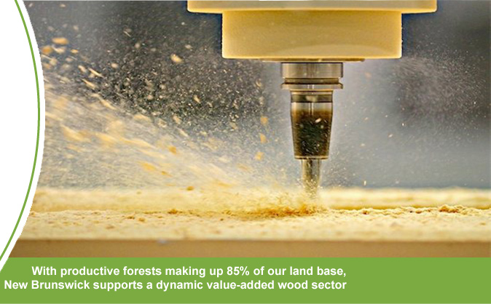
LG 4.6: Forestry

Slide 14
Now Complete the Assignment!
For each of the learning goals:
Research one business that already exists in New Brunswick.
Be creative! Think of one way that an entrepreneur could benefit from that sector.

