Slide 1
Coop 120… #bhsmake
‘Project based independent learning where students are given an opportunity
to be creative, innovative and take ownership of their learning!’

Slide 2
What is MAKE? STEM? STEAM? MakerSpace?
MAKE – an opportunity to explore, create and invent
STEM – integrating Science, Technology, Engineering &
Mathematics into real world problems
STEAM - incorporating the Arts into STEM through design
and creativity
MakerSpace – a place where people gather to work on
projects while sharing ideas, equipment
and knowledge

Slide 3
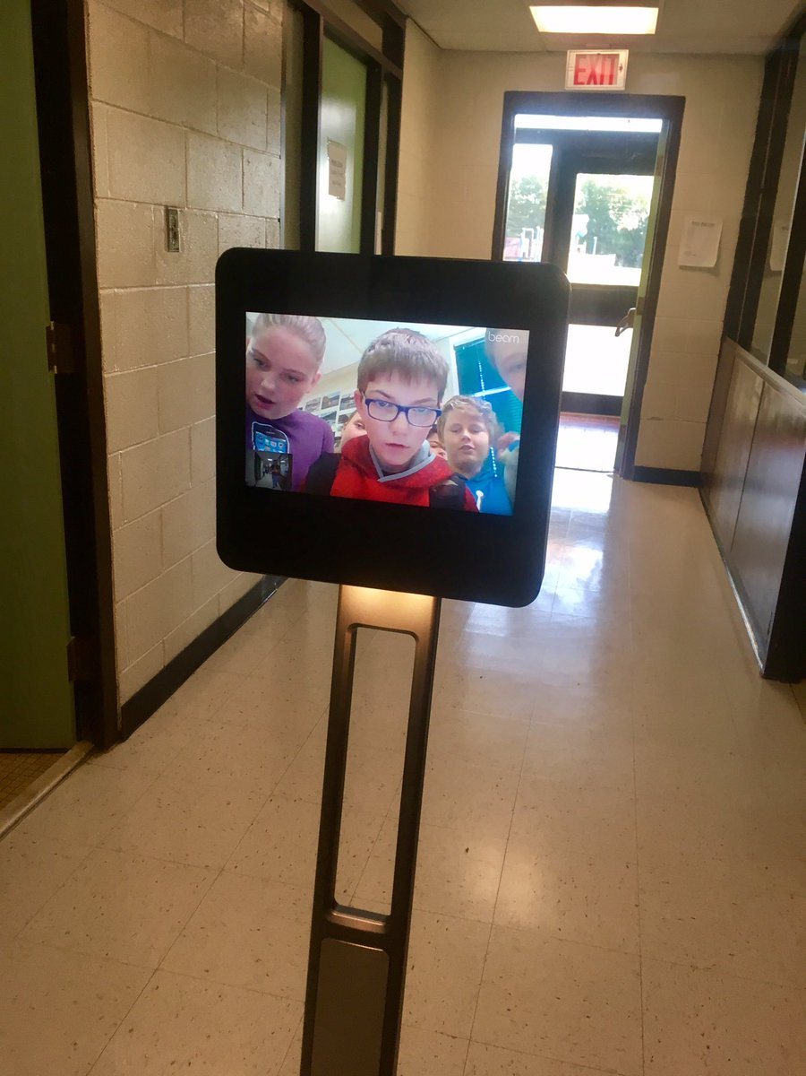
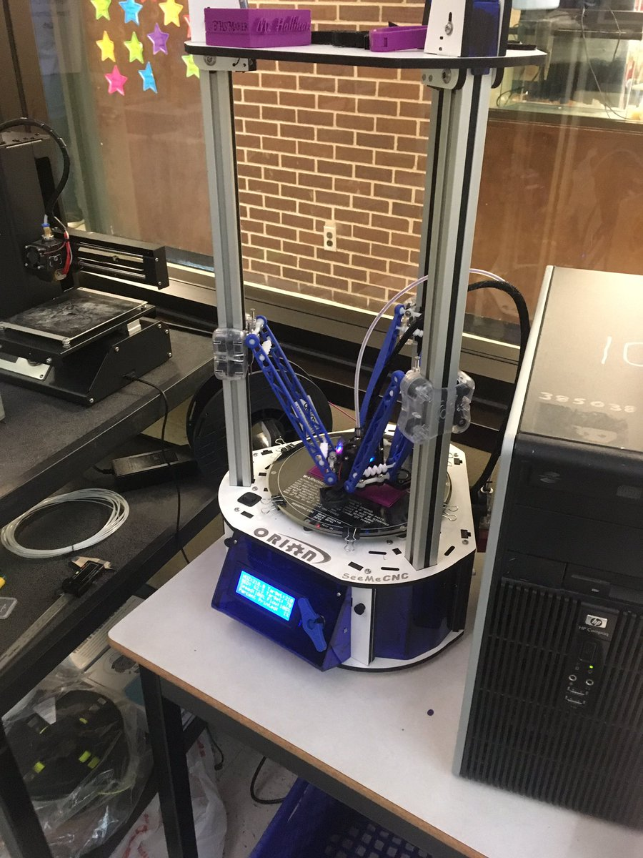
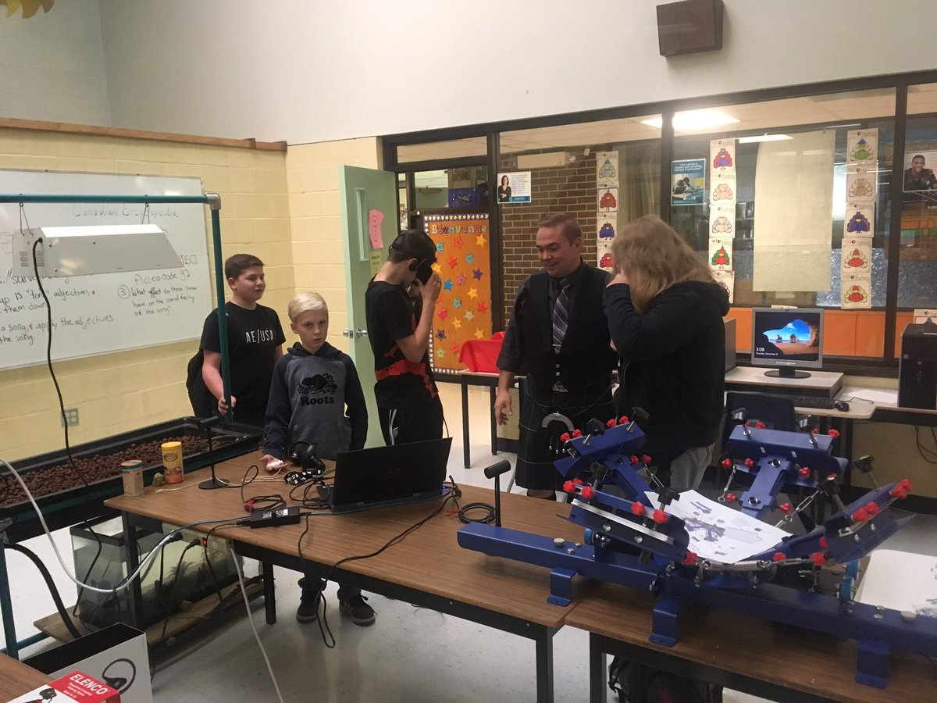
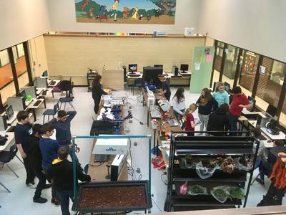
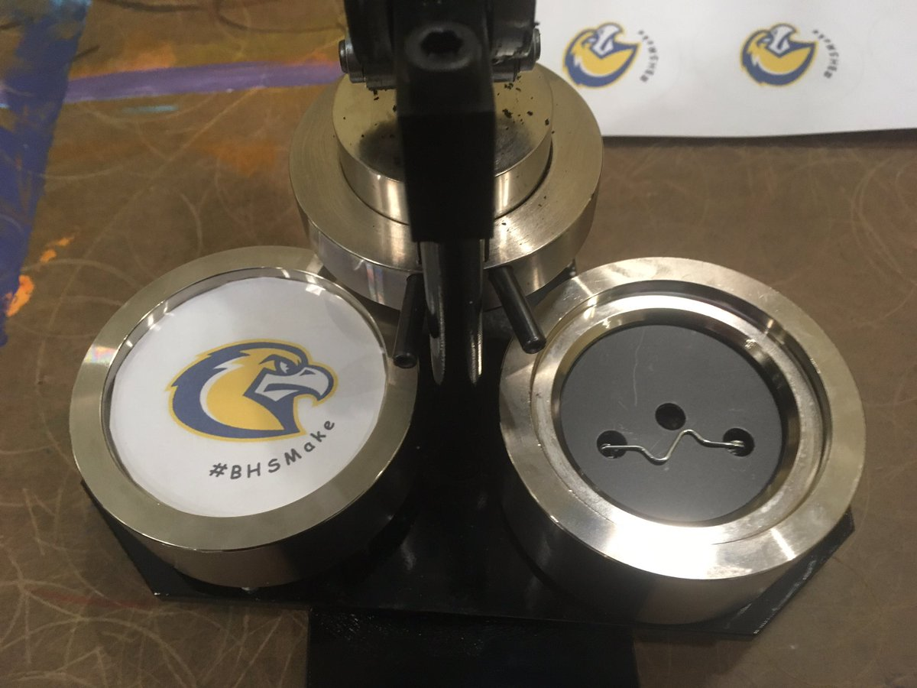
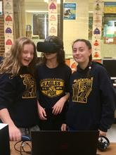
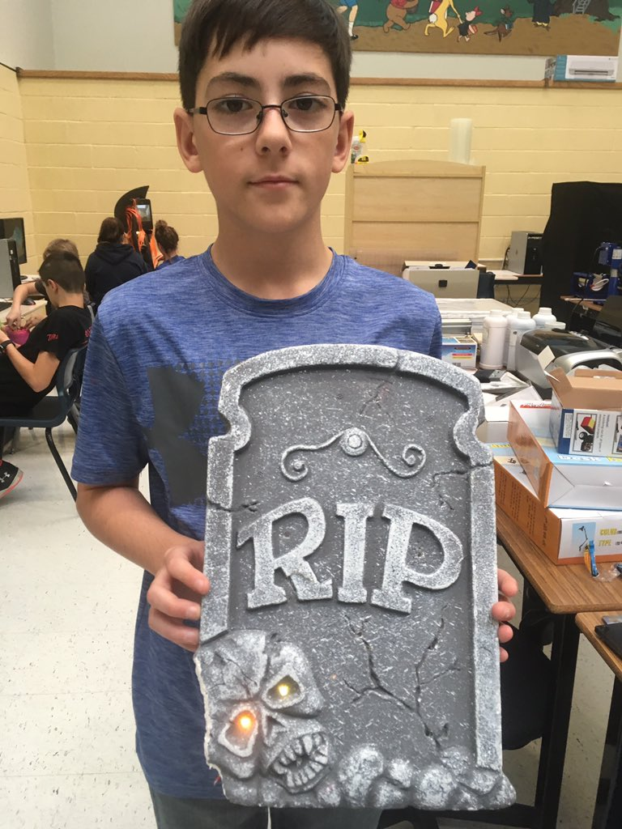
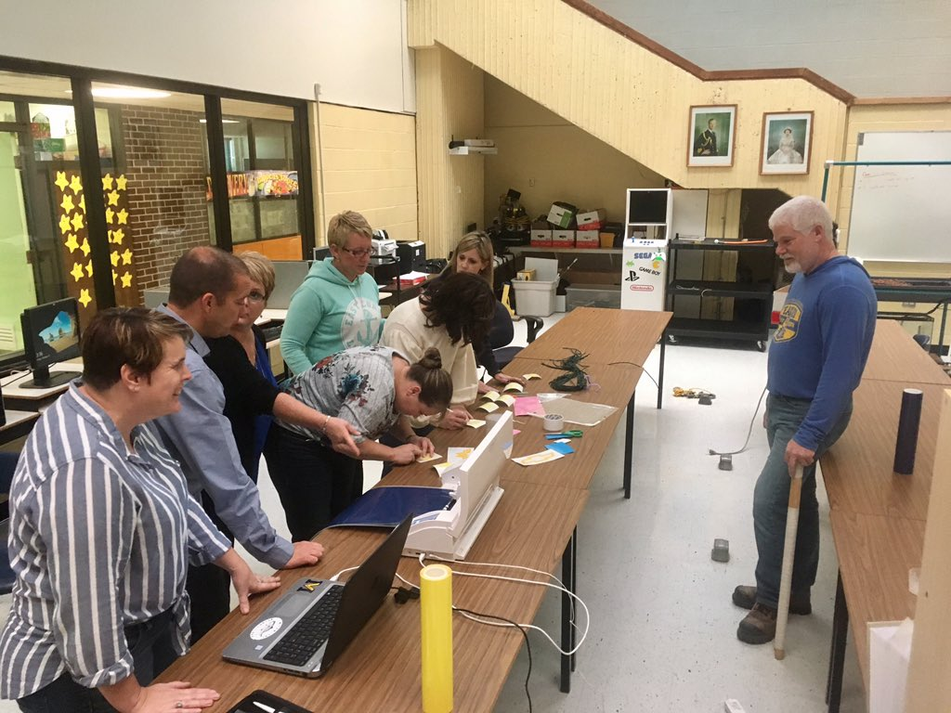
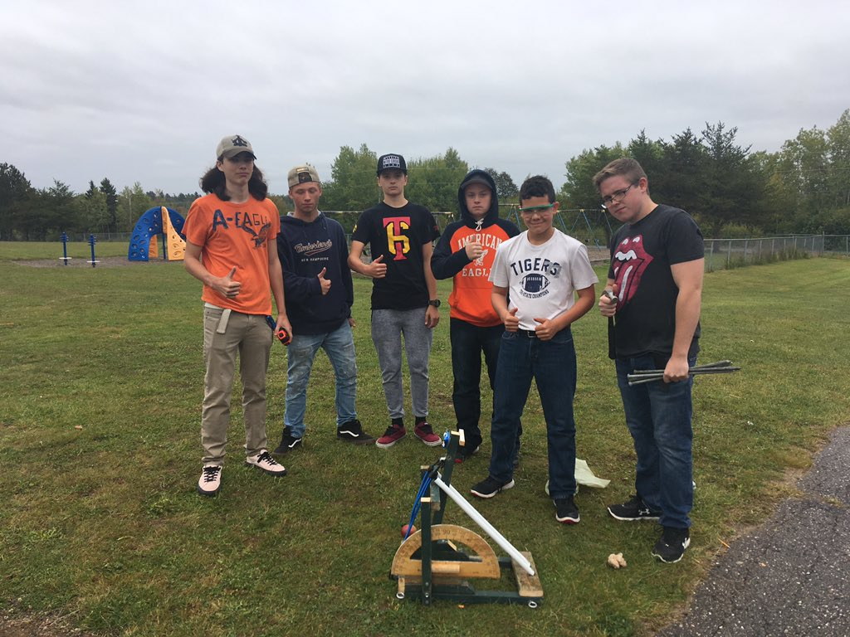
BHSMakerSpace…

Slide 4
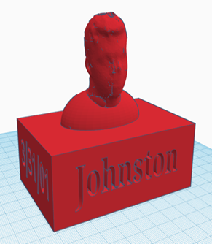
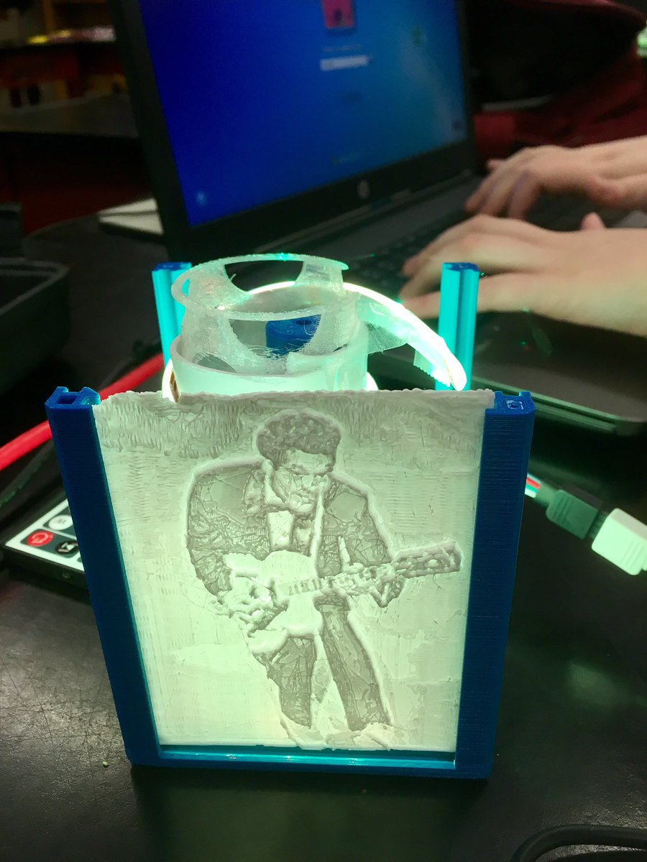
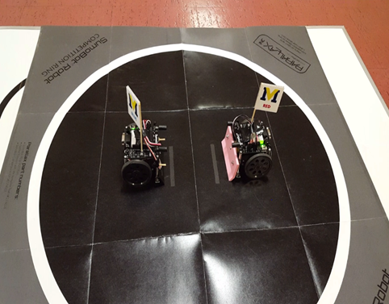
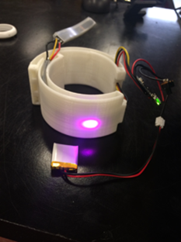
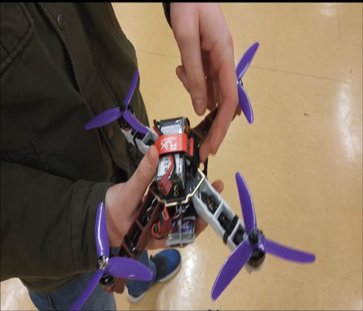
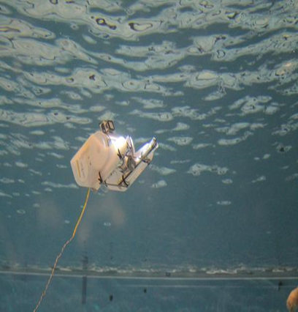
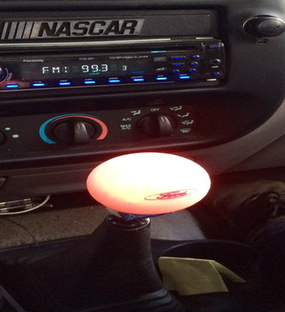
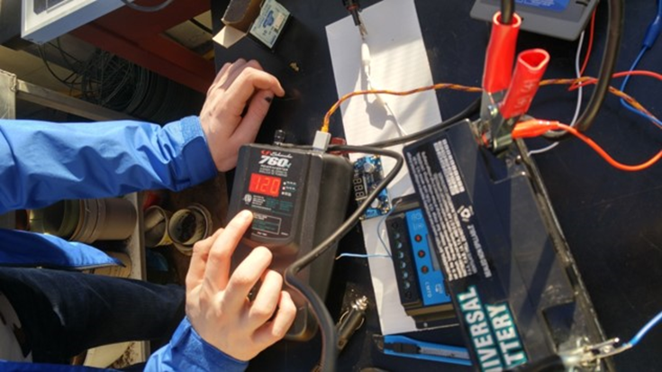
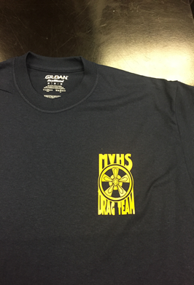
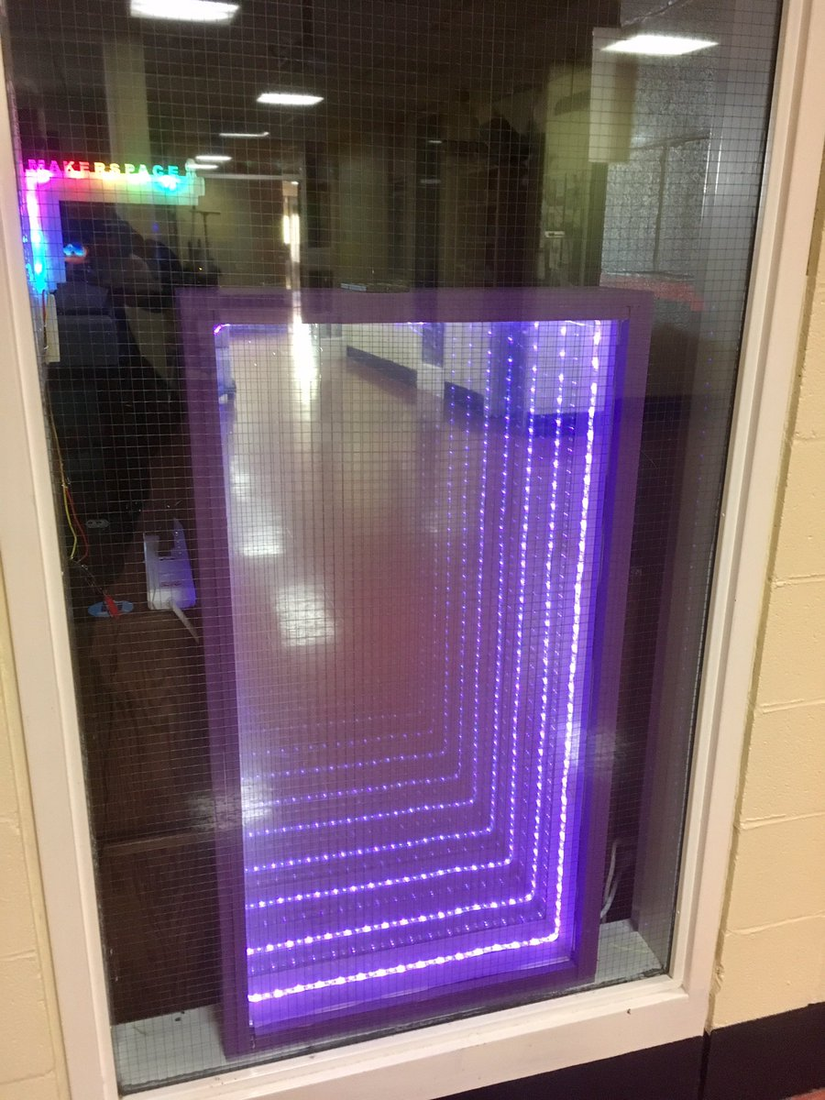
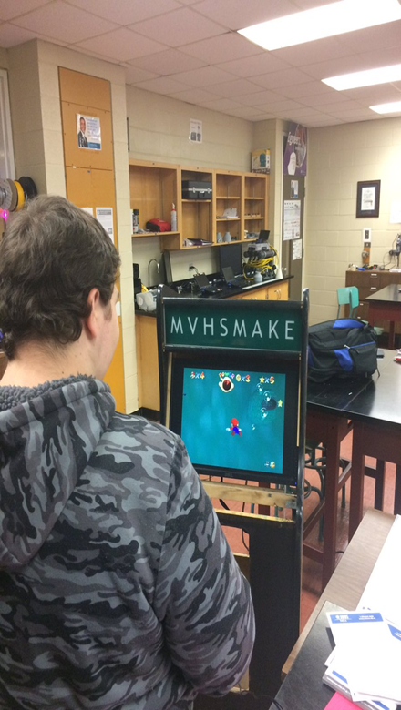
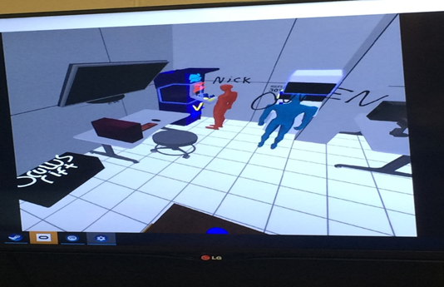
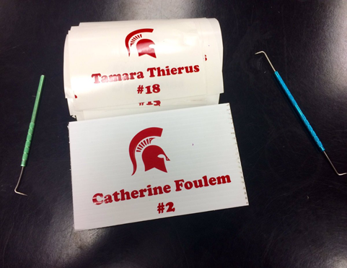
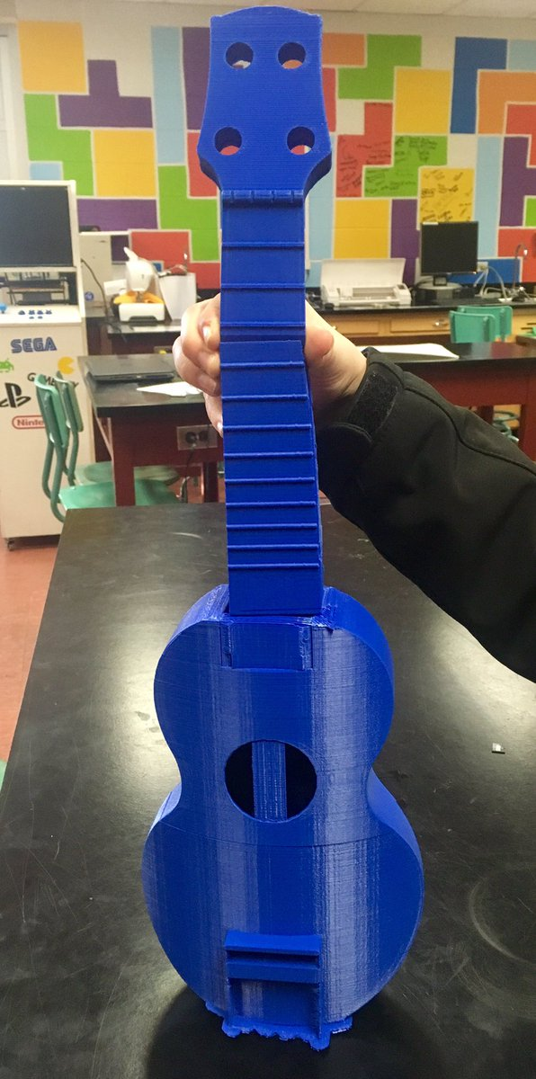
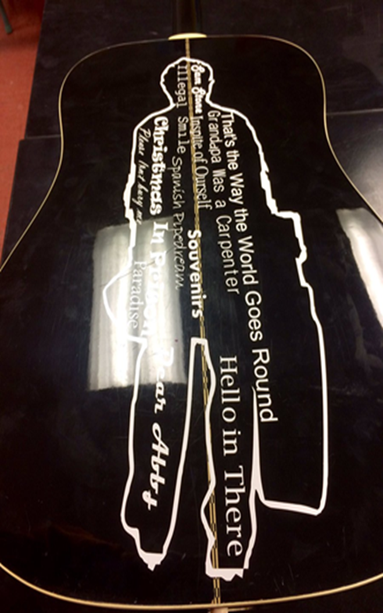
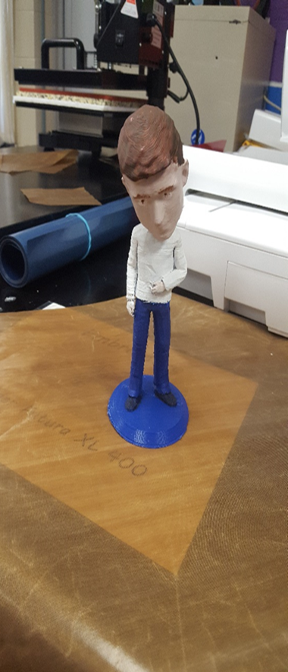
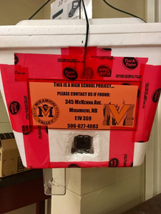
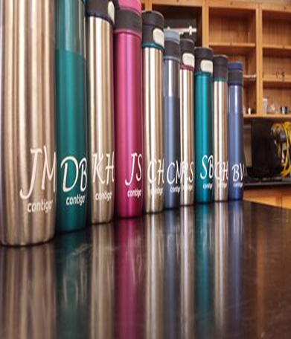
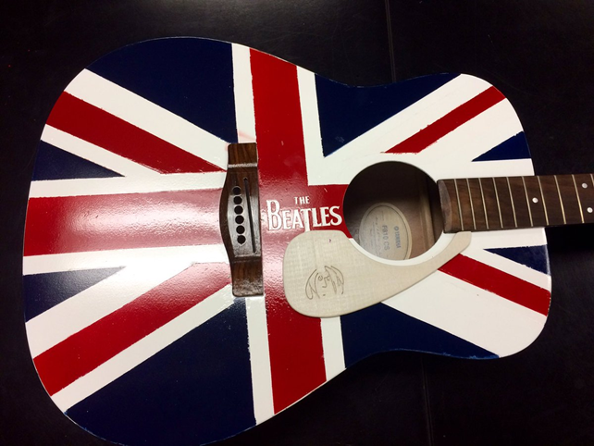
Previous Coop(MAKE) Innovations…

Slide 5
BHS MakerSpace will allow students to explore STEAM projects that involve Science, Technology, Engineering, Arts and Mathematics with an opportunity to develop these projects into Entrepreneurial Ventures.
Coop (MAKE) 120 will enable students to undertake creative and innovative projects in the MakerSpace. Students will explore a variety of technologies while designing and engineering their own projects with the following components: project proposal, journaling, independent research, design, prototyping, techpoints, presentation and summary video.
Coop (MAKE) 120 will be offered periods 1 & 3… each class will have a max of 18 students.
Entrepreneurship 110 will be offered period 2… where these students are ‘doubling up’ by taking both this course along with Coop (MAKE) 120. NOTE: If there are more than 18 students interested, then there will be an application process.
Both courses are designed to improve the NB Global Competencies: Critical Thinking/Problem Solving; Innovation/Creativity/Entrepreneurship; Learning to Learn/Self Aware/Self Directed; Collaboration; Communication; Global Citizenship/Sustainability

Slide 6
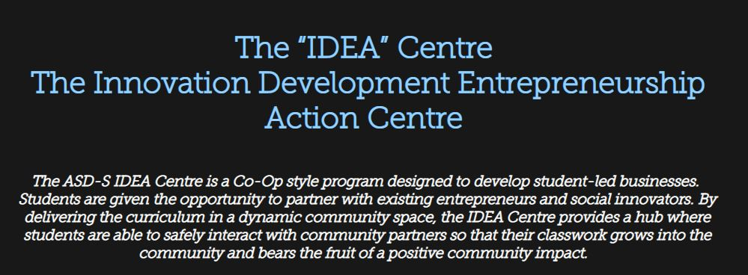
Opportunity is knocking…Answer???

Slide 7
COMMUNICATION & COLLABORATION
School Website & Online Journals…BHS MakerSpace
http://blackville.nbed.nb.ca/other/bhsmakerspace
Facebook… @BHSMakeEnvSciandOP
https://www.facebook.com/BHSMakeEnvSciandOP/?ref=bookmarks
Twitter…@BHSMaker
https://twitter.com/BHSMaker
YouTube…Search BHSMake for our channel
https://www.youtube.com/channel/UCadmqIZlcXTmxg9JWjE-lxw?view_as=subscriber
BHS ICE Center… Being Developed By Mr. Lehnert
http://bhsice.com/
PowerPlay Young Entrepreneurs Program Being Done By Middle School Students!!!

