Slide 1
Basic Infant Care
Newborns at Home, Basic Information, Care, and Techniques to Do for the Infant

Slide 2
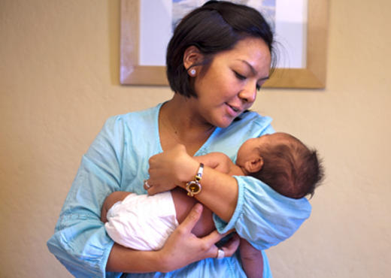
Holding Newborn Baby
Give support to baby’s head, for several months until baby can hold its head up alone
Carry your baby so his chest is against yours and his head is resting on your shoulder
Cradle the baby in your arms
Always be aware of the soft spots
When picking baby up, hold under its head and bottom

Slide 3
Crying Baby
How to Calm a Crying Newborn –
Distinguish between hunger or fatigue cries
Check to see if baby is wet/dirty diapers, hungry, or too hot or too cold
Before helping baby, learn the reason for crying

Slide 4
Soothing Baby
Soothing Methods for Crying Baby –
Nurse or Feed Baby
Rock, move side to side, walk holding baby in arms or in front sling
Stroke head/tummy or give gentle body massage. Patting back may help release trapped gas or help to burp
Short walk outside, fresh air/distractions help
Swaddle in security blanket or swaddle blanket
Sing or talk to baby

Slide 5
Baby Sleeping
Babies sleep cycles are shorter than adult’s sleep habits
Babies spend time in REM rapid eye movement sleep – development in their brains
6-8 weeks, sleep shorter in day, longer at night, but still need feedings at night
4-6 months, sleep for 8-12 hours through the night, it can happen at 6 weeks, but don’t plan on it

Slide 6
Baby Sleeping
At 2 wks, distinguish night from day, interact and play as much as possible during the day
Setting up a sleep schedule, do not play when baby wakes up at night
Make a bedtime routine by changing baby for bed, sing, rocking, or giving a goodnight kiss
At 4 months, babies should develop a regular sleep/walk pattern, not needing night feedings

Slide 7
Swaddle the baby
Swaddling the Baby, settles baby, keeps him warm
Lay receiving blanket on flat surface, make a shape like a diamond, & fold down the top corner. Place baby on his back with his neck on the fold.

Slide 8
Swaddling the Baby
Hold baby’s right arm down flat at his side. Pull left corner of blanket over his right arm & across his body, then tuck it under his left arm, roll him to your left to wrap the remaining under his back.

Slide 9
Swaddling the Baby
Hold the baby’s left arm down & pull the bottom corner up over his left shoulder. Tuck extra around his left arm. Leave enough room at the bottom of the blanket for baby to bend his legs up and out from his body.

Slide 10
Swaddling the Baby
Bring the loose right corner of the blanket straight out, then pull it across the baby’s front, roll him to your right, wrap the corner all the way around his back

Slide 11
Feeding Newborn
Feeding a newborn is a round-the-clock commitment and a Bonding time
Feed your newborn on demand. Most newborns need eight to 12 feedings a day — about one feeding every two to three hours
Breast milk is the best for baby however, the choice is Breast or Formula for baby

Slide 12
Feeding Newborn
The baby’s signs of hunger, such as stirring and stretching, sucking motions and lip movements. Fussing and crying are later cues. The sooner you begin each feeding, the less likely you'll need to soothe a frantic baby.

Slide 13
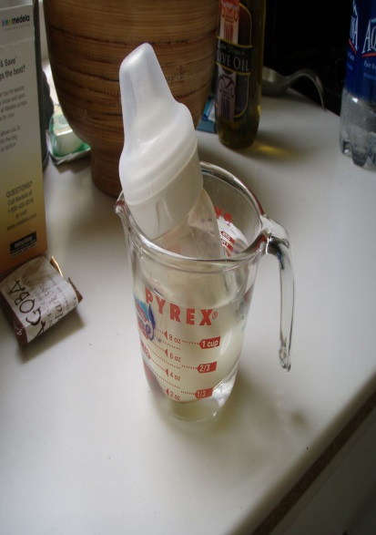
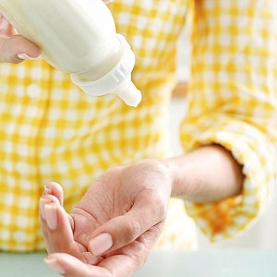
Feeding Newborn
Some babies prefer their milk or formula warm. Be sure to test the temperature of the milk by sprinkling a few drops on the back of the hand or the inside of the wrist. It should be warn…not hot.
When using a microwave, only heat the water in a cup/bowl then place bottle in water to warm. Putting formula/milk in the microwave can damage the nutrients for the baby.

Slide 14
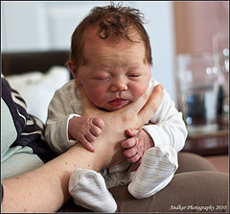
Burping the Baby
Three Methods for Burping Baby
Sit upright and hold your baby against your chest. Your baby's chin should rest on your shoulder as you support the baby with one hand. ...
Hold your baby sitting up, in your lap or across your knee. ...
Lay your baby on your lap on his or her belly.

Slide 15
Newborns Spit up or Vomit
About half of all babies experience gastroesophageal reflux (infant reflux), during their first three months.
Spit up is normal flow from stomach to mouth, however vomit is flow that is forced.

Slide 16
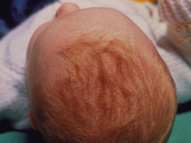
Newborn Baby Cradle Cap Care
Cradle Cap is a scalp condition common in newborns. Dry skin that looks like dandruff, but can appear anytime from birth to several months.
Massage scalp and shampoo then rinse.

Slide 17
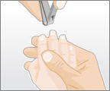
Newborn Fingernails Care
Newborn nails are soft, but sharp, grow fast, which can scratch his face. They need to be cut a few times a week. Toenails require less trimming.
Best time to cut baby’s nails, when he is asleep.

Slide 18
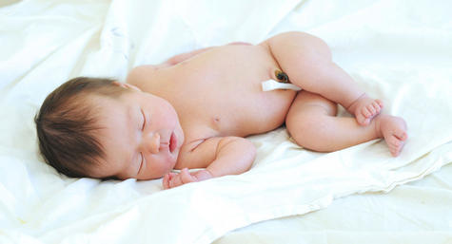
Baby’s Umbilical Cord Stump
Keep umbilical stump clean and dry. It takes 10-21 days to dry up & fall off
The belly button make take a few more days to heal completely, leaving a little blood on the diaper.
Fold the diaper below the stump, avoid tub baths, in warm weather allow air to circulate and aid the drying process. Give baby sponge baths, any change swelling, redness, pus, call the doctor

Slide 19
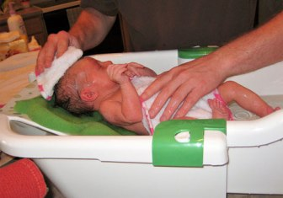
Bathing a Newborn
Sponge bath for the first weeks, with a warm, damp washcloth, cleaning face, hands, and genital area after each diaper change.
Support baby’s head,
Keep towel over body,
to keep warm. Test water
With elbow feeling the
Temperature of water.

Slide 20
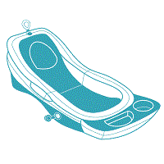
Bathing a Newborn
After umbilical cord stump falls off, area heals, then newborn can have a tub bath. It is in sink, or small plastic tub filled with warm water. For some babies it is soothing, others scream the whole time. Baths can occur three times or so weekly. Bathing too often can dry out their skin.

Slide 21
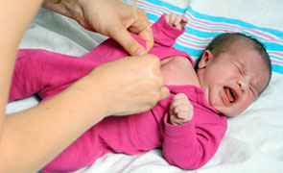
Dressing the Newborn
Newborns can not regulate their body temperature until 6 months – to check their temperature feel the nape of their neck
Support the baby on your lap, stretch the garment neckline ,pull it over baby’s head then, use your fingers to keep it from catching on face or ears.
Put your hand into the sleeve from the outside, grasp your baby’s hand, and pull it through gently.
When undressing, take off the sleeves one at a time while supporting baby’s back and head.
Then stretch the neckline, lifting it free of baby’s chin and face as it is gently slipped off.

Slide 22
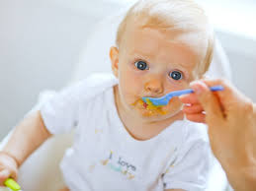
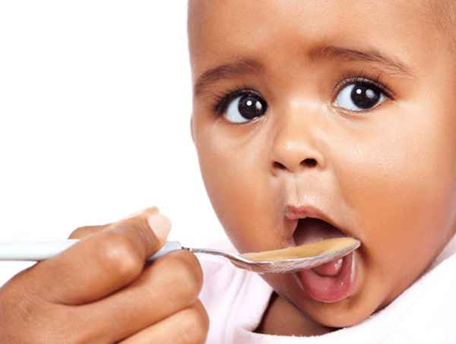
Feeding solid foods to infants
Ready for Solids? When baby can hold head up, stops using tongue to push food out, and can sit up alone.
Solid foods can be given between 4 & 6 months of age.
Only give 1 new food every 3-4 days.

Slide 23
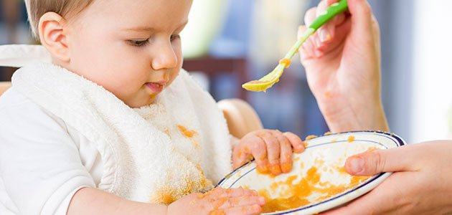
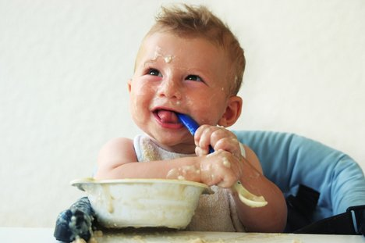
Feeding solid foods to infants
Foods that should be avoided for the entire first year, as baby has or easily develops allergies to them: chocolate, citrus fruits, peanut butter (it also presents a choking hazard for children under 3), egg whites, honey (may contain botulism food poisoning), wheat products, cow’s milk

Slide 24
Feeding solid foods to infants
Beta-carotene is the orange pigment that gives carrots, sweet potatoes, and other vegetables their characteristic coloring.
Sometimes too much orange can discolor the infant’s skin to look like jaundice.
Peaches, oranges, are some foods that are too acid for infants, can cause digestion or rash.

Slide 25
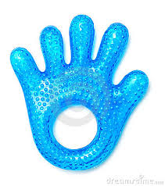
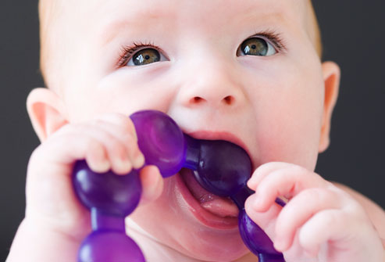
Teething
Signs of teething are: drooling, irritability, gum swelling and sensitivity, sleeping problems, refusing food, the urge to bite on hard objects and possibly a low grade fever. The discomfort that results from teething is due to the pressure exerted on the tissue in the mouth, called the periodontal membrane, as the teeth erupt.
Teething usually is about 6-8 months, but can be earlier or later in life.
Use teething rings, cold washcloth, or numbing medicine.

Slide 26
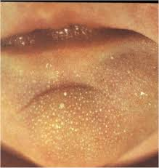
Infant Skin
Baby’s skin is very dry, however, and a lotion is needed, (which is especially true in overdue babies) you should avoid some product ingredients. Make sure the lotion contains:
NO GREASE / OIL
NO ARTIFICIAL COLORS
NO ARTIFICIAL ODORS
Mila are tiny white papules, actually plugged sebaceous glands or oil ducts, located over nose, cheek, and chin. They will disappear within a couple of weeks.

Slide 27
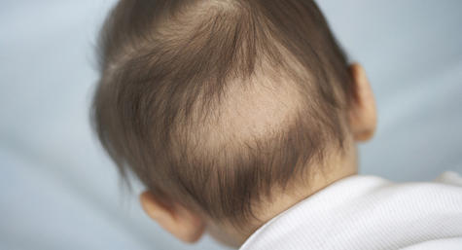
Newborn Infant Hair
A baby may also have bald patches on his scalp from sleeping in the same position or rubbing his head against the mattress.
Babies born with hair often lose it during the first six months of life. They can lose it all and it comes in a different color or texture. Some babies do not loose their hair.

Slide 28
Infant Diaper Changes
Newborn infants need 10-12 diaper changes daily. Do not use powder on newborns, they can breathe it in causing problems.
Open a new clean diaper, place the back half (the half with tabs on either side) under your baby and the top of the back half should come up to your baby's waist. Now the clean diaper is ready to go – and is there to protect your changing table from getting dirty. (If your baby's dirty diaper is a big mess, you might want to lay a cloth, towel, or disposable pad under your baby instead of the clean diaper while you clean up your baby.)

Slide 29
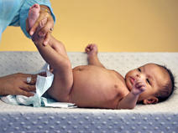
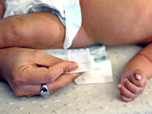
Infant Diaper Changes
Unfasten the tabs on the dirty diaper. To prevent them from sticking to your baby, fold them over.
If there's poop in the diaper, use the front half of the diaper to wipe the bulk of it off your baby's bottom.

Slide 30
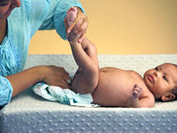
Infant Diaper Changes
Fold the dirty diaper in half under your baby, clean side up. (This provides a layer of protection between the clean diaper and your baby's unclean bottom.) Be sure to lift your baby's bottom off the table by grasping both ankles with one hand and gently lifting up.

Slide 31
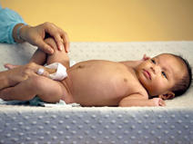
Infant Diaper Changes
Clean your baby's front with a damp baby wipe, cloth, or gauze. If your baby's a girl, wipe from front to back (toward her bottom).
Let your baby's skin air dry for a few moments or pat it dry with a clean cloth. Put diaper cream (Destin) or petroleum jelly on the bottom. This will help prevent diaper rash.

Slide 32
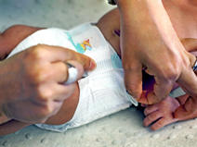
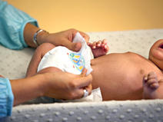
Infant Diaper Changes
Remove the dirty diaper. Pull the front half of the clean diaper up to your baby's tummy. For a boy, be sure to point the penis down so he's less likely to pee over the top of the diaper.
Do not over the umbilical cord, make sure to see that the diaper between the legs is wide and comfortable.
Fasten both sides of the diaper tabs.

Slide 33
Diarrhea
Baby's diarrhea may be caused by a gastrointestinal infection, antibiotics, too much fruit or juice in the diet, food poisoning, an allergy to milk sugar (lactose), an enzyme deficiency, and perhaps even teething due to extra swallowing of saliva.
Electrolyte solutions such as Pedialyte and sports drinks such as Gatorade can help hydrate baby. They can live on these for 3 days and will like them since they are slightly sweet. Then, they may need to go to the doctor.
Some babies have loose stools normally.

Slide 34
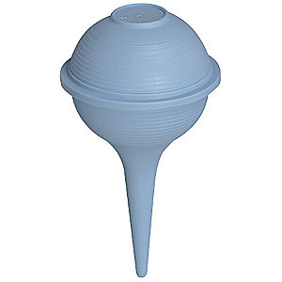
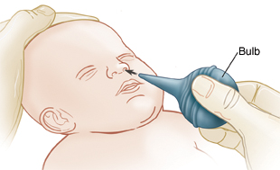
Infant’s nose/mouth
Bulb Syringe will help clean out the mucous out of the baby’s nose and mouth (being stuffy).
To use, first squeeze the bulb until it is collapsed. Place it in one nostril and quickly release the bulb. This will bring the formula or mucus into the bulb.
Remove the bulb syringe from the nose and squeeze the bulb quickly into a tissue to get rid of this material.

Slide 35
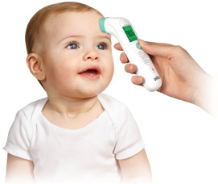
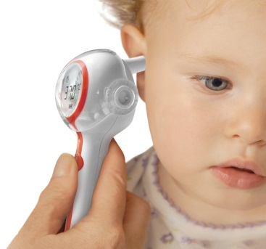
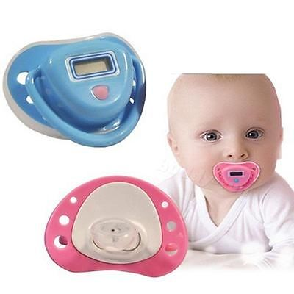
Infant’s Temperature
Digital thermometers use electronic heat sensors to record body temperature. They can be used in the rectum (rectal), mouth (oral) or armpit (axillary) –less accurate.
Digital ear thermometers use an infrared ray to measure the temperature inside the ear canal.
Digital pacifier thermometer, child simply sucks on the pacifier until the peak temperature is recorded.
Temporal artery thermometers use an infrared scanner to measure the temperature of the temporal artery in the forehead.

Slide 36
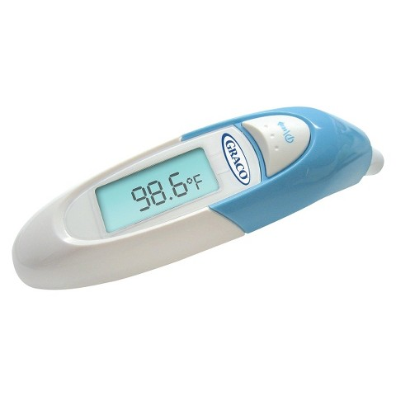
Infant’s Temperature
Most doctors recommend the digital ear or temporal artery thermometers for the best and accurate temperature.
Call the doctor, tell him how old the child is, how you took the temperature, what medications have been given to the child.
Wait 20 minutes after giving the child a bath or has been swaddled to take the temperature
The high temperatures read as: 106 degrees rectal,105 degrees oral,104 degrees axillary

Slide 37
Baby’s Colic
Nearly 15-25% of all babies will suffer from colic.
Some believe it is from immature digestive system, or nervous system.
Babies cry for 3 hours or more a day, for more than 3 days of a week. It can last for 3 weeks or 3 months.
The Five S's are some of the main solutions for calming baby’s colic, which include swaddling, shooshing loudly in baby's ear, swinging baby, allowing baby to suck on a pacifier, and laying her on her side or stomach (across your forearm or lap with her head resting in your hand).

Slide 38
Washing Baby’s Clothes
Wash baby’s clothes separate from the family.
Use soaps –Ivory or Dreft, (not detergents)
Rinse twice
Use oxygen bleaches, not chlorine bleach
Do not use fabric softener

Slide 39
Get to Know the Infant Rounds: similar to centers in elementary school. Have students divide into small groups so that each group can go and learn/show partners how to do the following for the infant.
Get to Know the Infant-
Round 1 – Diaper the Infant (Students demonstrate how to properly diaper an infant
Supplies: doll, wet wipes/damp cloth, diapers, cloth/lap blanket for under doll
Round 2 – How to complete the 5 S’s = Soothing Techniques: Swaddle, shooshing into doll’s ear, rocking/moving side to side, holding doll on forearm supporting doll, sucking on pacifier
Supplies: doll, swaddling blanket,
Round 3 – Swaddling Techniques, demonstrate how to swaddle an infant
Supplies: doll, swaddling blanket, pacifier
Round 4 – How to bath a baby
Supplies: doll, wet washcloth, towel, baby’s plastic bath tub, shampoo bottle, soap bottle, lotion bottle, diaper (shampoo, soap, lotion bottles can be empty)
Round 5 – How to dress a baby – How to take baby’s temperature
Supplies: doll, baby onesie, diaper, pacifier thermometer, forehead thermometer, rectal thermometer, or forehead thermometer that lies on forehead and shows thermometer
Round 6 – How to hold an infant
Supplies: doll
Student Names:
I can demonstrate how to properly hold an infant, how to diaper an infant, how to sooth an infant with the F S’s, how to swaddle an infant, how to bath an infant, how to dress an infant, and how to take an infant’s temperature.
Signed:__________________________________________________________________

