Slide 1
Atlantic
Salmon
on
the
Miramichi
Katie Wallace, Julianna Hache, Luc Richard, Kayla Arseneault

Slide 2
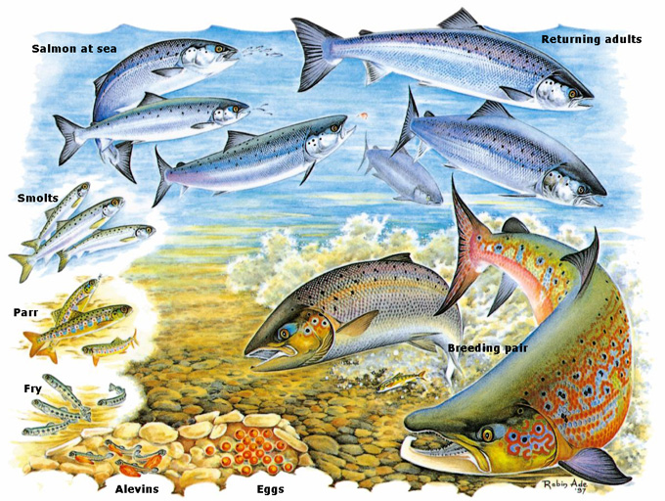
Lifecycle

Slide 3
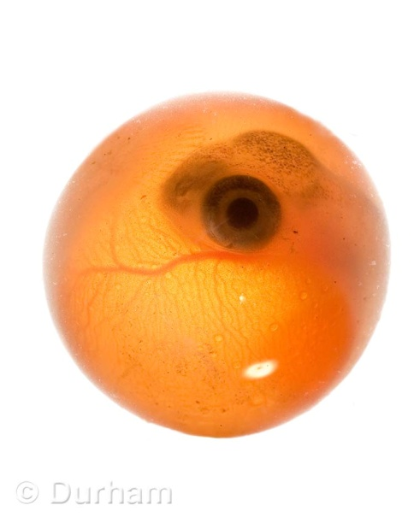
Eggs:
The Atlantic Salmon seek out shallow, rapid areas of a river and its tributaries (is a stream or river that flows into a main stem (or parent) river) when they are ready to spawn.
From June until October the principal runs of this anadromous fish will allow them to enter and inhabit these areas where spawning gravel is available.
In late October, the female salmon will choose her spawning ground and she will dig a shallow nest called a depression or red with her tail, and she will deposit her eggs.
Soon after, the eggs deposited by the female will be fertilized by the male’s milt or sperm, and then covered by gravel to protect them.
The newly deposited eggs will now take around 6 – 12 weeks to hatch
Salmon Egg

Slide 4
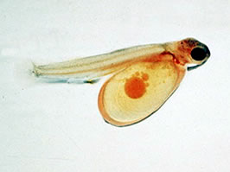
Alevins:
Once the eggs hatch in the spring, they become alevins. The alevins must stay in the gravel to absorb their yolk sac until around late May to early June, and then they will emerge from the gravel and begin to find food for themselves such as small insects in the stream.
At this point the alevins will measure around 2-3 cm in length and are also referred as ‘underyearling parr’ or ‘fingerlings’.
Alevin

Slide 5
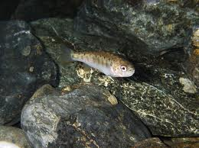
Fry
Once the alevin absorbs all the yolk in their sac, they now have to fend for themselves when it comes to food and other aspects as well. At this point, the young salmon is called a fry.
Fry will already have the necessary instincts to hide from predators, use river currents, create schools together and other survival skills.
Fry

Slide 6
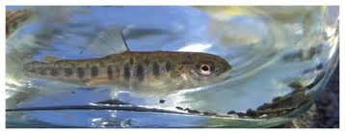
Parr:
After the fry spends one year in fresh water, it are referred to as postyearling par.
Most of these young salmon will spend up to three years in the freshwater stream before swimming to sea, however; the fry kept in a hatchery will go to sea after spending only one year in freshwater.
Parr

Slide 7
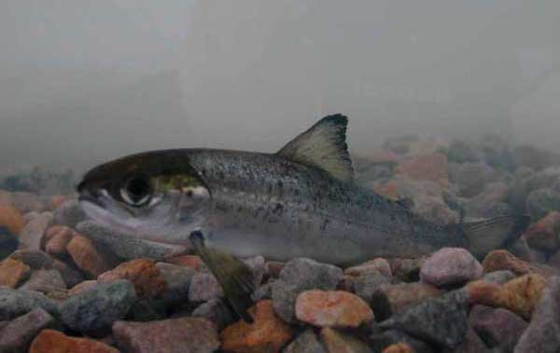
Smolts:
The parr will begin to migrate to sea in May or June, after reaching a length of about 15 cm and finally changing to the silvery color of a mature salmon. At this point the fish are called smolts.
The fish may now live in salt water without absorbing the salt into its blood stream.
Smolt

Slide 8
ADULT STAGES: GRILSE & LARGE SALMON

Slide 9
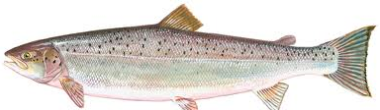
Grilse
The number of years spent at sea before returning to their freshwater river to breed differs. Salmon that spend only one winter out at sea before returning to spawn are called grilse.
Grilse weigh up to 2.5 kg at this time.
Grilse

Slide 10
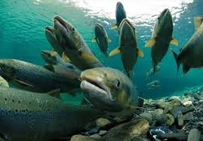
Large Salmon
Salmon that spend two or more winters at sea before returning to their freshwater river to spawn are referred to as large salmon.
They can way from 3.5 -12 kg, as they increase in size each migration cycle.
However, less than 10 out of 100 spawning fish return to spawn again.
Large Salmon
When the adult salmon return to migrate, most grilse are males and most of the large salmon are females. The (large) female salmon releases around 7 600 eggs, only of which about 100 will survive and become smolts.

Slide 11
Adaptations

Slide 12
Atlantic Salmon are anandromous, which means that they migrate from the rivers to the sea.
Because they are born in fresh water and they travel to salt water, the Atlantic salmon have had to adapt to their changing environments. One of the most important adaptations the Atlantic salmon has made is how they are able to go from areas with fresh water (for example, the rivers or streams they travel through) to areas with high concentrations of salt water (for example, the salt water in the Atlantic Ocean). The salmon have four sets of gills, which each have specialized cells to help them get the most oxygen out of any kind of water (fresh or salt).

Slide 13
Atlantic Salmon Must Adapt to their Environment:
They have specific adaptations that are used in salt water and other adaptations for fresh water:
One of the main adaptations is their gills. There are four sets and each gill contains “specialized cells” that allow them to travel between salt water and fresh water.
“The Lateral Line” is very important. It allows salmon to “detect” movement in the water, whether it be other fish, or even water currents. Knowing the flow of the water is important because the salmon need to know the difference between upstream and downstream to migrate.

Slide 14
The design of the Atlantic salmon helps them swim fast to allow them to get away from predators quickly. It also allows them to be good predators themselves.

Slide 15
Osmolarity
“Osmolarity is the measure of solute concentration, defined as the number of osmoles (Osm) of solute per litre (L) of solution (osmol/L or Osm/L)” (http://en.wikipedia.org/wiki/Osmolarity).
Salmon have the ability to filter the salt water in their gills without absorbing it into the blood stream.
The gills act as a gate. They are able to get the oxygen from water in and diffuse the salt out. This means the salmon’s gills are very efficient at dissolving oxygen. The mouth of the salmon also allows the water to glide over the gills, making them even more efficient.

Slide 16
Since many different types of fish have to travel from salt water to fresh water and vice verca, the fish have become great osmoregulators. Osmoregularity is when a fish is able to control the level of water and mineral salts in its blood. All fish, including the Atlantic Salmon, that have to travel from fresh water to salt water have to go through this process. Even though the fish never have equillibrium between themselves and water around them, this process is very helpful. If the fish were unable to do this, they could die in a very short time because the high levels of salt in their bodies would be much greater than normal. The Salmon could suffer from dehydration, killing them also. In fresh water, salmon have the opposite problem. When the salt concentration is too low outside the body, the salmon can suffer from things like salt loss (when they don’t have enough salt in their systems).

Slide 17
Other Adaptations
Salmon have a Swim Bladder, which gives them natural buoyancy in water.
And best of all, their vision is spectacular. They have polarized vision. Polarization is the “phenomenon in which waves of light or other radiation are restricted in direction of vibration”, an example being the sunlight on water. Scientists believe this may be one of the reasons why most Atlantic Salmon can find their way back to the rivers (where they go to reproduce) so easily. Salmon are also able to see considerably far distances in clear water.

Slide 18
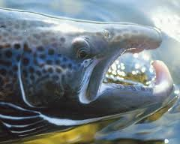
The two main branches that salmon return to are the Northwest branch and the Southwest branch. Both branches flow into the Gulf of St Lawrence. Salmon travel from the sea to the river to spawn. The barrier we are focusing on is the Northwest Barrier.

Slide 19
Size Groups and Returning Salmon
Atlantic salmon come in two size groups: small salmon (less than 63cm fork length) and large salmon (greater than 63cm fork length). Small salmon spend one year out at sea before returning to the river to spawn, and large salmon spend 1-3 years at sea before returning. Large salmon can either be returning for the first time or they may have returned the year before.
It is not possible to count every single salmon that returns to the Miramichi river, so salmon counts are not completely accurate. They estimate numbers of salmon, and they depend on “mark and recapture methods” to get count returning salmon. They record the sizes of the returning salmon as well.

Slide 20
Barriers
Fish barriers are used to prevent fish from swimming to places where they could be put in danger. In Miramichi, we use barriers so that salmon can have a safe place to spawn.

Slide 21
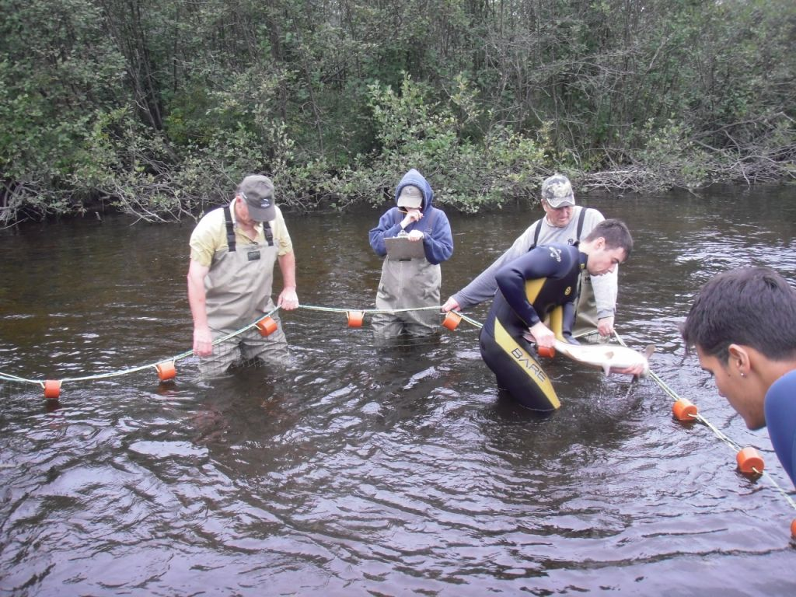
Northwest Barrier

Slide 22
Small And Large Salmon Population for the Northwest Barrier: 1998 - 2009

Slide 26
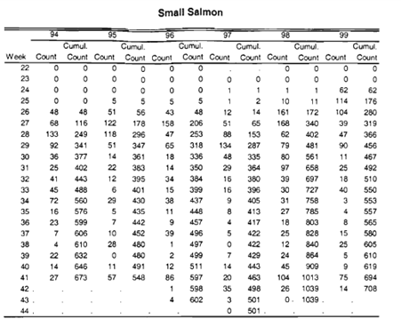

Slide 27
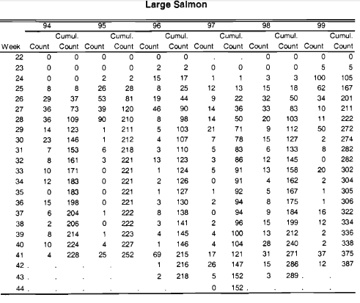

Slide 28
Works Cited (MLA)
< http://www.atlanticsalmontrust.org/learning-zone-assets/atlantic_salmon_anatomy.pdf >
http://bioweb.uwlax.edu/bio203/s2009/webb_laur/Habitat.htm
http://www.seymoursalmon.com/lifecycle.php
< http://www.atlanticsalmontrust.org/knowledge/salmon-facts.html >
http://www2.mar.dfo-mpo.gc.ca/science/mactaquac/lcycle.html

