Slide 1
Business Plan
‘A binder that has all the details to your venture’

Slide 2
What is a Business Plan?
Why is it important to create a business plan?
You’ll want to conveying the opportunity and strategy:
Goal or objective: What are you trying to do?
Strategy: How will you achieve it?

Slide 3
Business Plan
A business plan is the written presentation of a business idea.
It predicts the success of a business and outlines how it will operate.
A good business plan is based on solid research.

Slide 4
DRAGON’S DEN ADVICE…
https://www.youtube.com/watch?v=CE9xdIThIS4

Slide 5
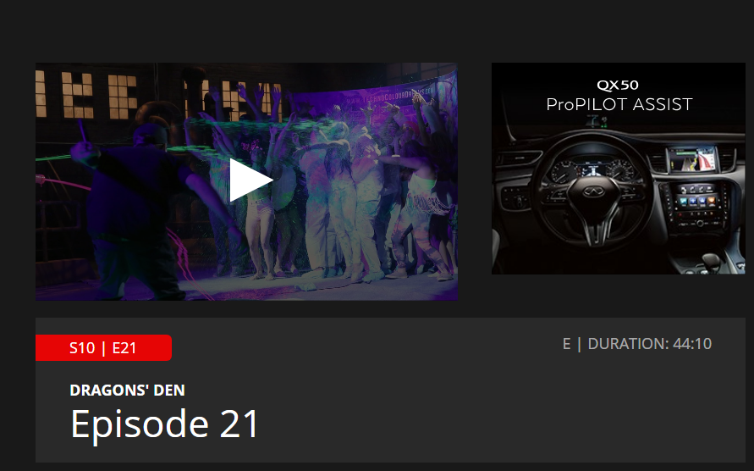
Dragon’s Den… S10E21
Paint Party

Slide 6
Helpful Hints
Business plans are written in the third person
Visual aids like diagrams, drawings, photos, advertisements, logos are required.
You can add extra sections if you feel they are needed.
The information should be meaningful, not there to fill space.

Slide 7
Components of a Business Plan
Cover Page
Table of Contents
Business Model Canvas
Value/Personal Mission Statement
Business Overview
Management
Marketing Research
Marketing Plan
Suppliers/Employees
Financial Plan

Slide 8
Market Research
To get customers to buy your product or service, you have to know what they want.
Market research attempts to gather information about consumers’ perceptions and attitudes.
You can then use the information to design your product/service that meet customers’ needs, and to design marketing campaigns that communicate to them.

Slide 9
Brainstorm
What are some ways that companies can gather market information?

Slide 10
Company and Brand
Note the company and the brand…
What are they selling?
Why would Nike want to gather market information?
http://www.youtube.com/watch?v=rHHMaiNyztk

Slide 11
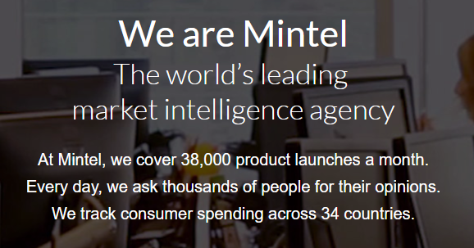
MINTEL… what do they do?
https://www.mintel.com/

Slide 12
Mintel Insight…Market Research In Action
Beauty Trends
Artificial Intelligence

Slide 13
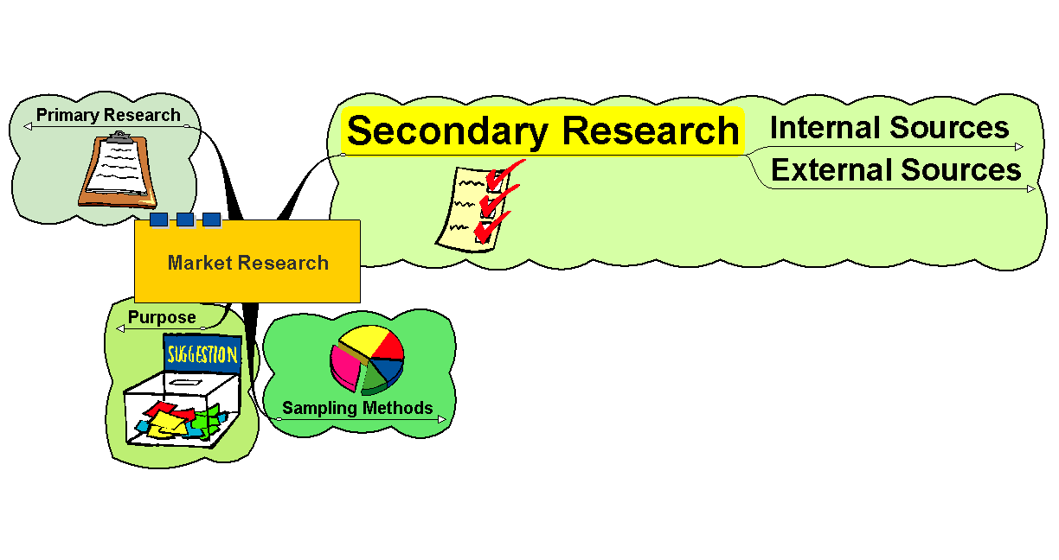
Secondary Research

Slide 14
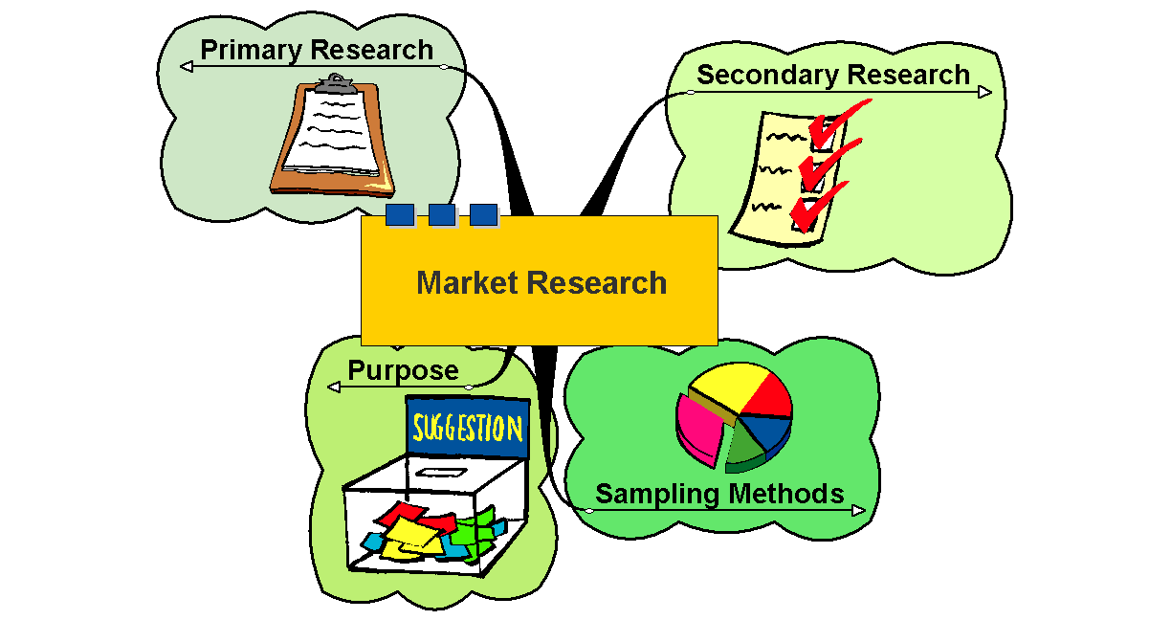
What is Market Research?

Slide 15
Internal Sources
Company Accounts
Internal Reports and Analysis
Stock Analysis
Retail data - loyalty cards, till data, etc…

Slide 16
External Sources
Government Statistics (Stats Canada)
Trade publications
Commercial Data - Gallup, Mintel, etc.
Household Expenditure Survey
Magazine surveys
Other firms’ research
Research documents – publications, journals, etc.

Slide 17
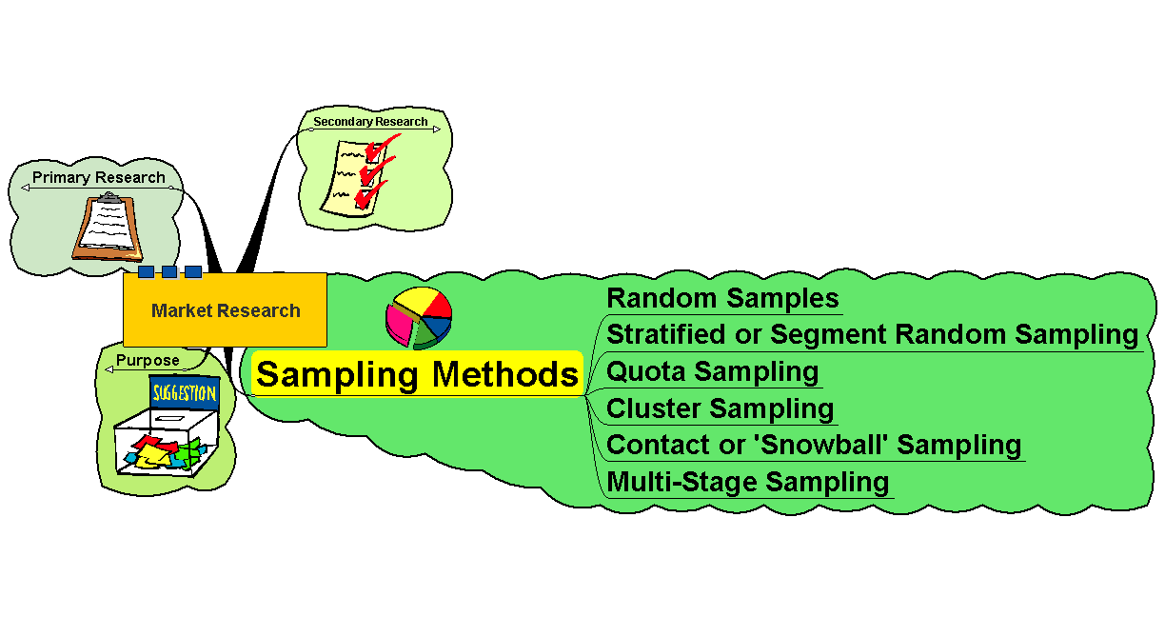
Sampling Methods

Slide 18
Market Research
Sampling Methods:
Random Samples – equal chance of anyone being picked
May select those not in the target group – indiscriminate
Sample sizes may need to be large to be representative
Can be very expensive

Slide 19
Market Research
Stratified or Segment Random Sampling
Samples on the basis of a representative strata or segment
Still random but more focussed
May give more relevant information
May be more cost effective

Slide 20
Market Research
Quota Sampling
Again – by segment
Not randomly selected
Specific number on each segment are interviewed, etc.
May not be fully representative
Cheaper method

Slide 21
Market Research
Cluster Sampling
Primarily based on geographical areas or ‘clusters’ that can be seen as being representative of the whole population
Multi-Stage Sampling
Sample selected from multi-stage sub-groups
Snowball Sampling
Samples developed from contacts of existing customers – ‘word of mouth’ type approach!

Slide 22
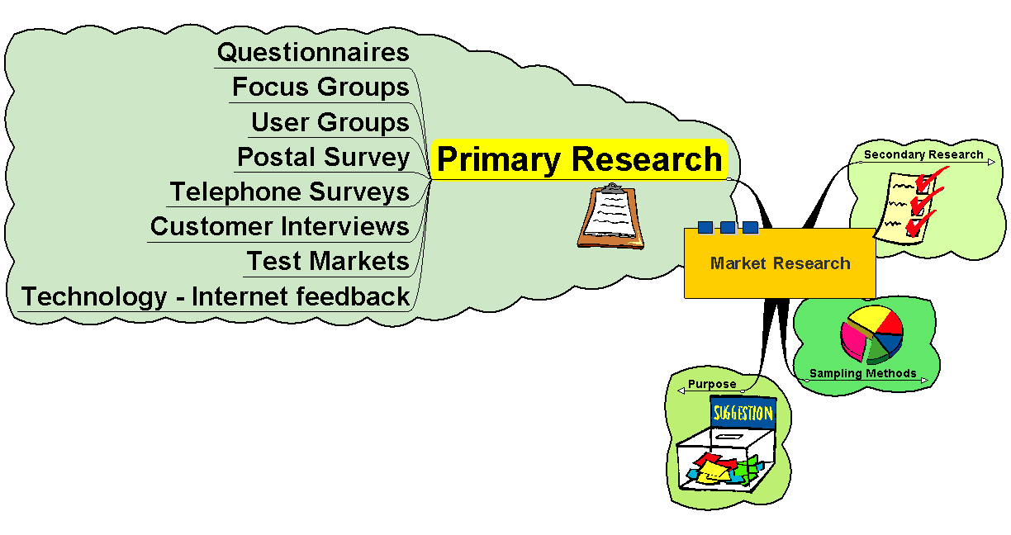
Primary Research

Slide 23
Market Research
Primary Research
First hand information
Expensive to collect, analyse and evaluate
Can be highly focussed and relevant
Care needs to be taken with the approach and methodology to ensure accuracy
Types of questions…
1) closed: limited information gained
2) open: useful information but difficult to analyse

Slide 24
Market Research… Quantitative VS Qualitative
Quantitative – based on numbers…doesn’t tell you why, when, how
Qualitative – more detail…tells you why, when and how!

Slide 25
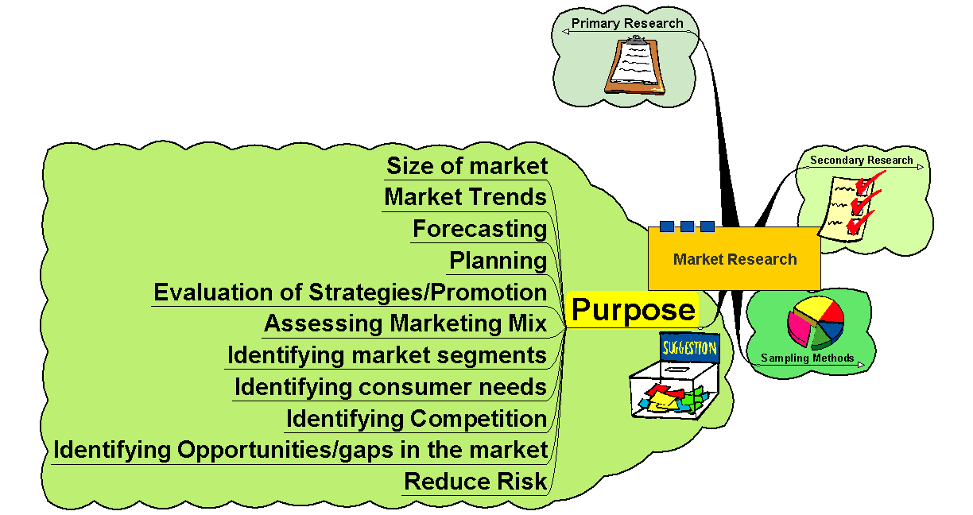
Purpose

Slide 26
Market Research
Advantages of Market Research
Helps focus attention on objectives
Aids forecasting, planning and strategic development
May help to reduce risk of new product development
Communicates image, vision, etc.
Globalisation makes market information valuable

Slide 27
Market Research
Disadvantages of Market Research
Information only as good as the methodology used
Can be inaccurate or unreliable
Results may not be what the business wants to hear!
May stifle initiative and ‘gut feeling’
Always a problem that we may never know enough to be sure!

Slide 28
Your Turn… Do Some Market Research
Develop a purpose for your market research – what is your goal?
What form of primary research will you use?
Start planning how you’re going to do it

Slide 29
MARKET RESEARCH DETAILS…
The goal of your survey – what you hope to find out
Who the market is for your product/service
Your sampling method
The form of research you are going to use
If your research is quantitative or qualitative
The actual plan/survey/questionnaire

Slide 30
RESEARCH ETHICS…

Slide 31
WORD NOTES… Good Surveys

Slide 32
SURVEY TIME…

Slide 33
MARKET RESEARCH REPORT…

Slide 34
Components of a Business Plan
Cover Page
Table of Contents
Business Model Canvas
Value/Personal Mission Statement
Business Overview
Management
Marketing Research
Marketing Plan
Suppliers/Employees
Financial Plan

Slide 35
Business Overview
TASK (1-2 paragraphs): Explain exactly what your business does and
how it does it by answering the following questions:
What does your business do?
What is the opportunity in the market that justifies your business idea?
Who are the business owners?
Where is the business located?
What form of business ownership will the business have?
What market will be serviced?
What is unique about your business?
How will your business be better than your competitors?
What stage is the business in? (Start-up for us)
What is the size of the business? (small for us)

Slide 36
Business Overview Examples…
ABC Laundry Soap Inc. will be laundry detergent manufacturer located in warehouse space at Lansdowne Place in Saint John’s North End. John Smith will be the sole owner of the incorporated company that will employ 15 workers that will focus on manufacturing a quality liquid laundry detergent.
Skyrocketing freight prices and the high value of the Canadian dollar have created a great opportunity for a local manufacturer to supply Maritime grocery stores and department stores with an affordable alternative to their current suppliers in the U.S. The challenge the business faces will be to persuade customers that the product has consistent quality and will appeal to their customers. The product will be environmentally friendly and unique in that it will donate a portion of its profits to the Environment Trust Fund. It is hoped that this will appeal to consumers who are becoming environmentally and socially conscious. The detergent will be packaged in the factory and sold by sales agents throughout Atlantic Canada.

Slide 37
Components of a Business Plan
Cover Page
Table of Contents
Business Model Canvas
Value/Personal Mission Statement
Business Overview
Management
Marketing Research
Marketing Plan
Suppliers/Employees
Financial Plan

Slide 38
Management Profile
The Management Profile should describe the management team by answering the following questions:
Who are the owners and key managers of the business?
What role will each person have in running the business?
What are their backgrounds?
What are their strengths and skills that they bring to the business?
How much time and money will each owner be contributing to the business?
How will the management team be paid?

Slide 39
Management Profile Examples…
Croutons R Us Bakery understands that its success depends primarily on a strong management team.
Marion Green will lead the baking team because of her strong baking background which includes ten years of baking experience at Ben’s Bakery and three years of management experience.
Don Black brings a strong financial background to the business which includes a CA designation and ten years of managing the finances of a reputable bakery in British Columbia.
Tina Reid will be responsible for developing marketing materials and for managing human resources. She brings six years of experience in working for a PR firm with her.
All members of the team will be working full-time and be paid a yearly salary.

Slide 40
Components of a Business Plan
Cover Page
Table of Contents
Business Model Canvas
Value/Personal Mission Statement
Business Overview
Management
Marketing Research
Marketing Plan
Suppliers/Employees
Financial Plan

Slide 41
Marketing Plan…PART A
Customer Profile
Should describe your target market by addressing the following questions:
Who are your customers?
Where do they live?
How many are there?
Describe their age, income, population, etc.
Are there any trends influencing your market?
What will influence their decision to buy your product or service?
This section will contain the results of your market research survey.

Slide 42
A. Customer profile example
Green Health Food Supplements is a multi-use product and will focus on three different customer groups.
The primary target group will be allergy sufferers. This group is growing at 15% a year with 32,000 potential customers in the Greater Saint John area. Allergy sufferers are known to try many products in their quest to rid themselves of allergy symptoms so they are often quite willing to try new products.
The second target is medical professionals and doctors in particular. This segment is also growing at 15% with 14,200 potential people served by doctors in the local area. Doctors are quickly beginning to understand the benefits of natural products and are beginning to refer patients to them.
The last group is the health conscious group. This segment is typically making modifications to their diet based on their desire to become healthier and prevent the onset of disease. This niche also is growing at 15% with 48,000 possible customers. Health conscious consumers frequently read about and try new products in their quest to find products that help them feel strong.

Slide 43
Marketing Plan…PART B
Competition
Will profile your major competitors and how your business will compete with them.
Identify major competitors and describe their company in terms of size, location, and name.
List the strengths and weaknesses of each competitor, including: product quality, price, image, etc.
Predict how your business will compete

Slide 44
B. Competition example
In today’s childcare market, parents are often looking beyond price willing to pay a little more for quality educational programming that will give their children an advantage at school. Programming, service, certification and reputation are critical success factors in the child care services industry. The Children’s College will compete well in the market by offering a leading edge educational program delivered by certified college-trained instructors.
There is no competitor in the market that is offering a focused, quality educational childcare program. Our educational approach is unique and will be difficult to duplicate by competitors.
Main Competitors
Those facilities located within a 5 mile radius are considered to be the company’s main competitors. They are as follows:
South End Church Day Care:
South End Church Day Care is located in the basement of the South End Church at 52 Bay Drive. There are 6 employees on staff and they are licensed to take up to 45 children.
Strengths: Large church congregation. Already established in market.
Weaknesses: May not appeal to customers of different religious beliefs. The staff don’t have any accredited training. The program offered is play based with no emphasis on education.

