Slide 1
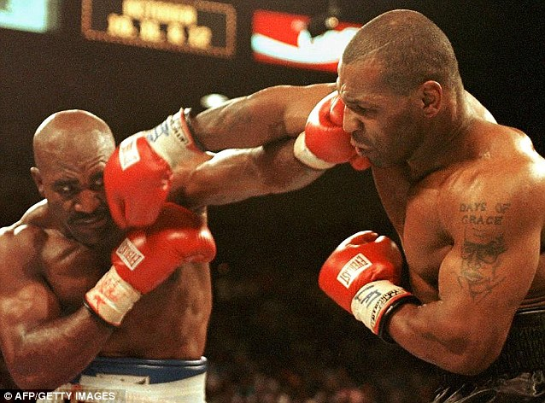
Scandalous Character – MIKE TYSON
This was the fight everyone had anticipated -- Tyson vs. Holyfield II.
They were calling it "The Sound and the Fury," the $100-million rematch between these titans. The first Holyfield-Tyson bout, eight months earlier, produced a shocking upset -- a knockout victory for Holyfield.
Now here we are, in July of 1997, and the rematch is drawing more attention than the first bout, with Tyson getting $30 million, Holyfield $35 million

Slide 2
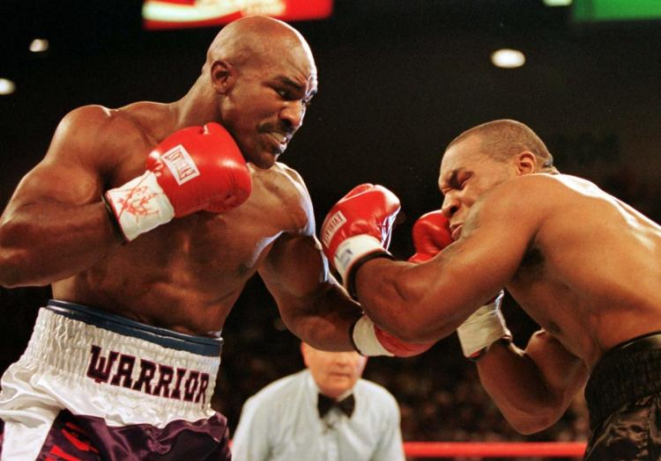
The Scandal Continues…
Holyfield wins the first two rounds on all three judges' scorecards. Tyson is clearly frustrated and irritated. As the third round is about to begin, Tyson storms out of his corner. But he is not wearing his mouthpiece. No one notices except Holyfield.

Slide 3
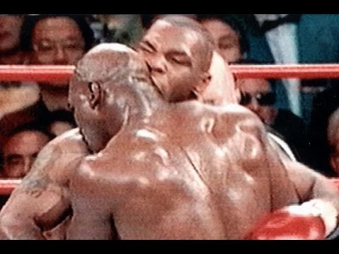
WOW!! What a scandal…
Breathing heavily, Tyson stumbles back as Holyfield charges and nails him with a solid right to the ribcage. Tyson counters with two solid hooks, but neither makes the champion budge. Suddenly, with 40 seconds left in the round, the fight takes an ugly and ghastly turn: Tyson gets Holyfield in a clinch, rolls his head above Holyfield's shoulder, spits out his mouthpiece, and then in an inexplicable and gruesome move, crunches down hard with his teeth on Holyfield's right ear and bites off a chunk!!!!!!

Slide 4
Mike Tyson – The Biter

