Slide 1
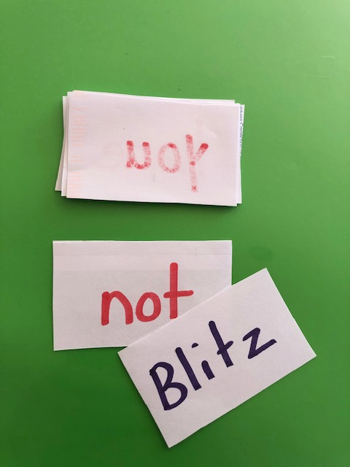
Sight Word Blitz
Sight Words Blitz is a Sight Word game for one or more players. Children will collect cards by correctly reading the sight words printed on the card.
Instructions:
Shuffle the cards and put them in a face-down stack. Player A draws a card from the stack and reads the word.
If they read the word correctly, they get to keep the card. Then Player B takes a turn.
But watch out for the BLITZ cards! Draw a BLITZ card, and you lose all the cards you collected and have to start over.

