Slide 1
Maps, Compass, GPS and stuff
Blackville High School
OP class
December 2018

Slide 2
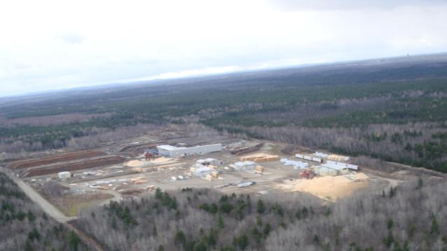
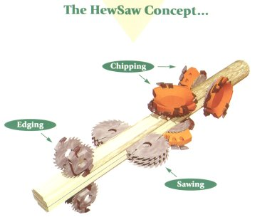
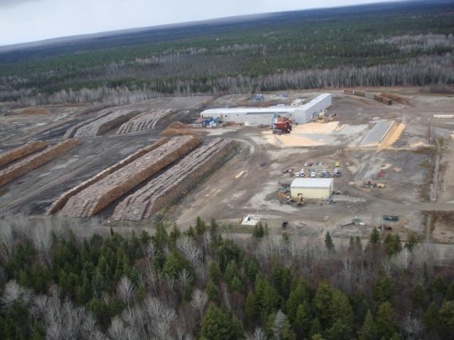
Fornebu Lumber: A Sawmill Owner/Operator
Modernized the sawmill ($8 million)
107 full-time jobs in the sawmill
Production: 100 million fbm/year (200,000cds/yr)
Enough to frame 6,250 houses/yr
About 26 houses/day

Slide 3
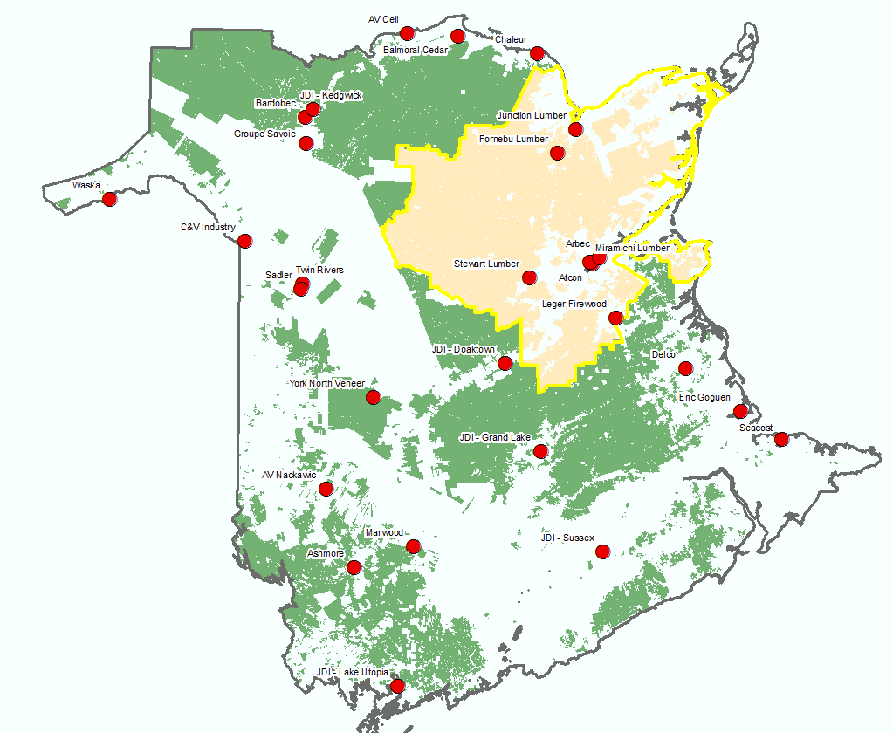
Crown Allocations and Sub-Licensees on Lic#3
Permanent Wood Allocations from Crown License #3:
1.5 million m3
22% to Fornebu Lumber
21 Companies (Sub-Licensees)
28 mills
5 First Nation communities

Slide 5
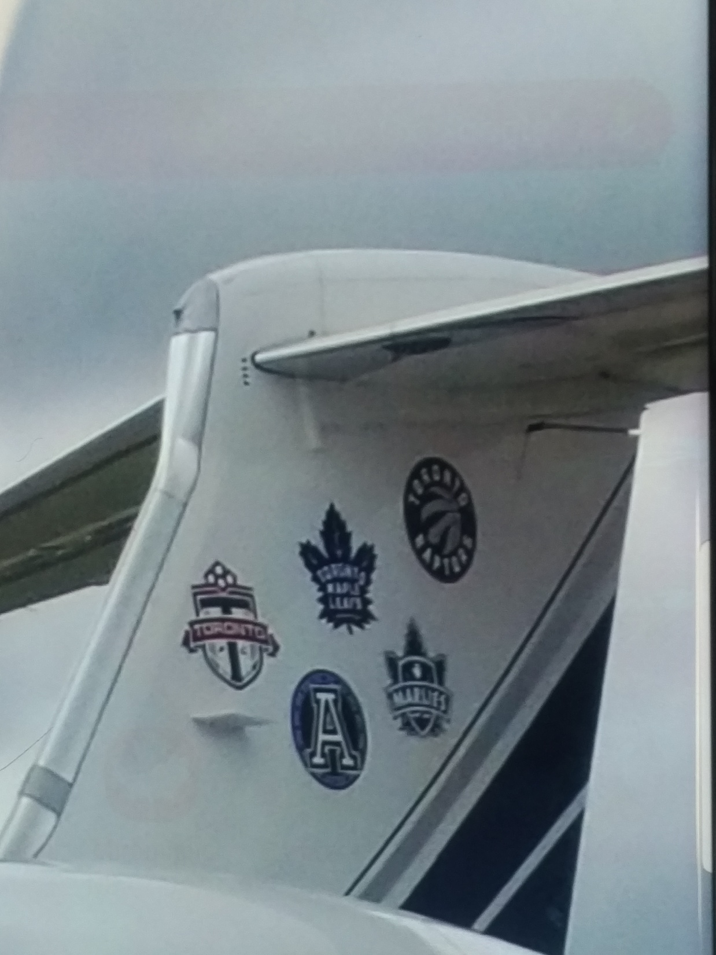

Slide 6
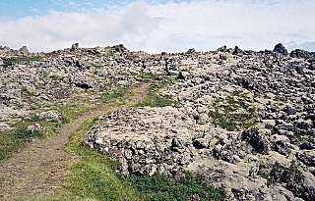
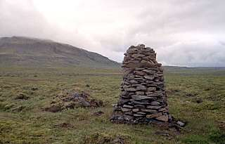
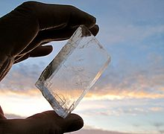
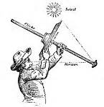
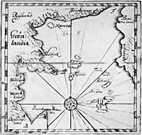
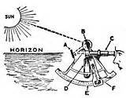

Slide 7
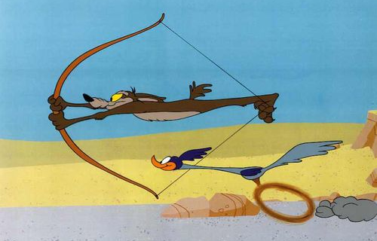
Know your starting point
Know your destination
Understand how far you must travel to reach your destination (scale)
Getting from point A to point B
Roadrunner = 1.6 Hours
Wile E. Coyote = 2.8 Hours
Is this considered “scale”

Slide 9
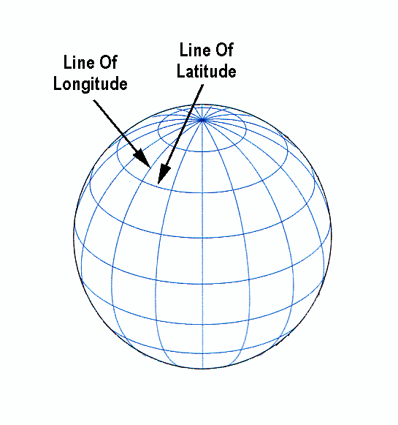
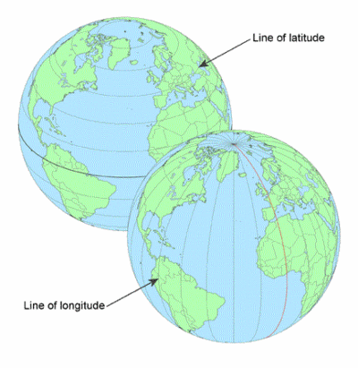
Greeks developed a grid system for locations over 2000 years ago.
Continued to be developed, and improved by various scientists (primarily for ocean travel)
What are the implications of Lat-Long today?

Slide 10
The “idea” of a compass was used as early as the 1200’s.
1700’s and 1800’s saw major improvements in compasses.

Slide 11
Mapping Early 1700’s

Slide 12
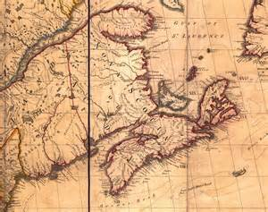
Mapping (1755)

Slide 13
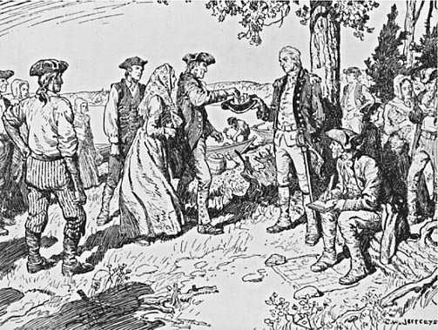
1780’s – drawing land “grants”

Slide 14
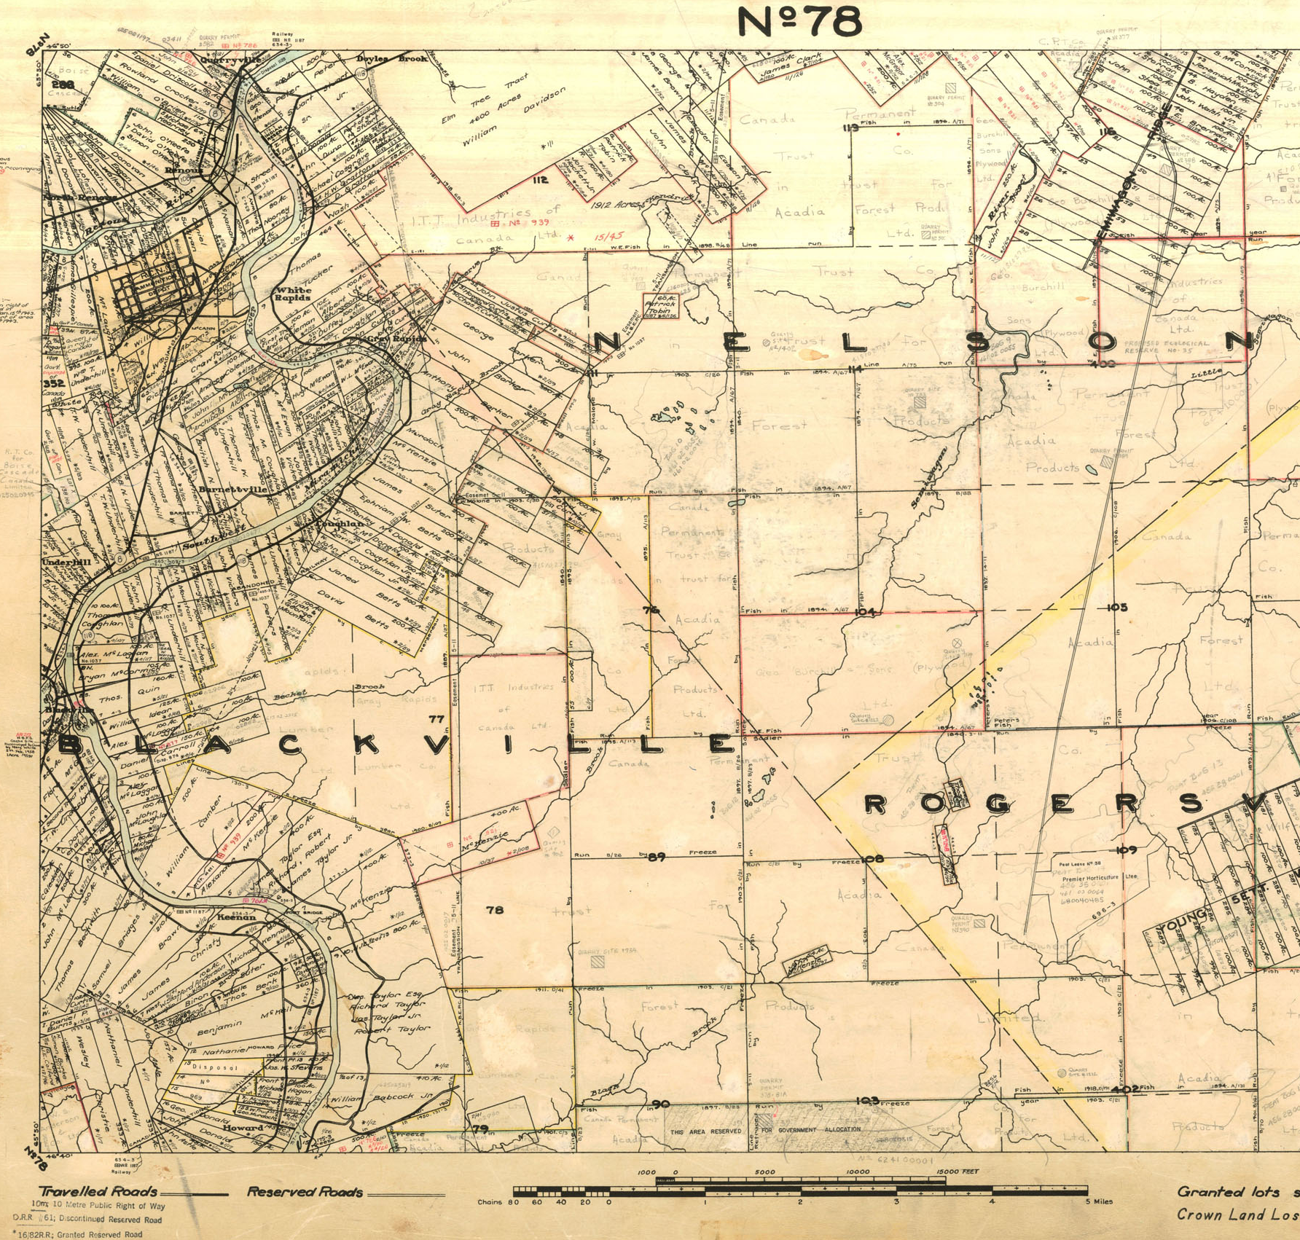
Riparian rights? 1884

Slide 15
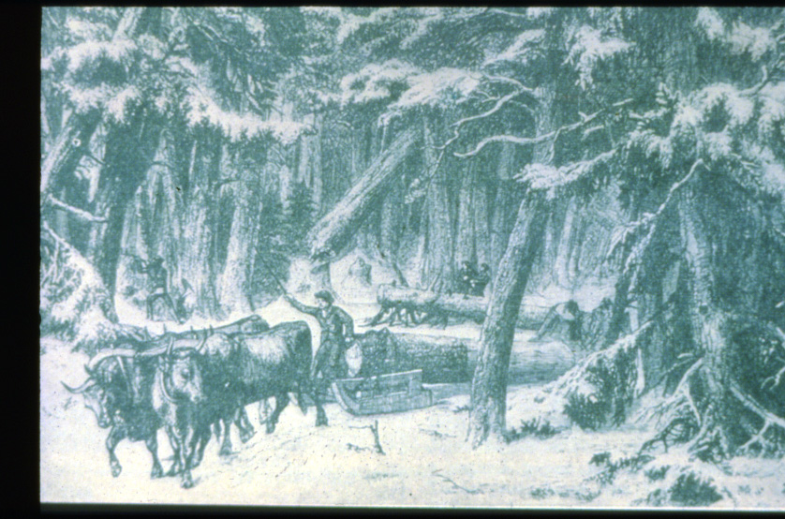

Slide 16
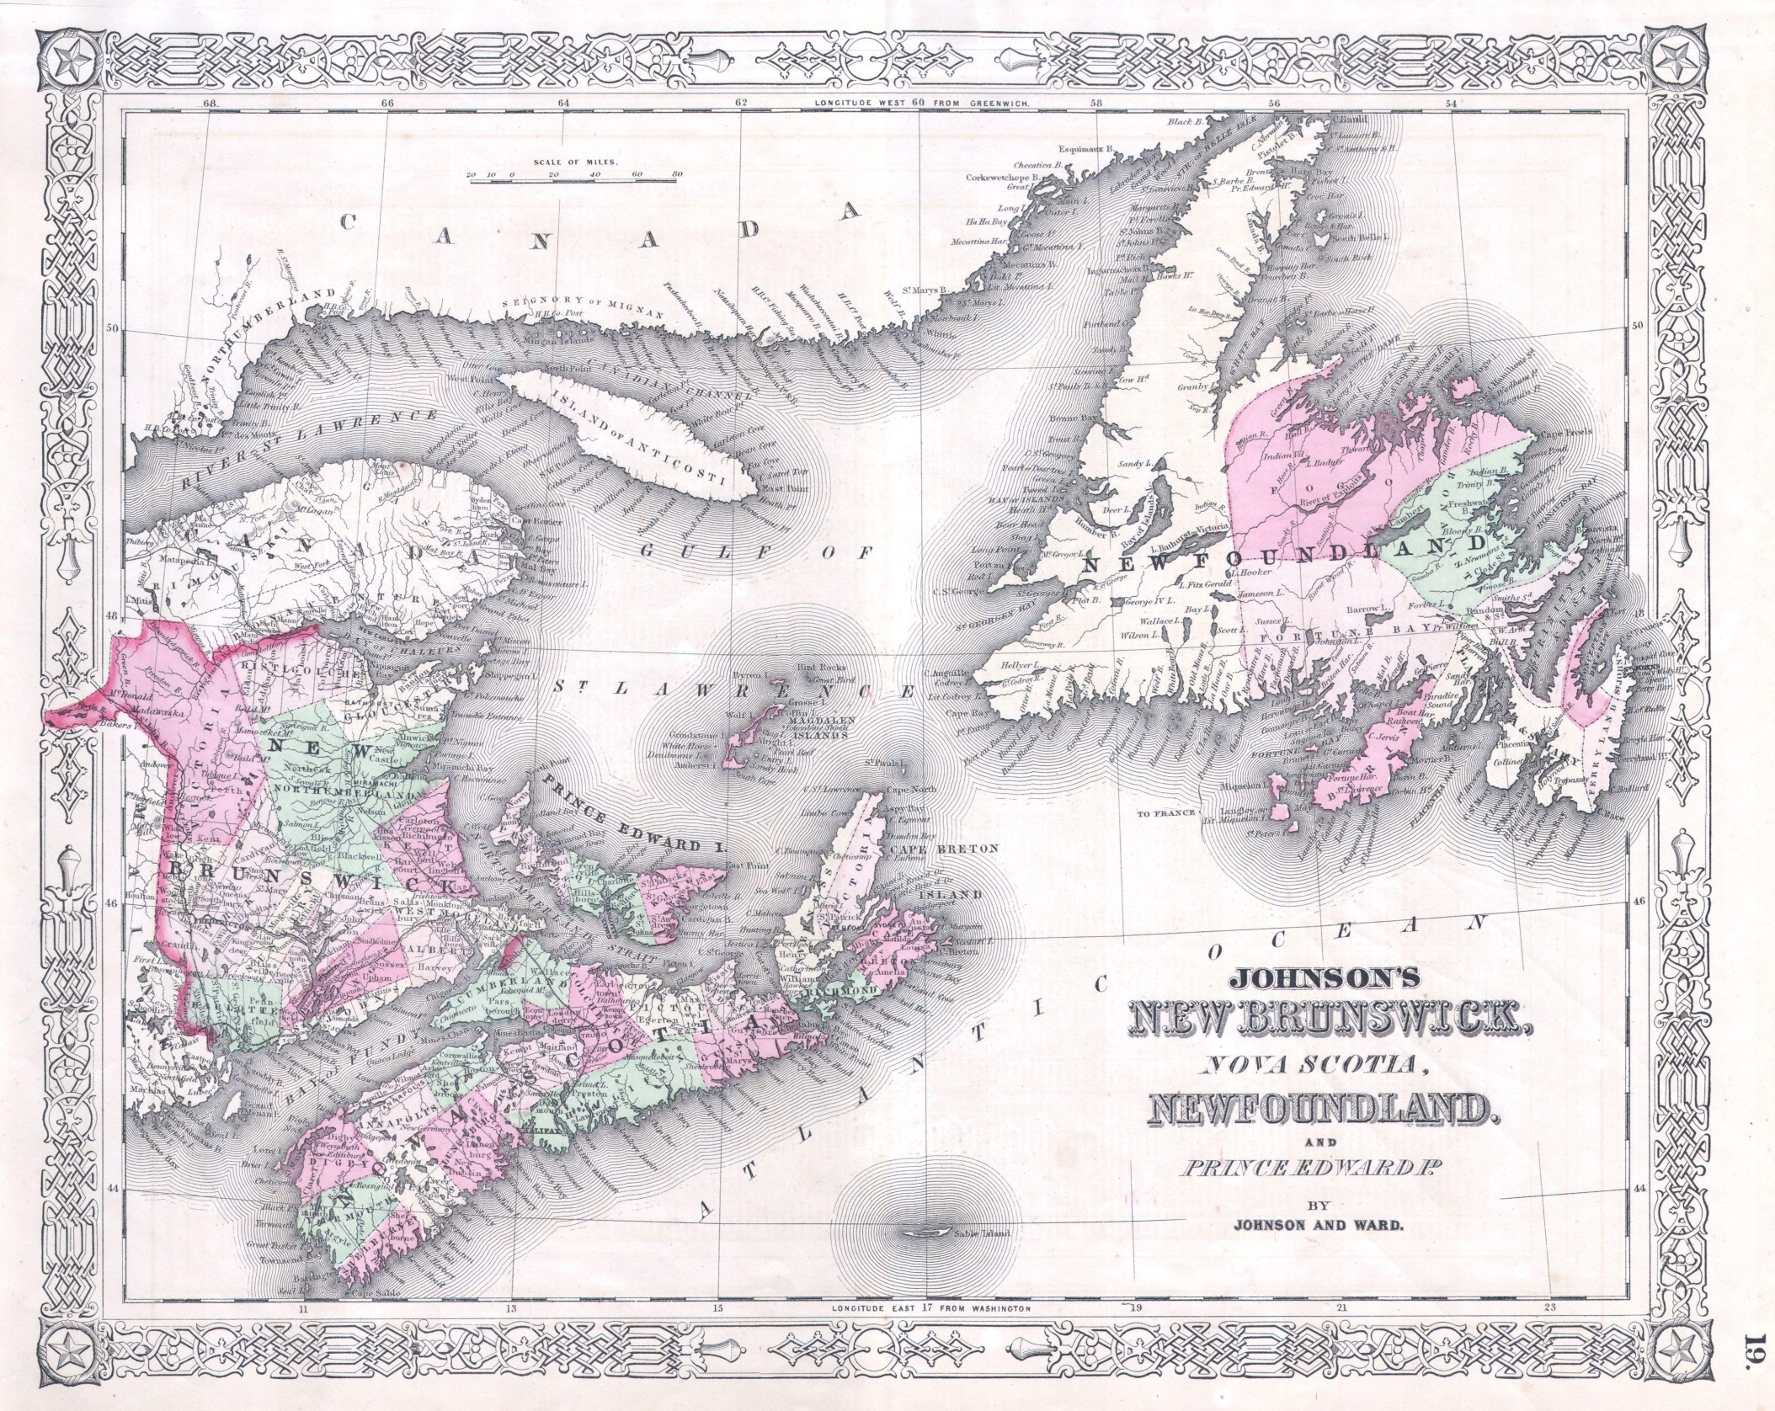
(1864)

Slide 18
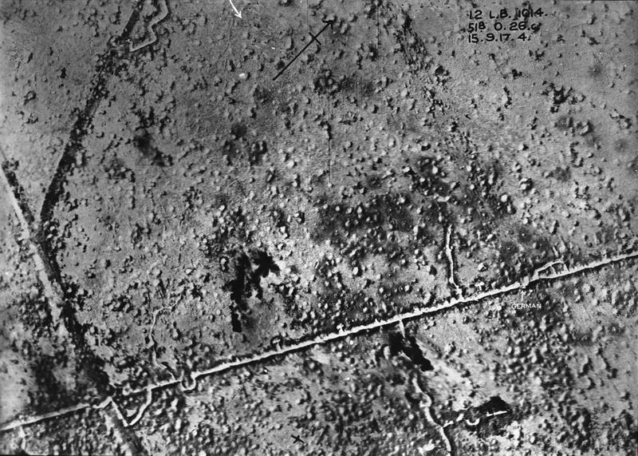
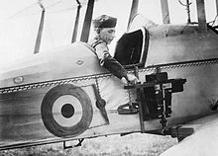
Aerial photography really “took off” in World War 1 (1914-1918)

Slide 19
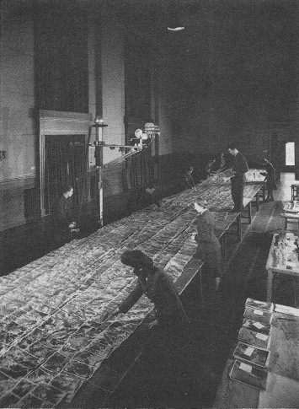
Photogrammetry mapping in Canada from aerial photos (1930’s)

Slide 20
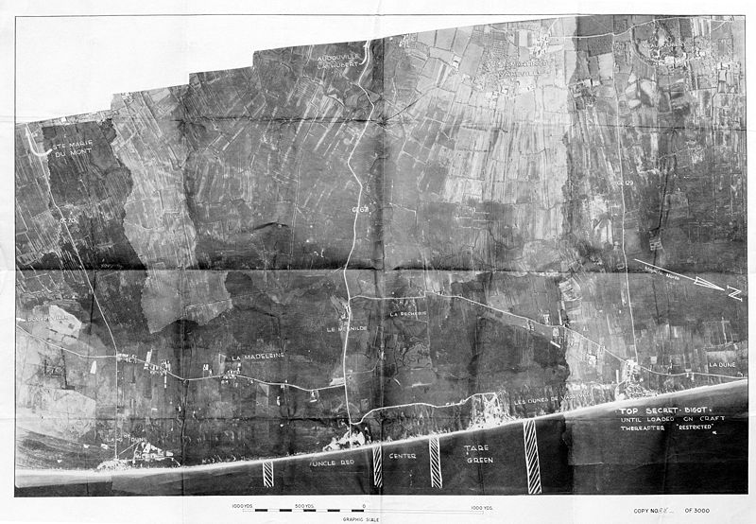
The Spitfire was the top British fighter plane in WW2. They were stripped of guns, armor and other weight to make them fast “photography planes”
Aerial photography saw many changes in World War 2 (1939-1945)

Slide 21
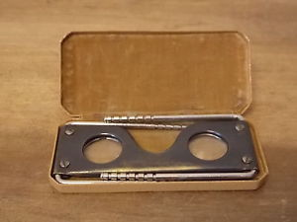
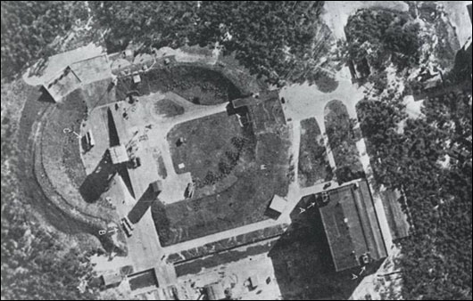
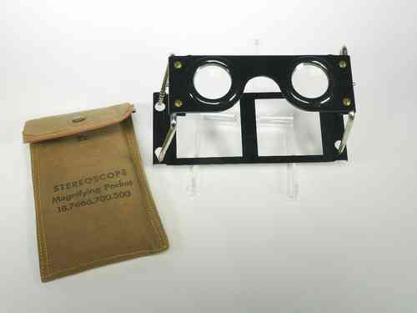
Nazi rocket site
WW2 Air Ministry RAF Stereoscope Type D viewer
E-bay $140.00

Slide 23
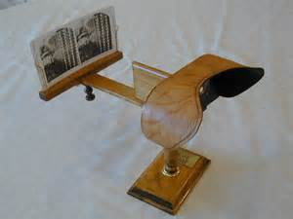
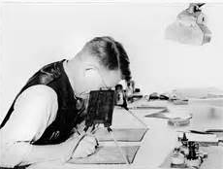
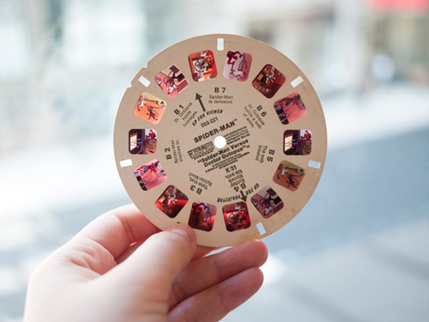

Slide 24
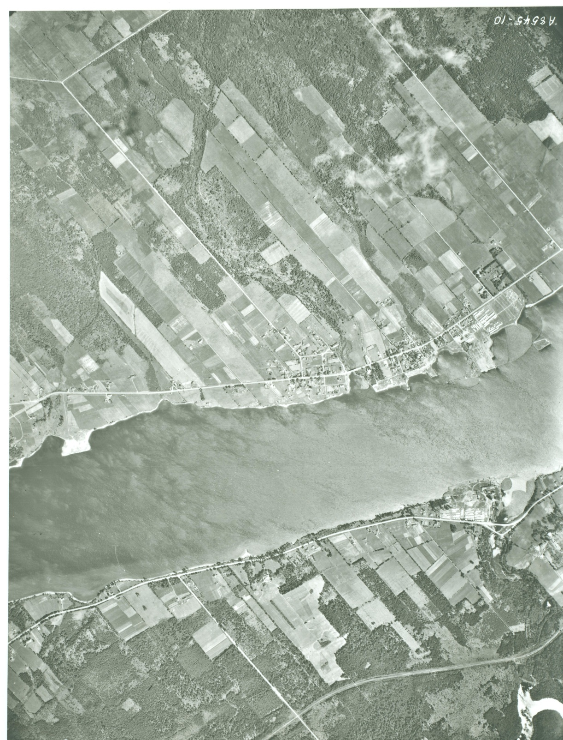
1945 Aerial Photograph
Douglastown Area
Scale 1:20,000

Slide 25
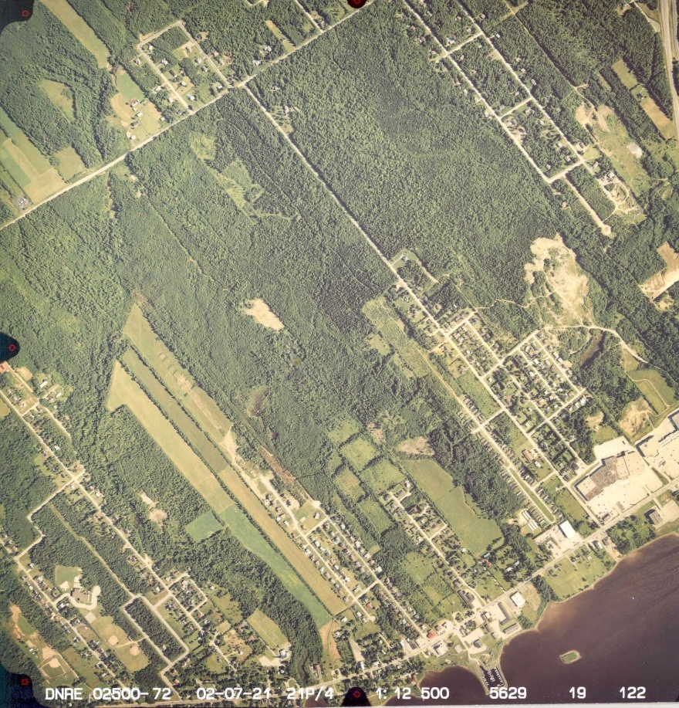
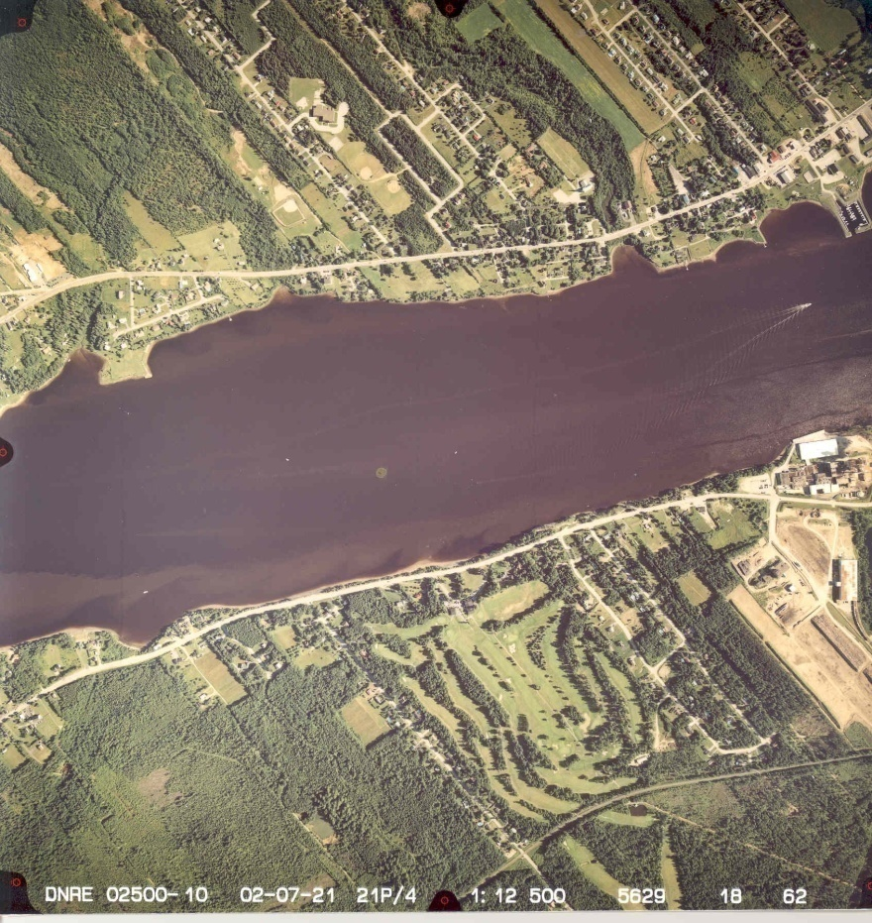
Aerial Photograph
Douglastown Area
Starting around 1983, aerial photos were taken in “color”
Scale 1:12,500

Slide 26
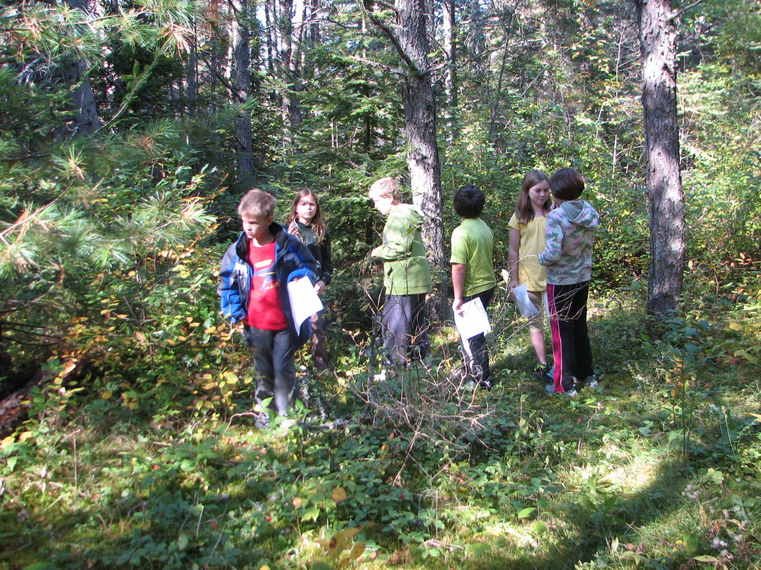

Slide 27
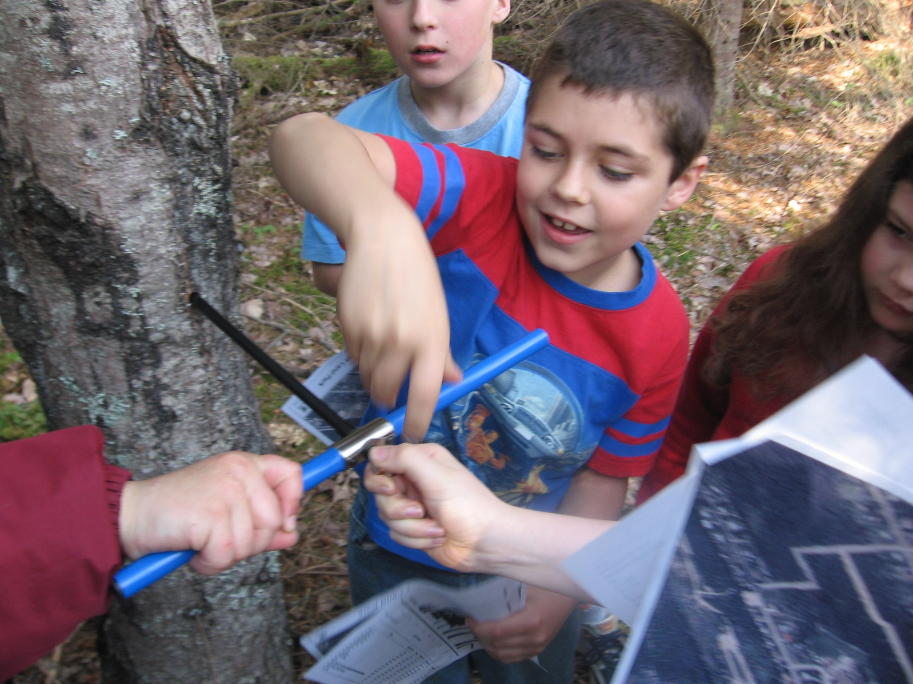
Most trees were approximately 60 years old

Slide 28
2017
1945
2002
2012

Slide 30
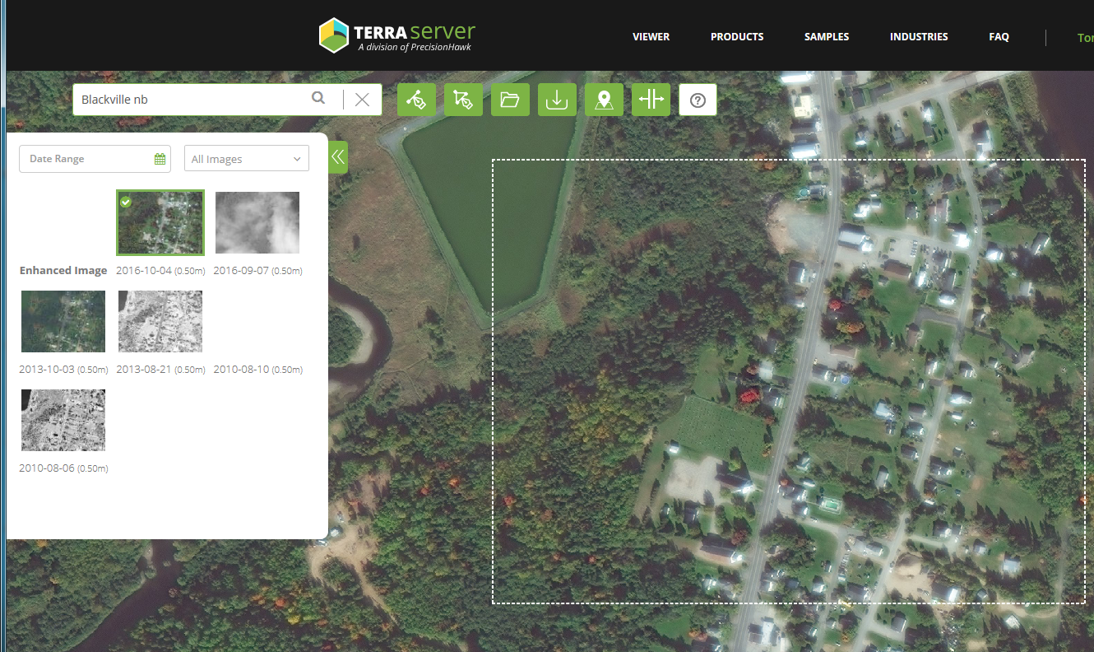

Slide 32
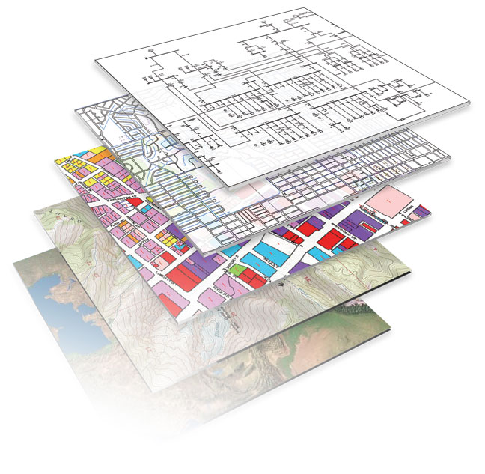
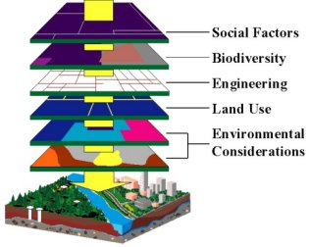
Geographic Information System (GIS)

Slide 33
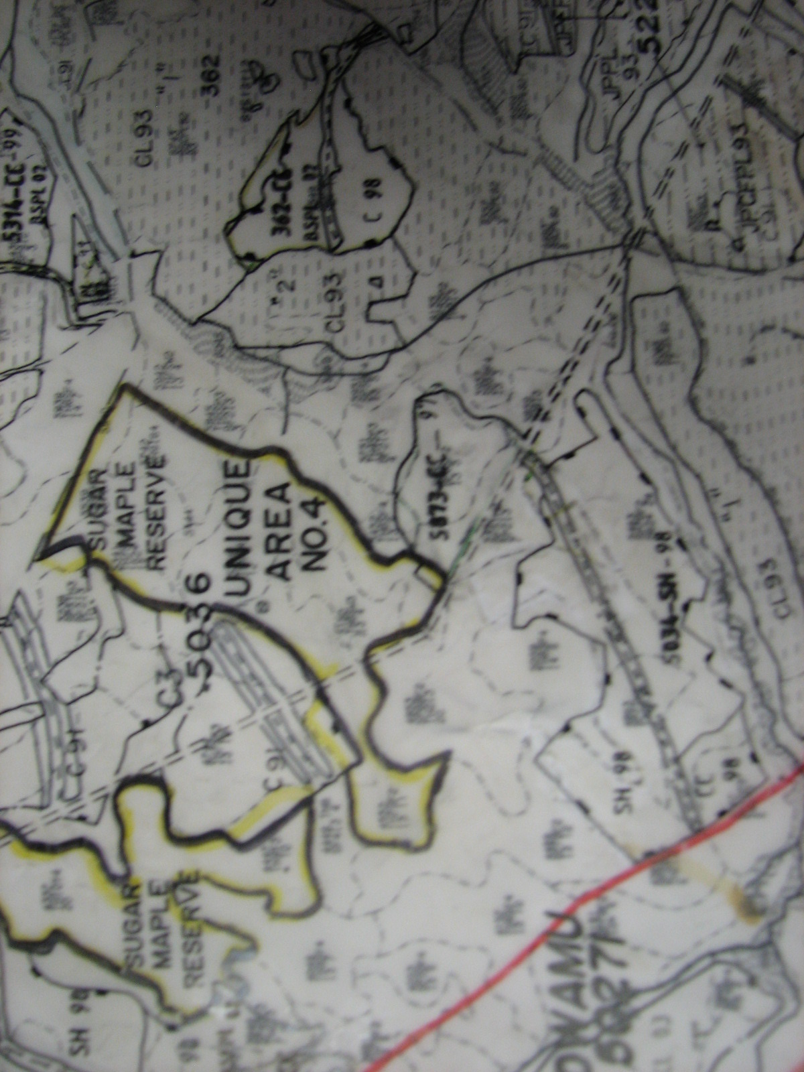
All new information was “drafted” onto the map

Slide 35
Show us where the black spruce stands are.

Slide 37
Show us where the “mature” (70-110 yrs old)black spruce stands are.

Slide 38
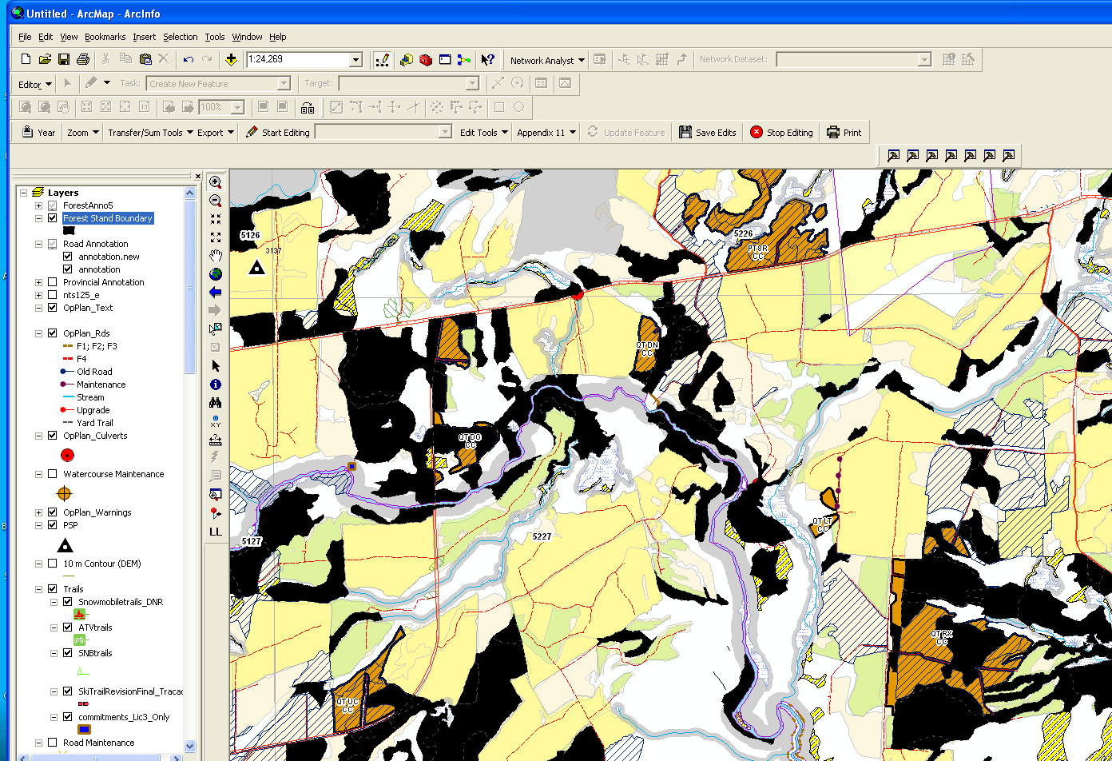

Slide 40
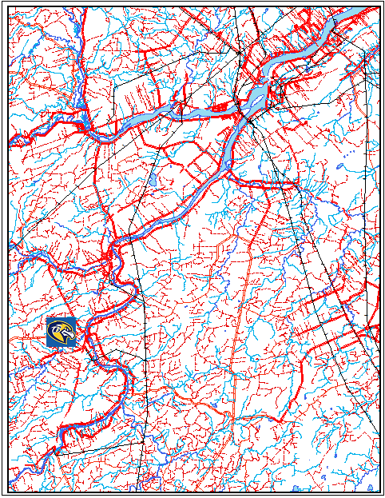
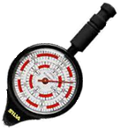
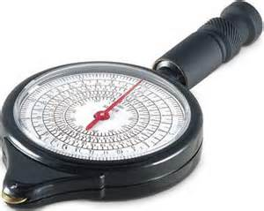
Challenge: How many kms from Blackville High School to the Arbec mill?
Map wheel reading (cm) X Scale = Answer

Slide 42
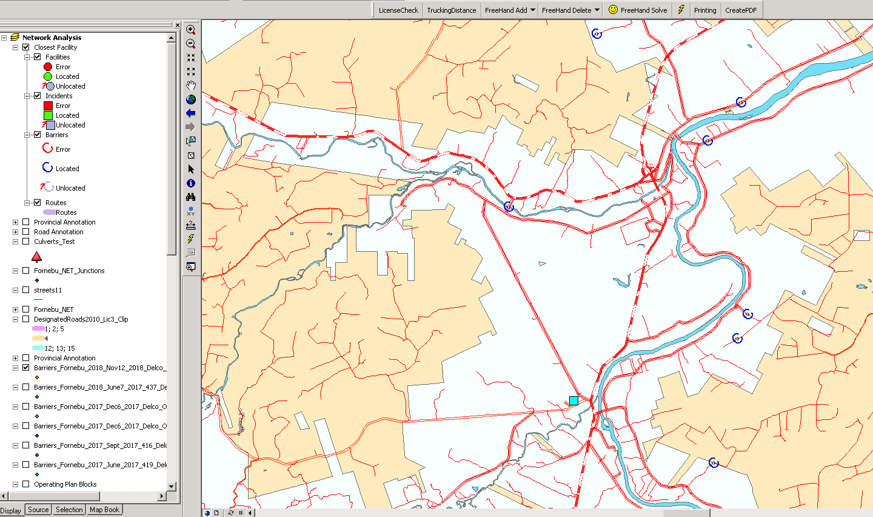

Slide 45
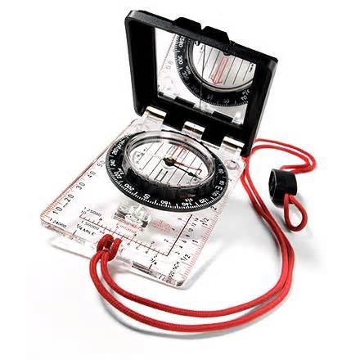
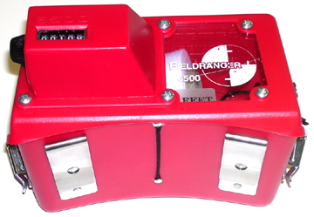
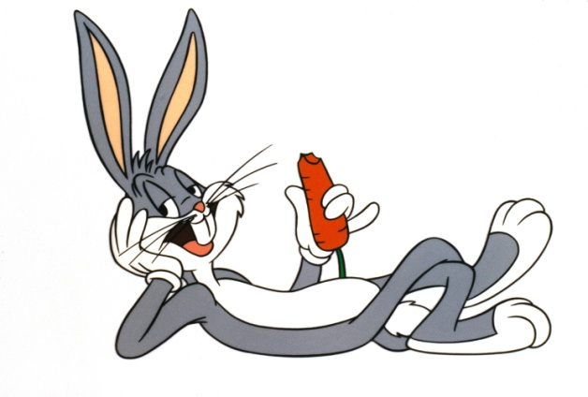
2005 tools for forestry
…how did you measure distance before string boxes were around?

Slide 46
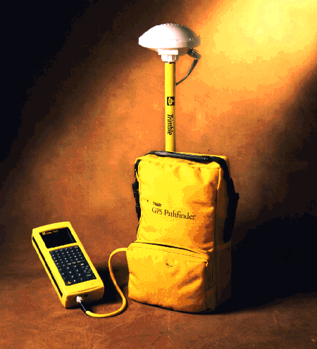
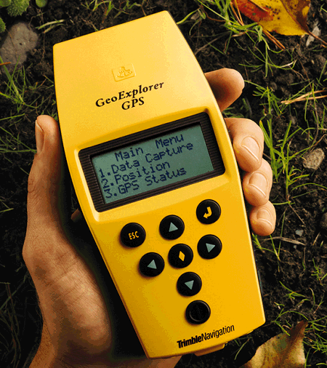
(geographic positioning system) First forestry use was to get area of planted or thinned areas (1998)
Did not always work well “under” trees

Slide 47
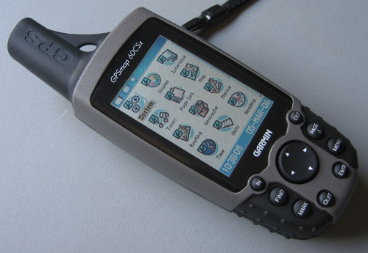
The “savior”!
Forestry information was placed in the unit
2006

Slide 48
GPS coordinates are a Latitude – Longitude system

Slide 49
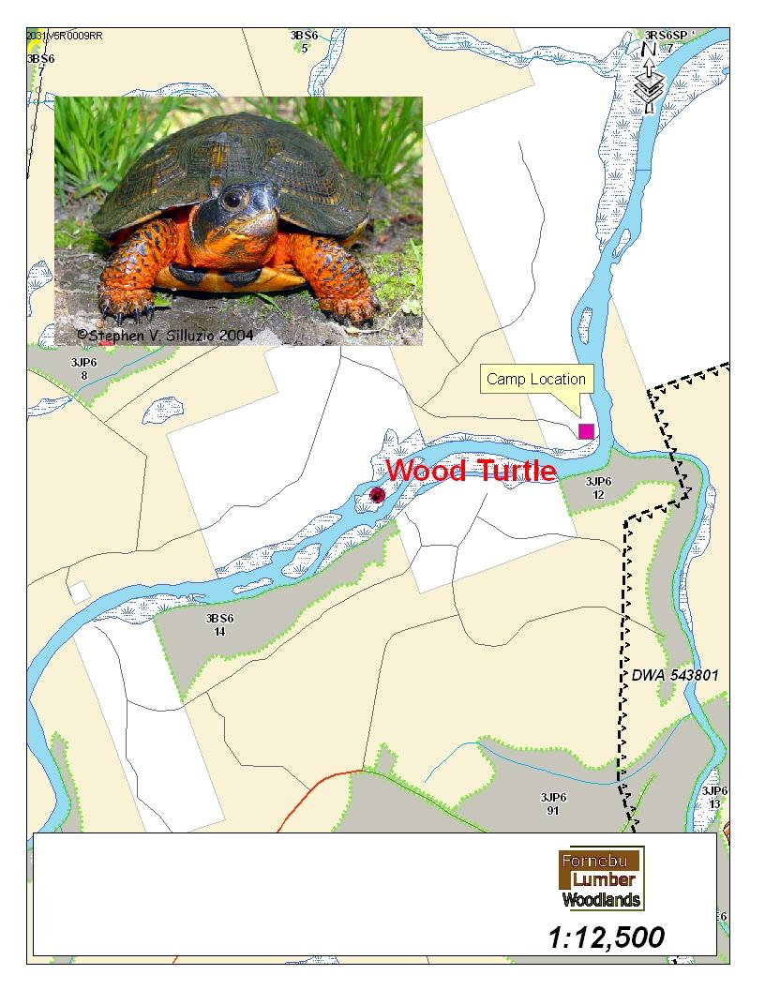

Slide 50
What are the strengths of each tool?
What happens if a GPS unit has incorrect base data? (i.e. – roads)

Slide 51
Newer technology

Slide 53
Light Detection and Ranging

Slide 57
GIS
GPS
(proposed & updates)
Previously mapped information
Lidar
Light Detection and Ranging
“On the ground” info.
Photo Updates

Slide 58
“On-board” GPS

Slide 61
Post Track Log – Commercial Thinning

Slide 62
Smart phones are “smart”!
They are a map/GPS “tool”
They are a reporting “tool”
They can help determine slope, work as a safety device, gather information, etc.

Slide 71
Non timber Values - Industrial
Wreath tip industry
Maple sugary Leases
Mineral exploration and development

Slide 76
Water
Necessity
Increasing world wide demand

Slide 77
Recreational use of the forest
Forest Values – People
We work with a variety of individuals
and groups with interests in the
forest.

Slide 78
We were meant to be outdoors…?!
Story telling – often about the outdoors

Slide 80
Do we still embrace winter?

Slide 84
1959 – 225 sold
1963 – 8210 Sold

Slide 85
$32,000,000+ tourism business for NewBrunswick

Slide 87
$10,000,000 business

Slide 88
Bald Mountain
Motorized vehicles are prohibited

Slide 90
#1 Safety Issue
Reduce speed and increase awareness on woods roads.

Slide 91
There are Critters out there!
Know your safety "zones"
Little Critters
Wasps, Bees, Hornets ( know your tolerance, know their habitats – benadryl , epi-pen)
Ticks – You must wear long pants in the woods

Slide 92
Keep the bear in sight
look large and intimidating
Do not climb a tree

Slide 93
Clacking, Blowing and Huffing sounds?
“Springtime Danger”

Slide 95
$18.00 launcher
$3.00 Cartridge
Bear bangers
Store safely, think safety

Slide 96
Here's what you can do to improve your personal safety:
Do not feed coyotes .
Properly dispose of garbage sources.
Hike with friends and a solid walking stick when in known coyote areas.
If the coyote approaches or is close by
Maintain your distance.
Do not turn your back or run away.
Stay together.
Try to scare the animal away. Make noise and act big.
If a coyote attacks
Fight back. Shout, throw stones, use whatever is available to defend yourself.
Protect your pets

Slide 97
Too much power?
Icy conditions, uneven surface, there is no seat belt, trees along trail, alcohol, moose, open water...

Slide 98
Waterfalls and swimming places:
Check for broken glass/debris
Beware…sunken wood and under water rock outcrops (from one season to the next)
Water levels can change rapidly!

Slide 99
Modern Technolgy
Appeals to our story telling traditions – people of all ages.
Can give us outdoor adventures without going outdoors! (minus the health benefits)
“I saw an amazing wildlife photo on FB” versus…

Slide 100
“Getting outdoors and photograph your own memories!

Slide 101
Forestry has become a “high-tech” industry. Training is very important.

Slide 102
It seems…
GPS & GIS (and smart phones)have changed the way we view our world!

Slide 103
Thanks to Mr. Hallihan for “great OP experiences” !
Thank you!

