Slide 1
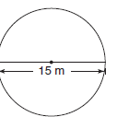
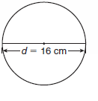
1) BEDMAS: 13 - 10 + 2
2)10 % of 23
3) 50% of 85
4) What is the radius?
5) 1/3 of 18
6) 20% of 5
7) Estimate the Circumference of the circle:
8) 25 X 20
9) 6008 ÷ 2
10) What is the LCD for 4 and 5 ?

Slide 2
Homework...
A desk has dimensions 45 cm by 30 cm.
A coffee mug has a radius of 3cm.
How many coffee mugs can you fit on the desk?

Slide 3
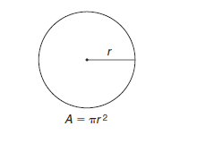
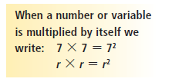

Slide 4
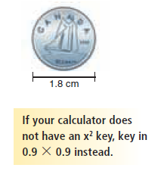
a)

Slide 5
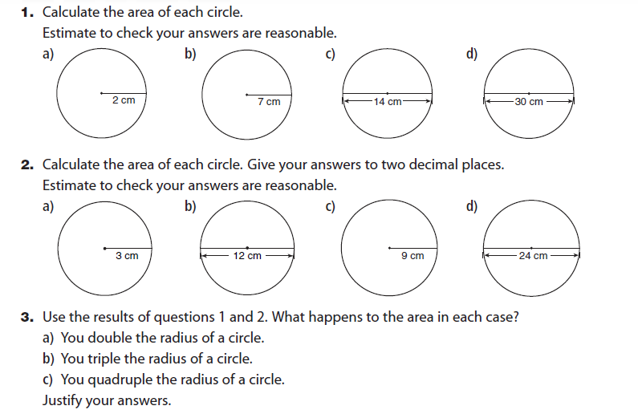
Page 150

Slide 6
