Slide 1
The early years…
Who will you recognize?

Slide 2
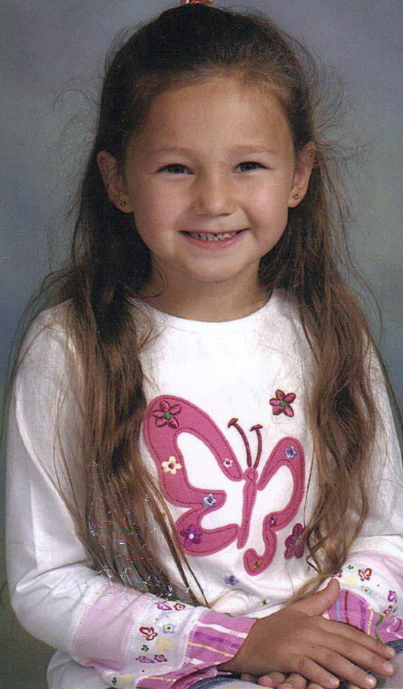
Abby D.

Slide 3
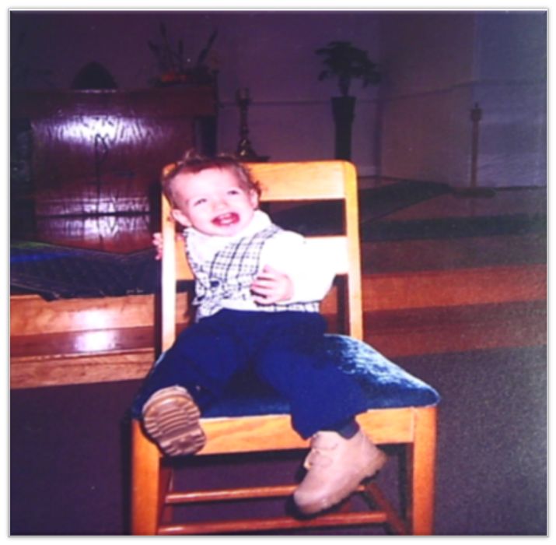
Jesse

Slide 4
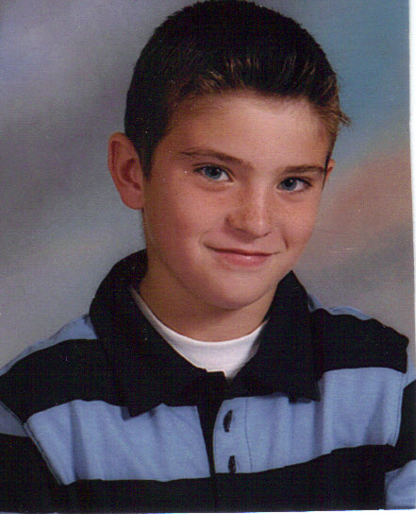
Aaron

Slide 5
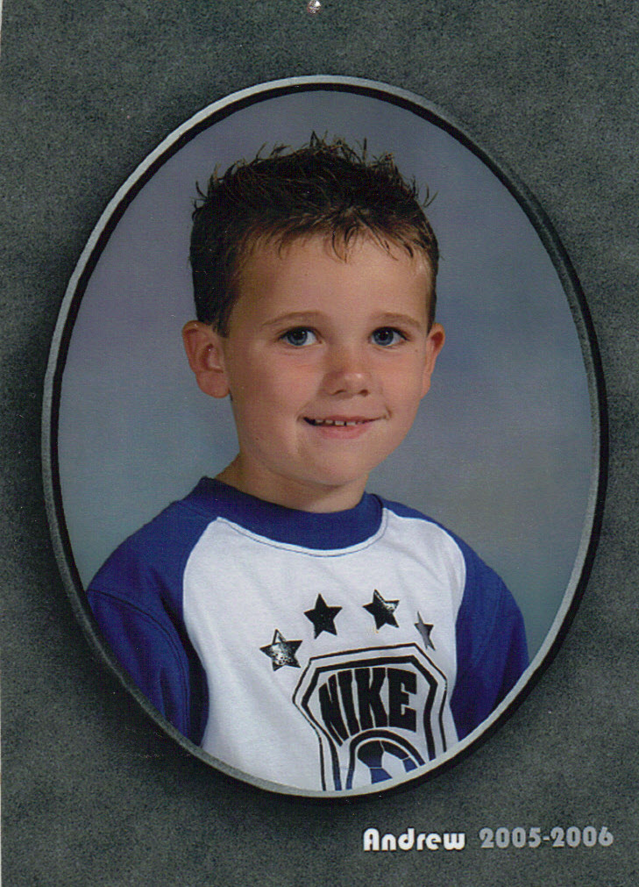
Andrew

Slide 6
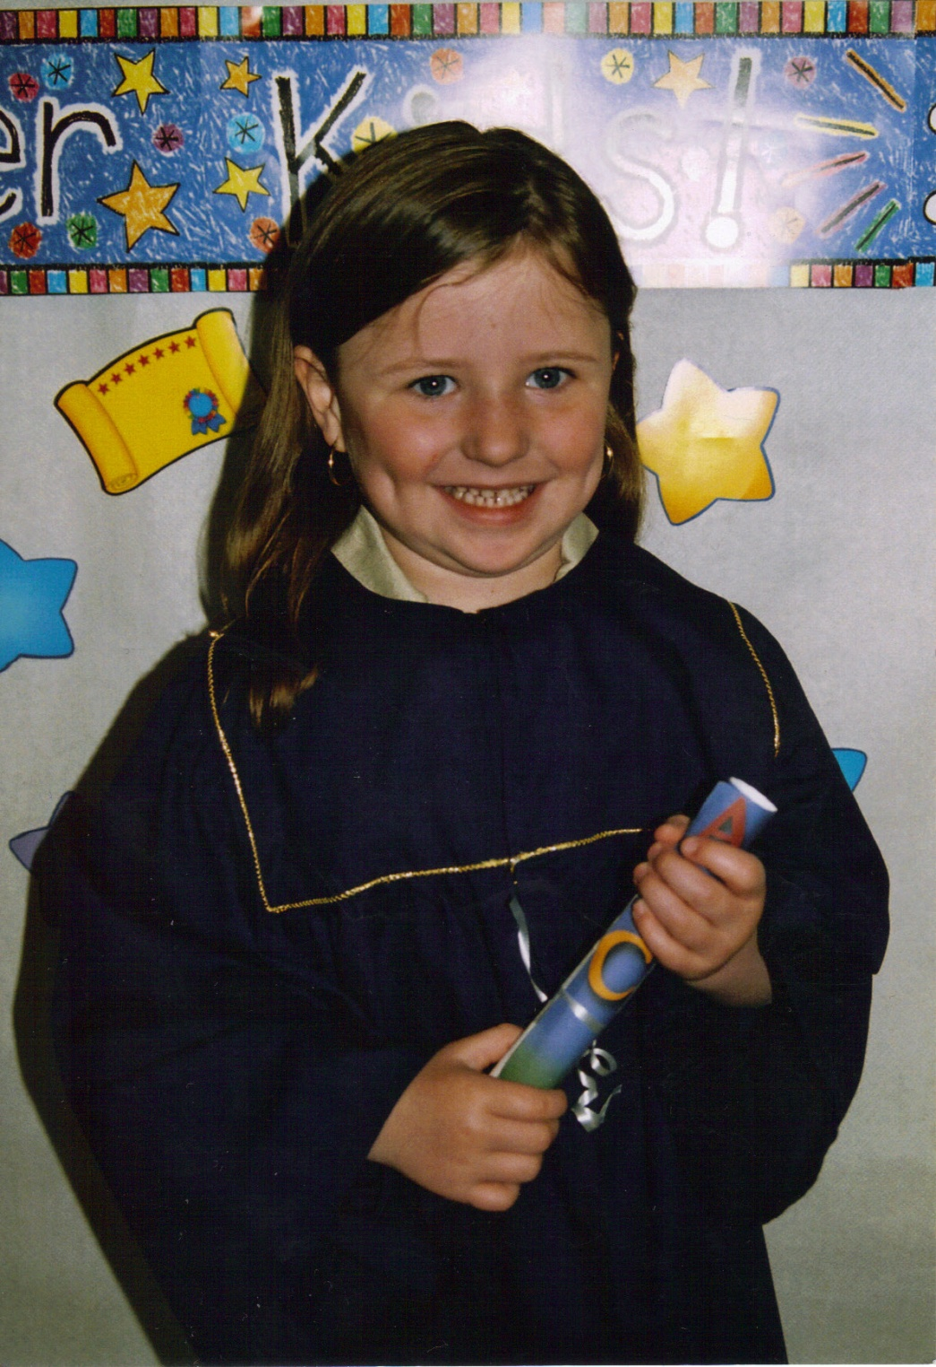
Amber

Slide 7
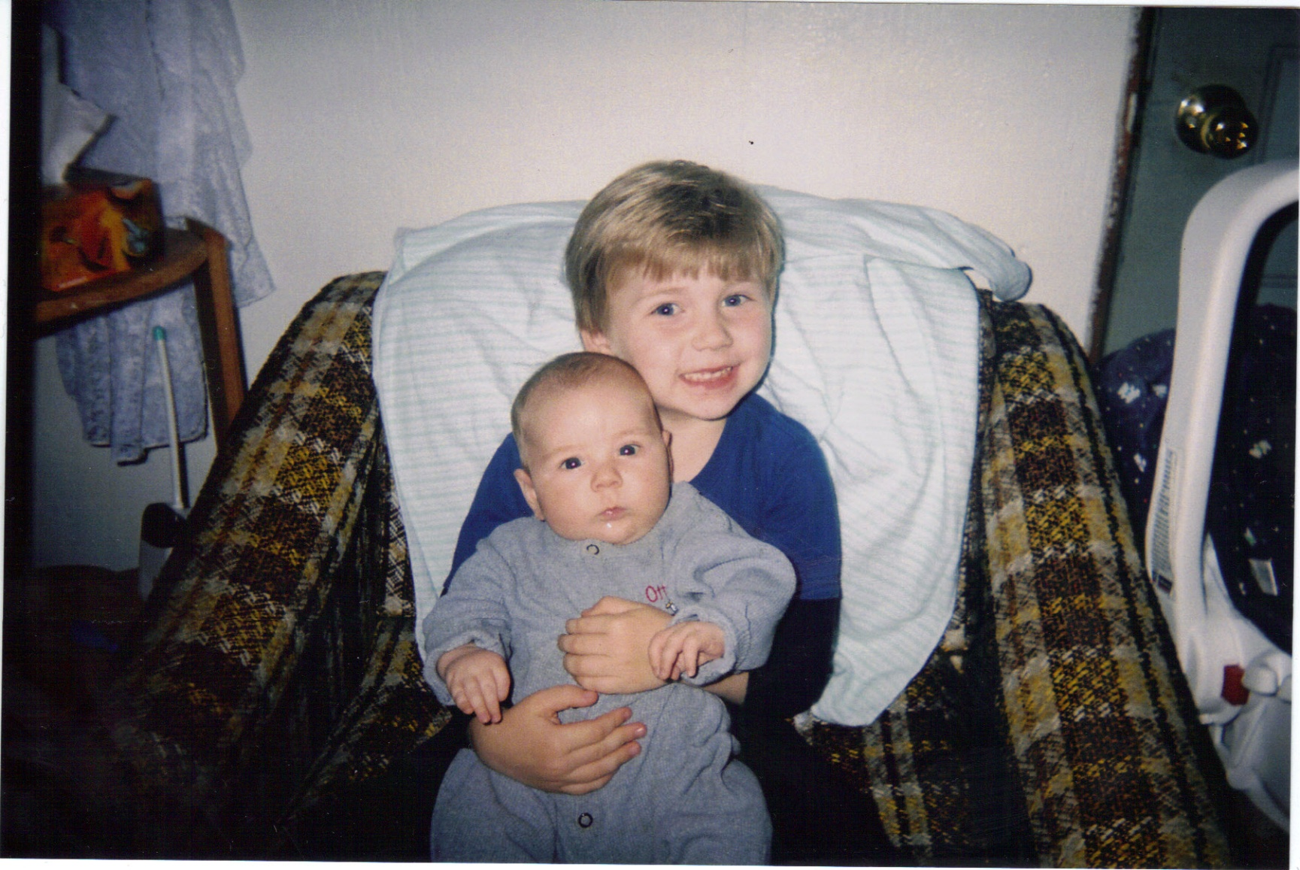
Brett

Slide 8
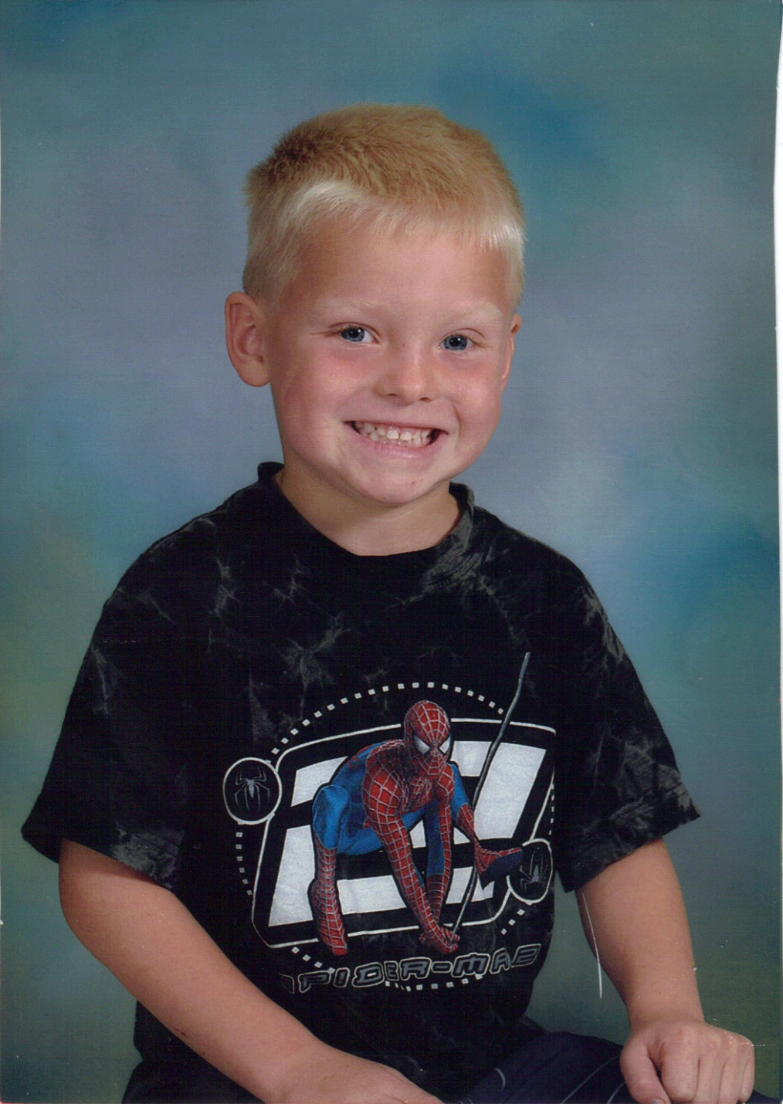
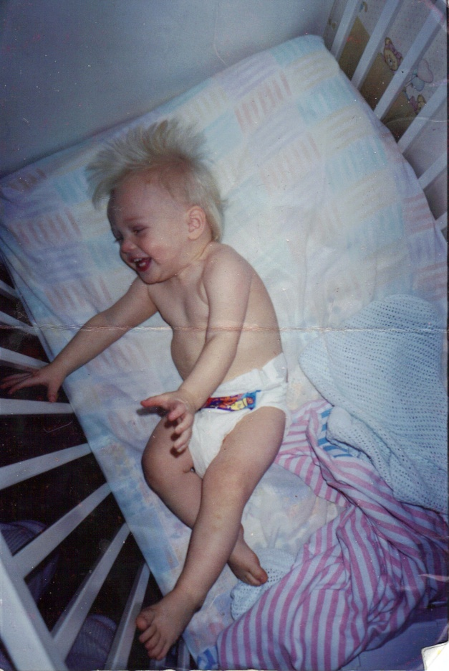
Caleb

Slide 9
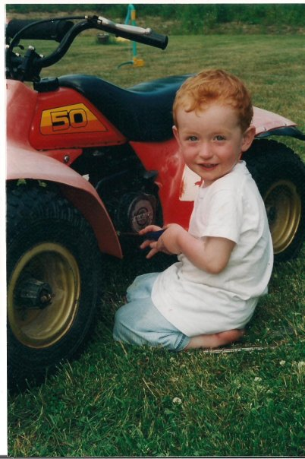
Alex

Slide 10
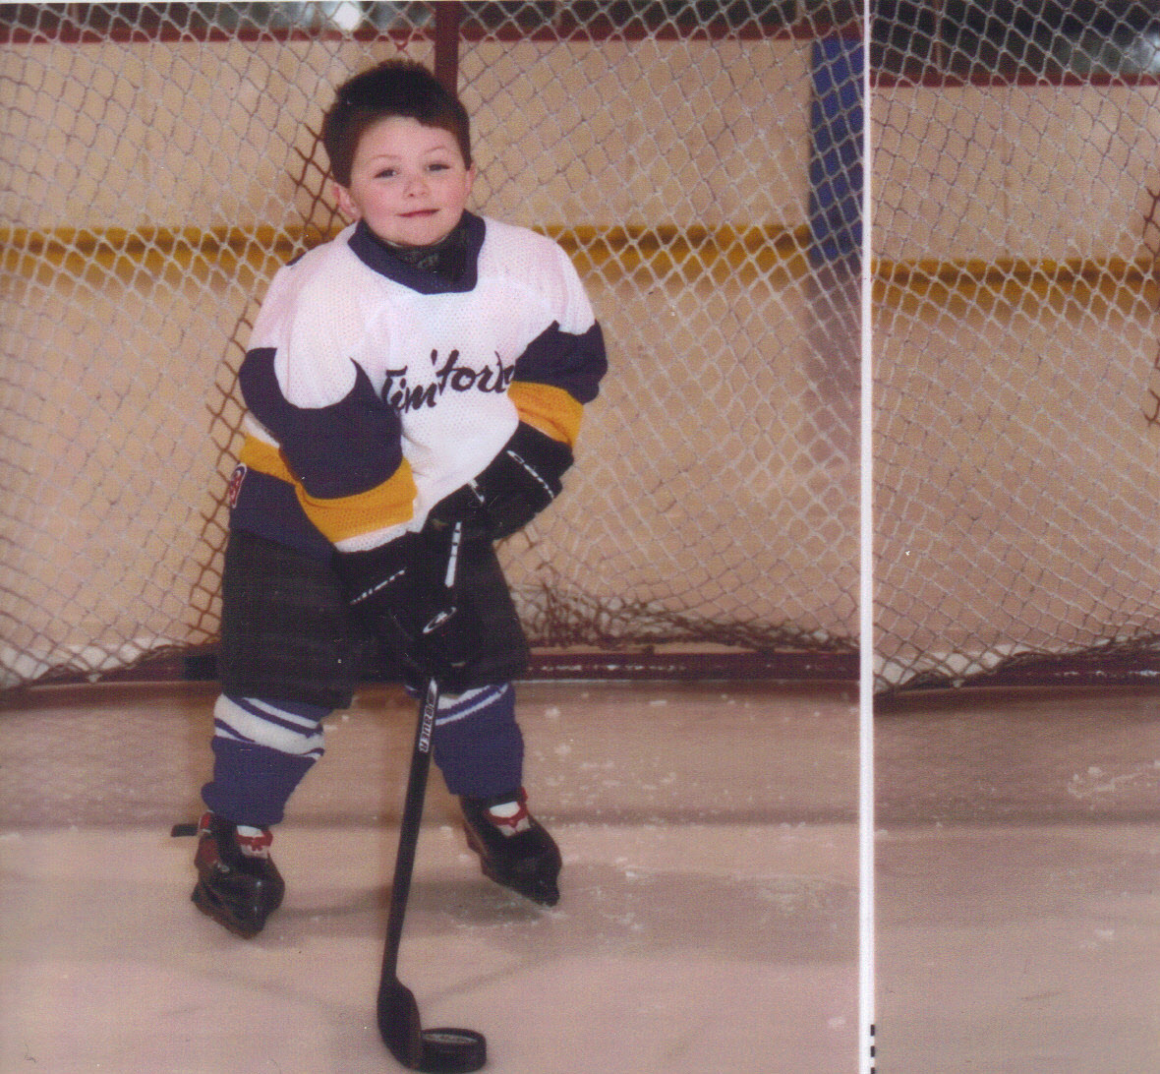
Carson

Slide 11
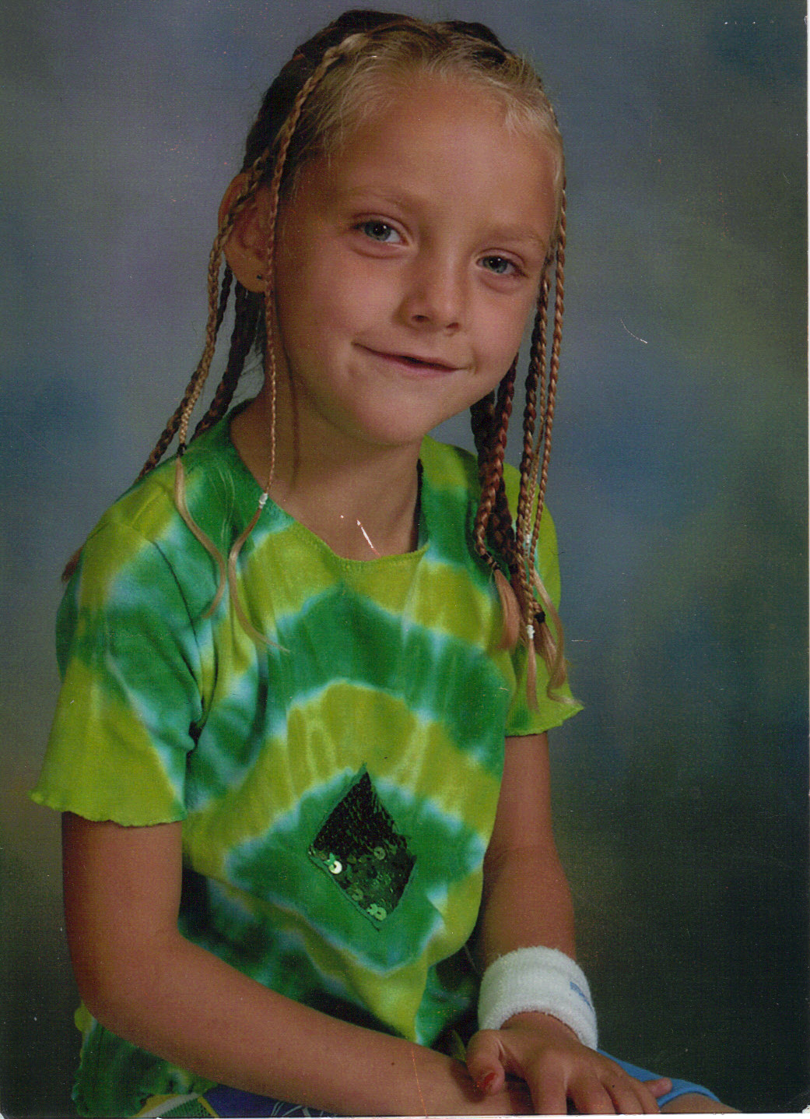
Darian

Slide 12
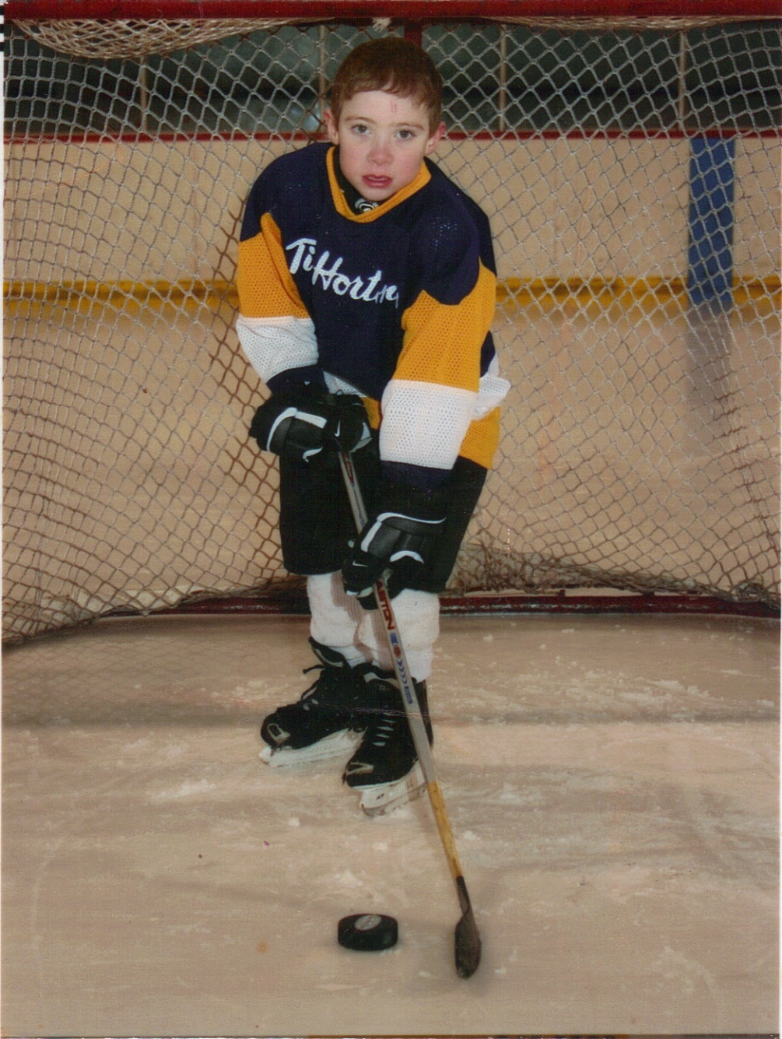
Chad

Slide 13
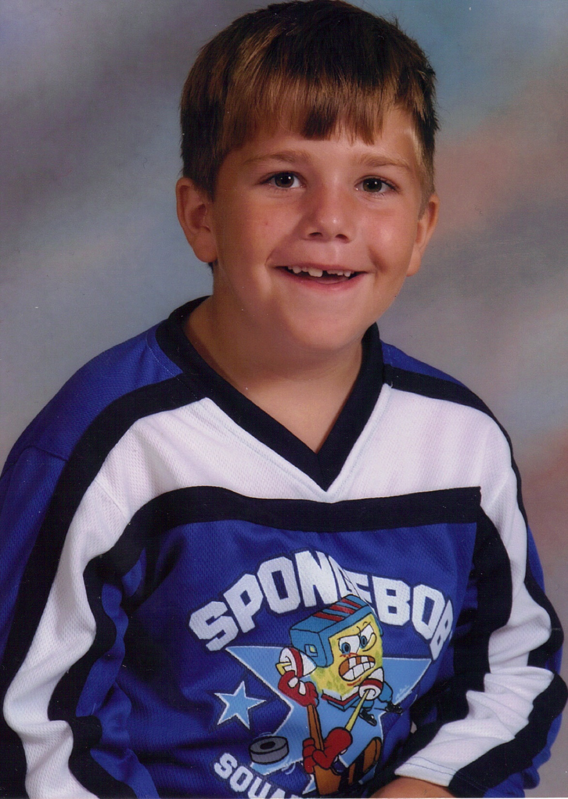
Christian

Slide 14
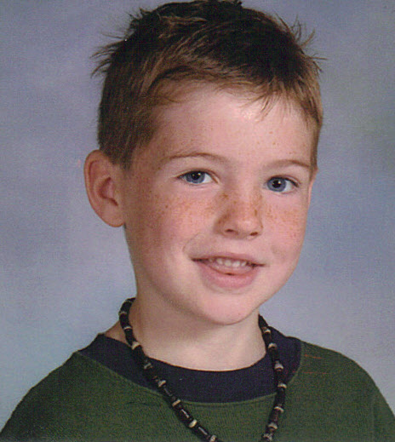
Daniel M.

Slide 15
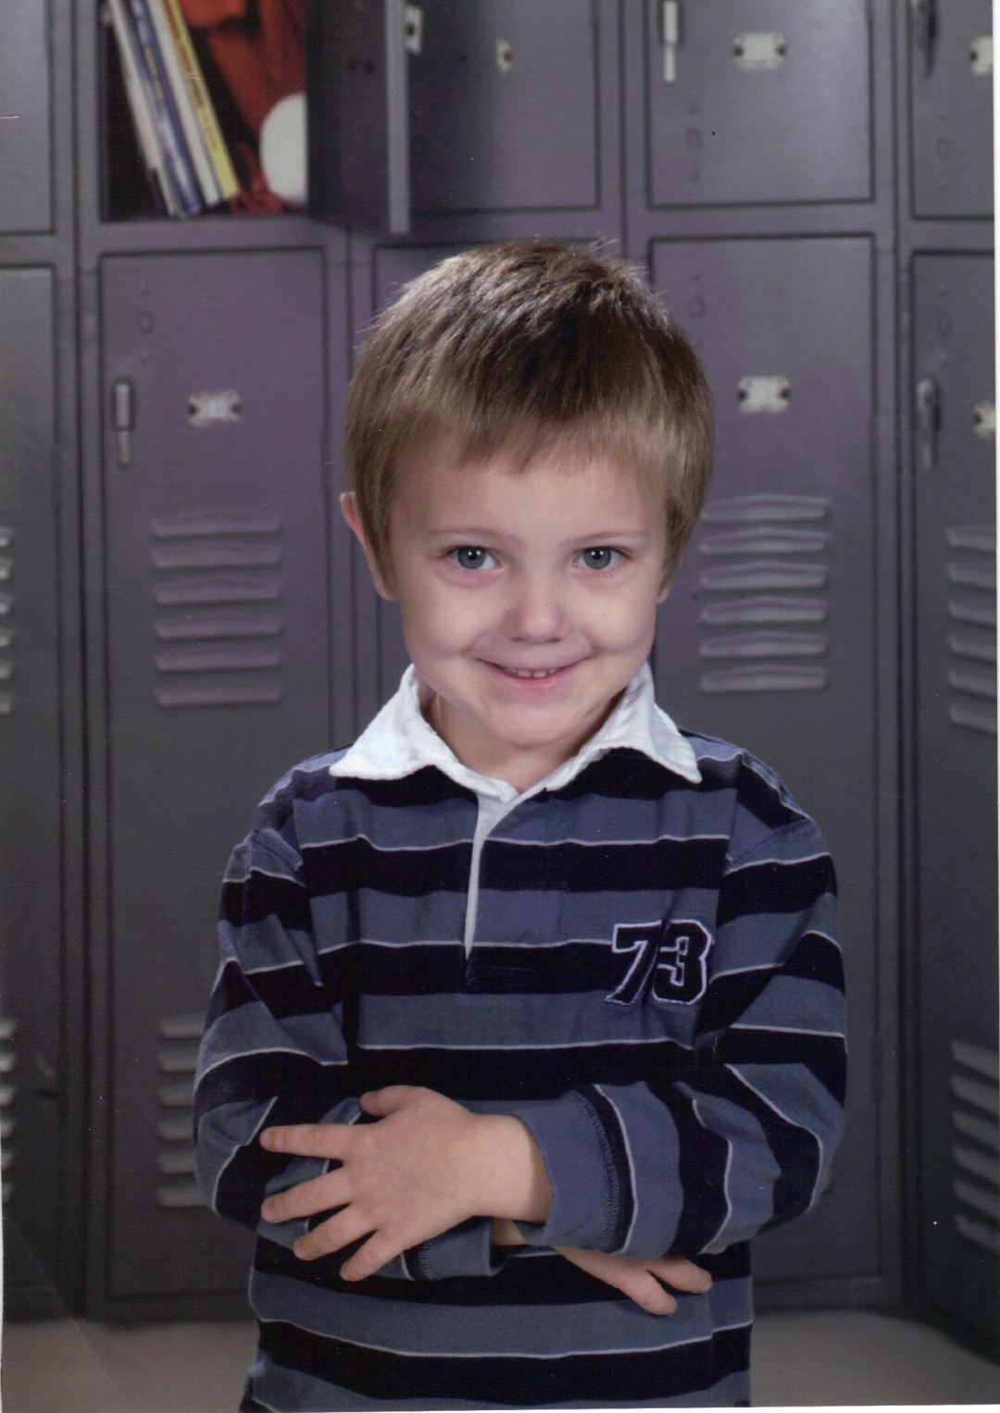
Daniel R.

Slide 16
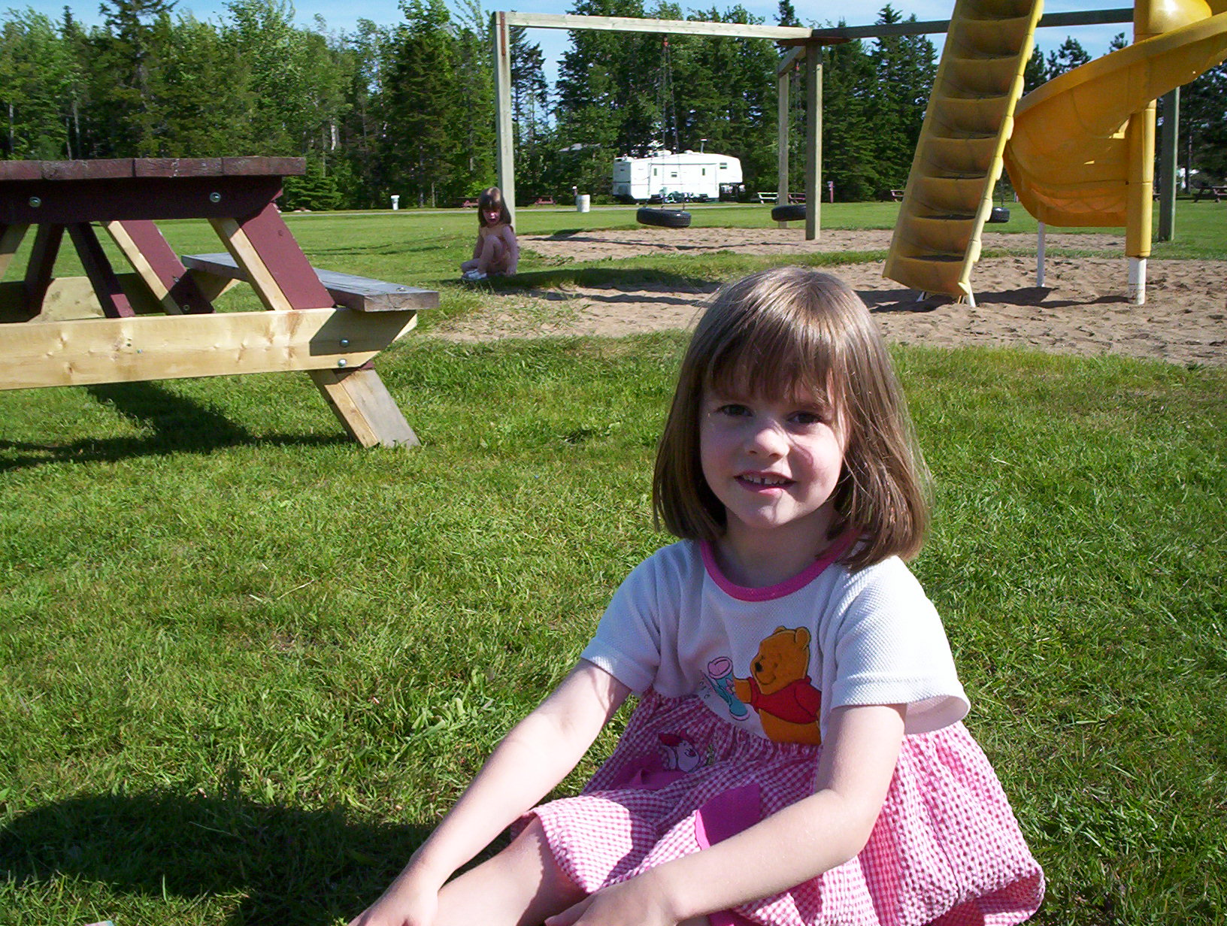
Jules

Slide 17
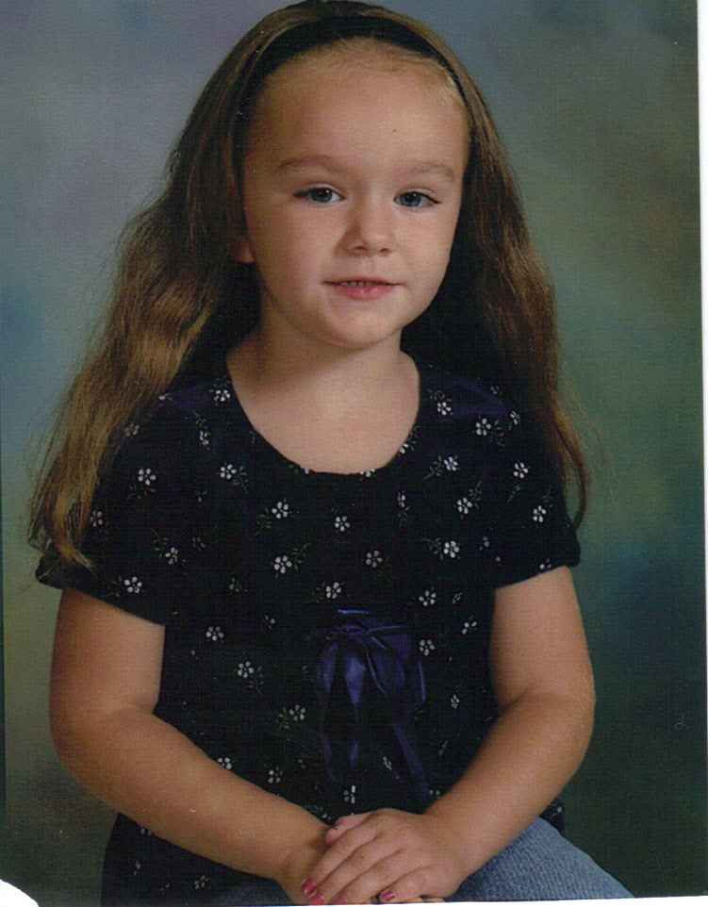
Eve

Slide 18
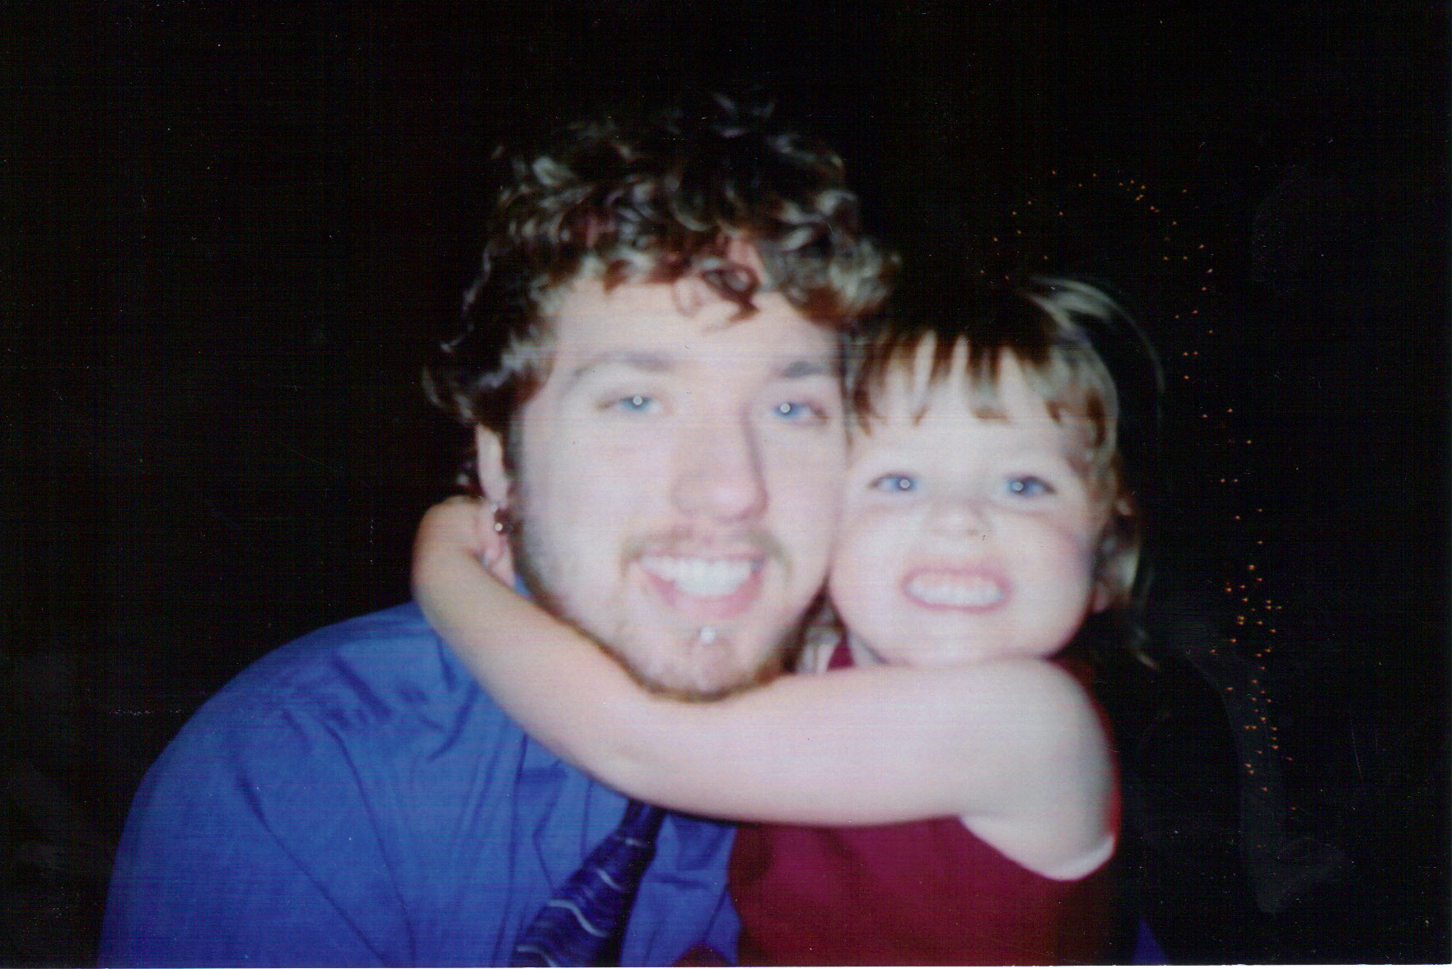
Emily

Slide 19
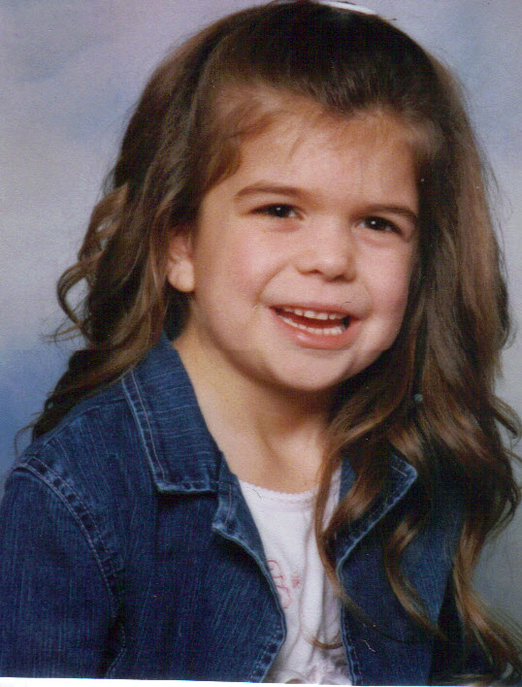
Delanie

Slide 20
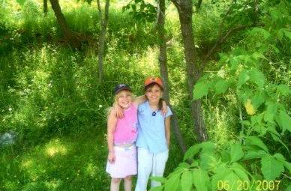
Mackenzie

Slide 21
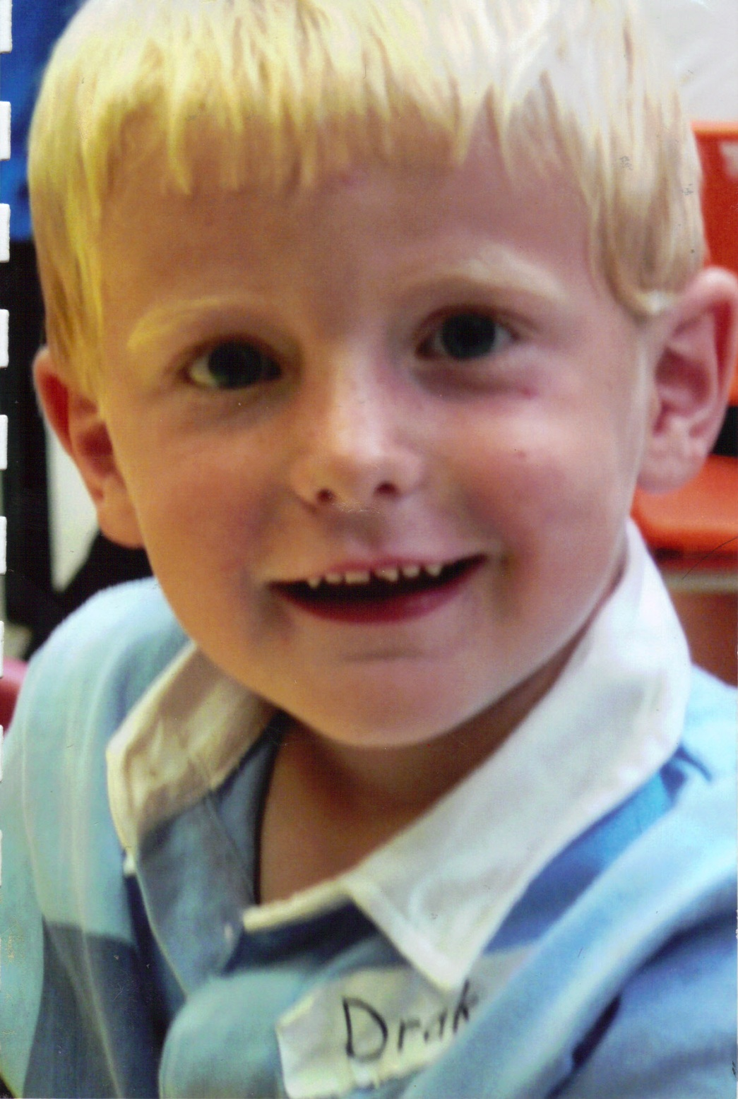
Drake

Slide 22
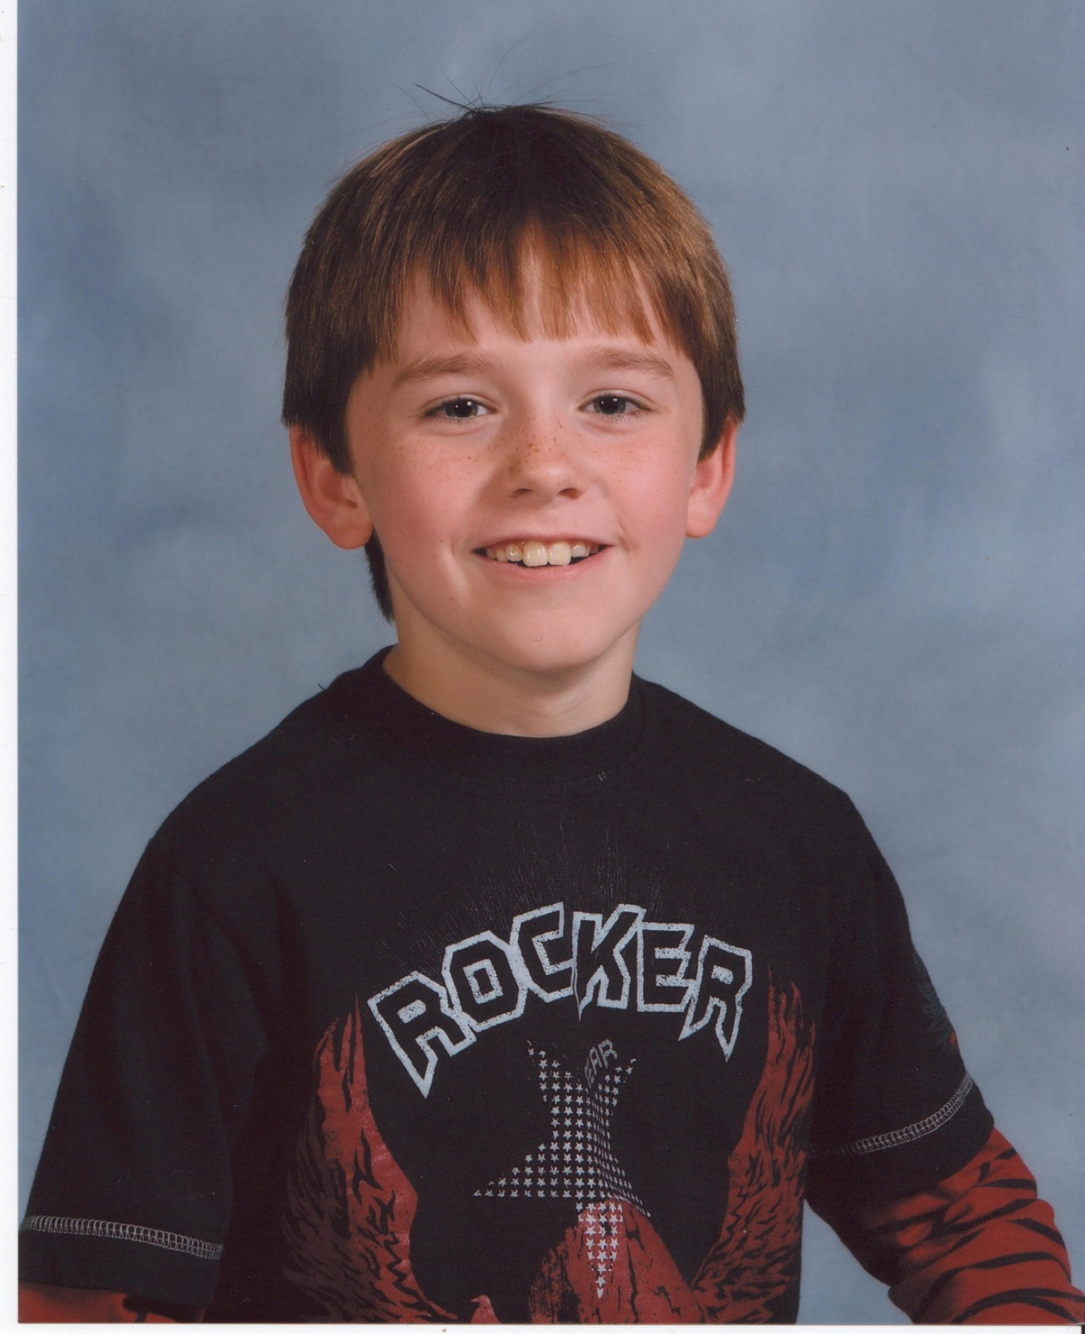
Samuel

Slide 23
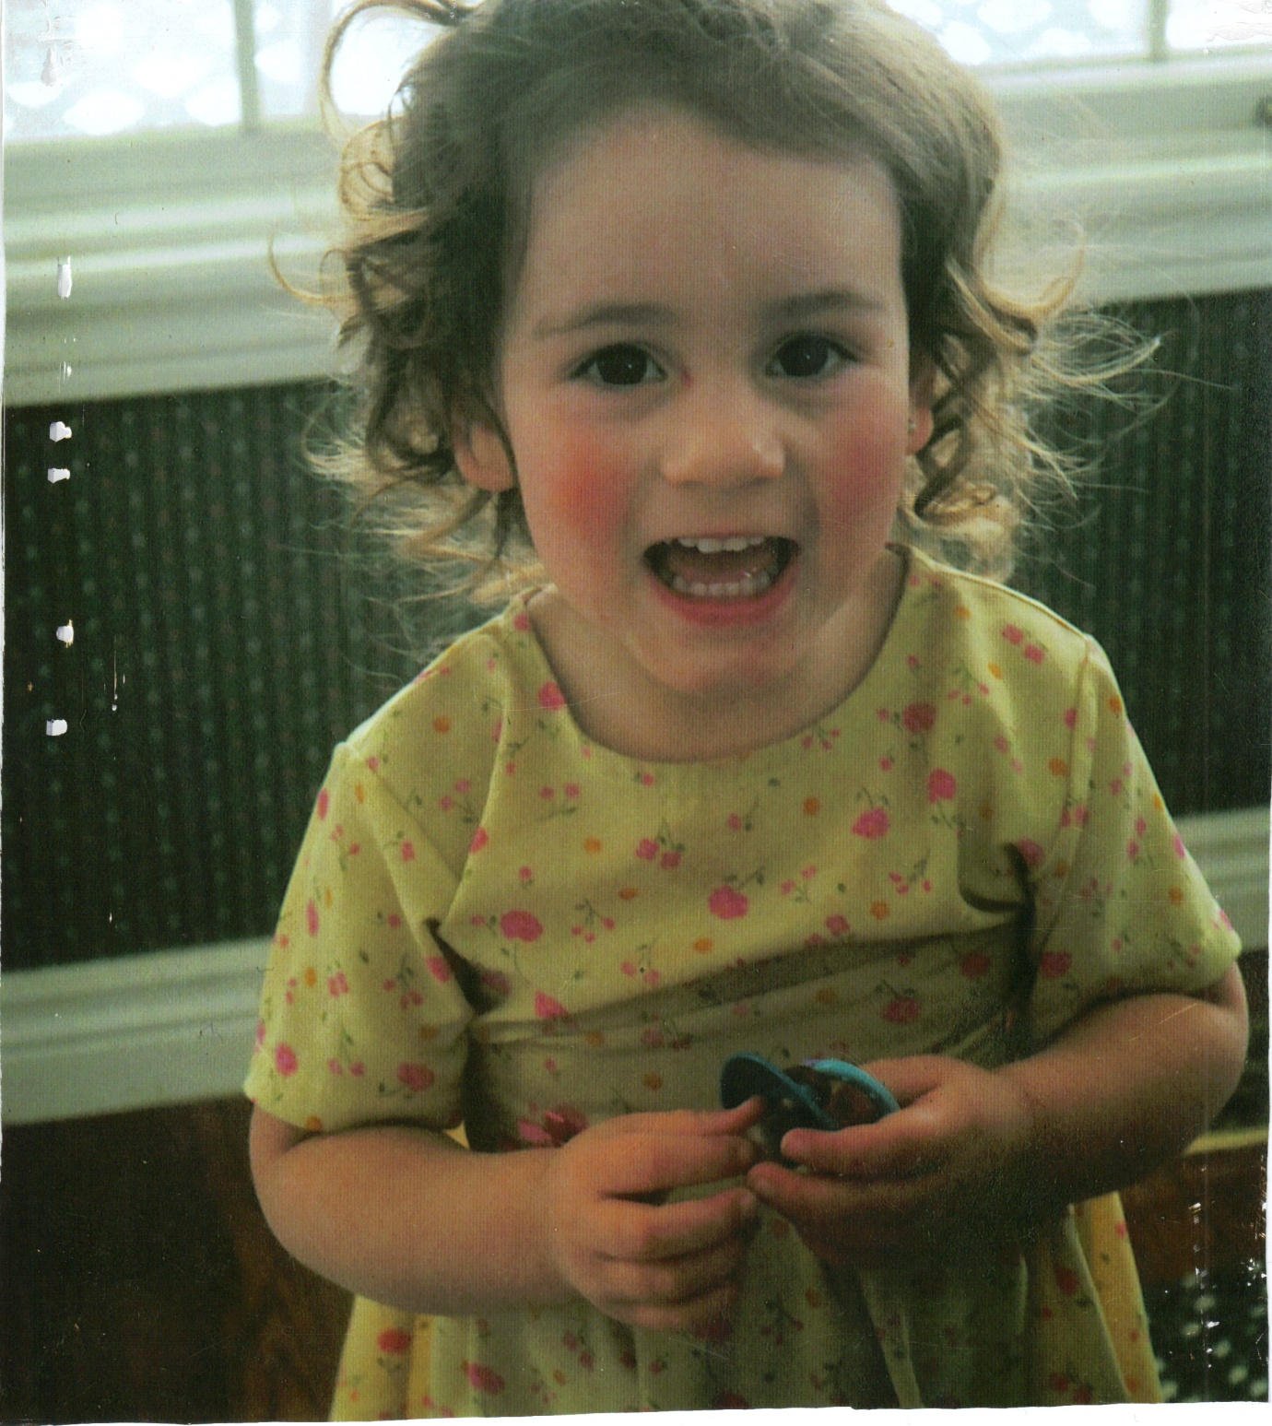
Haliey

Slide 24
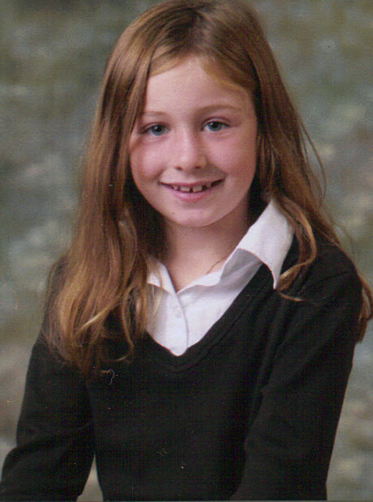
Erin

Slide 25
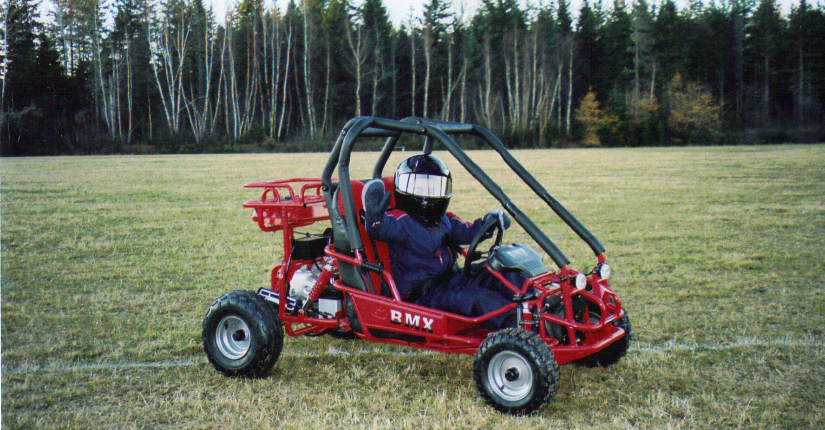
James

Slide 26
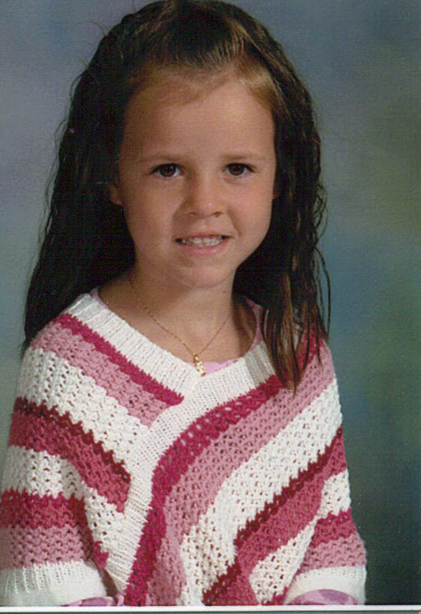
Gina

Slide 27
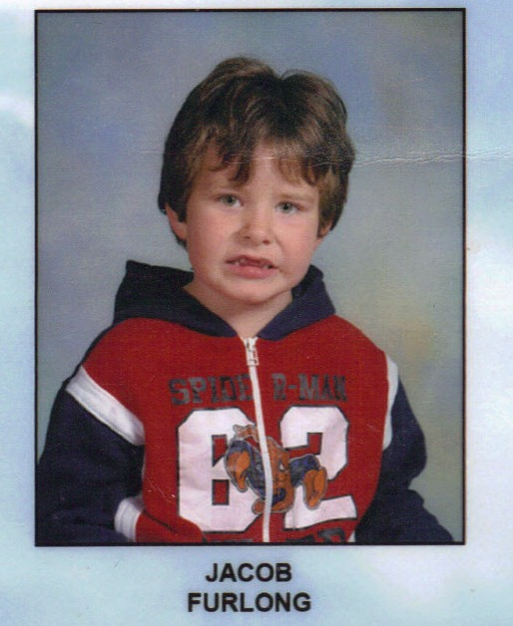
Jacob

Slide 28
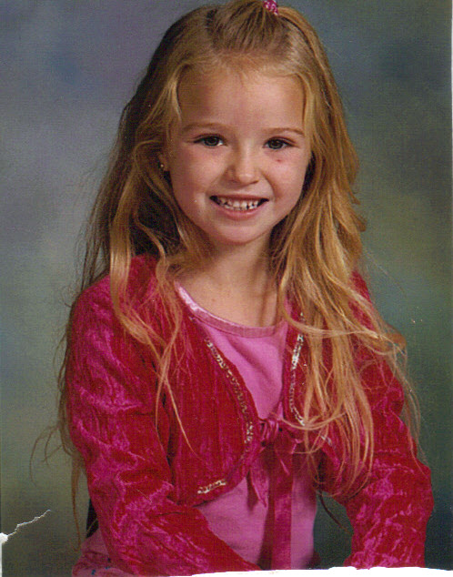
Jaime

Slide 29
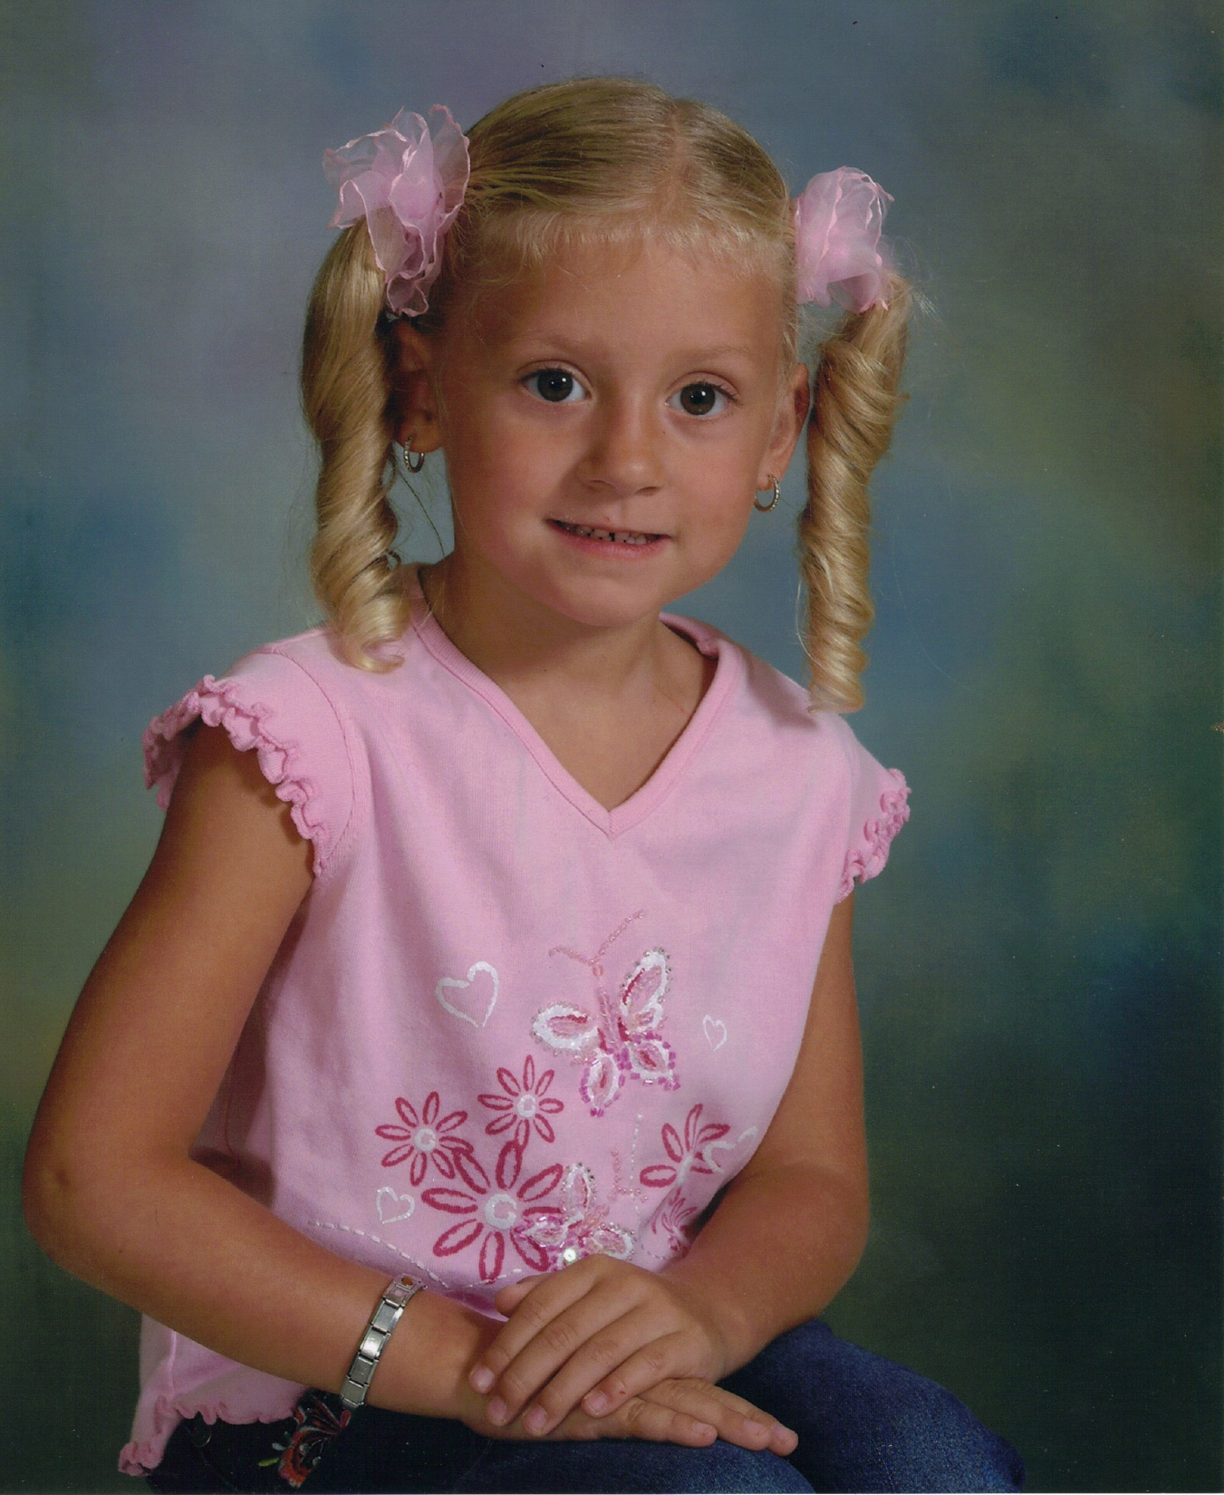
Tiffany

Slide 30
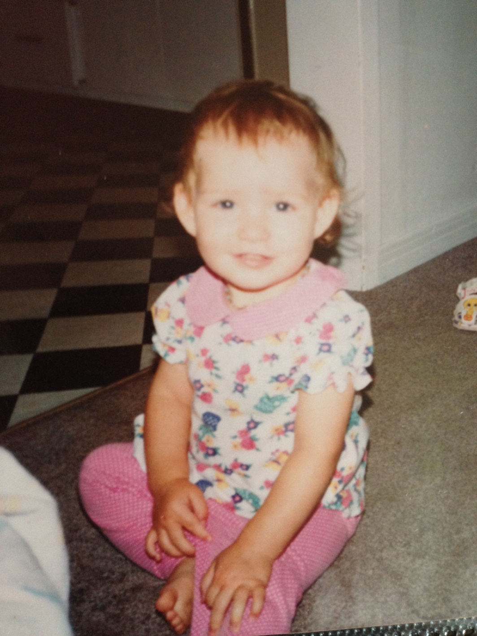
Abby K.

Slide 31
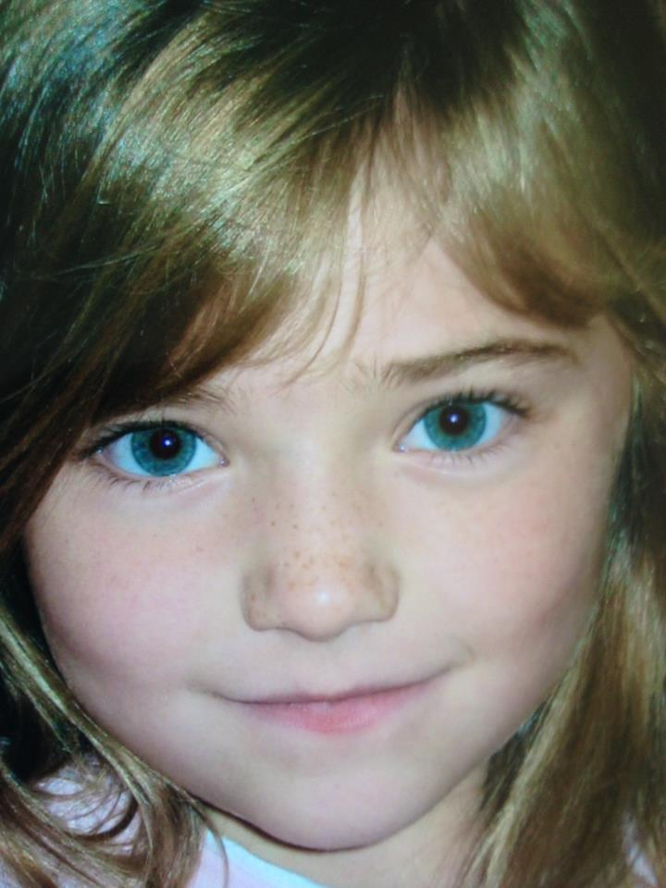
Janet

Slide 32
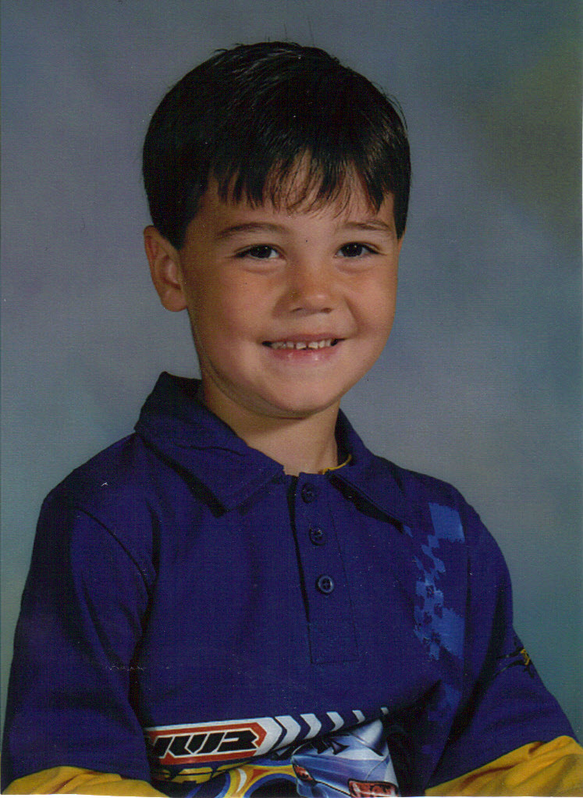
Jayden

Slide 33
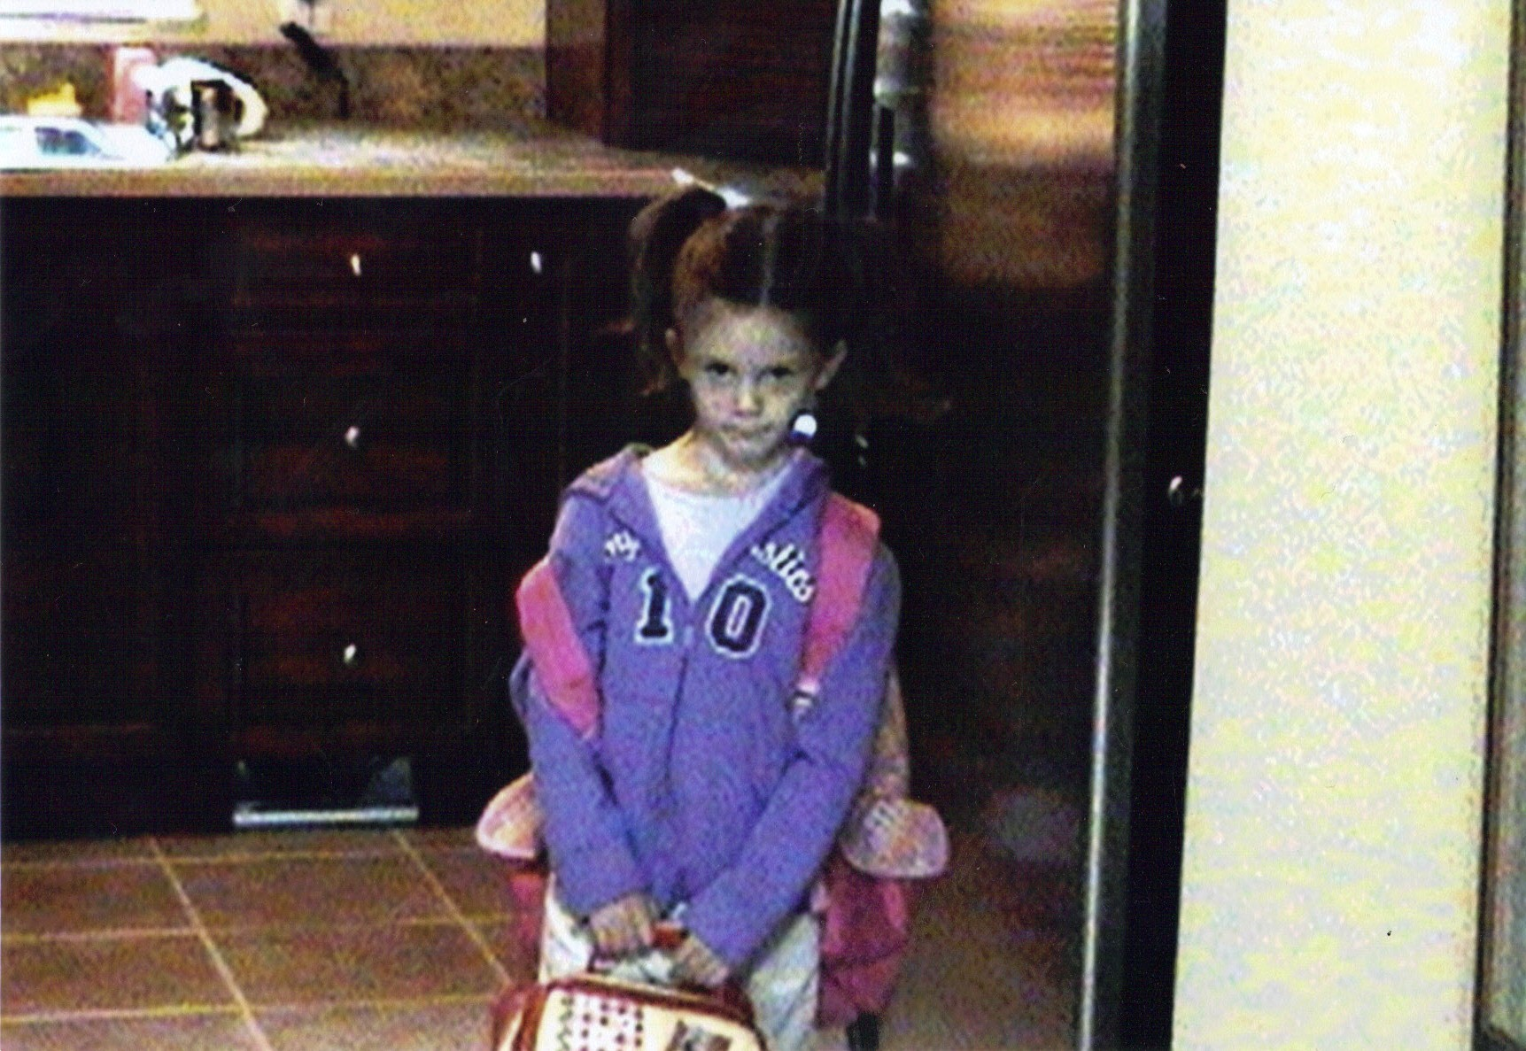
Olivia

Slide 34
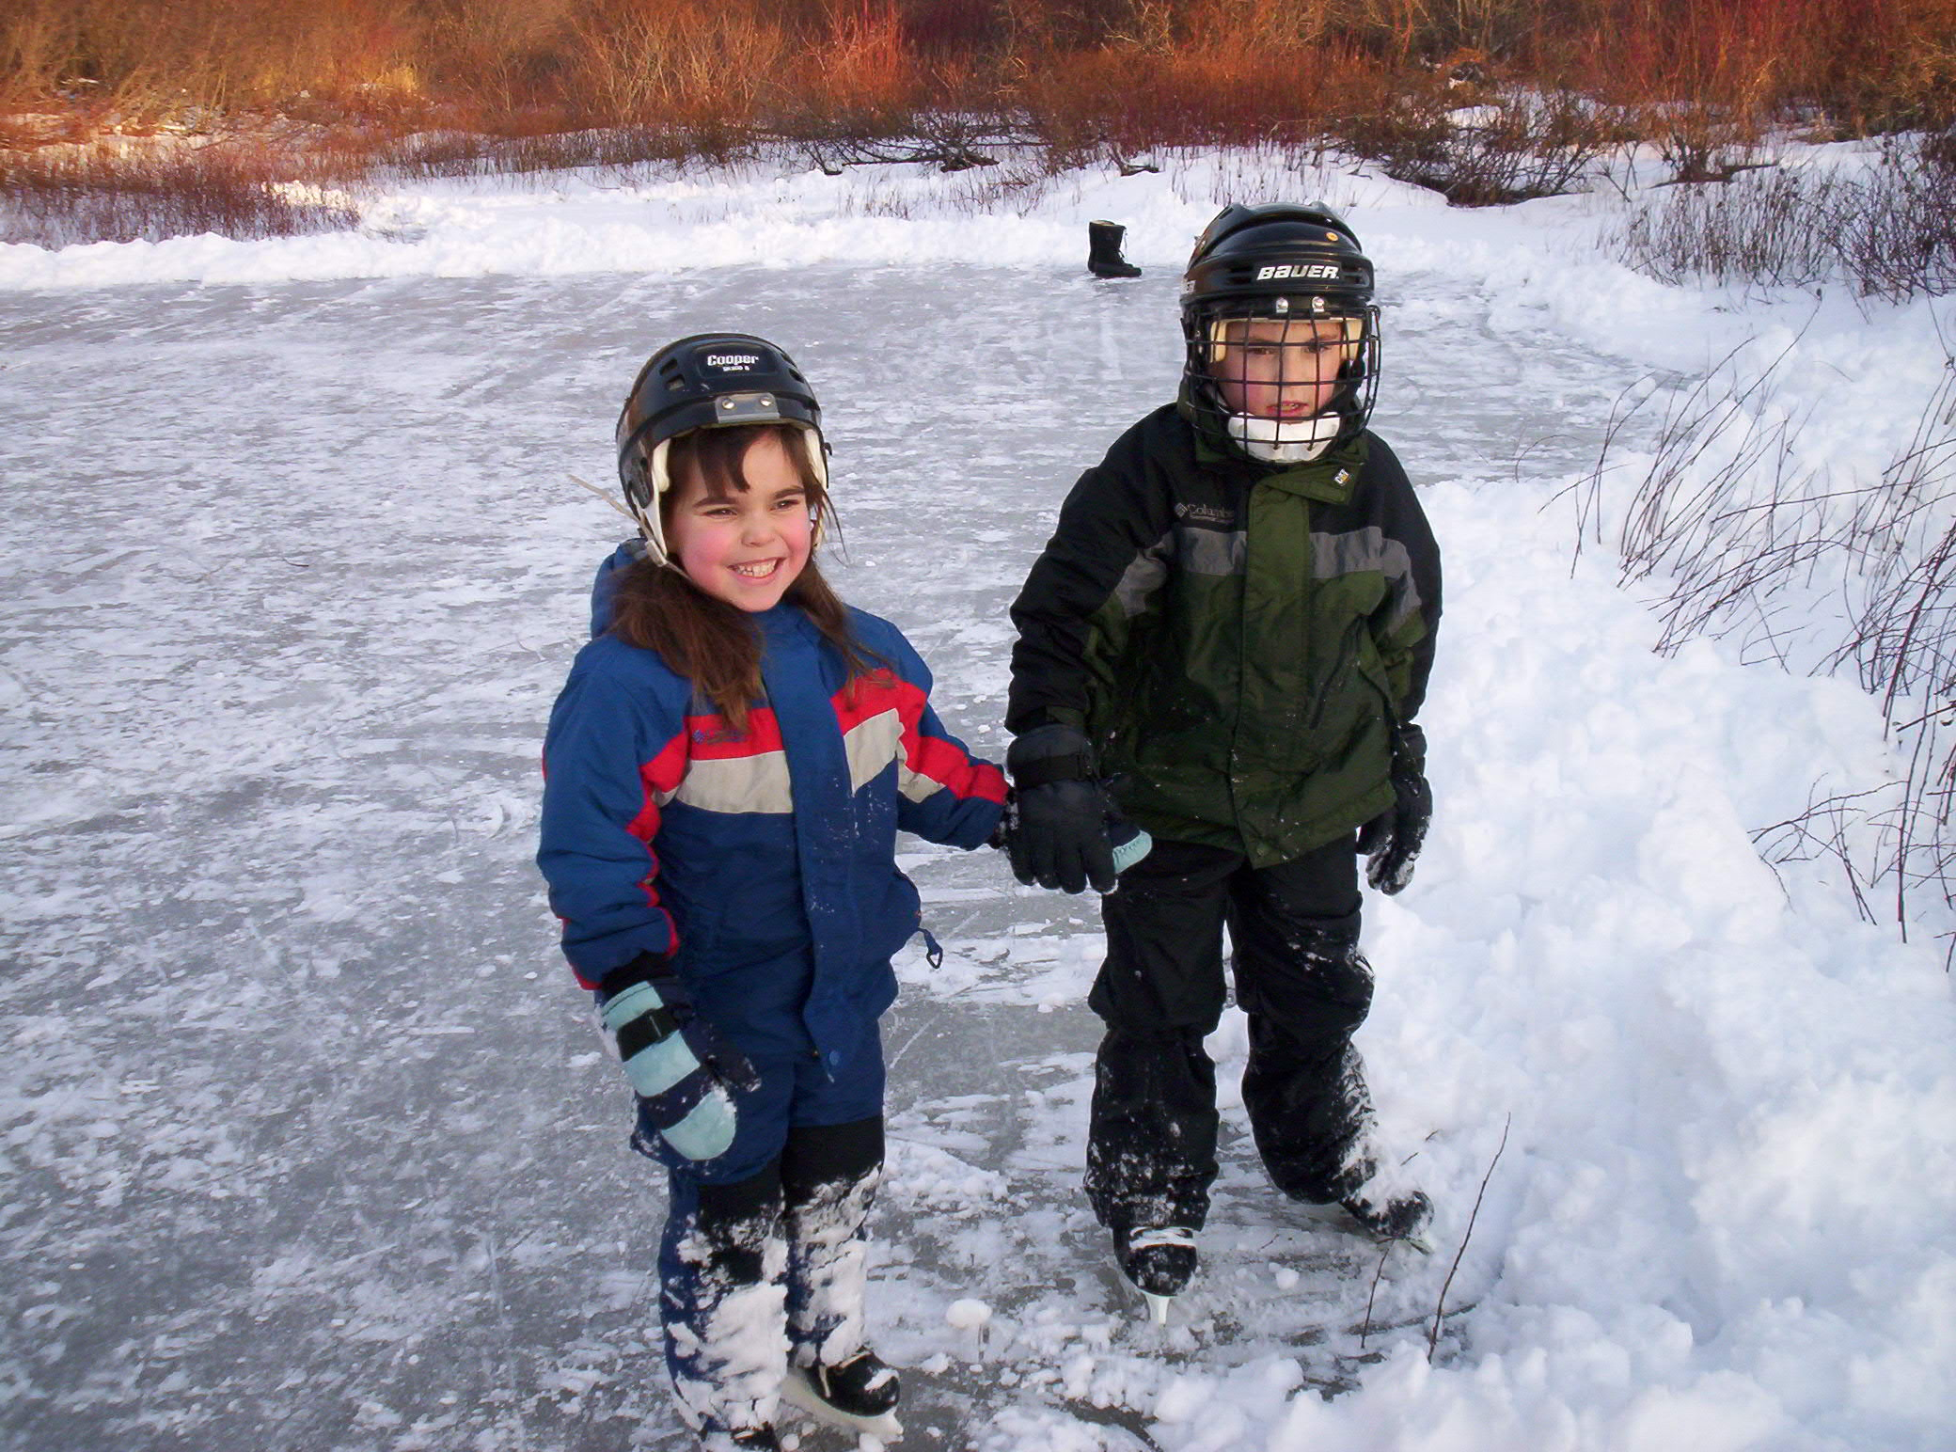
Kassidy

Slide 35
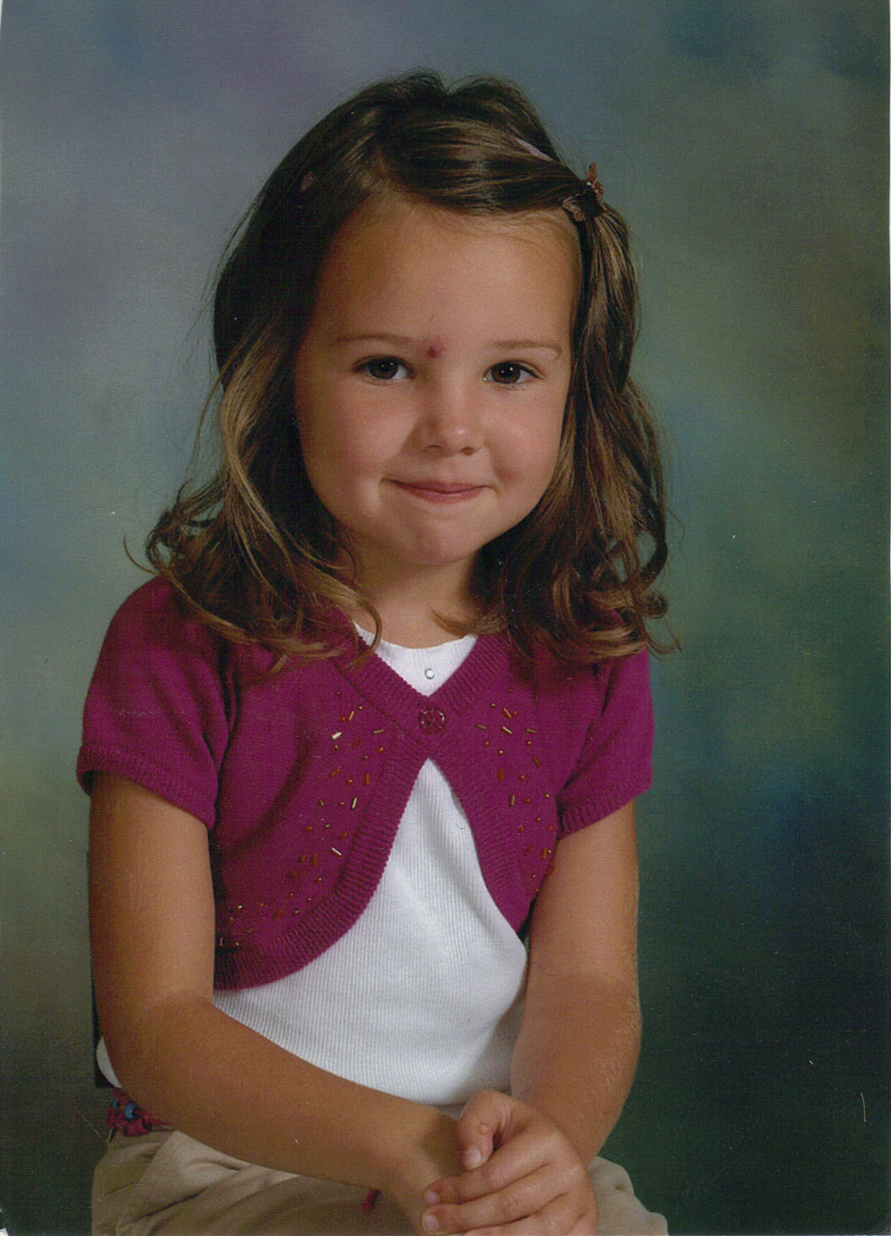
Laura

Slide 36
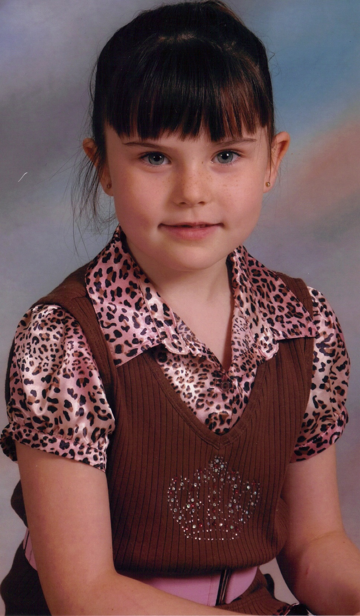
Maddie

Slide 37
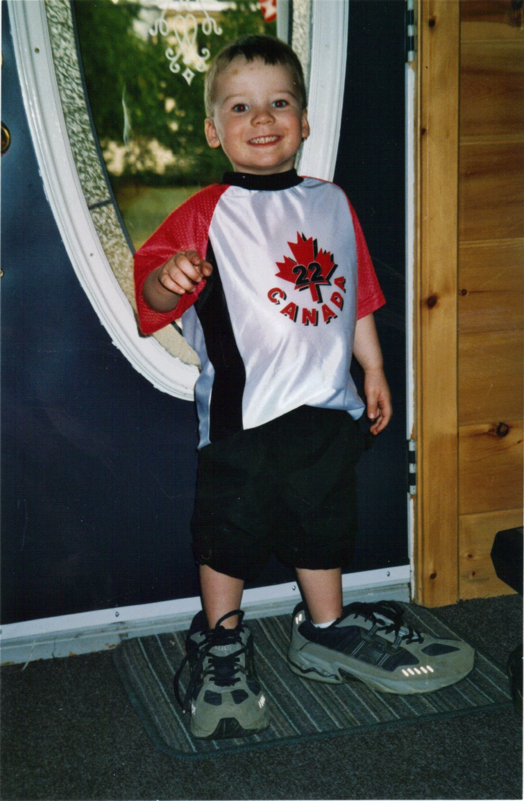
Maguire

Slide 38
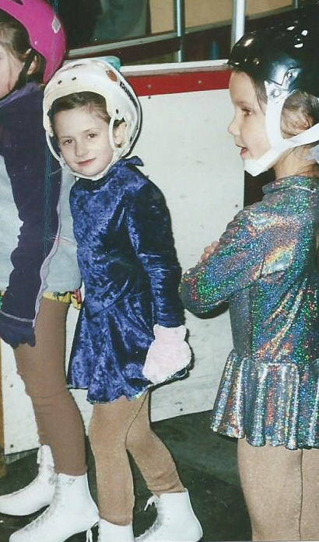
Marlee

Slide 39
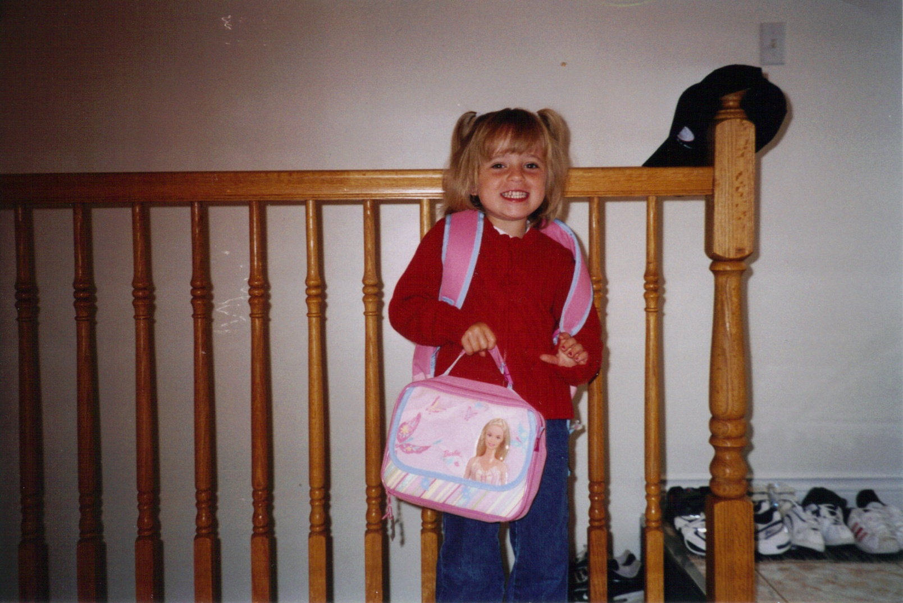
Megan

Slide 40
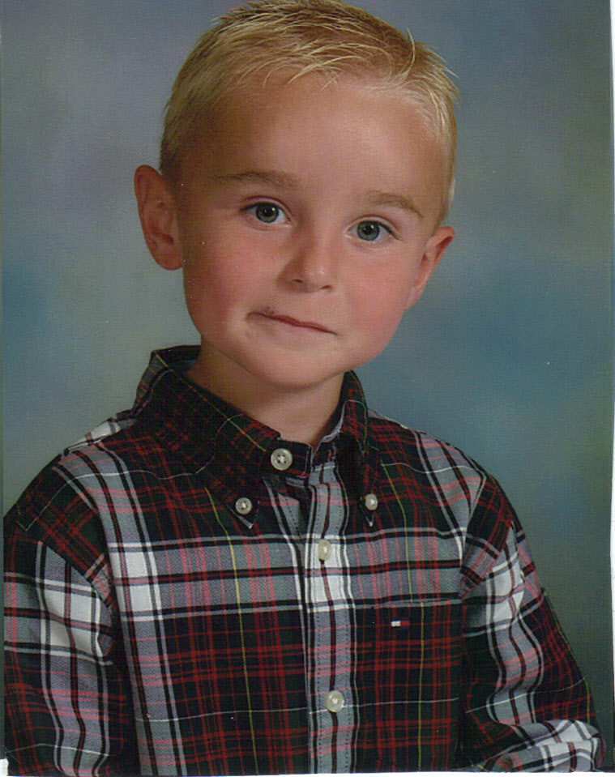
Morgan

Slide 41
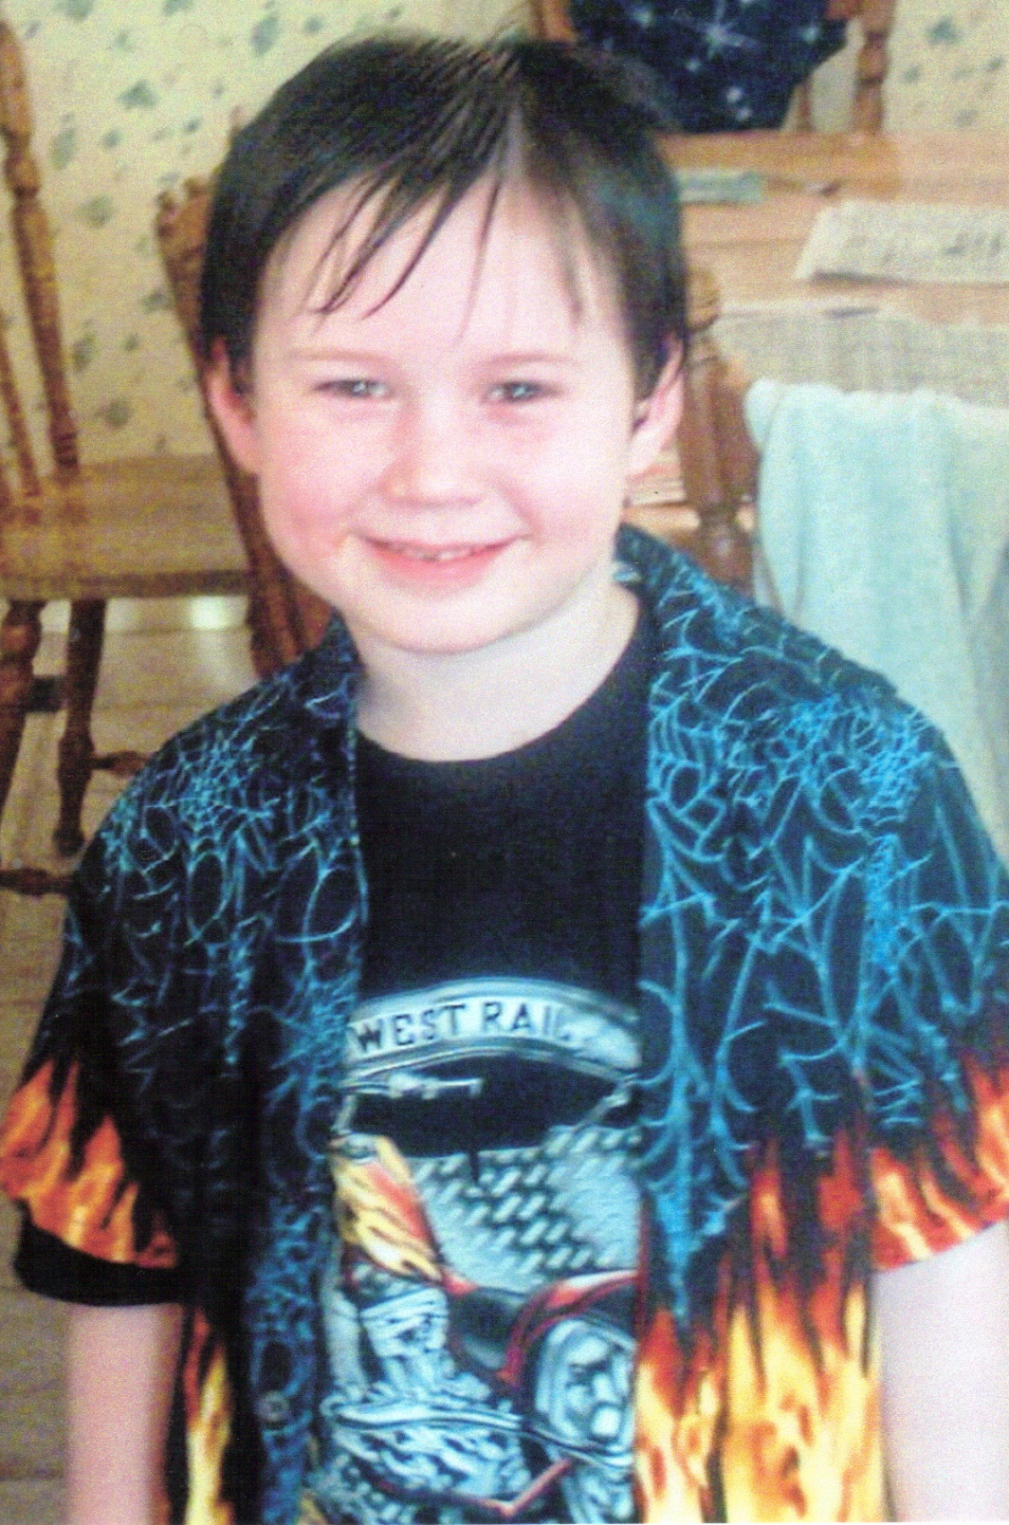
Nick

Slide 42
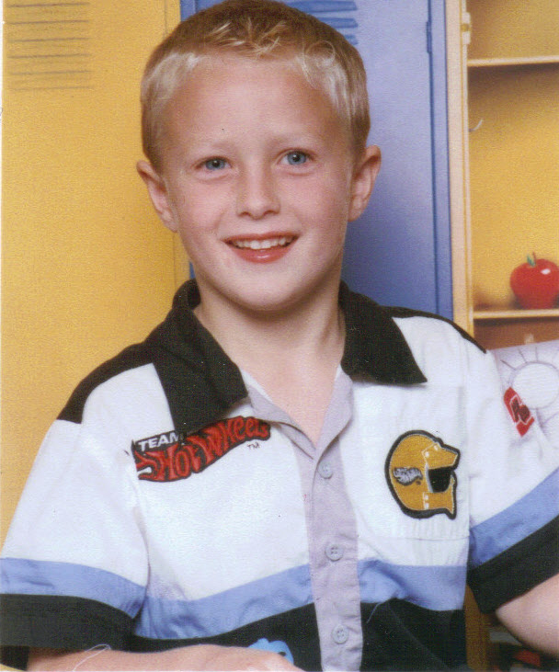
Noah C.

Slide 43
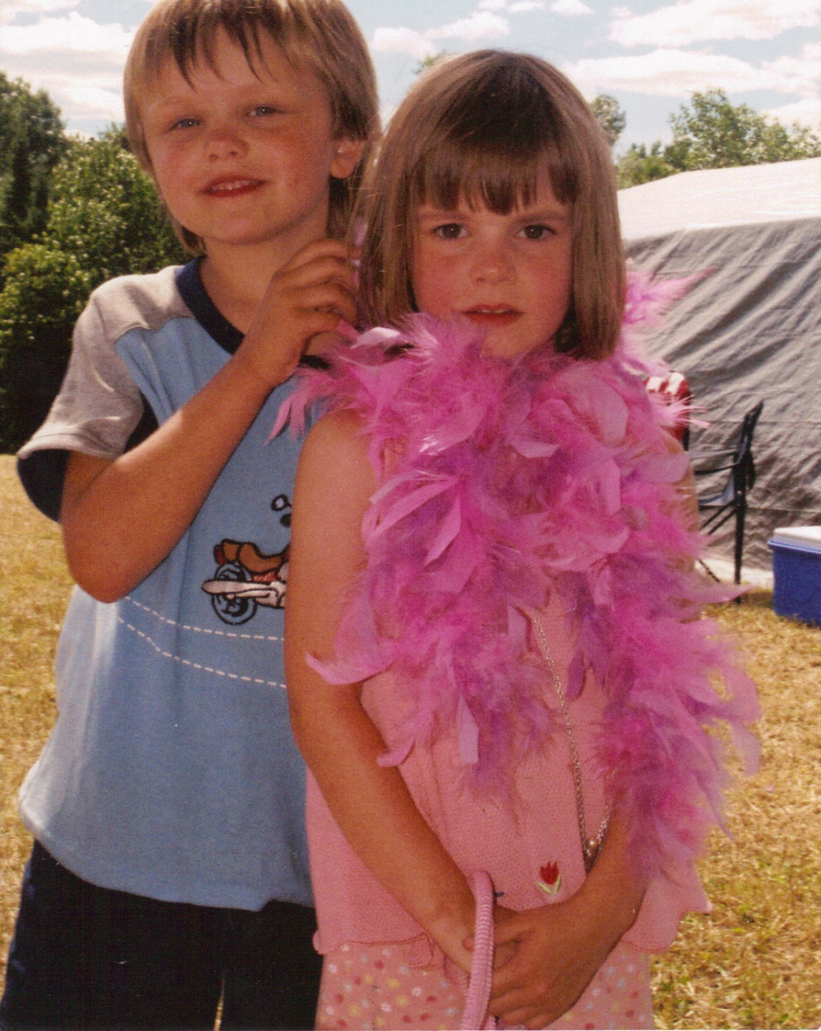
Noah D.

Slide 44
The In between…

Slide 45
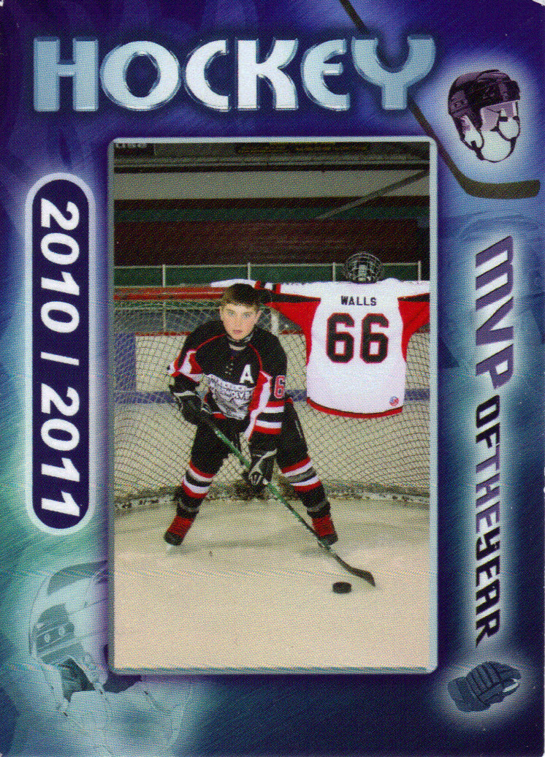
Hockey is my favorite thing to do.

Slide 46
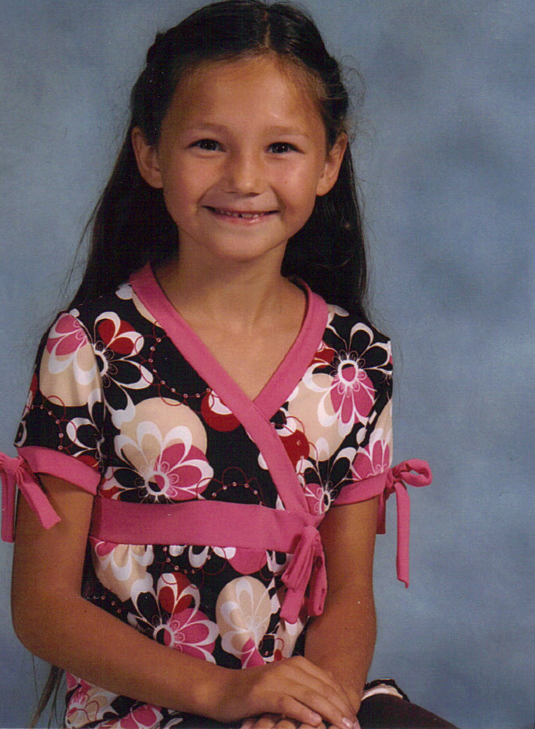
Sleeping is my favorite pass time.

Slide 47
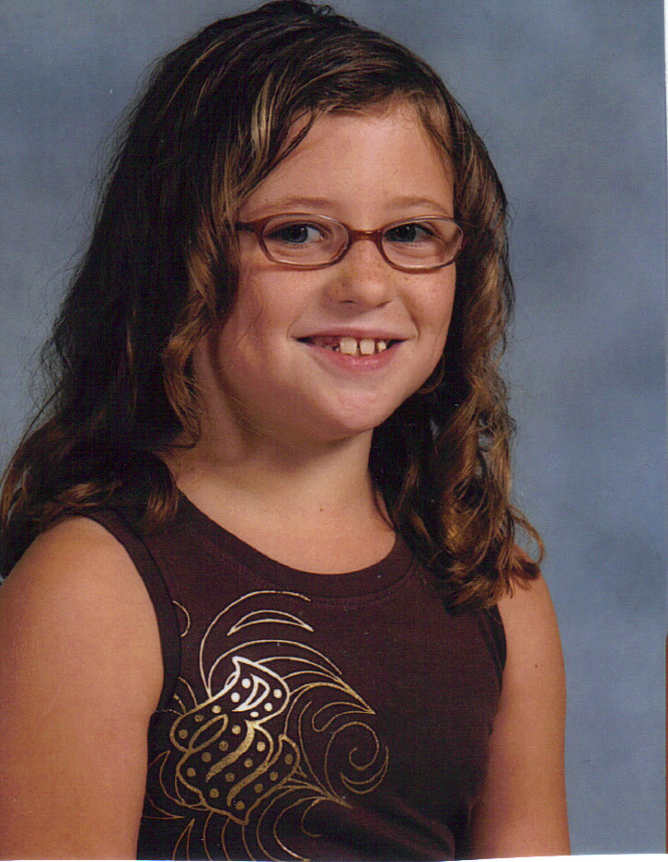
Hockey is my favorite sport.

Slide 48
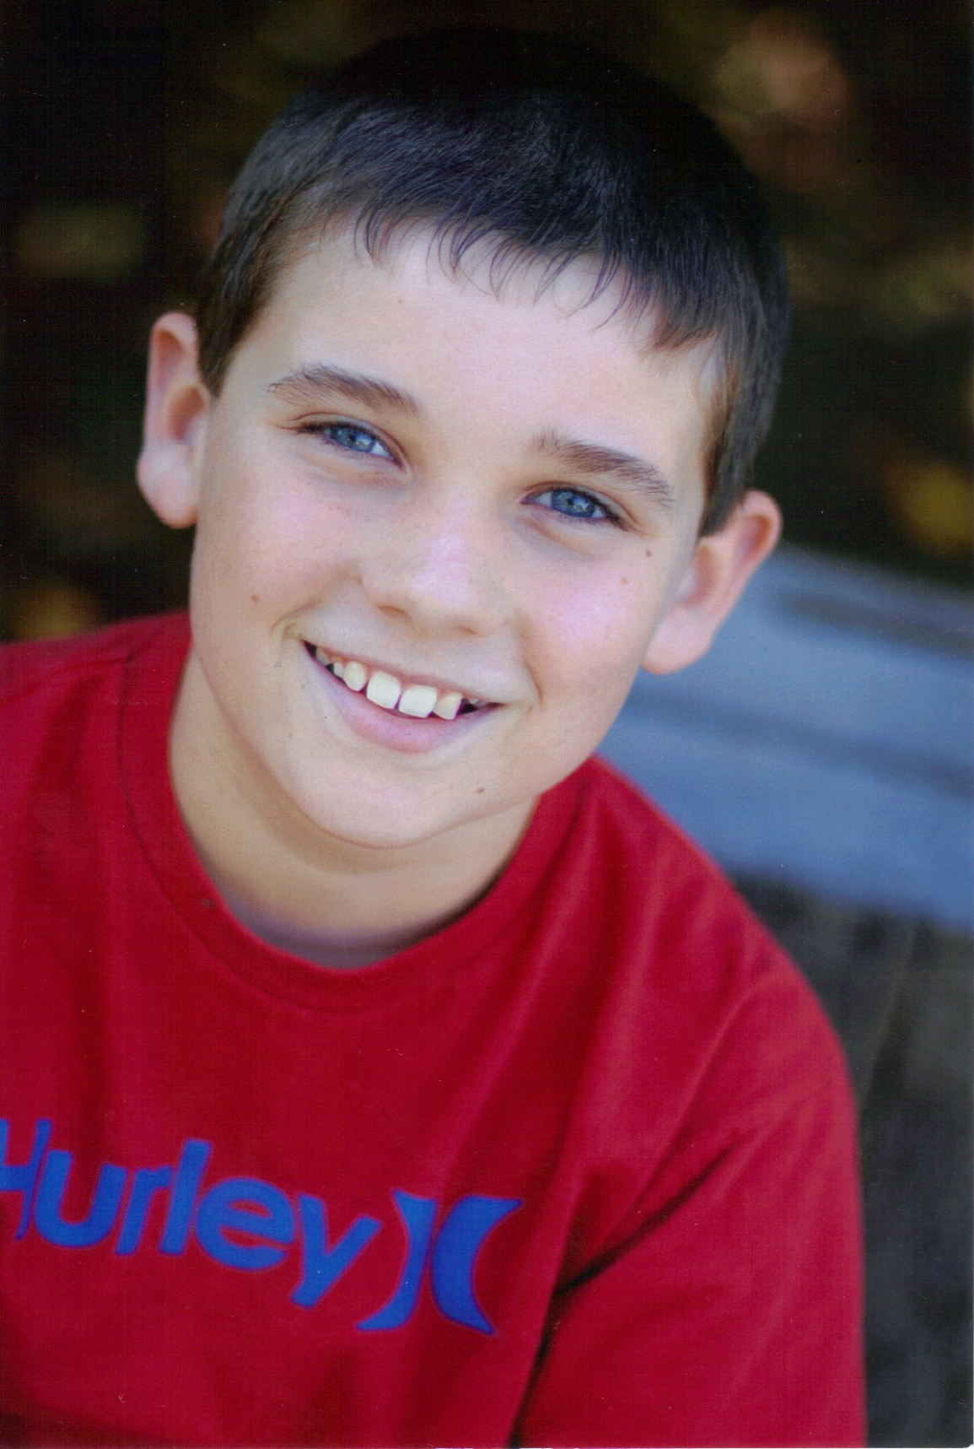
I love to race
my dirt bike.

Slide 49
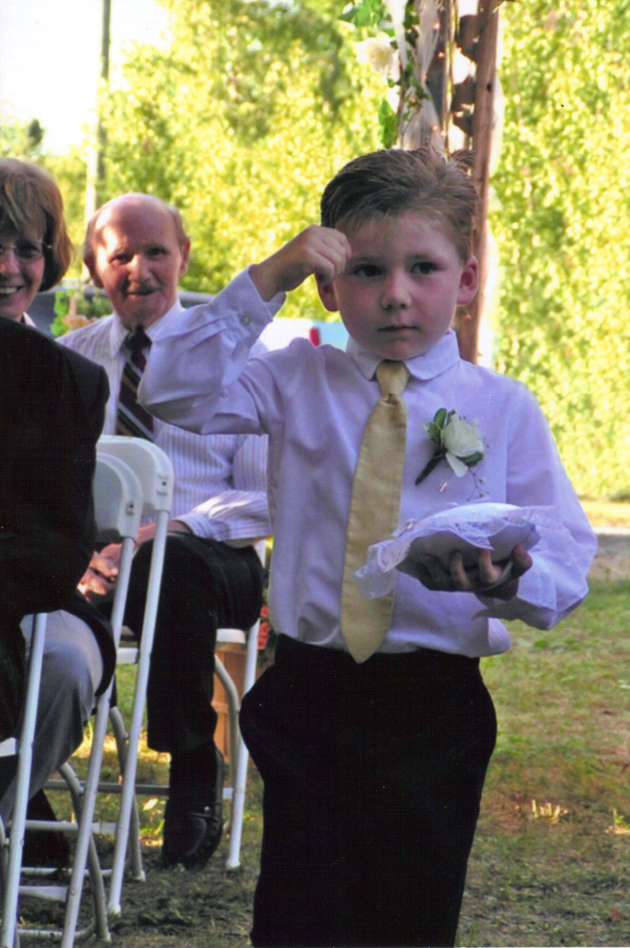
Soccer is my favorite sport.

Slide 50
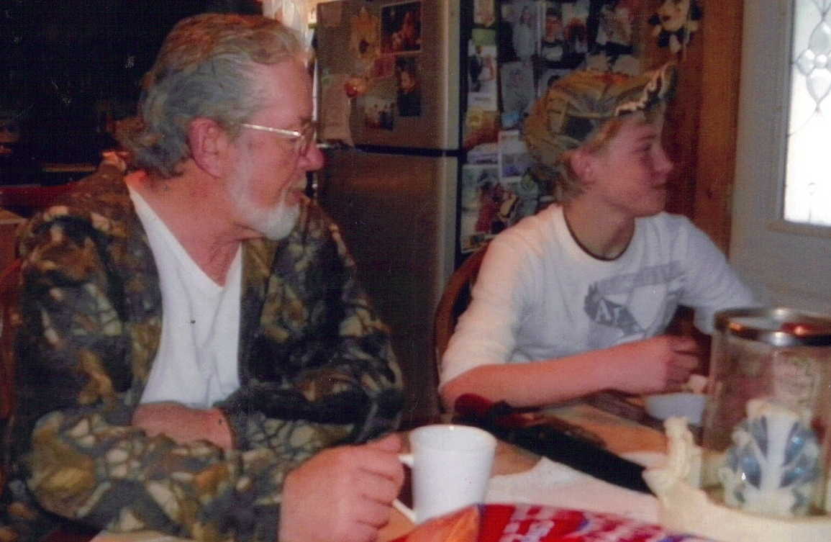
My girlfriend is my person.

Slide 51
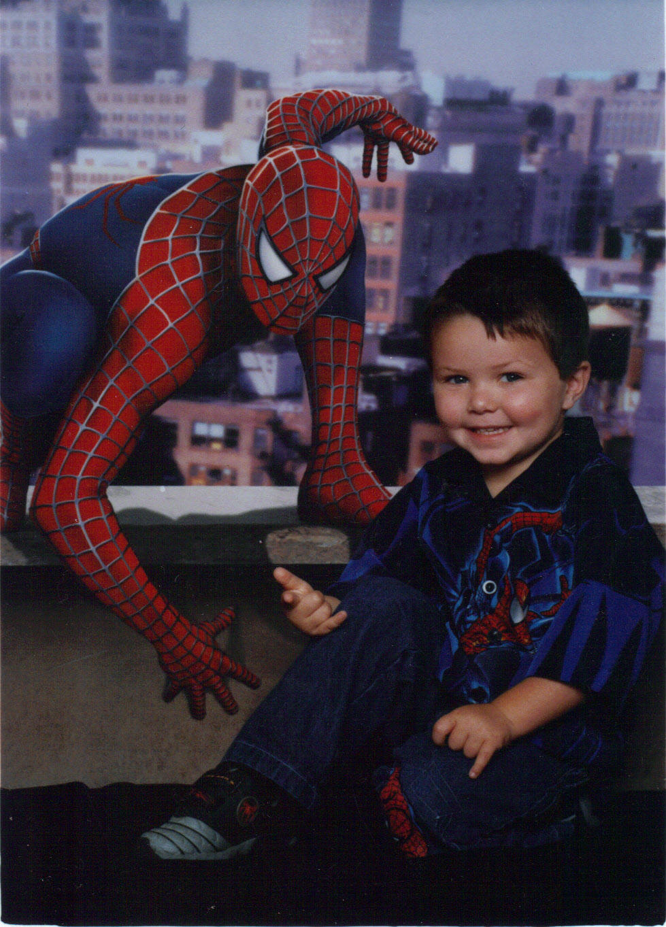
I love to play hockey

Slide 52
Riding my dirt bike is my
favorite thing.

Slide 53
Hockey is my favorite sport.

Slide 54
I love to go four wheeling.

Slide 55
Hockey is my
favorite sport.

Slide 56
Basketball is
my favorite
sport.

Slide 57
I love candy.

Slide 58
I love to play volleyball.

Slide 59
I love cats.

Slide 60
I love 1989 Chevrolet Caprices.

Slide 61
Giraffes are my favorite animal.

Slide 62
I love pigs.

Slide 63
Breaking Bad is my favorite TV show.

Slide 64
I love
to read.

Slide 65
I love music.

Slide 66
Pizza is my favorite food.

Slide 67
Blue is my favorite color.

Slide 68
I love to play sports.

Slide 69
I love shopping.

Slide 70
I love riding my dirt bike.

Slide 71
I love playing hockey.

Slide 72
Writing is my favorite thing to do.

Slide 73
Hockey is my favorite sport.

Slide 74
Soccer is my favorite sport.

Slide 75
I love shopping.

Slide 76
I love playing road hockey.

Slide 77
Snowmobiling is my favorite pass time.

Slide 78
I love everything Tampa Bay Lightening.

Slide 79
Volleyball is my favorite sport.

Slide 80
Four wheeling is my favorite pass time.

Slide 81
Hockey is my favorite sport.

Slide 82
Ice cream is my favorite food.

Slide 83
I love playing Xbox.

Slide 84
I love riding my dirt bike.

Slide 85
Tigers are my favorite animal.

Slide 86
Orange is my favorite color.

Slide 87
I love
music.

Slide 88
And now…
Our lives lay ahead of us.

Slide 89
I want to go
to the Olympics to
speed skate.

Slide 90
I want to race
dirt bikes.

Slide 91
I want to be in the army.

Slide 92
I want to be
in the army.

Slide 93
I want to be a woodsman.

Slide 94
I want to be a pediatrician.

Slide 95
I want to travel the world.

Slide 96
I want to play in the NHL.

Slide 97
I want to be
a carpenter.

Slide 98
I want to play
in the QMJHL.

Slide 99
I want to play in the NBA.

Slide 100
I want to travel Europe.

Slide 101
I want to be
a mechanic.

Slide 102
I want to be Prime Minister.

Slide 103
I will own the
Tampa
Bay Lightening.

Slide 104
I want to write.

Slide 105
I want to see a giraffe.

Slide 106
I want to get rich quick.

Slide 107
I want to sing
in an orchestra.

Slide 108
I want to be a social worker.

Slide 109
I want to play in the NHL.

Slide 110
I want to be president of
the world.

Slide 111
I want to be a photographer.

Slide 112
I want to travel the world.

Slide 113
I want to be a carpenter.

Slide 114
I want to be an orthodontist.

Slide 115
I want to be a pediatrician.

Slide 116
I want to be a nurse.

Slide 117
I want to play in the NHL.

Slide 118
I want to work in
law enforcement.

Slide 119
I want to bungee jump off
Eifel Tower.

Slide 120
I want to race motocross.

Slide 121
I want to be
a teacher.

Slide 122
I want to be a teacher.

Slide 123
I want to play baseball.

Slide 124
I want to travel
the world.

Slide 125
I want to be a welder.

Slide 126
I want to own a pig farm.

Slide 127
If I could do anything,
I would four wheel.

Slide 128
I want to be a vet.

Slide 129
I want to test cars.

Slide 130
I want to be an
orthodontist.

Slide 131
I want to win the
bronze, silver, and gold B.

